Slide 1
Containers Virtualization and the linux kernel
Data Engineering
School of Data Science
University of Virginia

Slide 2
Containers
Leveraging the Linux kernel
What is a container?
Container versus Virtual Machine

Slide 3
Container Definition
A standard unit of software that packages up code and all its dependencies so the application runs quickly and reliably from one computing environment to another

Slide 4
Containers are like a slice
A process called ‘jailing’ keeps processes from running in same space
A ‘jailed’ space is created re-using the linux kernel
Linux versions are a layer on top of a common kernel
We can configure the slice to interact with disk space, and => ports.

Slide 5
Closeup on linux ‘ports’
Computers exchange messages with each other across numbered ‘ports’.
A computer can open or close ports for security.
By agreement, only certain types of messages are sent/received on specific ports. For example
Http, port 80
MySQL, port 3306
We CONNECT a container by opening ports

Slide 6
Comparison to Virtual Machine
Virtualization is the running of a machine inside a machine
Unlike a ‘slice’, a VM carries with it an operating system.
The OS is run like an application, as far as the host, it’s just like any other app.
As with the slice approach we can share disk, open ports etc.

Slide 7
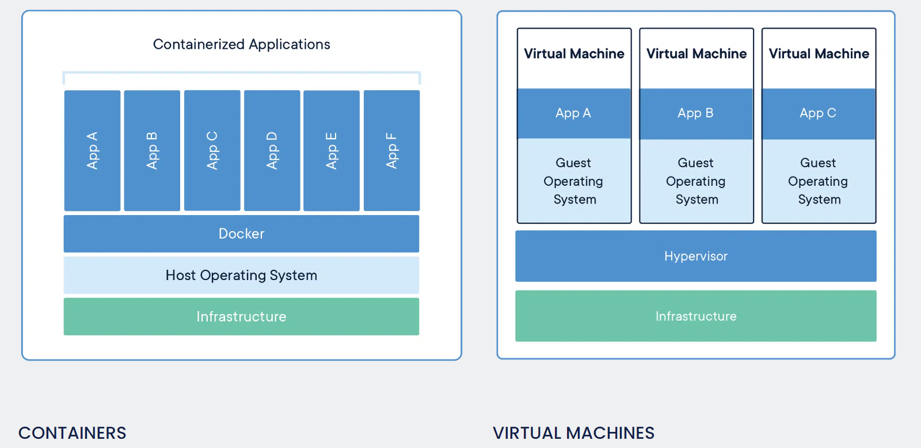
Container vs Virtual Machine
source

Slide 8
Pros and cons
Container pros
Lightweight, since they only carry the ‘extra’ code
Turn on and off really fast
Really secure, ‘jailing’ was intended to make processes isolated
By comparison
VMs are usually large files, carrying the full OS
Slower to boot
Slower to run

Slide 9
Pros and cons II
Container cons
Since they rely on kernel, they are all ‘linux like’
Usually rely on command line, since slice would conflict with host UI
By comparison
VMs can run any OS that has been adapted, you can run windows on linux, or Mac on windows etc.
Each VM can have it’s own UI. The experience is complete.

Slide 10
Side bar - what is Amazon’s EC2?
Hypervisor = An application specifically to create and run VMS
Server = A larger than usual computer, with lots of disk and RAM, designed specifically to run vms or containers
Data Center = A building full of Servers running Hypervisors
When you ‘rent’ an EC2 machine you are basically timesharing a VM on a hypervisor.

Slide 11
It can get complicated, since they can stack
A VM usually won’t support running a VM inside it…
However, you can have a Server, running a Hypervisor, running a VM running a docker image!

Slide 12
But why do we want containers anyway?
Reproducibility: Make the “it runs on my system” problem go away.
Deploy “ready to run” applications, since the container can carry dependencies and configuration
Reproducing development environments, and testing environments.
Easy to “compose” a system of machines, a multi app system.
An example of a composed system is the 3-tier
Front end load balancer, with app in the middle and database back-end.

Slide 13
Docker - The prime container application
Docker is an app you can run at the command line to download and run containers
Docker has VMs running on Mac and Windows in order to run the containers
Dockerhub - hosts containers so we can version and share

Slide 14
Container orchestration
Kubernetes is a popular tool for deploying and orchestrating containers at scale
AWS ECS allows you to deploy containers on EC2
We’ll focus on Docker-compose. A CLI to orchestrate and connect containers locally.

Slide 15
Docker-compose
In our lab this week, we’ll take a set of prebuilt and tested containers and hook them up together to make a Data Science system.

