Slide 1
DBT Data Analysis, Transformation, Testing
Data Engineering
School of Data Science
University of Virginia

Slide 2
DBT is:
A Development Framework
A Transformation Workflow
A Data Test Framework

Slide 3
DBT is both open source, and SaaS
This tool is an example of both models:
Open source dbt-core is available as a python package and used via CLI
Open-source/SaaS model is Web based, and is free up to a point. Advanced features require a subscription.

Slide 4
DBT works with many other tools
It’s part of a larger process, and it is built to inter-operate with other Data Analysis, Data Engineering tools.
Snowflake
Airflow
Can be used in Circle/CI

Slide 5
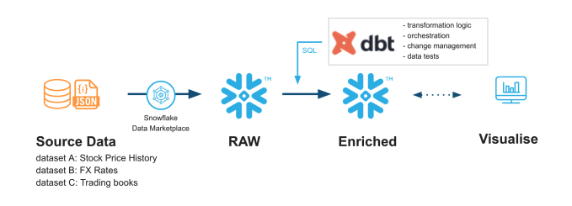
DBT and Snowflake
Write data transformations in DBT, execute and store in Snowflake.
SQL is the common language here!

Slide 6
DBT core usage
Key point of use => Modular sql
A DBT model is a single sql file containing a SELECT statement.
Transforms, or is part of larger transformation of Data.

Slide 7
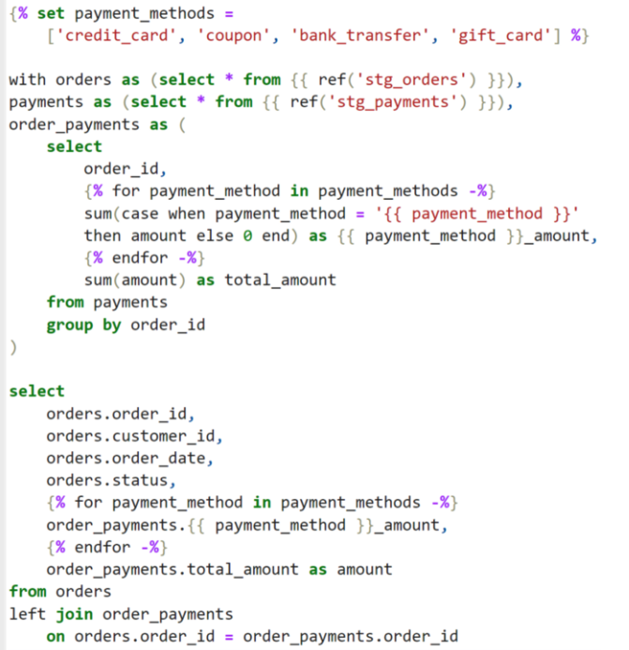
DBT uses Jinja for SQL templates
Jinja is widely used for web UI
In this context it’s used for SQL
But the concept is identical.
Write templatized code.

Slide 8
DBT: Templates are ‘compiled’
What do we mean by ‘compiled’?
When DBT sql templates are converted to explicit executable sql, they are said to be compiled.
Compile code, usually refers to the transformation of human readable code to machine executable code.
In this case, SQL is our universal ‘executable’

Slide 9
DBT: SQL will execute remotely in SFlake
To execute our SQL we need to establish a connection to Snowflake
Setting up the connection will be done in YAML files.
In our lab this week, we’ll use the Snowflake account creds.

Slide 10
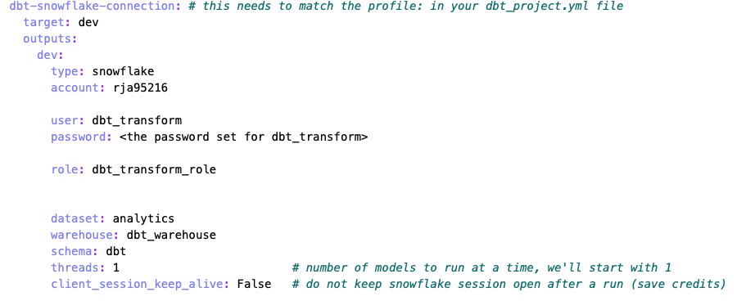
DBT: Closeup on yaml configuration

Slide 11
DBT: Work in DBT, execute in SFlake

Slide 12
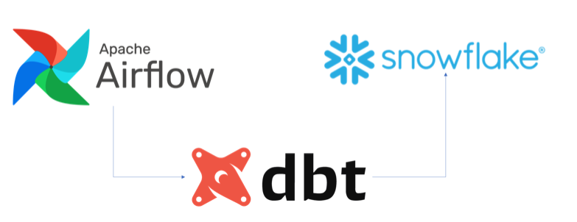
DBT: Common Setup with our tools
Airflow, DBT and Snowflake are often set up together
DAG Workflow Data store/execute
Define Models/Transforms

Slide 13
One giant Data eco system
EC2
Database
Docker
CircleCI
Airflow
Snowflake
DBT

