Slide 1
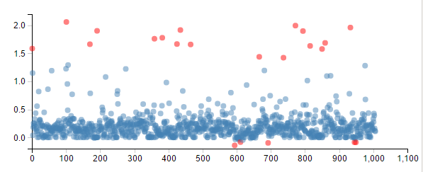

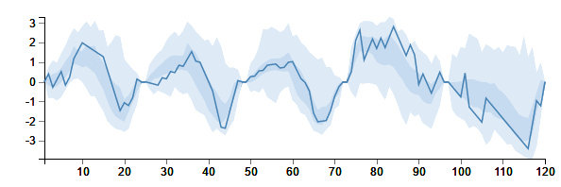
Rosenblatt Lab
MultiNav
Tools for Multivariate Explanatory Data Analysis
Efrat Vilenski Jonathan Rosenblatt

