Slide 1
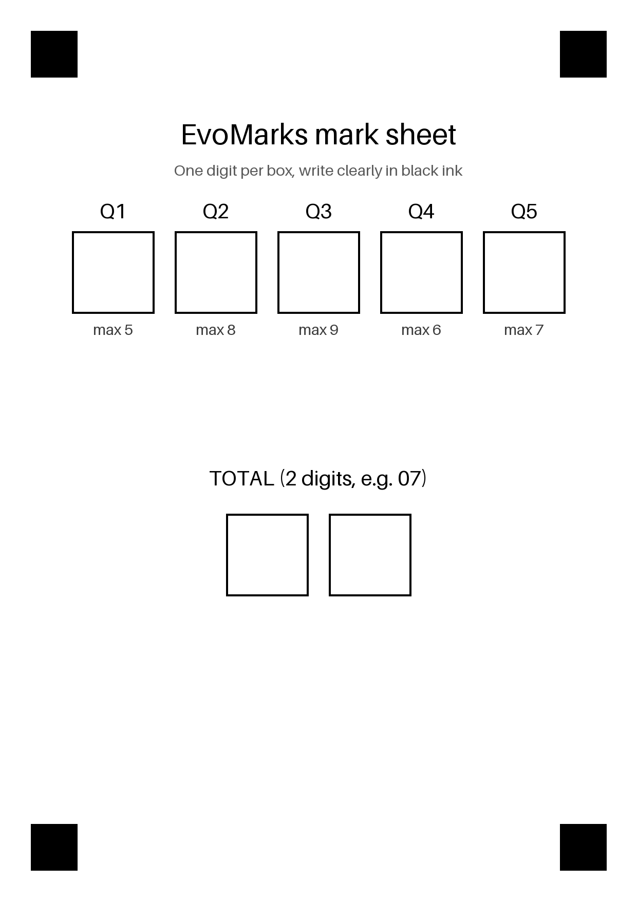
TITLE
EvoMarks: checking handwritten mark sheets with verified self-improvement and distillation
Read the marks and the total, check that they add up, flag the sheet. Offline, phone-sized.
Both tracks: A (recursive learning with an independent verifier) and B (knowledge distillation).

Slide 2
PROBLEM AND DESIGN
Arithmetic is the independent judge
5 marks + 2-digit total per sheet = 7 digits; ~5% of totals are genuinely wrong.
Verifier: marks within maxima and sum equals total. It never sees confidence or labels.
Splits: seed 150 (labeled), pool 3000 (unlabeled), dev 300, meta_dev 300, test 750 (unseen writers, read once).
Fixed evaluator + sandbox + rollback; every version archived, accepted or rejected.

Slide 3
METHOD
Three levels of improvement, then distillation
Level 0: self-training on sheets that pass the sum check; dev gate, rollback.
Level 1: improver edits pipeline.py with AST operators; fixed evaluator accepts or rejects.
Level 2: improver edits its own source; kept only if its utility on meta_dev is higher.
Distillation: L = alpha CE + (1-alpha) T^2 KL; 25k-parameter student, T/alpha chosen on dev, 3 seeds.

Slide 4
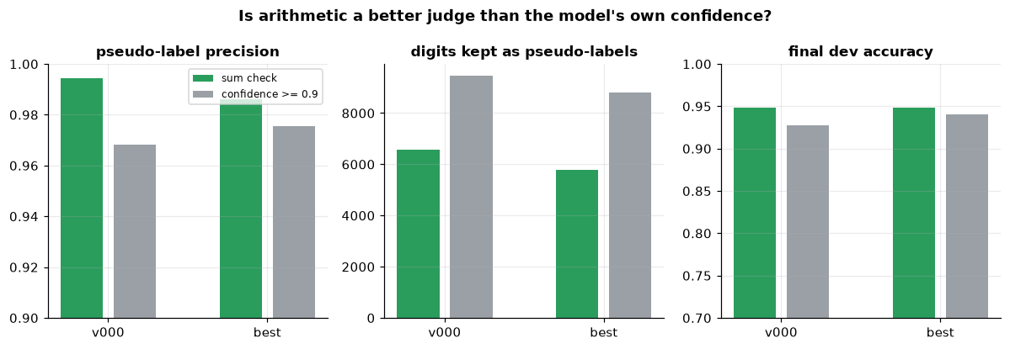
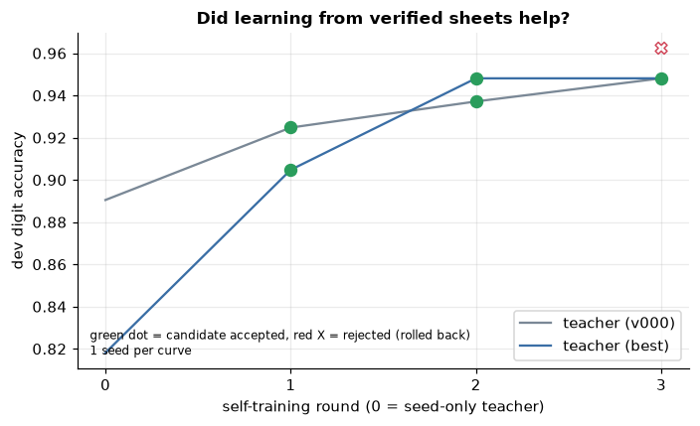
RESULTS: LEVEL 0
The sum check beats confidence (confirmation bias)
Seed-only teacher 0.887 -> 0.944 test digit accuracy.
Pseudo-label precision 0.994 vs 0.968 for a per-digit confidence threshold; final dev 0.948 vs 0.928.

Slide 5
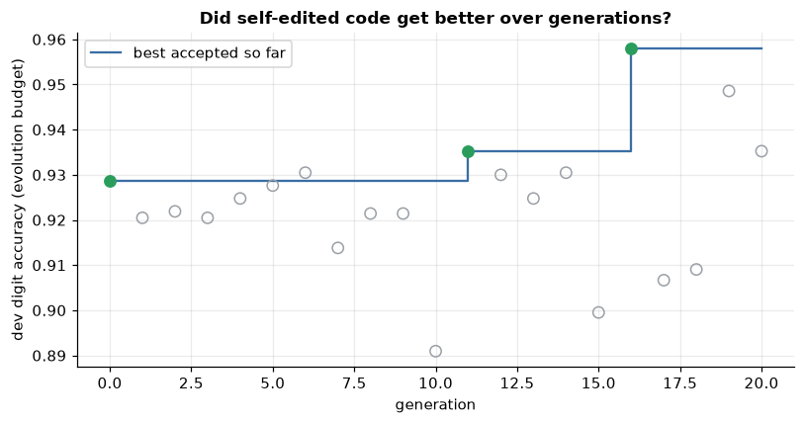
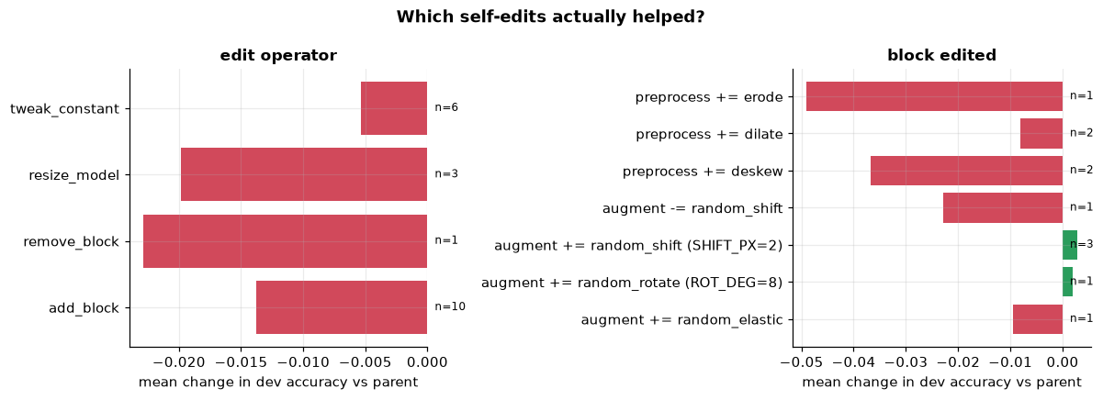
RESULTS: LEVEL 1
Mostly rejection; a small gain that does not survive full budget
20 candidates, 2 accepted, 18 rejected (all no_improvement).
Noise floor (8 seeds): v000 dev 0.934 +- 0.005, 2.4x the gate margin 0.002.
Paired by seed v016 - v000: +0.0105 +- 0.0039 (6/8 seeds) at evolution budget; at full budget test 0.9455 vs 0.9436 = within noise.

Slide 6
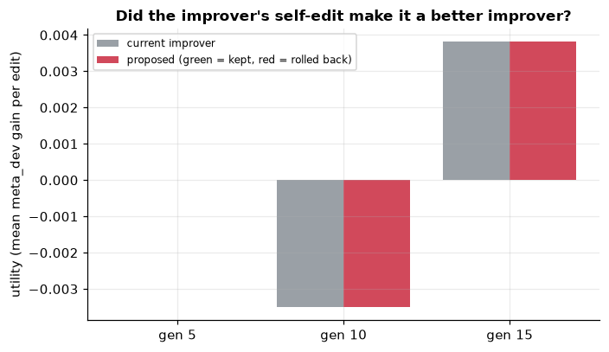
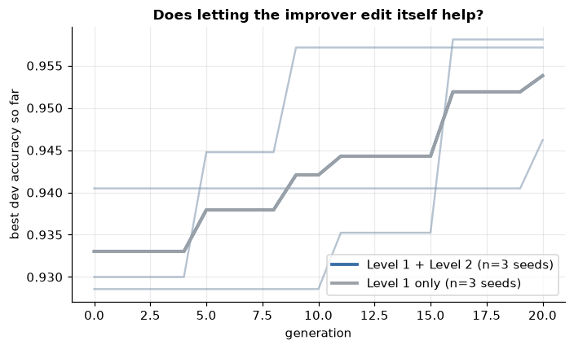
RESULTS: LEVEL 2
A null result, and why
3 self-edits proposed, 0 accepted; Level 1 + 2 and Level 1 only are identical (0.9538 both).
Utility is measured from a fixed parent, so PARENT_SELECTION edits cannot change it: a limit of the gate.
The ablation therefore says nothing about whether recursion could work.

Slide 7
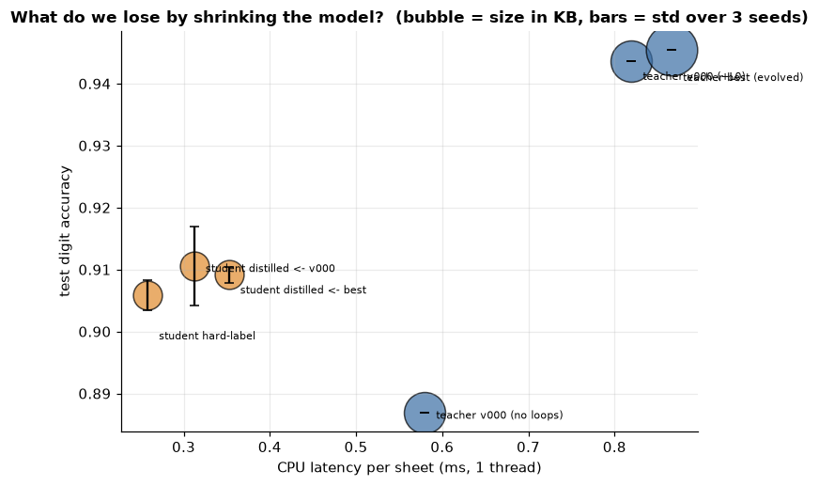
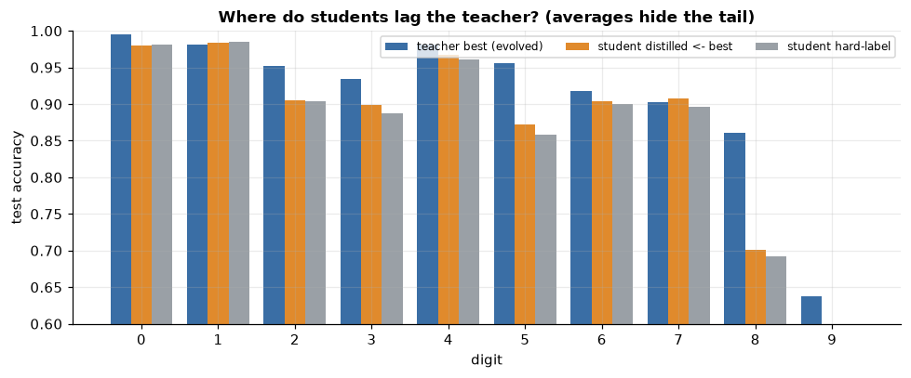
RESULTS: DISTILLATION
3.2x smaller, 2.5-4x faster, 3.6 points less accurate
Hard-label 0.906 +- 0.002; distilled from v000 0.911 +- 0.006; from best 0.909 +- 0.001 (3 seeds).
Distilled vs hard-label +0.3 points: no clear effect.
Digit 9: teacher 21 points ahead; the average hides the tail.

Slide 8
DEMO
Reading a sheet
streamlit run app/streamlit_app.py -> Try it (upload a photo or a random synthetic sheet).
Version vs previous version: colored code diff, metric deltas, per-digit bars.
Backup: python demo.py photo.jpg

Slide 9
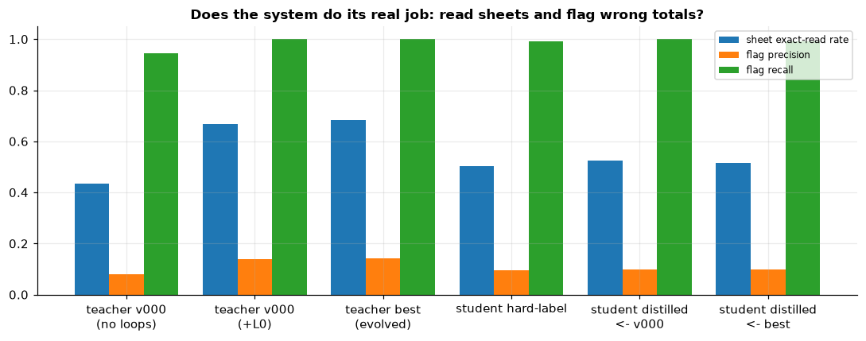
FAILURE ANALYSIS
What did not work, and why
Edits rarely helped: every operator type lowered dev accuracy on average; evolution is mostly rejection.
The small-budget gain vanished at full budget: the loop optimised the cheap evaluator.
Compensating errors pass the sum check (39 accepted sheets in the best run).
Flag precision 0.14 at recall 1.0: most flags are misreads, not miscounts.

Slide 10
INTERFACES BETWEEN TRACKS
Verified pseudo-labels feed the student
Teacher improved by verified feedback -> pseudo-labels (+ seed digits) -> student transfer set; teacher logits = soft targets.
Noise in pseudo-labels passes into the student; the evolved teacher gave no better student than v000.
Possible reverse link (not built): student as a cheap scorer inside the loop.

Slide 11
LIMITS
What this does not show
Real handwriting: the real-photo test was not run; MNIST sheets are cleaner than phone photos.
Small edit space, few seeds, single-training teachers, dev optimism after 20 candidates.
Latency from one machine, one thread; the sandbox is not OS-level.
Bounded, sandboxed recursion only: not open-ended self-improvement.

