Slide 1
Software testing
Postman
Efrem Gokinan

Slide 2
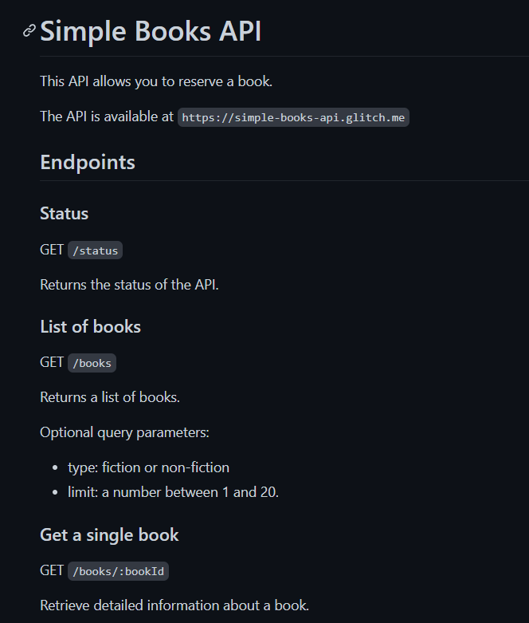
Simple books api

Slide 3
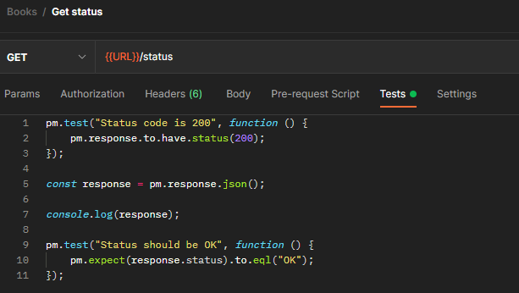

Get status

Slide 4
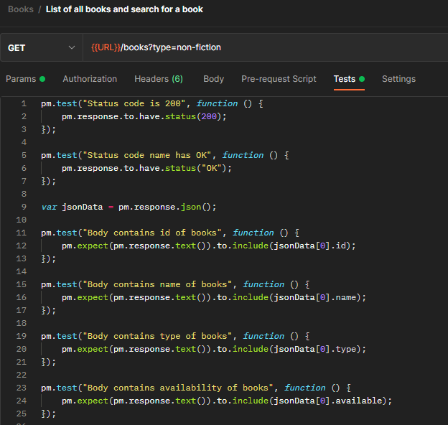
Get list of books & search for a book

Slide 5
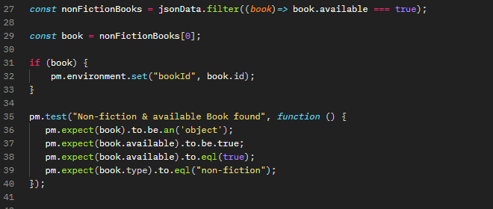
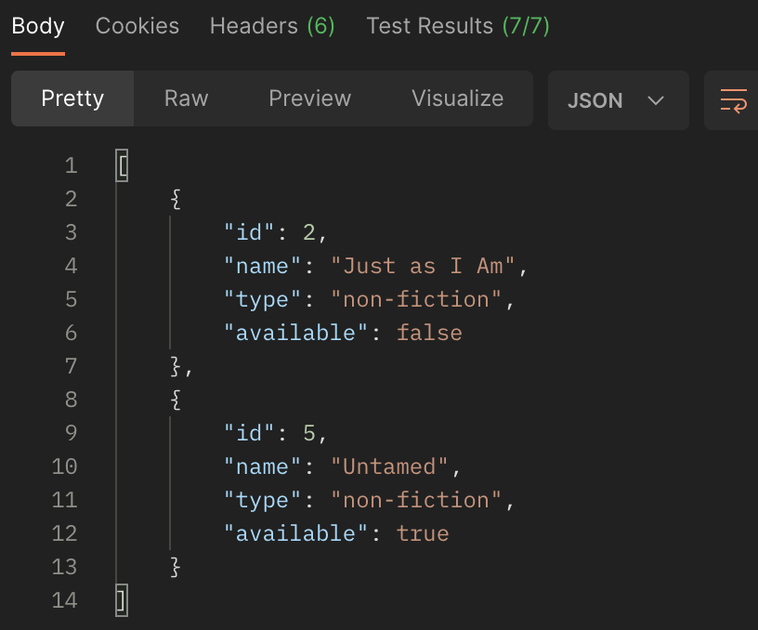
Get list of books & search for a book

Slide 6
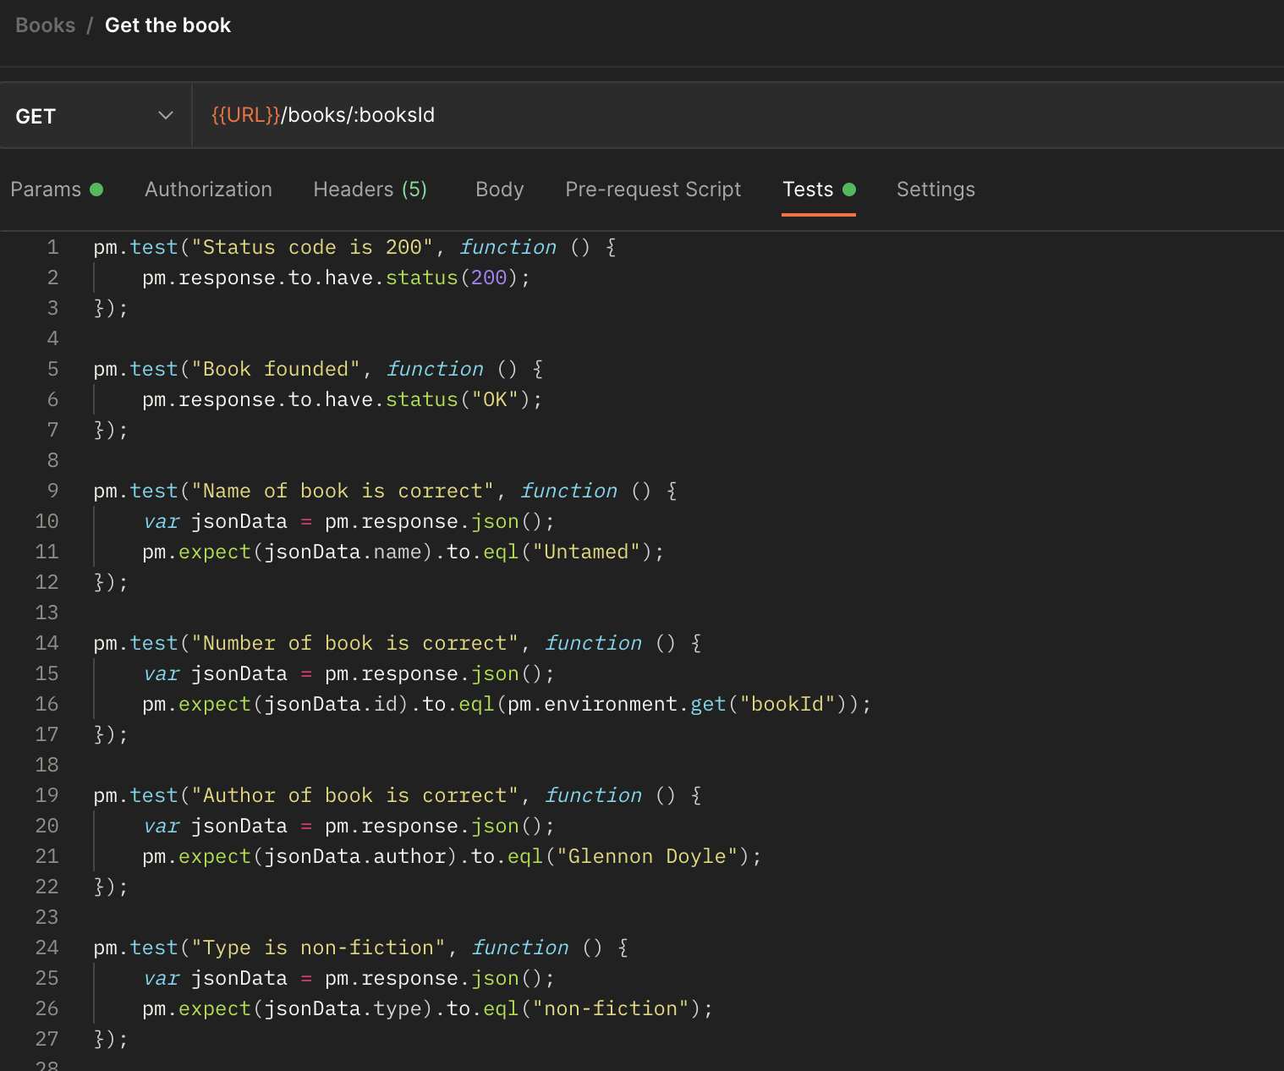
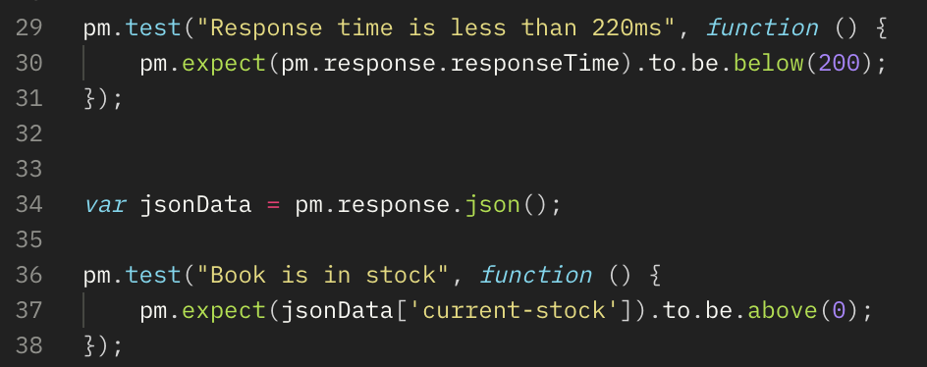
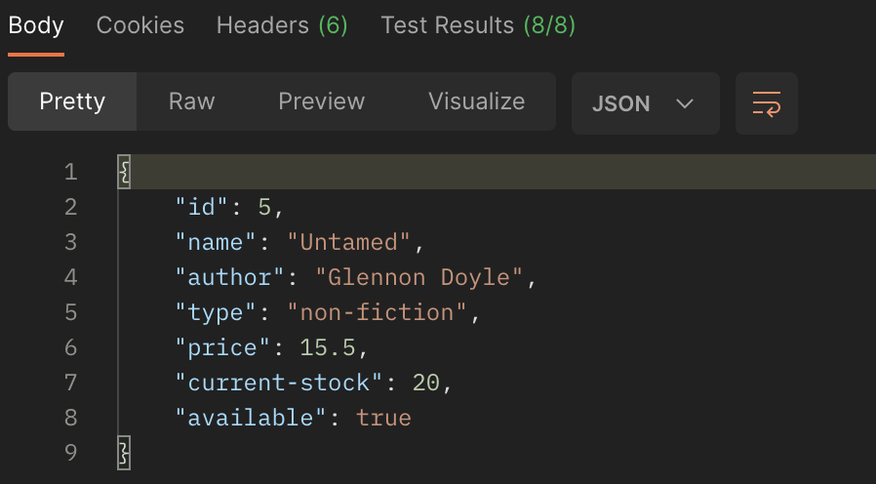
Get the founded book

Slide 7
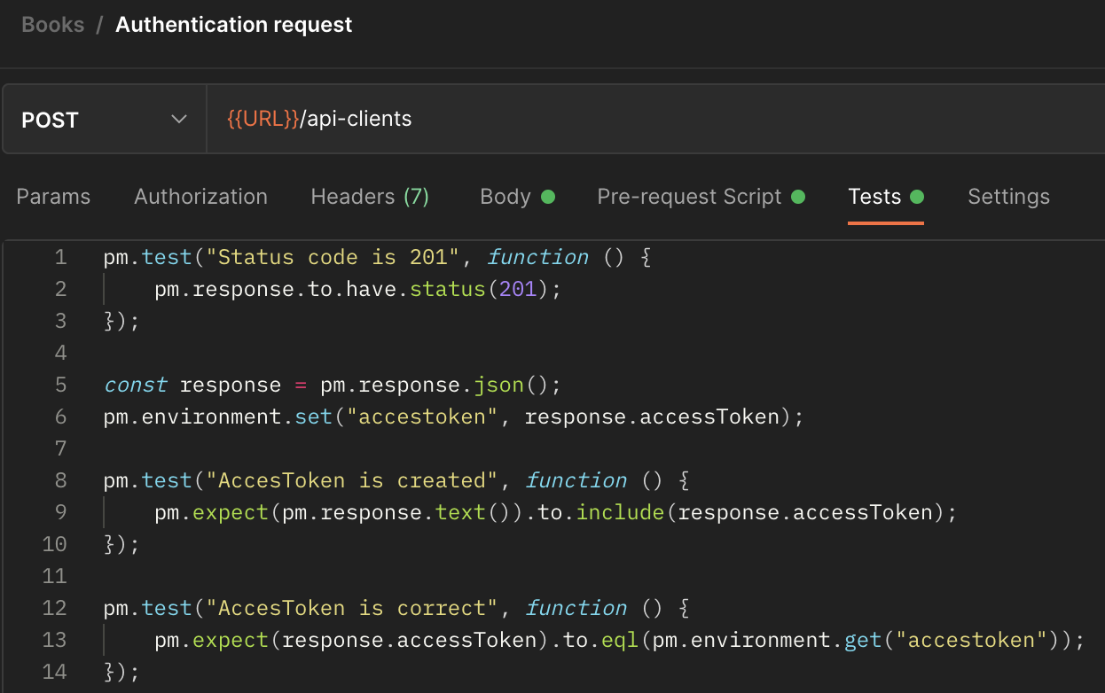



Auth request

Slide 8

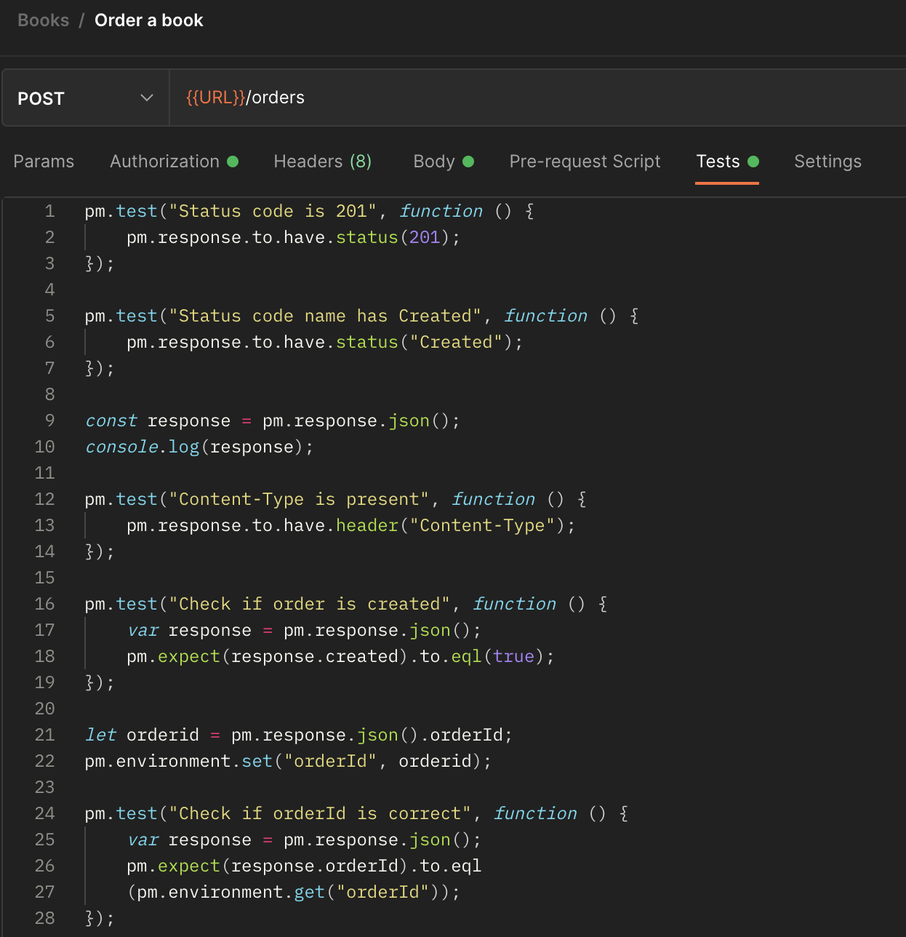


Order a book

Slide 9
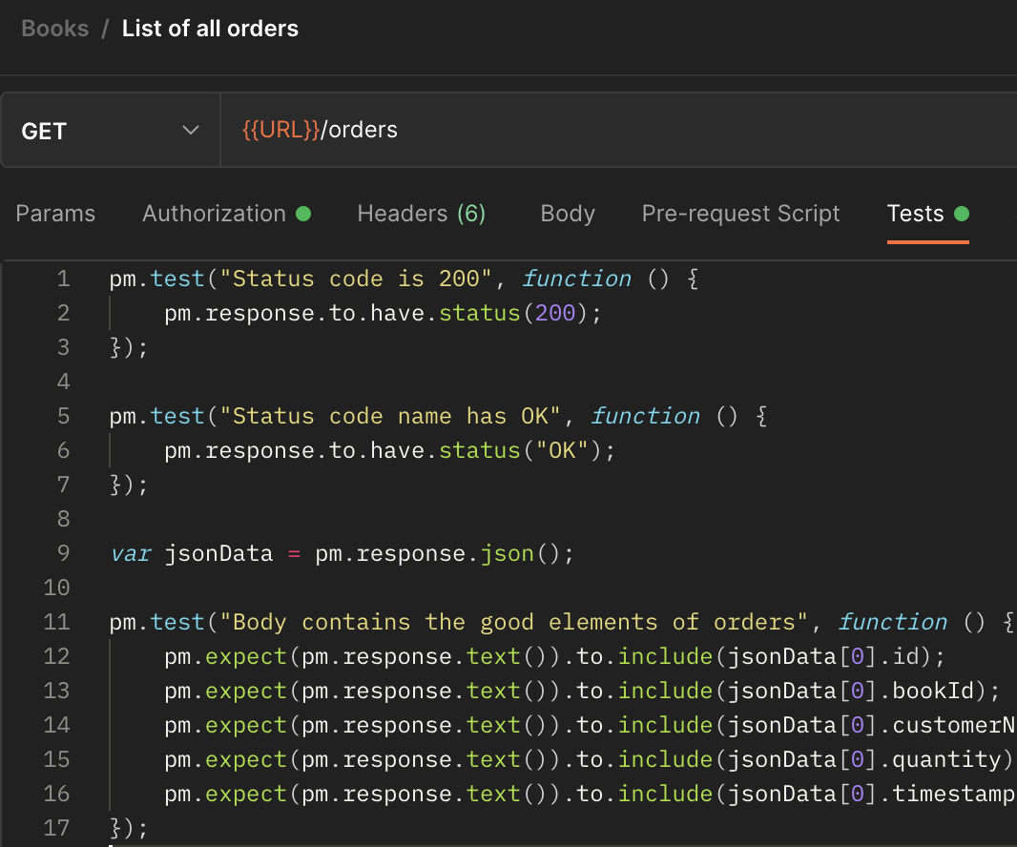
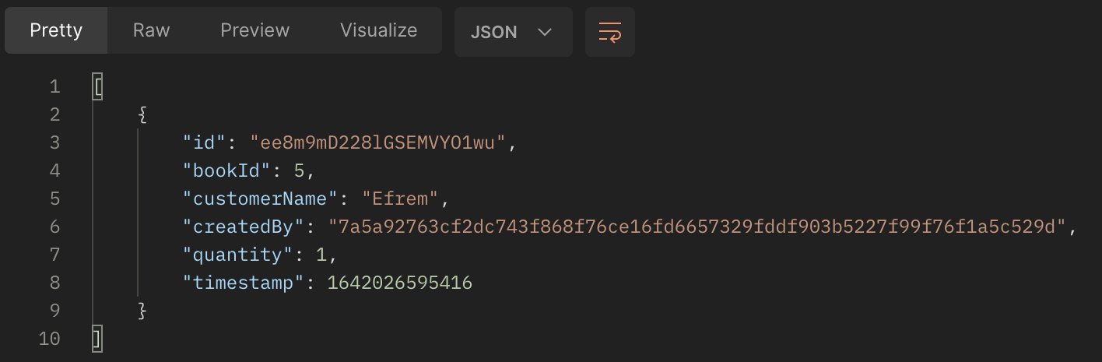
Get all orders

Slide 10
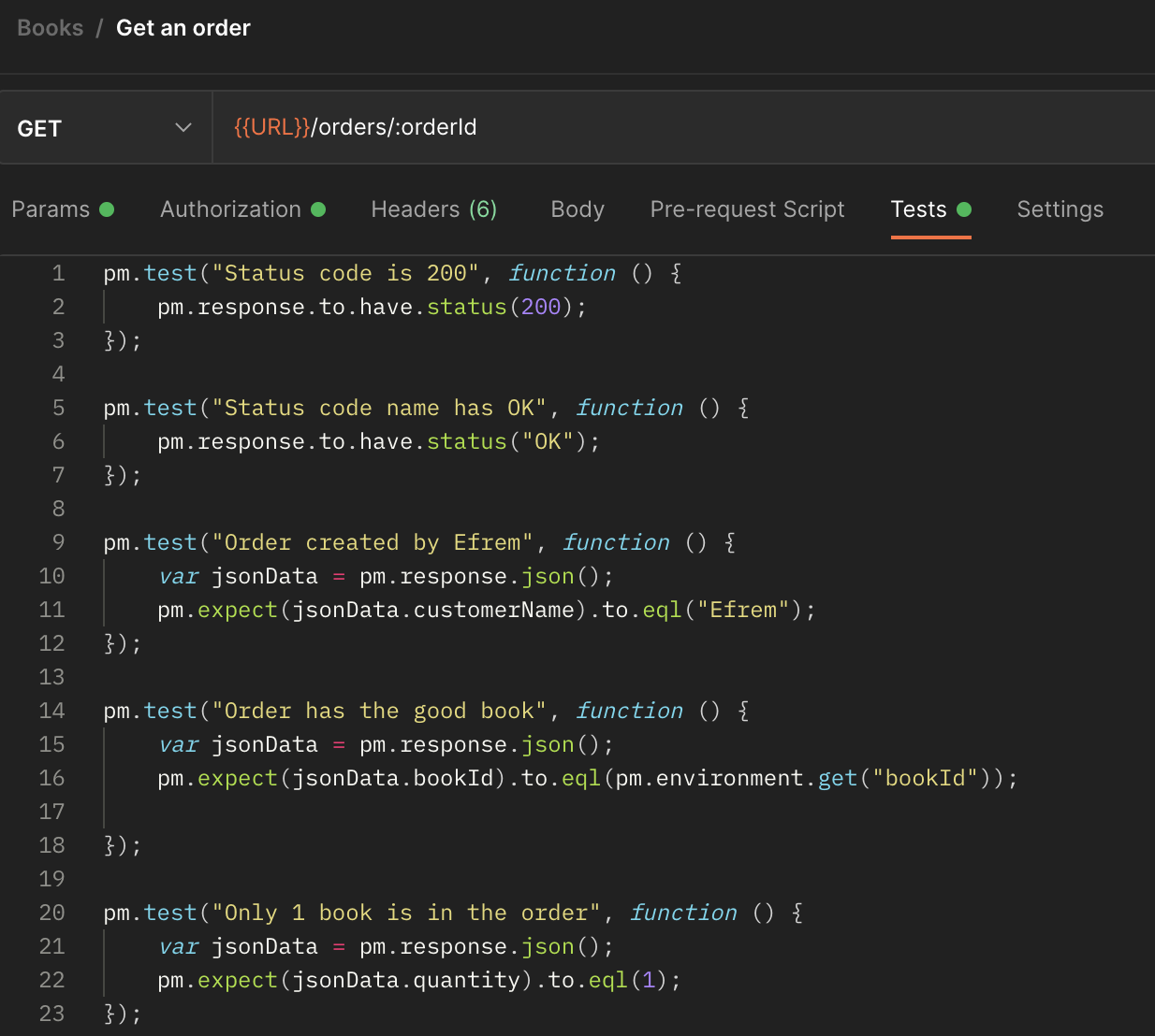
Get an order

Slide 11
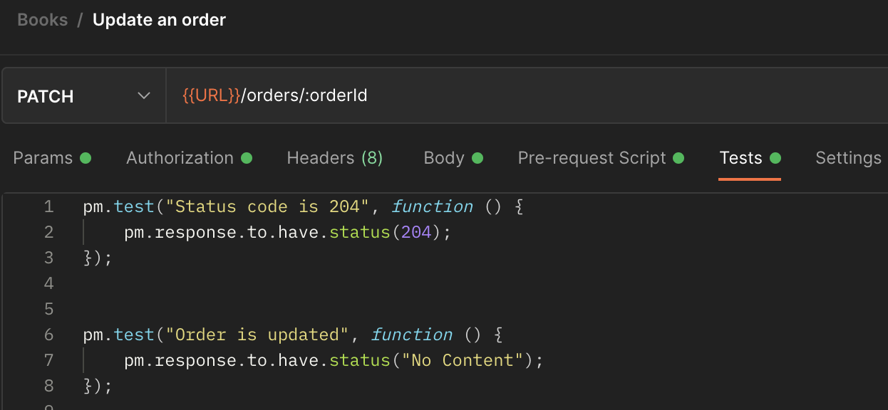


Update order

Slide 12
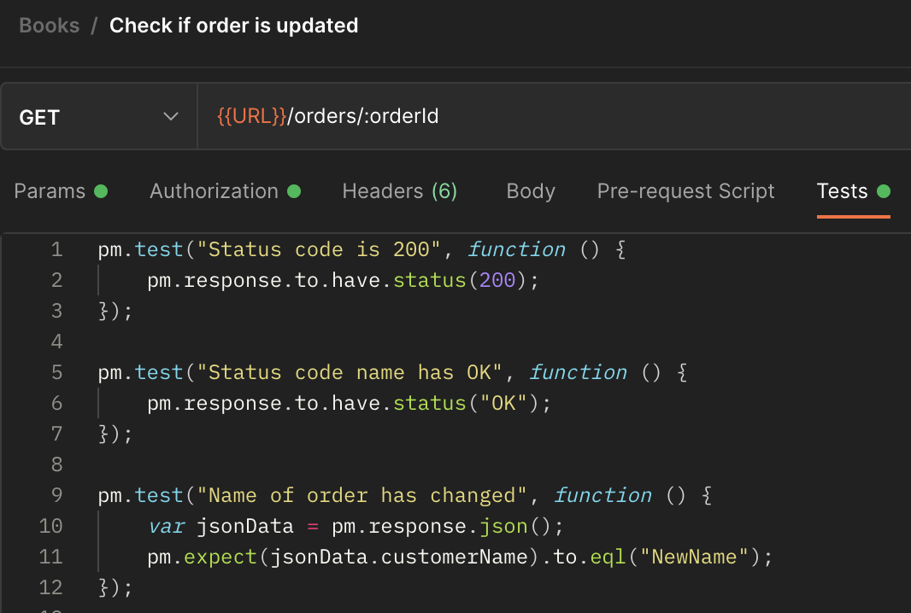
Check if order is updated

Slide 13
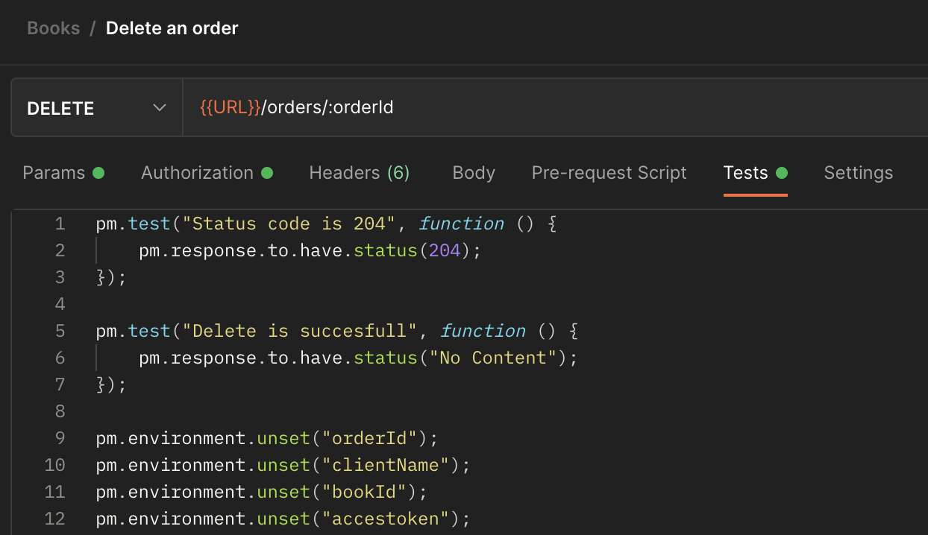
Delete an order

Slide 14
Collection runner

Slide 15
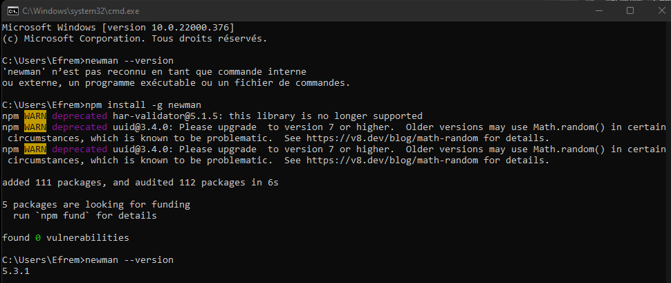
Collection runner w/ newman

Slide 16
Collection runner w/ newman
https://www.getpostman.com/collections/ac2cbb00e3d0b4dd8a63

Slide 17
Collection runner w/ newman
https://www.getpostman.com/collections/ac2cbb00e3d0b4dd8a63

Slide 18
Einde

