Slide 1
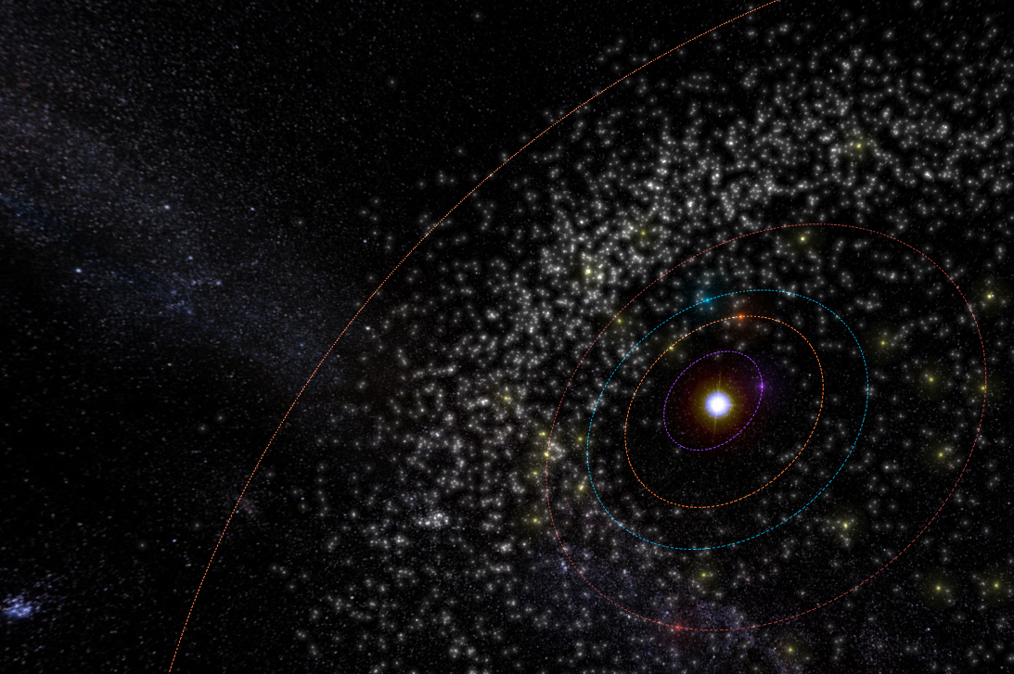
An Analysis of Asteroid Orbits
Group Members:
Paul Hoogestraat
Brent Sergent
Erik Fritzsche

Slide 2
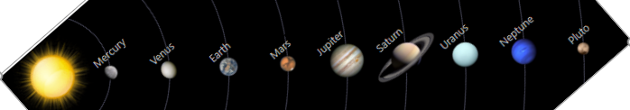
Overview
The known number of asteroid is estimated to be 1,016,447. –NASA
The majority of asteroids orbiting the sun are located between Mars and Jupiter (estimated 1.1 to 1.9 million). These are known as the Main asteroid belt. –NASA
Asteroids located near earth are estimated at 10,000. Roughly 800 are 1 kilometer in diameter. –NASA
The composition of asteroids predominately contain chondrite (known as C-type), silicates (S-type) , and metals (M-type). –NASA
What can we learn from all this data?
1 Astronomical Unit (AU)
Main
Asteroid belt
Near Earth Asteroids

Slide 3
Composition of Asteroids

Slide 4

The Hypothesis
Question
Do rare earth elements exist in significant quantities on asteroids near earth?
Null hypothesis (H_{o})
If an asteroid with rare earth elements are close to earth, then a measurable amount of rare earth elements will not be detected more or less observed.
Alternative Hypothesis (H_{a}):
If an asteroid with rare earth elements are close to earth, then a measurable amount of rare earth elements more or less will be detected.

Slide 5
Resources and Methods
Asterank Database - Link
Asterank is a scientific and economic database of over 600,000 asteroids. The database is a collection of data consisting of asteroid mass, spectral data, orbits, and other critical data points. Asteroid mass and spectral data are employed to estimate a financial value of an asteroid based on current metal prices. (examples: Os, Ir, Ru, Pt, Rh, Co, Au, Pd, Ni, and Cr) . These net values of an identified asteroid are reported on the Asterank website in a dollar amount.
Assumptions
For the purpose of this exercise, the financial value of each asteroid will serve as a metric to quantify the presence of precious metals and or rare earth elements. An asteroid estimated to be valued at 1 trillion dollars and above will be considered to have a significant amount of precious and rare earth metals. The categories assigned were as follows: less than one billion, Less than a trillion, 1 trillion to 99 trillion, greater than 100 trillion, and no observed metal.
A Dataset was constructed based on the proximity of an asteroid to earth. A range of 0.8 to 1.2 Astronomical Units (AU) will be used for this exercise.
Resources
Asterank Database
Juniper notebook

Slide 6
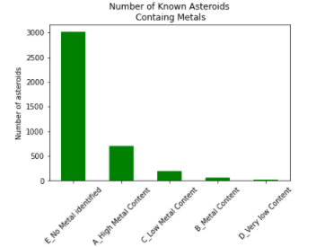
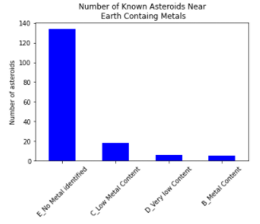
Number of Asteroids Near Earth Evaluated
A _High Metal Content (over 100 trillion)
B_Metal Content (1 to 100 trillion)
C_Low Metal Content( 1 to 999 billion)
D_Very Low Content (1 to 999 million)
E_No Metal Identified
A _High Metal Content (over 100 trillion)
B_Metal Content (1 to 100 trillion)
C_Low Metal Content( 1 to 999 billion)
D_Very Low Content (1 to 999 million)
E_No Metal Identified
4000 asteroids were considered
Max orbit 365 AU: Min orbit 0.642 AU
75% asteroids have no observed metals.
18% asteroids have over 110 trillion of identified metals
2% asteroids have between 1 to 110 trillion
5% asteroids have between 1 to 999 billion
1% asteroids have between 1 to 999 million
163 Asteroids met orbit criteria
Max orbit AU 1.2: Min orbit 0.8 AU
82% asteroids have no observed metals.
5% asteroids have between 1 to 110 trillion
11% asteroids have between 1 to 999 billion
4% asteroids have between 1 to 999 million

Slide 7
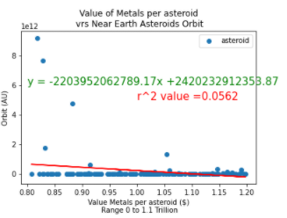
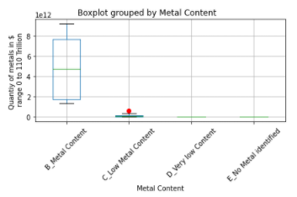
Near Earth Orbit Asteroids (0.8 to 1.2 AU)
Scatter plot
Plot represents 163 asteroids ranging from 0$ to 100$ trillion (Orbit of asteroids 0.8 to 1.2 AU).
X axis range is 0 (Low metal density) to 1.1 trillion (High metal density).
r² value suggests there is no correlation between orbit distance and quantity of metal on an asteroid
Boxplot
Plot represents 163 asteroids ranging from 0$ to 100 trillion$.
Orbit of asteroids 0.8 to 1.2 AU.
No asteroids over 110 trillion were observed in orbital restricted data set.
B_Metal content mean falls within the data distribution.
C_Low metal Content did have outliers. For this exercise not significant

Slide 8

One Sample t-test
One Sample t test criteria:
Asteroids orbiting in the range of 0.8 to 1.2 AU were considered
Sample 1 consisted of asteroids with no observed metals
Sample 2 consisted of asteroids believed to have Metal (1 to 100 trillion)
Results
p-Value = = 0.03398119
t-statistic = -31666205
The Null hypothesis can be rejected bassed on the p-value result. This would support the alternative hypothesis:
If an asteroid with rare earth elements are close to earth, then a measurable amount of
rare earth elements more or less will be detected.
The number of asteroids in proximity to the earth containing rare earth elements is significant bassed on the data accumulated. The p-value complimented with the data presented would suggest that rare earth elements exist in statistical meaningful quantities on asteroids near earth.
Conclusion

Slide 9
Analysis of Near Earth Objects

Slide 10
The Hypothesis
Question:
Are more asteroids posing an impact threat to Earth today then the did 15 years ago?
Null hypothesis (H_{o}):
If the number of asteroids posing an impact threat is unchanged per year over the last 15 years, then no changes in the number of asteroids posing an impact threat will be seen comparing the current year to the last 15 years.
Alternative Hypothesis (H_{a}):
If the number of asteroids posing an impact threat is changed per year over the last 15 years, then changes in the number of asteroids posing an impact threat will be seen comparing the current year to the last 15 years.

Slide 11
Resources
NASA: Link
NASA has many APIs available to the public. The one I choose is the Asteroid NeoWS API. This data contains all asteroids that have traveled within 10 Lunar Distances from Earth. Some of the data available for each asteroid in the database includes:
ID
Name
Distance from Earth at Approach
Velocity
Whether it is potentially hazardous to Earth
NASA has another API (SSD/CNEOS) that contains data about near-earth objects, but this data set did not include information on whether the asteroid would be potentially hazardous to Earth.

Slide 12
Challenges in Gathering Data
While working to gather the necessary data from the Asteroid NeoWS API, I experienced the following challenges.
A user is limited to 1,000 API requests in a 24-hour period.
Each request to the API is limited to a 7-day date range. In order to gather enough data for an analysis I had to create a loop that would pass a 7-day date range to the API for a span of 15 years. That works out to 825 requests.
Data returned in the request is organized by date. This posed the challenge of creating a loop that would run through each date in the response in order to gather data for each asteroid observed.
The data set for each date in the response was organized with multiple levels of lists nested inside dictionaries. This required me to have several nested For loops which added to the complexity of keeping the code clean.
I found the best way to keep my code clean was to break it down into functions. While I was able to see data being returned from the API, I could not figure out how to pass the lists of data from one function to another in order to create a dataframe.
Due to the complexity in the organization of the response object, I was not able to determine how to write the data to a .csv file which would have allowed me to analyze the data.

Slide 13
Planned Analysis
In the analysis of the data I wanted to gather I planned to complete the following for the time period of 1/1/2005 to 10/24/2020:
Find number of asteroids determined hazardous over the past 15 years
Find the number of asteroids labeled not hazardous over the past 15 years
Find the mean of asteroids observed each year (2005 to 2020). This would also include the mean of the asteroids labeled hazardous and not hazardous
Compare the number of asteroids observed in 2005 and 2006 that were labeled hazardous to the number of asteroids observed in 2019 and 2020 that were labeled hazardous.
Determine if there is an increase in the number of asteroids being labeled hazardous
Determine if there is an increate in the number of asteroids being labeled not hazardous
Determine if the data supports or rejects the Null hypothesis

Slide 14
Analysis of Asteroids and the Inner Planets

Slide 15
The Hypothesis
Question:
Are inner planets receiving more close approaches on average in the recent decade they did in the last 5 decades?
Null hypothesis (H_{o}):
If the average close approaches count is unchanged per year over the last 50 years, then no changes in the average close approaches count will be seen comparing the most recent decade to the last 4 decades from now.
Alternative Hypothesis (H_{a}):
If the average close approaches count is changing per year over the last 50 years, then changes in the average close approaches count will be seen comparing the most recent decade to the last 4 decades from now.

Slide 16
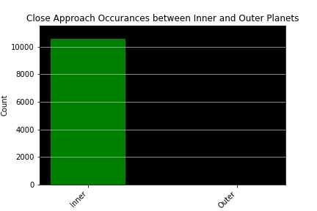
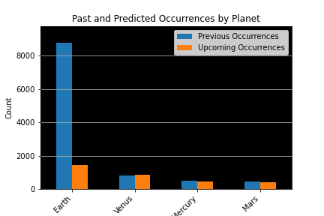
Narrowing the Scope
Variables:
Range: within 21 Lunar distances; ~5,000,000 miles
Date Range: 1969 to 2019
Inner Planets: Mercury, Venus, Earth, Mars
Observations across outer planets are not well documented as the events are harder to obtain.

Slide 17
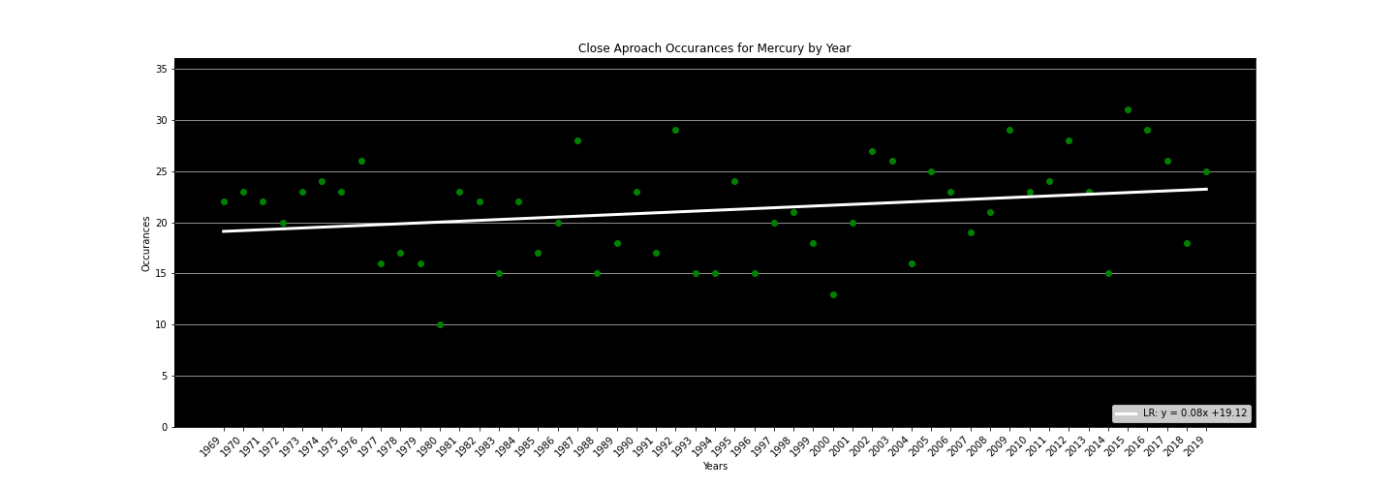
Close Approaches with Mercury
Statistical Values:
P Value: 0.070729
Correlation Coefficient: 0.065116
Statistical Analysis
Cannot Reject the Null Hypothesis
There is a very weak positive
correlation occurring.

Slide 18
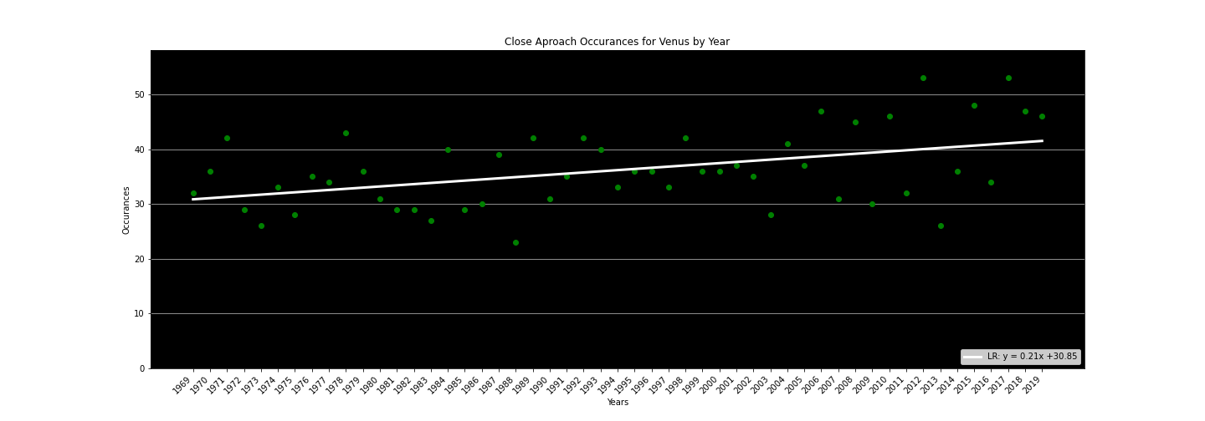
Close Approaches with Venus
Statistical Values:
P Value: 0.000970
Correlation Coefficient: 0.200959
Statistical Analysis
Significant enough to Reject
the Null Hypothesis
There is a weak positive
correlation occurring.

Slide 19
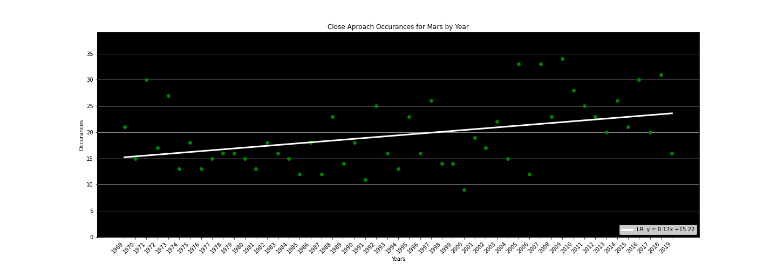
Close Approaches with Mars
Statistical Values:
P Value: 0.005003
Correlation Coefficient: 0.149908
Statistical Analysis
Can Reject the Null Hypothesis
There is a very weak positive
correlation occurring.

Slide 20
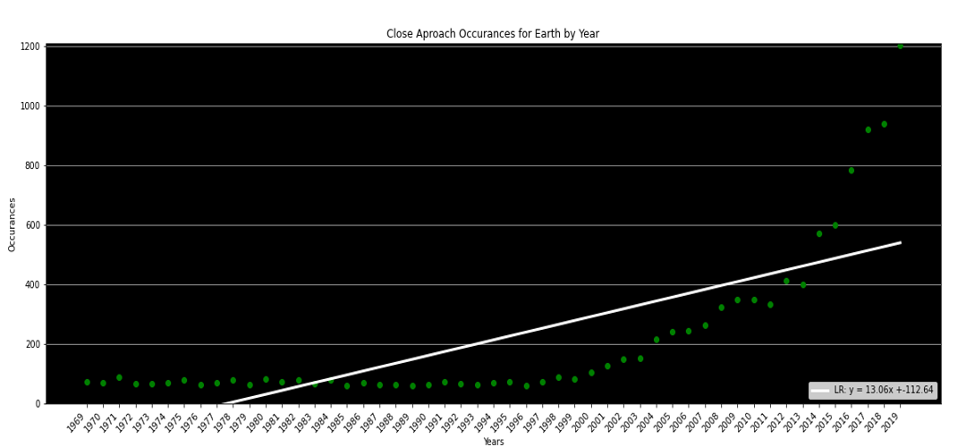
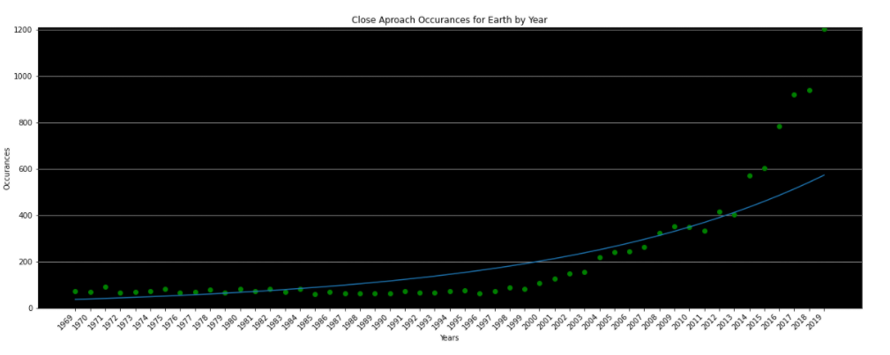
Close Approaches with Earth
Statistical Values:
P Value: 0.0000001
Correlation Coefficient: .551913
Statistical Analysis
Can Reject the Null Hypothesis
There is a moderately positive
correlation occurring.

Slide 21
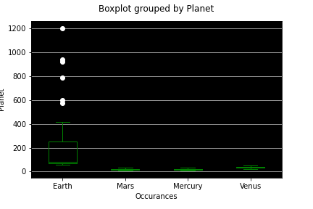
Analysis of the Data
T-Test:
Mercury and Mar’s T-test was the only one that did not show a significant difference between the sample set’s means.
F-statistic: 2.46485
P-Value: 0.119577
Statistical Analysis
High evidence to Reject the Null Hypothesis
There is a positive trend of asteroids detected across all inner planets, however at different rates.

Slide 22
References
References for the presentation
An Analysis of Asteroids Orbits overview: README.md
Final Report analysisFinal.pptx
GitHub Parent Repository Link
NASA API Link
Asterrank Link
Do rare earth elements exist in significant quantities on asteroids near earth?
Jupyter lab Notebook asteroid4.ipynb
GitHub Parent folder Link Link
Density of asteroids 10.1016/j.pss.2012.03.009
Review Review
Are more asteroids posing an impact threat to Earth today than they did 15 years ago?
Jupyter lab Notebook neo_asteroids.ipynb
Parent Repository Link
Are inner planets receiving more close approaches on average in the recent decade they did in the last 5 decades?
Jupyter lab Notebook GraphInfoBS25Oct2020.ipynb
GitHub Parent Folder link AsteroidsAmongstPlanets25Oct2020BS

