Slide 1
Security Access Control (SAC)
Multi-Factor Authentication (MFA)
Efstathios Chatzikyriakidis
M.Sc. in Informatics and Communications
Specialization in Computational Intelligence and Digital Media
School of Informatics, Faculty of Sciences
Aristotle University of Thessaloniki, Hellas
B.Sc. in Informatics and Communications
Specialization in Software Engineering
Department of Informatics and Communications, Faculty of Applied Technology
Technological Educational Institute of Central Macedonia, Hellas
27 July 2018
Thessaloniki, Hellas
Email : contact@efxa.org
Website : www.efxa.org

Slide 2
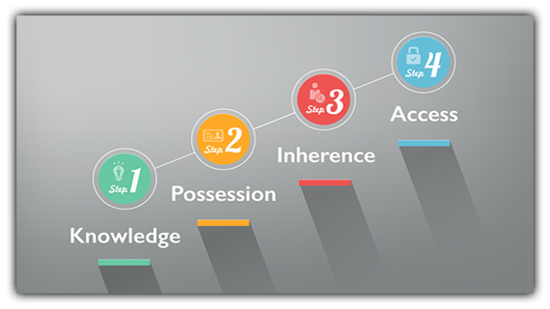
What is Multi-Factor Authentication (MFA) ?
Multi-Factor Authentication (MFA) is a method of confirming a user's claimed identity in which a computer user is granted access only after successfully presenting 2 or more pieces of evidence (or factors) to an authentication mechanism.

Slide 3
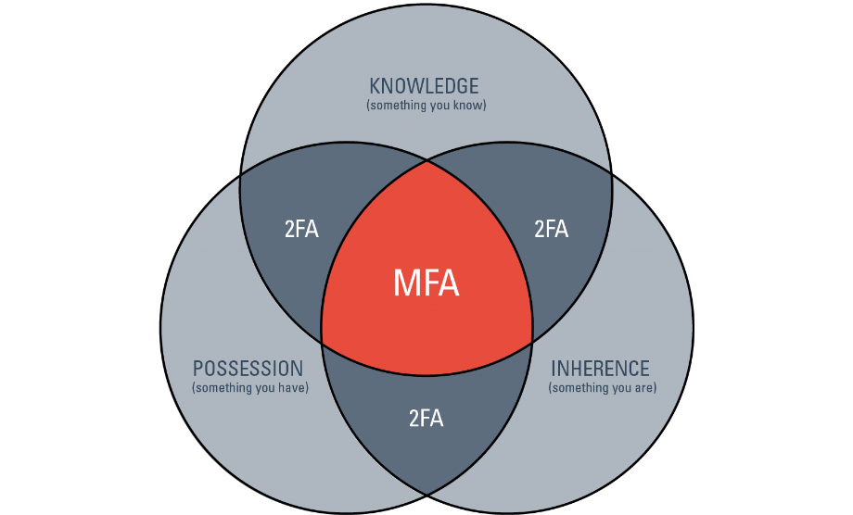
What is Multi-Factor Authentication (MFA) ?

Slide 4
1-Factor Authentication (1FA)
Knowledge (something the user knows)
  Password, Image, Pattern

Slide 5
2-Factor Authentication (2FA)
Knowledge (something the user knows)
  Password, Image, Pattern
Possession (something the user has)
  Fob that generates a pre-determined code
  Signed Digital Certificate
  Smartphone
  RFID Tag

Slide 6
3-Factor Authentication (3FA)
Knowledge (something the user knows)
  Password, Image, Pattern
Possession (something the user has)
  Fob that generates a pre-determined code
  Signed Digital Certificate
  Smartphone
  RFID Tag
Inherence (something the user is)
  Voice, Fingerprint, Palm Veins, Face, DNA, Hand Geometry, Iris, Retina

Slide 7
3FA Prototype with Arduino Platform
Something the user knows : Password
Something the user has : RFID Tag
Something the user is : Voice

Slide 8
Why Arduino Platform?
Open Source Hardware / Open Source Software
Cheap
Easily available
Easy to use
Easy to program
Very widespread
Various hardware modules available

Slide 9
Hardware Parts
Keypad Module (12 Button)
VRBot Module
RFID USB Reader
RFID Reader ID-12LA (125kHz)
RFID Tags (125kHz)

Slide 10
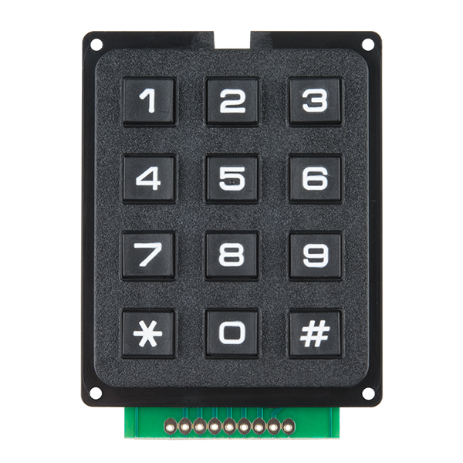
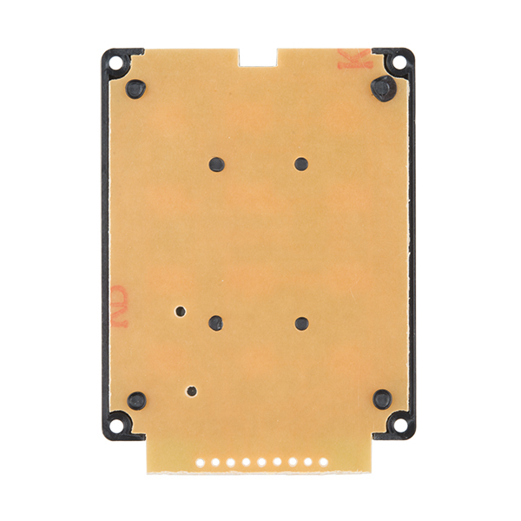
Keypad Module (12 Button)

Slide 11
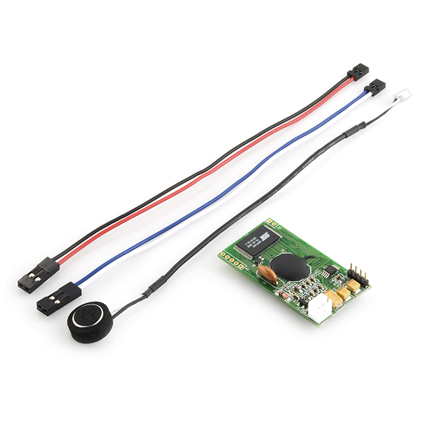
VRBot Module

Slide 12
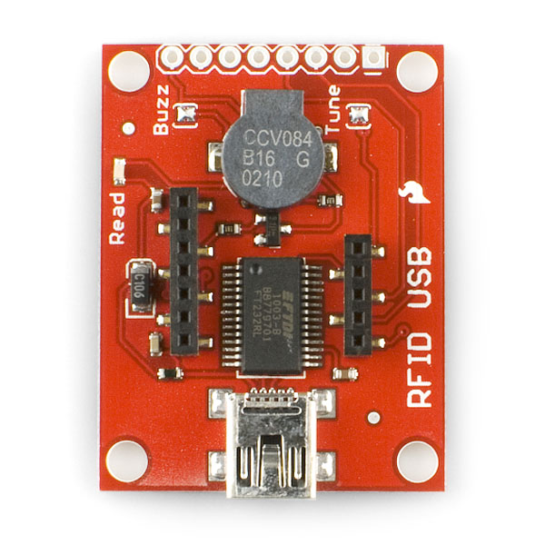
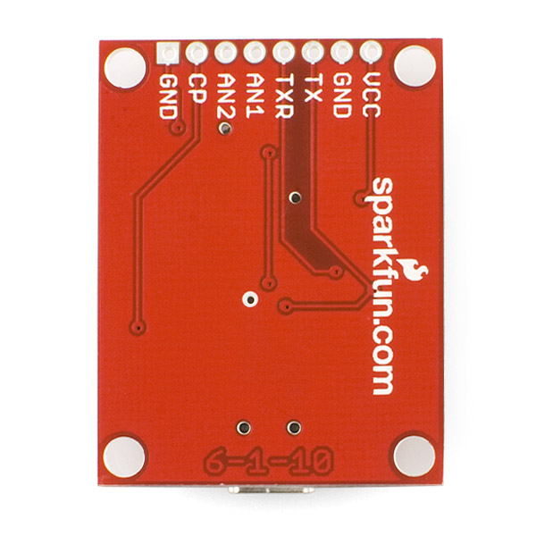
RFID USB Reader

Slide 13
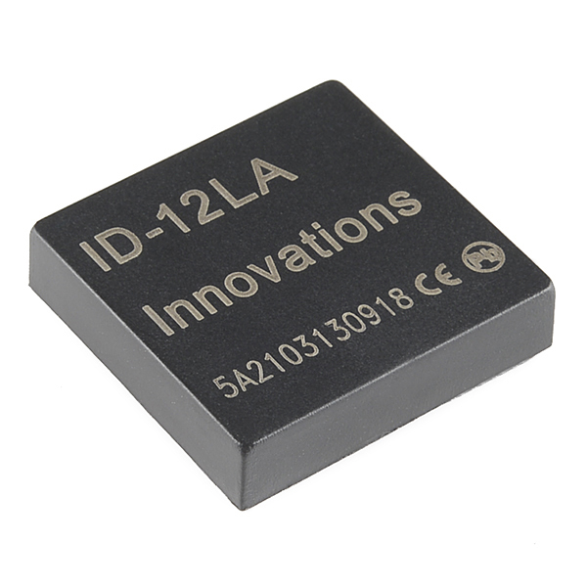
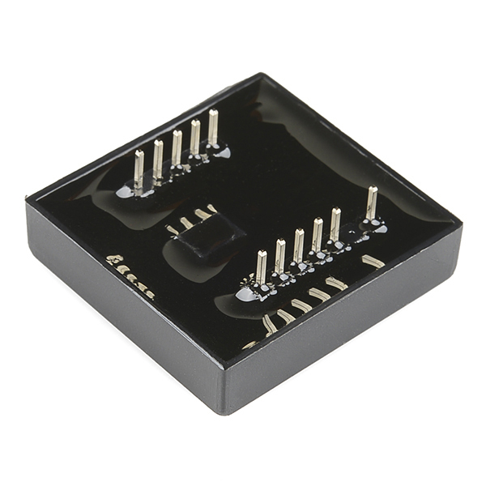
RFID Reader ID-12LA (125kHz)

Slide 14

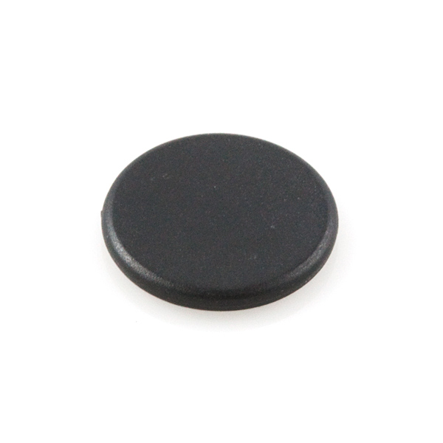
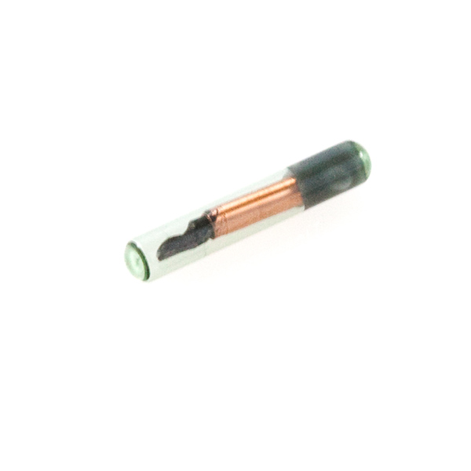
RFID Tags (125kHz)

Slide 15
External Software Libraries
Finite State Machine
Software Serial
Keypad
VRBot Module Communication Protocol
Musical Notes Pitches

Slide 16
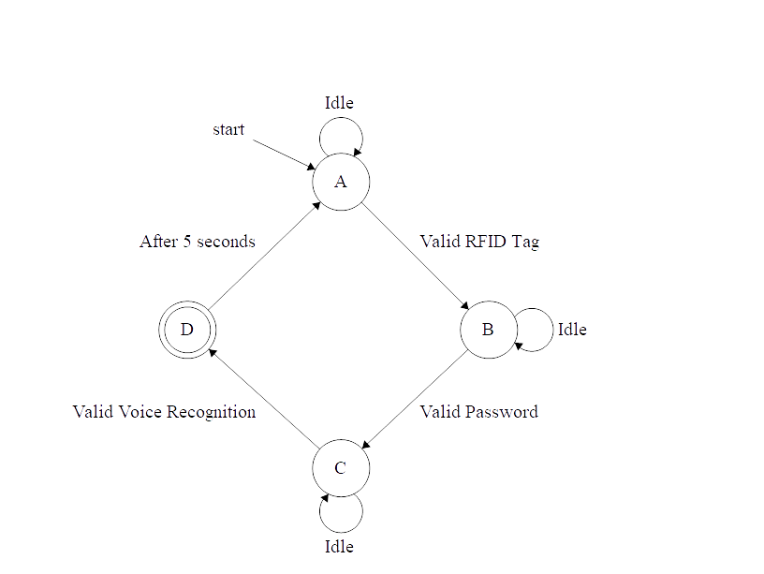
Finite State Machine
A - RFID Tag authentication
B - Password authentication
C - Voice authentication
D - Successful Access

Slide 17
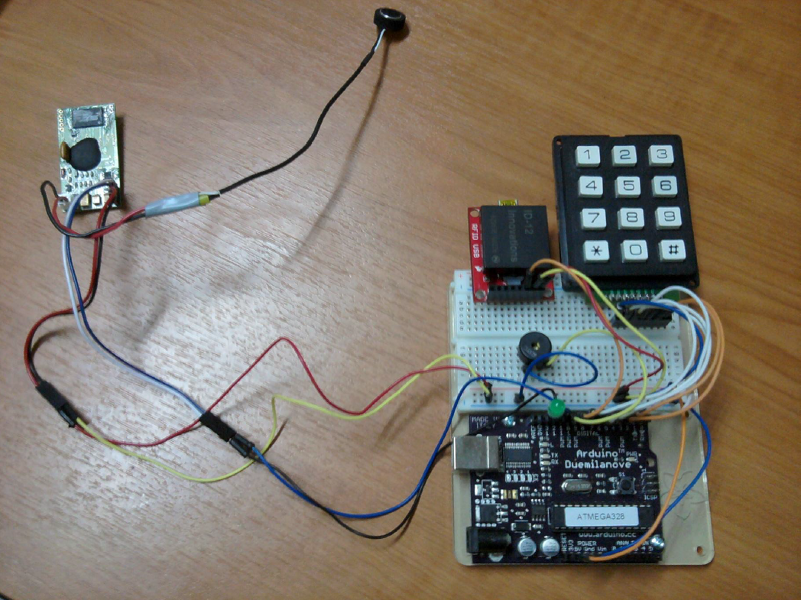
Prototype Photograph

Slide 18
Resources
http://www.arduino.cc
http://www.sparkfun.com
http://www.veear.eu
http://www.id-innovations.com
http://en.wikipedia.org/wiki/Multi-factor_authentication
http://efxa.org/arduino_security_control_multi_factor_authentication
http://gitlab.com/efxa/security-access-control-multi-factor-authentication

