Slide 1
CSE 4128 Image Processing and Computer Vision Laboratory Week 4:Frequency Domain Filtering
Dr. Sk. Md. Masudul Ahsan
Professor
Dept. of CSE, KUET
Dipannita Biswas
Lecturer
Dept. of CSE, KUET

Slide 2
2D Discrete Fourier Transform
Represents an image in a frequency domain where the original image is represented in a spatial domain.
2D DFT converts an image into a complex array that consists of :
Power Spectrum
Phase Angle

Slide 3
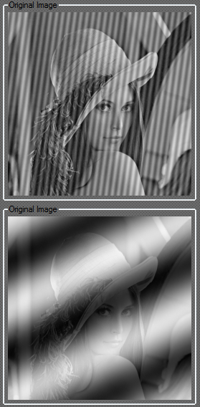
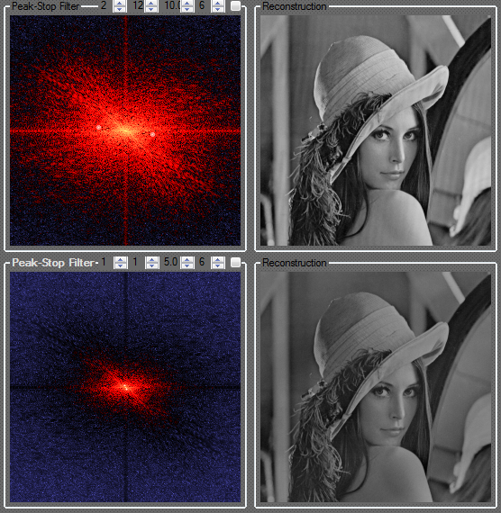
Fourier Transform

Slide 4
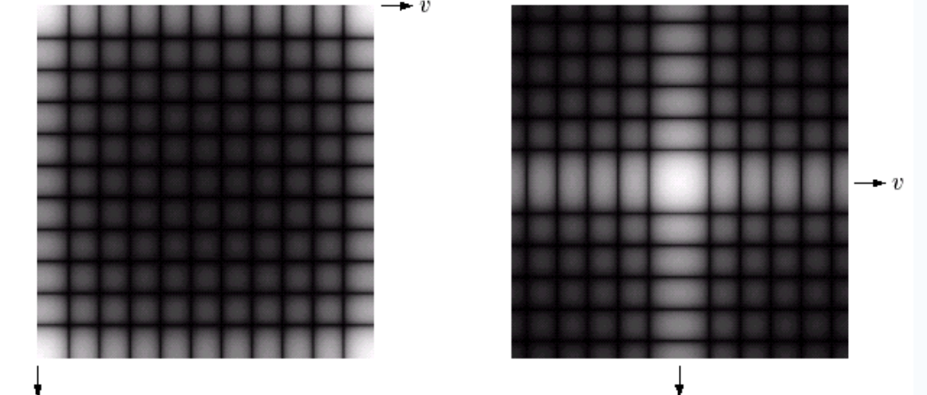
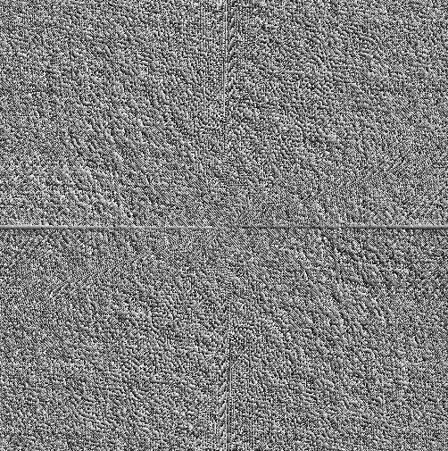
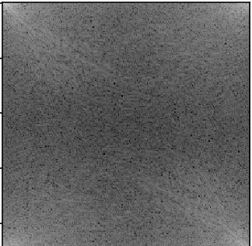
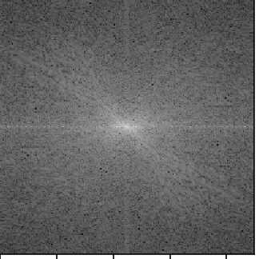
Basics of Filtering in the Frequency Domain
Phase
Spectrum moved into the centre

Slide 5
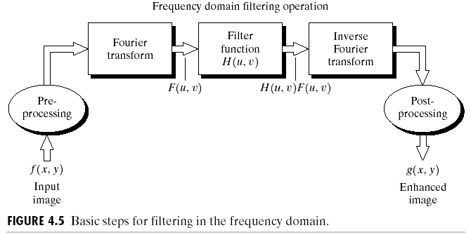
Basics of Filtering in the Frequency Domain
To filter an image in the frequency domain:
Compute F(u,v) by DFT of the image f(x,y).
Multiply F(u,v) by a filter function H(u,v).
Compute the inverse DFT of the result .

Slide 6
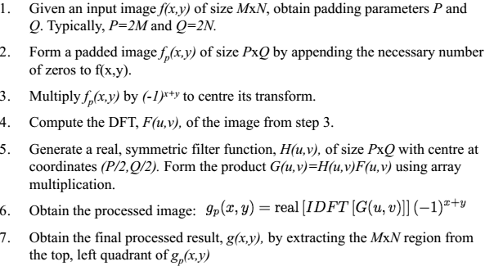
Steps for Filtering in the Frequency Domain

Slide 7
Classwork
Take an input grayscale image and apply Notch reject filters on the Fourier domain to remove periodic noise from the image.
Compute DFT F(u,v) for the input image.
Show the power spectrum of F(u,v)
Select the coordinates from the spectrum which you want to remove.
Generate the Notch reject filter around the coordinate(= center) to reject that specific frequency as H(u,v). The radius of the Notch will be user imput. Show H(u,v).
Form the product G(u,v) = F(u,v)H(u,v).
Apply Inverse Fourier Transform to generate the output image in the spatial domain.

Slide 8
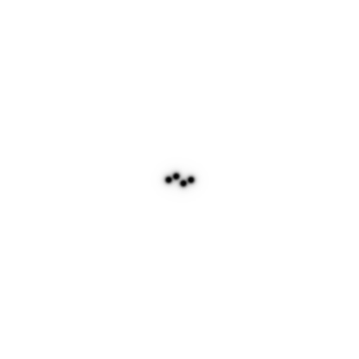
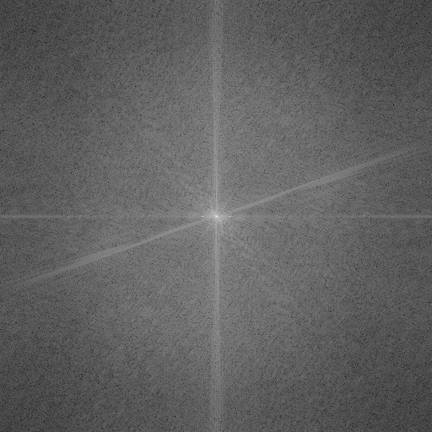
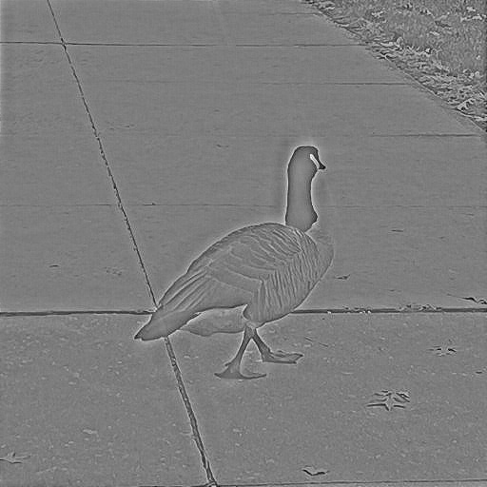
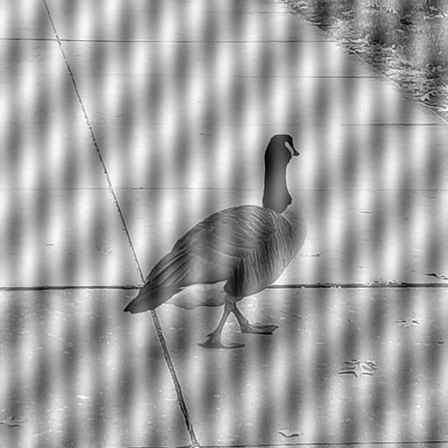
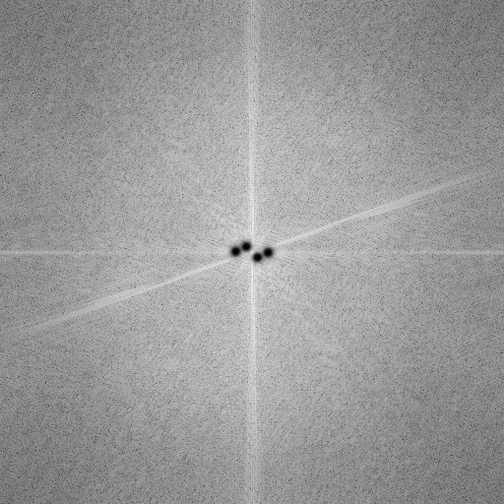
Classwork
Power spectrum
Notch filter
phase

Slide 9
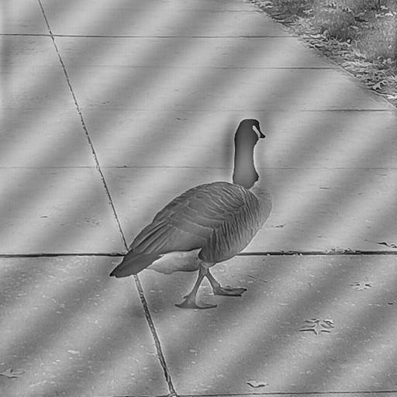
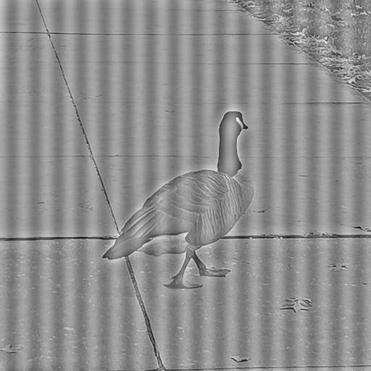
Classwork
Removing frequency at (u,v)= (272,256) , D0 = 5, n=2
Removing frequency at (u,v)= (262,261) , D0 = 5, n=2

Slide 10
Notch Filter
A notch filter rejects (or passes) frequencies in a predefined neighborhood about the center of the frequency rectangle.
A notch is symmetric about the origin (center of the frequency rectangle)
One with center at (u₀, v₀) must have a corresponding notch at location (-u₀, -v₀)

Slide 11
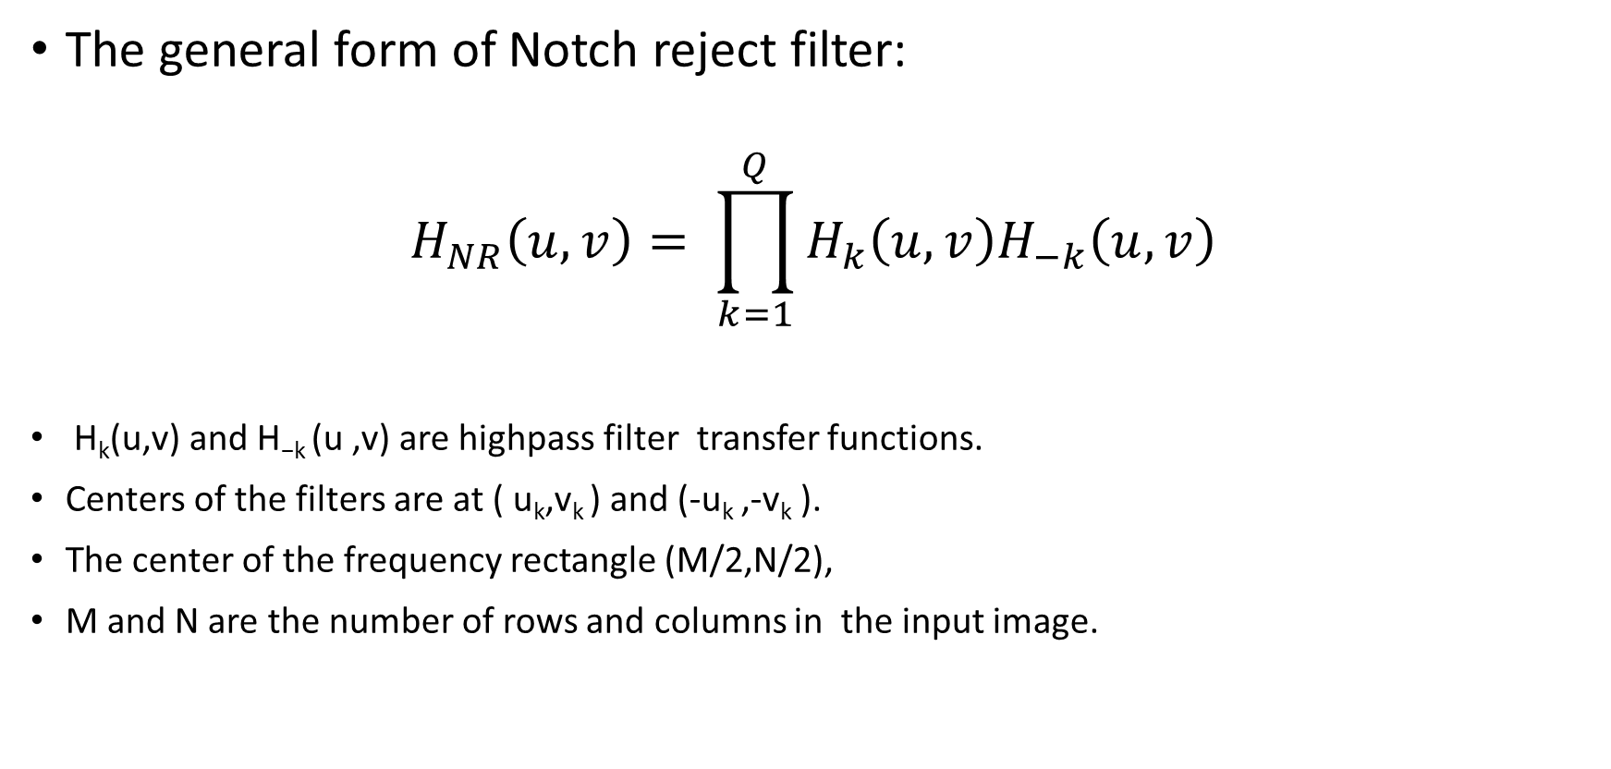
Notch Filter
The general form of Notch reject filter:
$$H_{NR}\left(u,v\right)= \prod_{k=1}^{Q}{H_{k}\left(u,v\right)H_{−k}\left(u,v\right)}$$
H_{k}(u,v) and H_{−k} (u ,v) are highpass filter transfer functions.
Centers of the filters are at ( u_{k},v_{k} ) and (-u_{k} ,-v_{k} ).
The center of the frequency rectangle (M/2,N/2),
M and N are the number of rows and columns in the input image.

Slide 12
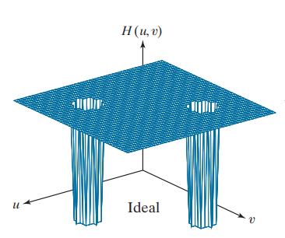
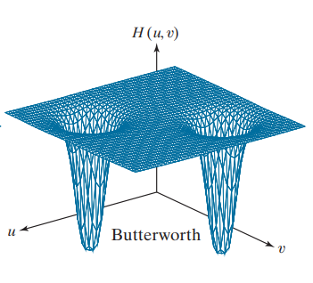
Ideal and Butterworth notch reject filter

Slide 13
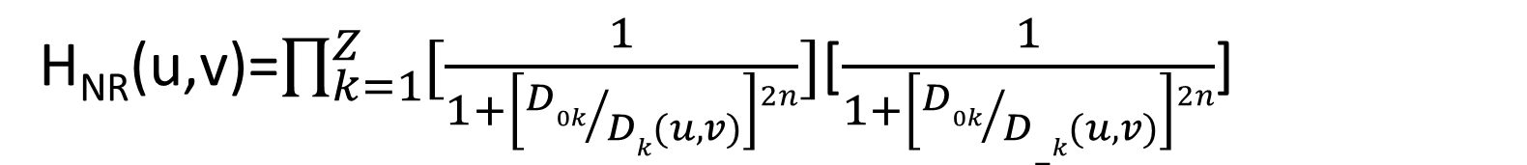
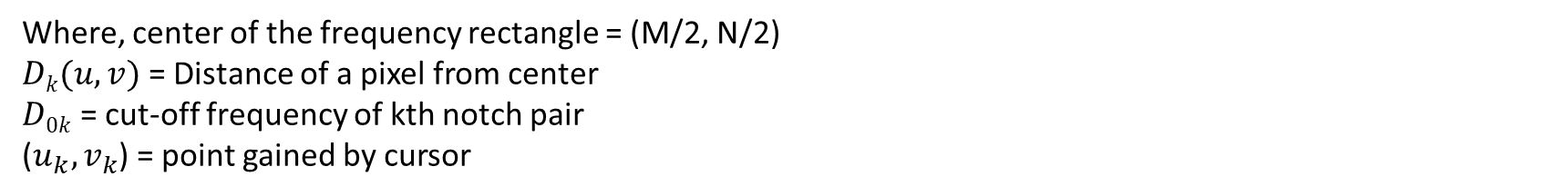
Butterworth Notch Reject Filter of order n
The general form of Butterworth Highpass filter:
The distance computations for each filter transfer function are given by
H_{NR}(u,v)=$\prod_{k=1}^{Z}{[\frac{1}{1+\left[{D0k}/{Dk(u,v)}\right]2n}]}$[$\frac{1}{1+\left[{D0k}/{D−k(u,v)}\right]2n}$]
$Dk(u,v)$ = $\left[\left(u−\frac{M}{2}−u_{k}\right)2+\left(v−\frac{N}{2} −v_{k}\right)2\right]1/2$
$D−k(u,v)$ = $\left[\left(u−\frac{M}{2}+u_{k}\right)2+\left(v−\frac{N}{2}+v_{k}\right)2\right]1/2$
Where, center of the frequency rectangle = (M/2, N/2)
$Dk(u,v)$ = Distance of a pixel from center
$D0k$ = cut-off frequency of kth notch pair
($u_{k},v_{k}$) = point gained by cursor

Slide 14
Assignment
Draw any portrait using DFT and epicycles.
Instructions:
Take a reference image of a person that you want to draw.
Apply canny edge detection to generate to find edges from the input.
Using the coordinates of the edges, generate Fourier coefficients.
Animate the coefficients to approximate the locations using lines and circles. You can use matplotlib or pygame package for the visualization.

Slide 15

Example

Slide 16
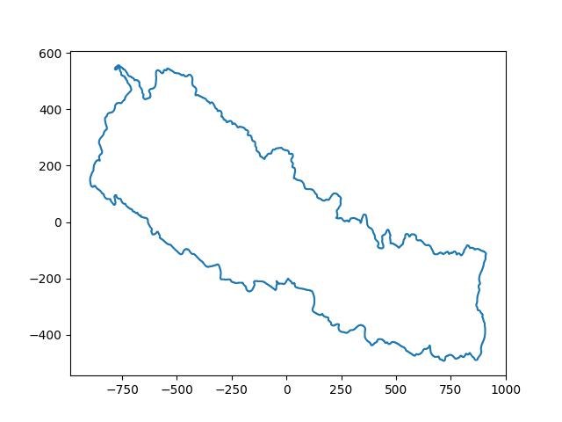
Example

Slide 17
References
https://www.amritaryal.com.np/posts/categories/mathematics-and-engineering/2.html
https://contra.medium.com/drawing-anything-with-fourier-series-using-blender-and-python-c0881e1b738c

