Slide 1

AI-Powered Waste Classification
Computer Vision Project | SAIA 2133 | Session 2025/2026
AHMAD IRFAN JOHAN BIN MAZLAN
A24AI0008

Slide 2
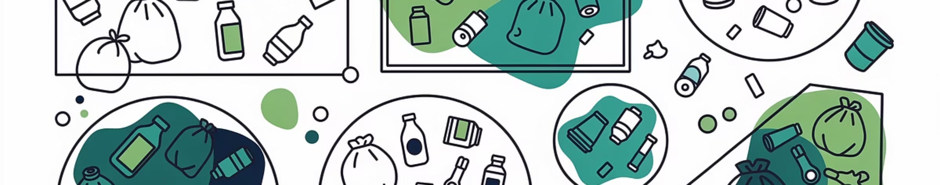

ENVIRONMENTAL CHALLENGE
The Waste Management Crisis
The Problem
The Solution
Manual waste sorting is labor-intensive and error-prone. Inefficient segregation contaminates recyclables, reduces recycling efficiency, and increases environmental pollution. Hazardous materials like batteries require special handling.
CNNs learn hierarchical visual features from raw pixel data, enabling automated waste classification. This project develops a system to categorize garbage into battery, brown glass, and cardboard classes.

Slide 3


Dataset Composition
2,443
3
224×224
Total Images
Classes
Image Size
Grayscale images across three garbage categories
Battery, brown glass, and cardboard
Standardized pixel dimensions
70%
15%
15%
Training Set
Validation Set
Test Set
1,710 images for model learning
366 images for tuning
367 images for evaluation

Slide 4
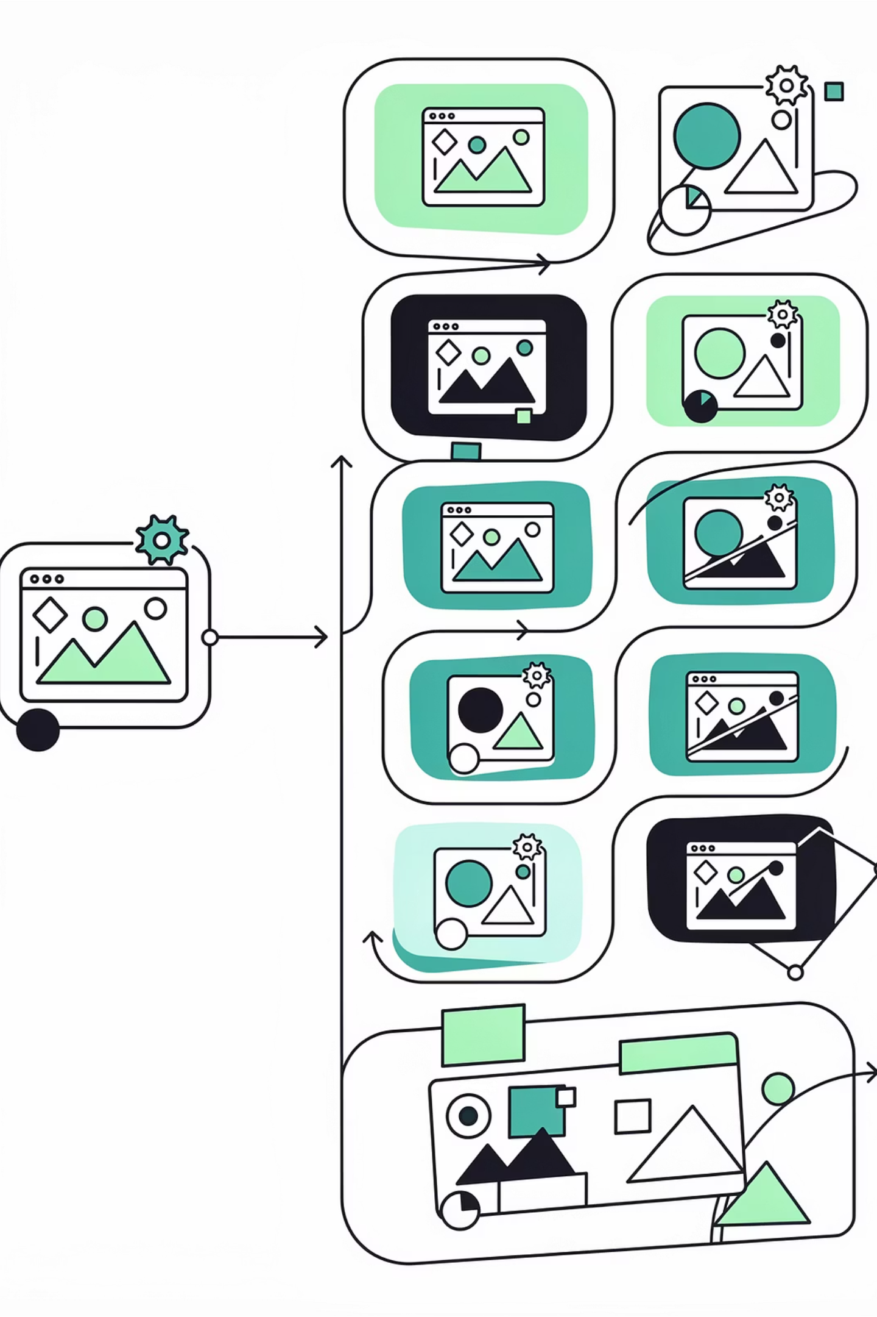




DATA PREPARATION
Preprocessing & Augmentation
Resizing
All images standardized to 224×224 pixels for consistency
Normalization
Pixel values scaled to [0,1] range for training stability
Augmentation
Random flipping, rotation, brightness adjustment, and zooming applied

Slide 5
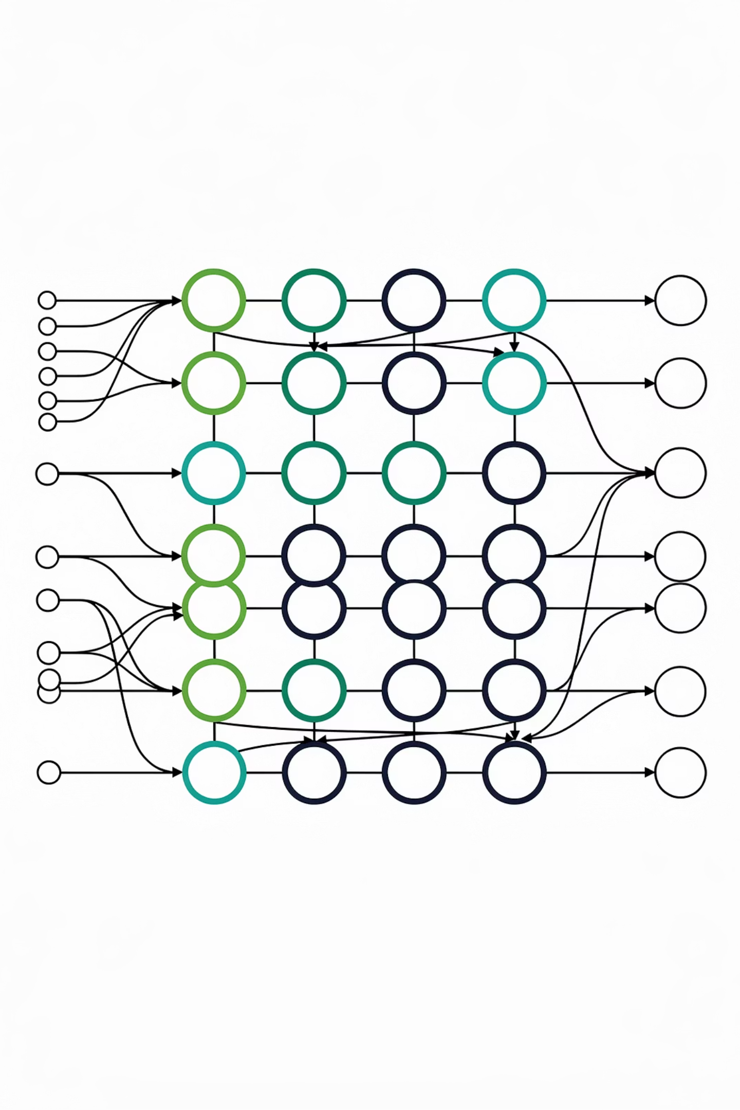
Model Architectures
Custom CNN
Transfer Learning
Lightweight architecture with 3 convolutional layers (32, 64, 64 filters), max-pooling, dropout, and fully connected layer. 3.27M trainable parameters.
EfficientNetB0 pre-trained on ImageNet with frozen convolutional base and custom classification head. Leverages pre-learned features.

Slide 6

TRAINING CONFIGURATION
Training Details
01
02
Optimizer
Loss Function
Adam optimizer with learning rate of 0.001
Sparse categorical cross-entropy
03
04
Training Duration
Learning Rate Strategy
10 epochs with early stopping
Reduction when validation plateaus

Slide 7
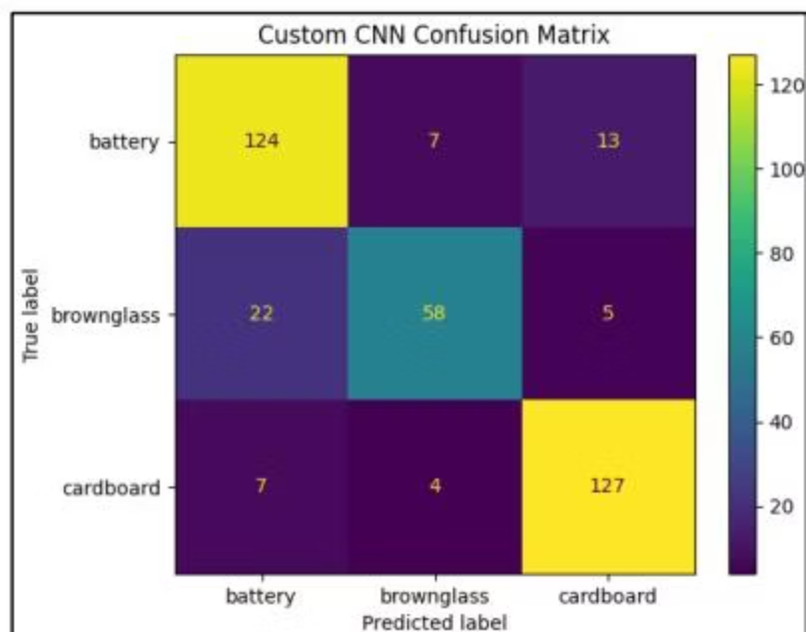
Custom CNN Performance
84.2%
Overall Accuracy
The custom CNN achieved acceptable performance but struggled with visually similar categories, particularly battery and brown glass.
Battery
Brown Glass
Cardboard
Precision: 0.8105 | Recall: 0.8611 | F1: 0.8350
Precision: 0.8406 | Recall: 0.6824 | F1: 0.7532
Precision: 0.8759 | Recall: 0.9203 | F1: 0.8975

Slide 8
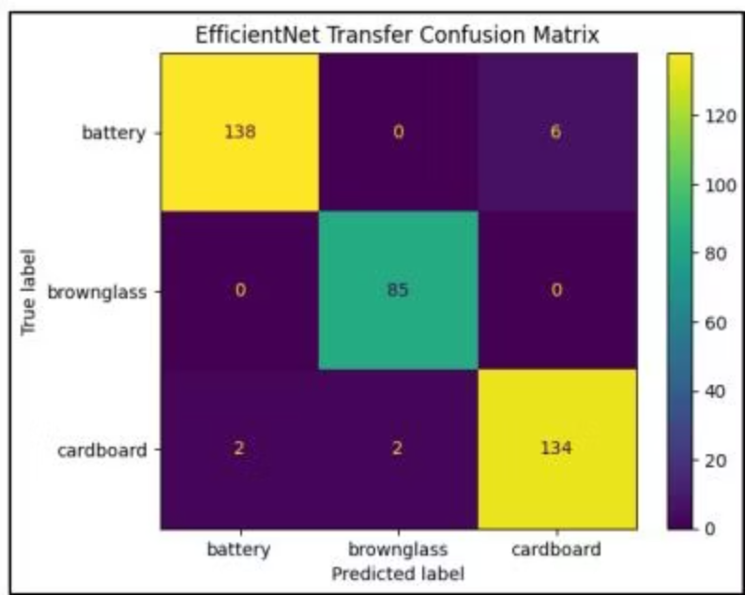



EfficientNet Transfer Learning Results
97.3%
Overall Accuracy
Transfer learning significantly outperformed the custom CNN with near-perfect classification across all categories.
Battery
Brown Glass
Cardboard
Precision: 0.9857 | Recall: 0.9583 | F1: 0.9718
Precision: 0.9770 | Recall: 1.0000 | F1: 0.9884
Precision: 0.9571 | Recall: 0.9710 | F1: 0.9640

Slide 9

ETHICS & PRACTICE
Ethical and Practical Considerations
Practical Potential
Dataset Bias
Human Oversight
Strong deployment potential for automated sorting facilities. Can reduce contamination, improve recycling efficiency, and lower operational costs.
Limited generalization to real-world conditions with varying lighting, backgrounds, and object appearances. Requires dataset expansion.
Systems should complement, not replace, human supervision. Over-reliance without oversight could result in incorrect sorting decisions.

Slide 10
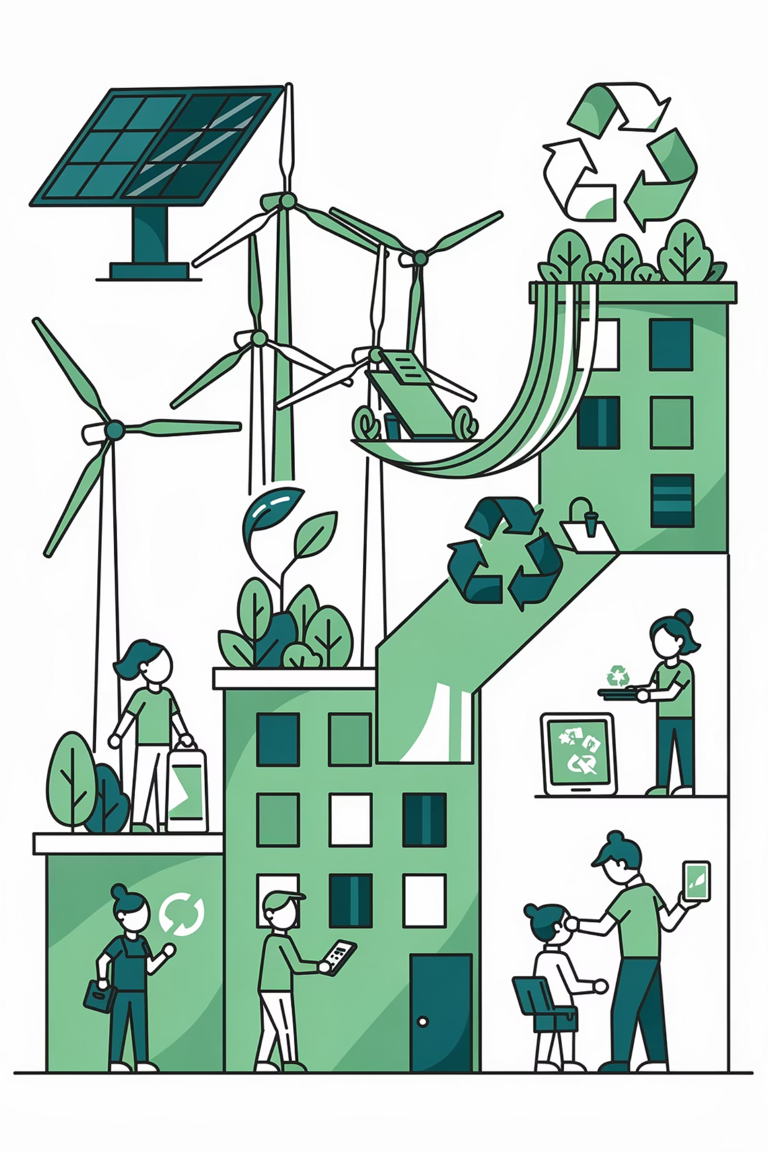
Conclusion & Future Directions
1
Project Success
Successfully demonstrated CNN-based garbage classification with two approaches
2
Transfer Learning Advantage
EfficientNet achieved 97.3% accuracy, significantly outperforming custom CNN at 84.2%
3
Environmental Impact
Deep learning systems can support sustainable waste management initiatives
"With further development, AI-powered waste classification systems have the potential to contribute meaningfully to environmental conservation efforts."

Slide 11



Thank You
For your attention and interest in my AI-powered waste classification project.
SUSTAINABLE FUTURE
SMART SOLUTIONS

