Slide 1
Overview of TJA3 Software Engineering - CSE 435 Michigan State University Fall 2022
Team Members:
Project Manager: Abhinay Devapatla
Project Facilitator: Gram Boyle
Customer Liaison: Matthew Crandall
Artifacts Manager: Eric Gabbard
Security Manager: Muxing Dai
Customer: Mr. William Milam
Instructor: Dr. Betty H.C. Cheng*
*Please direct all inquiries to the instructor

Slide 2
Project Overview
System Functionality
Activates once the vehicle’s GPS determines that it is on a limited access highway
Using the vehicle’s forward-looking radar system, maintains a set distance from the target vehicle and controls the closing rate
Using the vehicle’s forward-looking camera system, enables lane following
Motivation For The System
Helps the driver navigate traffic on limited access highways
Reduces driver error due to fatigue
The driver no longer has to switch between accelerating and braking
The driver no longer has to make adjustments to stay within their lane

Slide 3
Overview of Features
System Features
Activates once the vehicle’s GPS determines that it is on a limited access highway
Using the vehicle’s forward-mounted radar system, identifies the target vehicle
The driver chooses from one of three set distances to maintain from the target vehicle
Maintains the set distance from the target vehicle and controls the closing rate
Using the vehicle’s forward-looking camera system, enables lane following
Disengages after…
The driver presses the “cancel” button or engages the vehicle’s accelerator/brakes
The vehicle’s forward-mounted radar system no longer identifies traffic
The vehicle’s GPS determines that it is no longer on a limited access highway
The vehicle’s forward-mounted radar system fails or becomes compromised
The TJA system identifies a slip condition

Slide 4
Domain Research (1/2)
Investigated Area
Capabilities and Limitations of the Adaptive Cruise Control (ACC) System
Methods to determine how vehicle knows location and current traffic
Needed To Apply Domain Knowledge On
Setting up a Global Positioning System that communicates with the Global Navigation System
Developing secure internal databases
Building upon the ACC system to develop the TJA system

Slide 5
Domain Research (2/2)
Project Constraints
The TJA system is limited to forward movement
The TJA system relies on a functional forward-looking radar and camera system
Without the forward-looking radar system, the target vehicle cannot be detected
Without the forward-looking camera system, lane following no longer works
The TJA system relies on a functional actuator system
Without the actuator system, the TJA system can no longer brake and perform lane following
If the driver engages the vehicle’s accelerator, the TJA system must disengage
If a slip condition is detected, the TJA system must disengage
Lane changing falls outside the scope of the TJA system

Slide 6
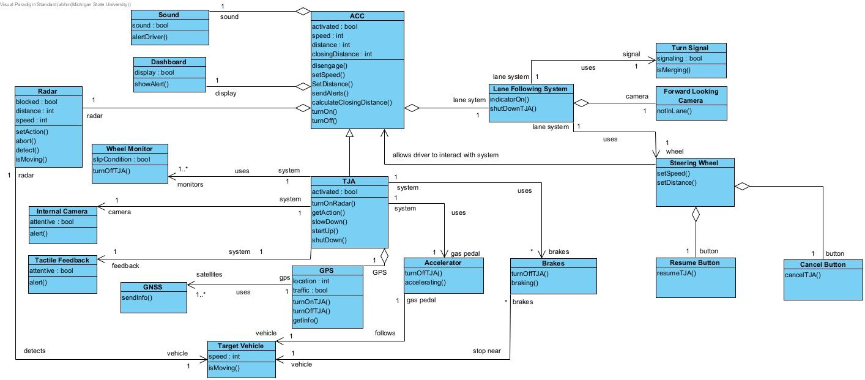
Model-Based View
Figure 1: Domain Model

Slide 7
Project Demonstration (1/6)
System Interface
The TJA system interfaces into the vehicle’s dashboard
The dashboard provides logistical information to the driver
The driver interacts with the system using the “resume” and “cancel” buttons on the steering wheel
Although the TJA system automatically activates on limited access highways, the “cancel” button can be used to temporarily deactivate the system, and the “resume” button can be used to reactivate the system

Slide 8

Project Demonstration (2/6)
Scenario #1: Activating The TJA System
Video 1: Scenario #1

Slide 9
Project Demonstration (3/6)
Scenario #2: Slowing Down/Accelerating
Video 2: Scenario #2/#3

Slide 10
Project Demonstration (4/6)
Scenario #4: Switching Lanes
Video 3: Scenario #4

Slide 11
Project Demonstration (5/6)
Scenario #5: Front-Looking Radar Issue
Video 4: Scenario #5

Slide 12
Project Demonstration (6/6)
Scenario #5: Deactivating The TJA System
Video 5: Scenario #6

Slide 13
Acknowledgements
We gratefully acknowledge and appreciate the participation of our customer, Mr. William Milam from W. Milam Consulting LLC

