Slide 1

Emergency Ambulance care
Connecting You to Ambulance Services

Slide 2
Team Members
Firoz Mahmud Rizvi
2019-2-60-076
Subtitle
Anik Lal Dey
2020-1-60-228

Slide 3

Project Overview
Ambulance Service Management System is a comprehensive web-based application designed to streamline and optimize the management of ambulance services. In emergency situations, swift and efficient ambulance services can make a critical difference in saving lives. This project aims to provide a robust platform that facilitates the seamless coordination of ambulance resources, drivers, and users.
Quick Ambulance Access
Enhance Emergency Response
Availability & Tracking

Slide 4
Technology Stack
Frontend
Backend
Read
Update
Delete
Html
Css
JavaScript
Ajax
Bootstrap
PHP
MySQL

Slide 5
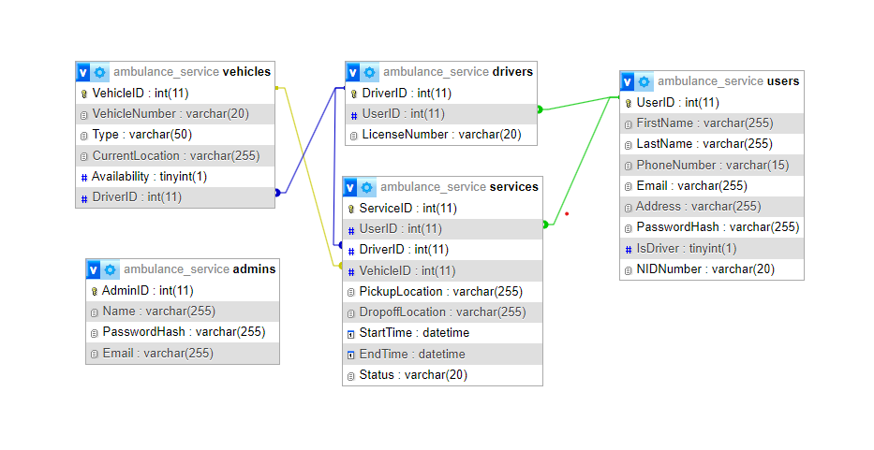
Database Schema
Ambulance Service
Quick Ambulance Access
Enhance Emergency Response
Availability & Tracking

Slide 6
CRUD
Create
Read
Update
Delete
Creating refers to the process of adding new data or records to the system.
Reading involves retrieving or accessing existing data from the system without modifying it.
Updating involves modifying or changing the existing data in the system.
Deleting refers to the removal or elimination of existing data from the system.

Slide 7
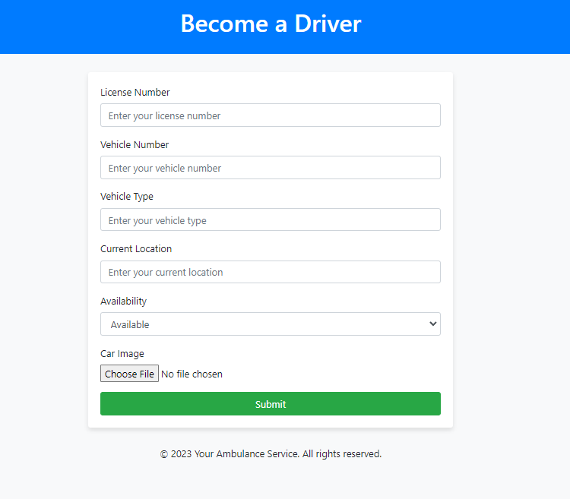
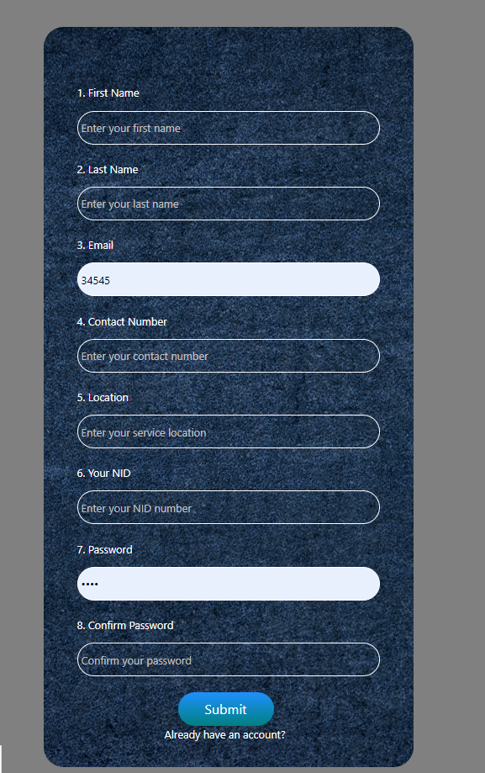
Create
Users can register with information stored in the Users tables.
Drivers can enroll with information stored in Drivers Table

Slide 8
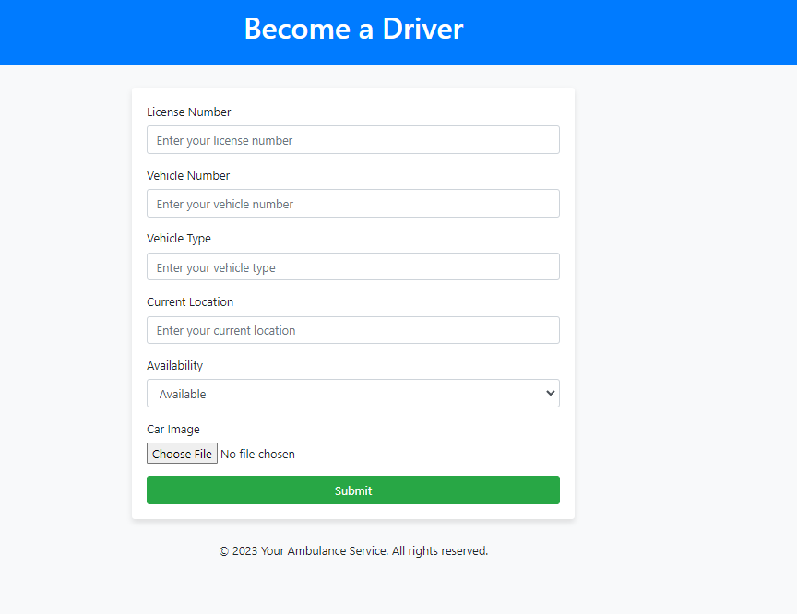
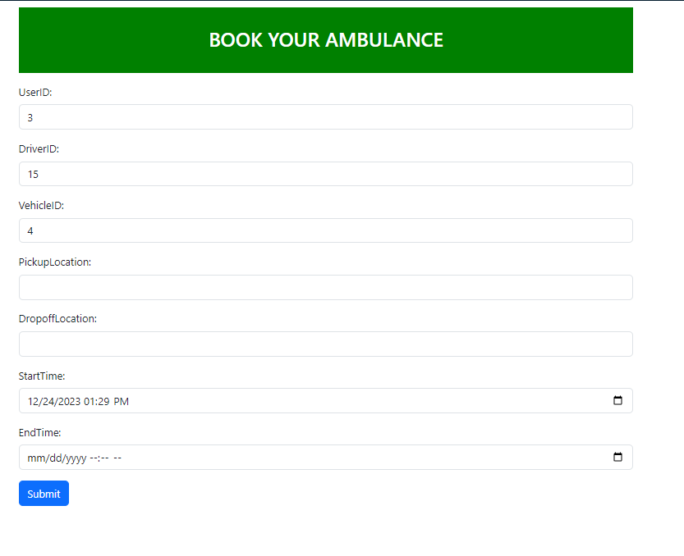
Create
Create Vehicle stored Information in Vehicle Table.
Ambulance Services are initiated and creating entries in Services Table

Slide 9
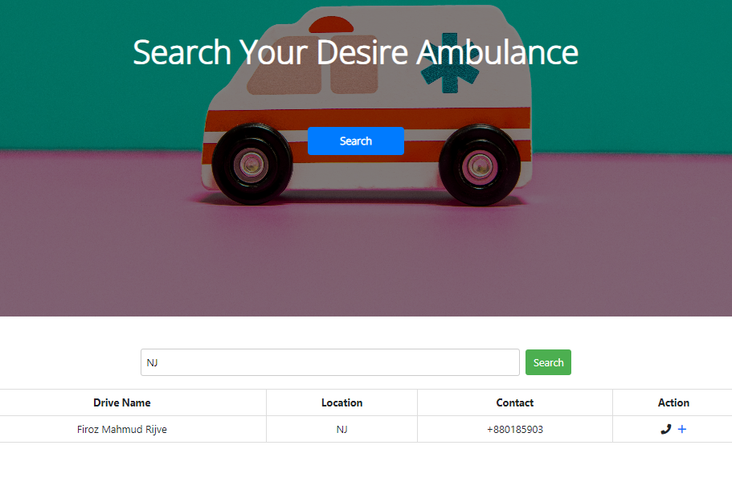
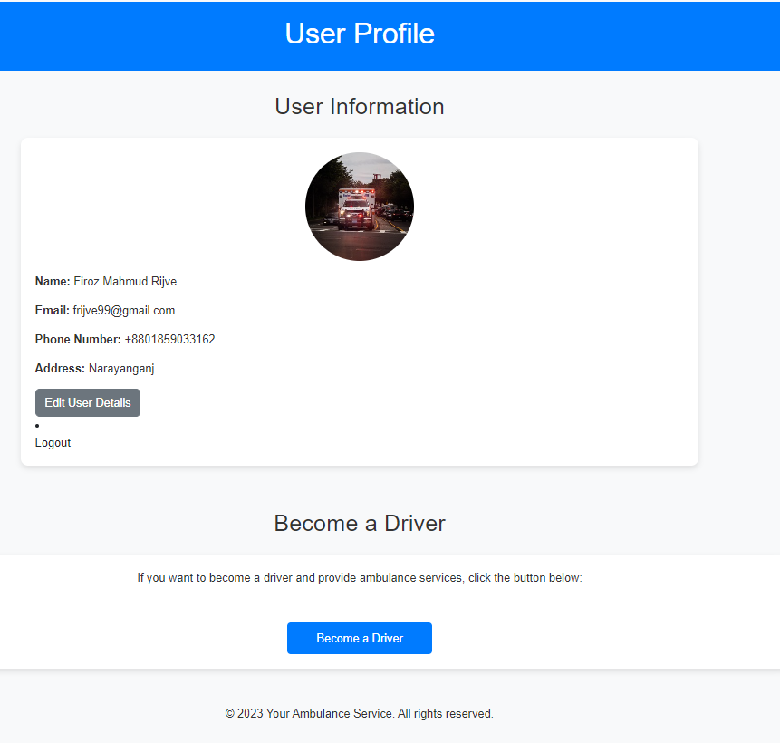
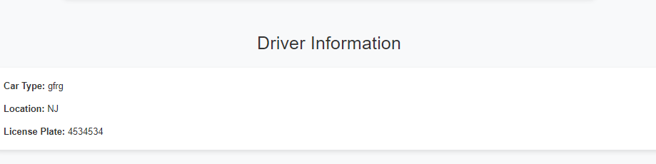
Read
Users can read and view his information.
Drivers can read and view about his and vehicles Information
User can search ambulances bases on location

Slide 10
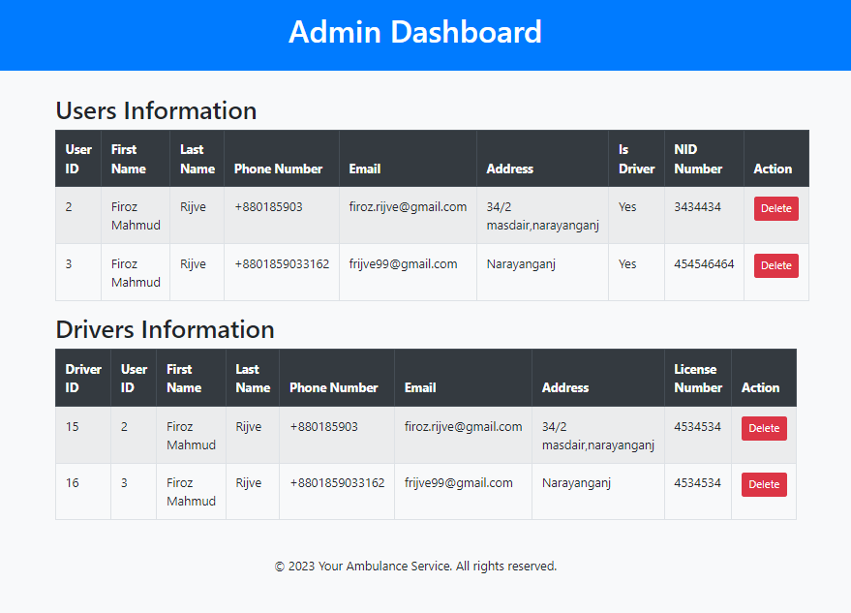
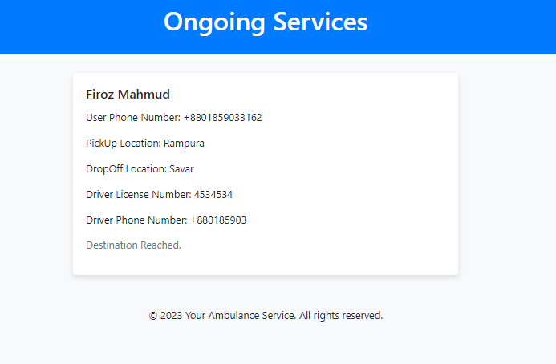
Read
Admin can see all the user and driver information
Ongoing and past services can be viewed

Slide 11
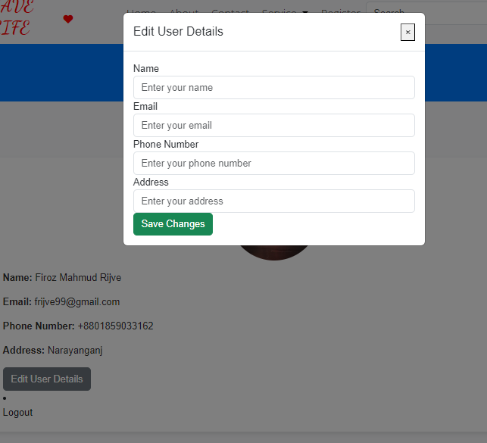
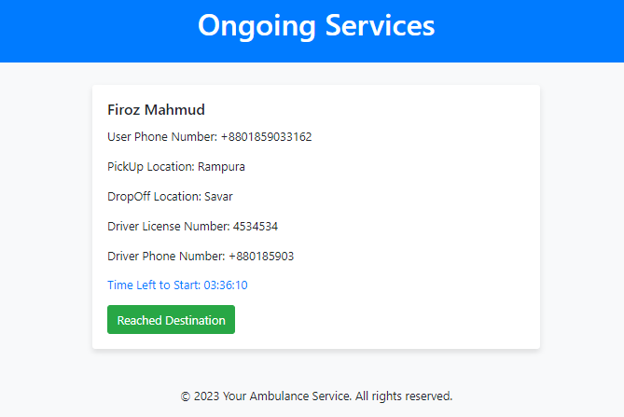
Update
Users can change the information about himself and update it.
Service status of a ongoing service can be updated, reflecting changes in the database.
Quick Ambulance Access
Availability & Tracking

Slide 12
Delete
Admins have the capability to remove users, drivers, and services from the system.
Enhance Emergency Response
Availability & Tracking

Slide 13
Conclusion
The project enhances emergency response systems, leveraging technology to optimize resource allocation and improve overall efficiency in ambulance services. The implementation of CRUD operations ensures a comprehensive and functional solution for both users and administrators.

Slide 14
Thank you

