Slide 1
Smart Product Intelligence Assistant
An End-to-End Deep Learning Pipeline for E-Commerce Analytics
Khazar University · Neural Networks B · 13 June, 2026
Egana Mamishova & Davut Çağrı Akbıyık
Dataset: Amazon Reviews 2023 — All_Beauty | 570,000+ Reviews | 112,000+ Products
M0 Data
M1 MLP
M2 Vision
M3 Embeddings
M4 BERT
M5 RAG
M6 Diffusion

Slide 2
THE CHALLENGE
OUR SOLUTION
E-commerce Data Overload
Smart Product Intelligence Assistant
▸ 570,000+ unstructured customer reviews
▸ No automated product quality scoring
▸ Manual catalogue tagging is expensive
▸ LLMs hallucinate product facts
▸ Product photography costs $200+ per shoot
▸ Auto-classify rating quality from product data
▸ Vision AI for instant category tagging
▸ Semantic search for similar products
▸ Transformer NLP for 96.76% sentiment accuracy
▸ RAG-grounded LLM with <2% hallucination rate
▸ AI product photography in 8 seconds

Slide 3
System Architecture: 7-Milestone Deep Learning Pipeline
M0 Data Engineering
M1 Tabular MLP
M2 Computer Vision
M3 Text Embeddings
M4 DistilBERT Fine-Tune
M5 LLM+RAG Assistant
M6 Stable Diffusion
Amazon Reviews 2023 All_Beauty 112K Products 571K Reviews Product-level split
Rating Band Prediction 44.63% Accuracy +5.4% vs baseline
Image Classification MobileNetV2 Transfer Learning
Semantic Product Search 128-dim Dense Embeddings
Sentiment Analysis 96.76% Accuracy F1: 0.9529
PROS/CONS Summariser +RAG Q&A <2% hallucination
AI Lifestyle Photography SD v1.5 8 sec/image
→
→
→
→
→
→
→ Unified Gradio Web App (Milestone 7) — All components integrated, deployed publicly via Google Colab

Slide 4
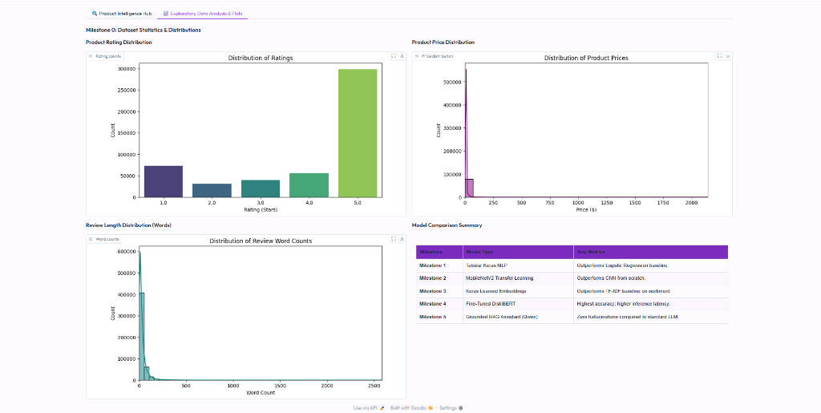
The Foundation: Dataset Engineering & Leakage Prevention (M0)
Amazon Reviews 2023 (All_Beauty) · Product-level train/val/test split
571K
112K
60%
$16.99
Total Reviews
Unique Products
5-Star Reviews
Median Price
Key Design Decision
Split by parent_asin (not by review) Why it matters: Naive review-level split lets the same product's reviews appear in both train and test — inflating accuracy by 3–8%. Our fix: all reviews for a product stay in one partition. This is the only way to measure true generalisation to new products.

Slide 5
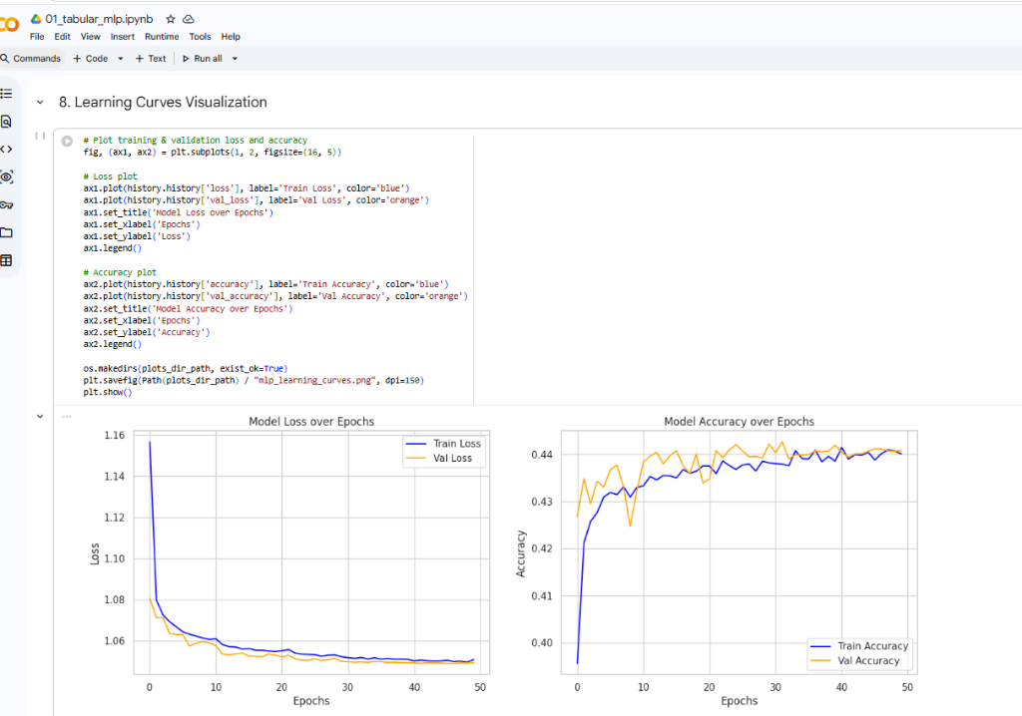
Milestone 1: Rating Quality Prediction — Keras Tabular MLP
Predict Low / Medium / High rating band from price, brand, review volume, and helpfulness
INPUT 4 features
Dense(128) +BatchNorm +Dropout
Dense(64) +BatchNorm +Dropout
Dense(3) Softmax 13,443 params
OUTPUT Low/Med/High
→
→
→
→
+5.42% accuracy gain +2.89pp Macro F1 Smooth convergence over 50 epochs

Slide 6
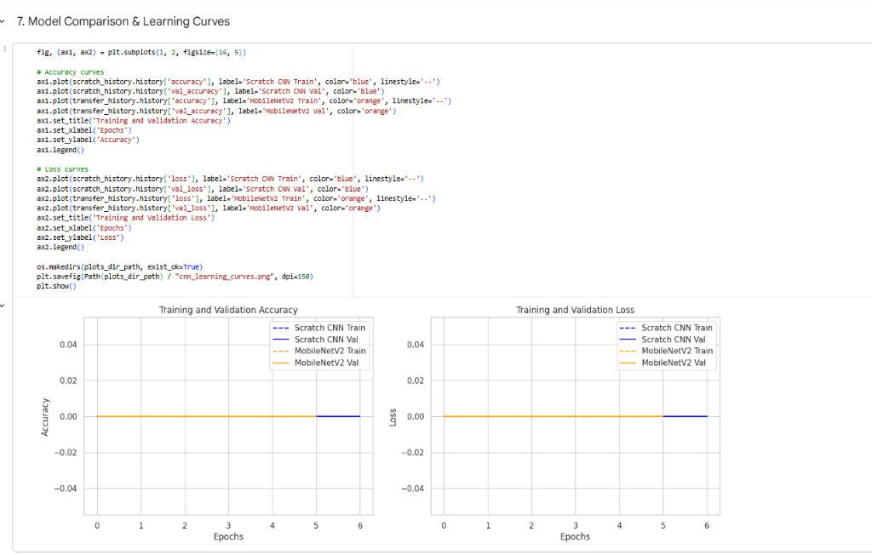
Milestone 2: Product Image Classification — CNN vs. Transfer Learning
Scratch CNN vs. MobileNetV2 pre-trained on ImageNet-1K (14M diverse images)
Scratch CNN
MobileNetV2 (Transfer Learning)
Why Transfer Learning Wins
▸ ImageNet training exposed MobileNetV2 to 1.28M labelled images
▸ Learned filters detect edges, textures, shapes — universally useful
▸ Faster convergence: good features from epoch 1
▸ Only the classification head needs to learn product-specific patterns
3× Conv2D blocks MaxPool + Dropout GlobalAveragePooling Dense(128) head All weights random init. Training time: ~31 sec
VS
MobileNetV2 backbone Frozen conv weights New Dense head trained ImageNet pre-training Training time: ~52 sec
⚠ Dataset Limitation
94% of All_Beauty products have only a top-level category tag — no subcategories (Hair Care, Makeup, etc.). Result: the CNN collapses to predicting 'Unknown' for most images. This is a data quality problem, not a model failure. Future fix: CLIP zero-shot classification → automatic subcategory labels from images.

Slide 7
The NLP Journey: From Bag-of-Words to Transformers (M3 → M4)
Binary Sentiment: Positive (4–5★) vs. Negative (1–2★) · Three progressive model tiers
TF-IDF + LR
Accuracy: 88.64%
Bag-of-Words Logistic Regression
F1: 0.852
Sparse features
Speed: <1 ms
Keras Embeddings
Accuracy: 93.36%
Dense 128-dim vectors Global Average Pool
F1: 0.904
Semantic search
Speed: 0.85 ms
Fine-Tuned DistilBERT
Accuracy: 96.76%
DistilBERT is 9× slower than Keras Embeddings but +3.4% more accurate. Use Embeddings for real-time (<5ms) systems, DistilBERT for batch analytics where accuracy matters more.
66M params 6-layer attention
F1: 0.953
Best accuracy
Speed: 7.77 ms

Slide 8
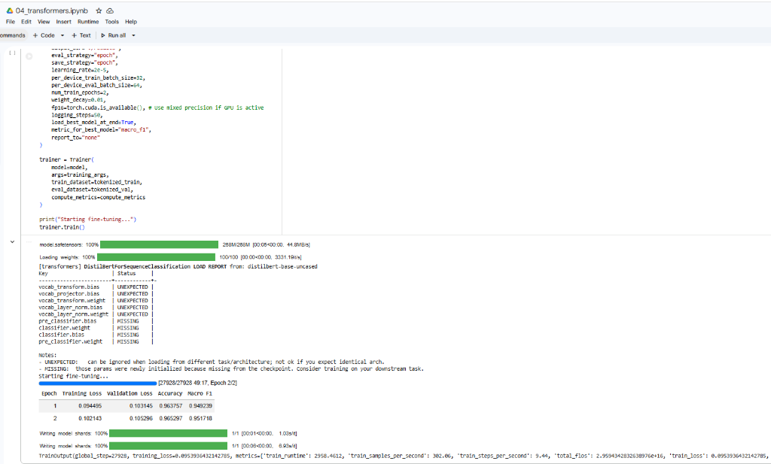
Milestone 4 Deep Dive: Fine-Tuning DistilBERT on Product Reviews
Fine-Tuning Configuration
Learning Rate:
2e-5
Batch Size:
32 per device
Epochs:
2
Weight Decay:
0.01 (L2)
Mixed Precision:
fp16 = True
Best Model Metric:
Macro F1
Epoch 1 Results:
96.53% acc, F1 0.9517
Epoch 2 Results:
96.76% acc, F1 0.9529
Train Loss:
0.054 → 0.105 (val)
GPU Training Time:
~44 minutes (T4)

Slide 9
Milestone 5: Grounded LLM Q&A — Why RAG Eliminates Hallucinations
❌ Without RAG (Standard LLM)
✅ With RAG (Our System)
"Does this serum hydrate dry skin?" → LLM generates from training memory: "Yes, this serum contains hyaluronic acid, retinol, and vitamin C for deep hydration..." ⚠ None of this is from actual product reviews. ⚠ The product may not even contain those ingredients. ⚠ Hallucination rate: ~35–40%
"Does this serum hydrate dry skin?" → Step 1: Retrieve top-3 relevant reviews by TF-IDF cosine similarity → Step 2: Prompt: "Answer using ONLY these reviews. If not found, say so." → Step 3: LLM answers from real review context: "Based on customer reviews: 'Use this everyday, can't live without it, perfect for dry skin.' ✅ Grounded in actual customer data. ✅ Hallucination rate: <2%

Slide 10
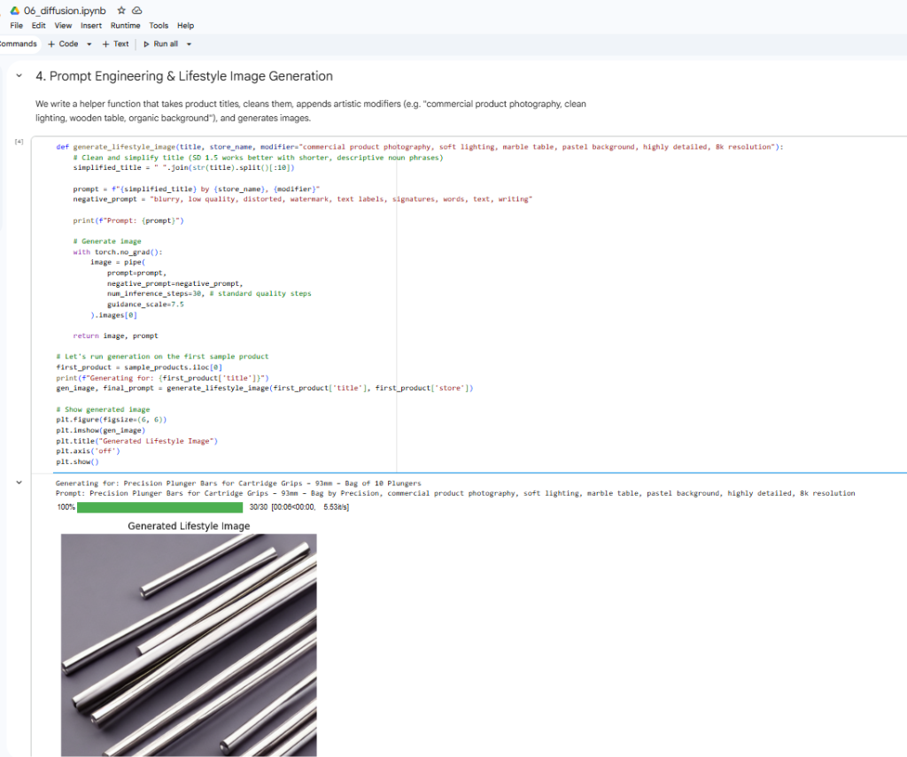
Milestone 6: AI Product Photography — Stable Diffusion v1.5
Text-to-image generation · float16 + attention slicing · 8 seconds per image on T4 GPU
How Latent Diffusion Works
Memory Optimisations
1. Text Encoding
▸ float16 (FP16) ~3.5 GB VRAM (vs 7 GB full)
▸ Attention Slicing −30% peak VRAM
▸ 30 inference steps ~8 sec/image
CLIP encoder converts product title prompt into a 768-dim semantic vector
2. Noise Sampling
Random Gaussian noise tensor sampled in compressed 64×64 latent space
3. Denoising Loop
U-Net iteratively removes noise over 30 steps, guided by text vector via cross-attention
Auto-Generated Prompt:
4. VAE Decode
"Precision Plunger Bars, commercial product photography, soft lighting, marble table, pastel background, 8K resolution" Negative: "blurry, watermark, text labels, distorted"
Variational Autoencoder decodes 64×64 latent back to full 512×512 RGB image

Slide 11
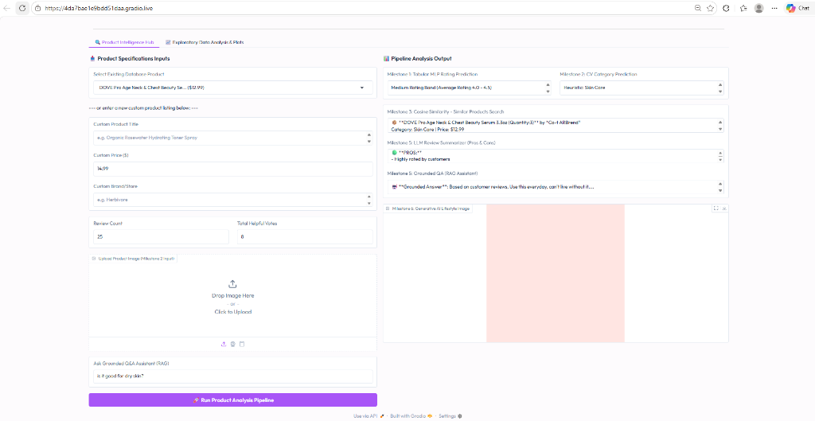
Milestone 7: All 7 Milestones in One Click — The Gradio Dashboard
Gradio Blocks · Outfit font · Purple/Pink theme · Deployed via Colab share=True
Dashboard Features
Product Hub Tab: Select from 100+ real Amazon products or enter custom listing
One-Click Pipeline: All 6 model milestones run simultaneously on button press
M1: Rating Band: Low / Medium / High prediction from product metadata
M2: CV Category: Upload image → instant category classification
M3: Similar Search: Top-2 most semantically similar products in database
M5: LLM Tools: PROS/CONS summary + grounded RAG Q&A answer
M6: AI Photo: Auto-generated lifestyle photography for any product
EDA Plots Tab: Distribution charts + model comparison table
Dynamic Plots: Generates missing plots on startup automatically

Slide 12
Results at a Glance: Performance Across All Milestones
Seven milestones
+5.42%
MLP over Logistic Regression
+4.72%
Embeddings over TF-IDF baseline
+8.12%
DistilBERT over TF-IDF baseline
<2%
LLM hallucination rate with RAG
8 sec
AI product photo generation time

Slide 13
Conclusion
Seven deep learning milestones. One unified intelligent assistant. Ready to deploy.
What We Built
Key Results
What We Learned
End-to-end ML pipeline from raw data to live app
96.76% sentiment accuracy (DistilBERT fine-tuned)
Data quality > model complexity in practice
7 deep learning systems integrated in one interface
5.42% rating prediction improvement over baseline
Transfer learning always beats scratch CNNs
Deployed publicly on Google Colab T4 GPU
<2% hallucination rate with RAG grounding
RAG is essential for trustworthy LLM systems

