Slide 1

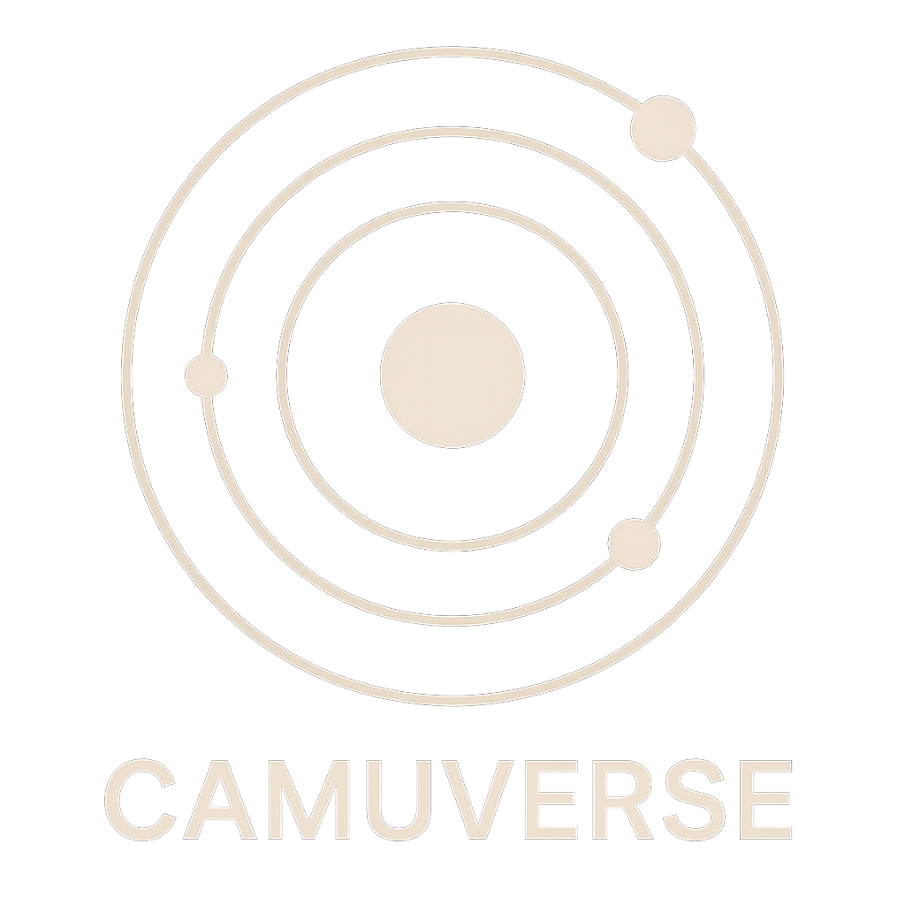

Cammunity DAO LLC
Legally formed as a Wyoming DAO LLC in July 2025
Camuverse: Powered by Creator Token Decentralized Subscriber Gating (CTDSG).

Slide 2
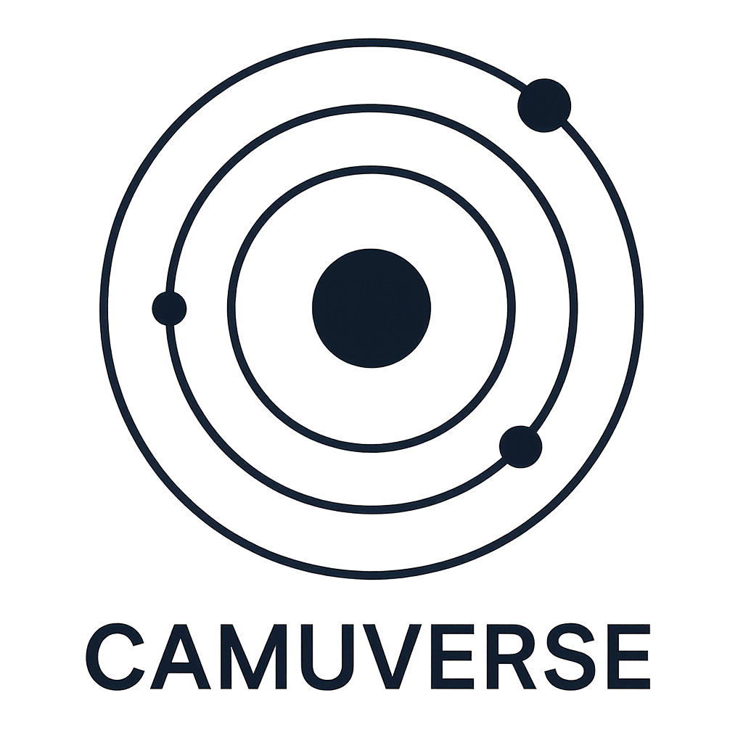
Empowering Creators Through Decentralized Monetization
CammunityDAO is a decentralized video monetization and engagement platform for creators of all types with optional gated access, allowing creators to control access to their content. It is not exclusively adult-oriented but is inclusive of various content types, catering to a diverse user base.
With optional gated access, creators can choose how to monetize and control access to their content — ensuring both freedom of expression and audience safety.

Slide 3
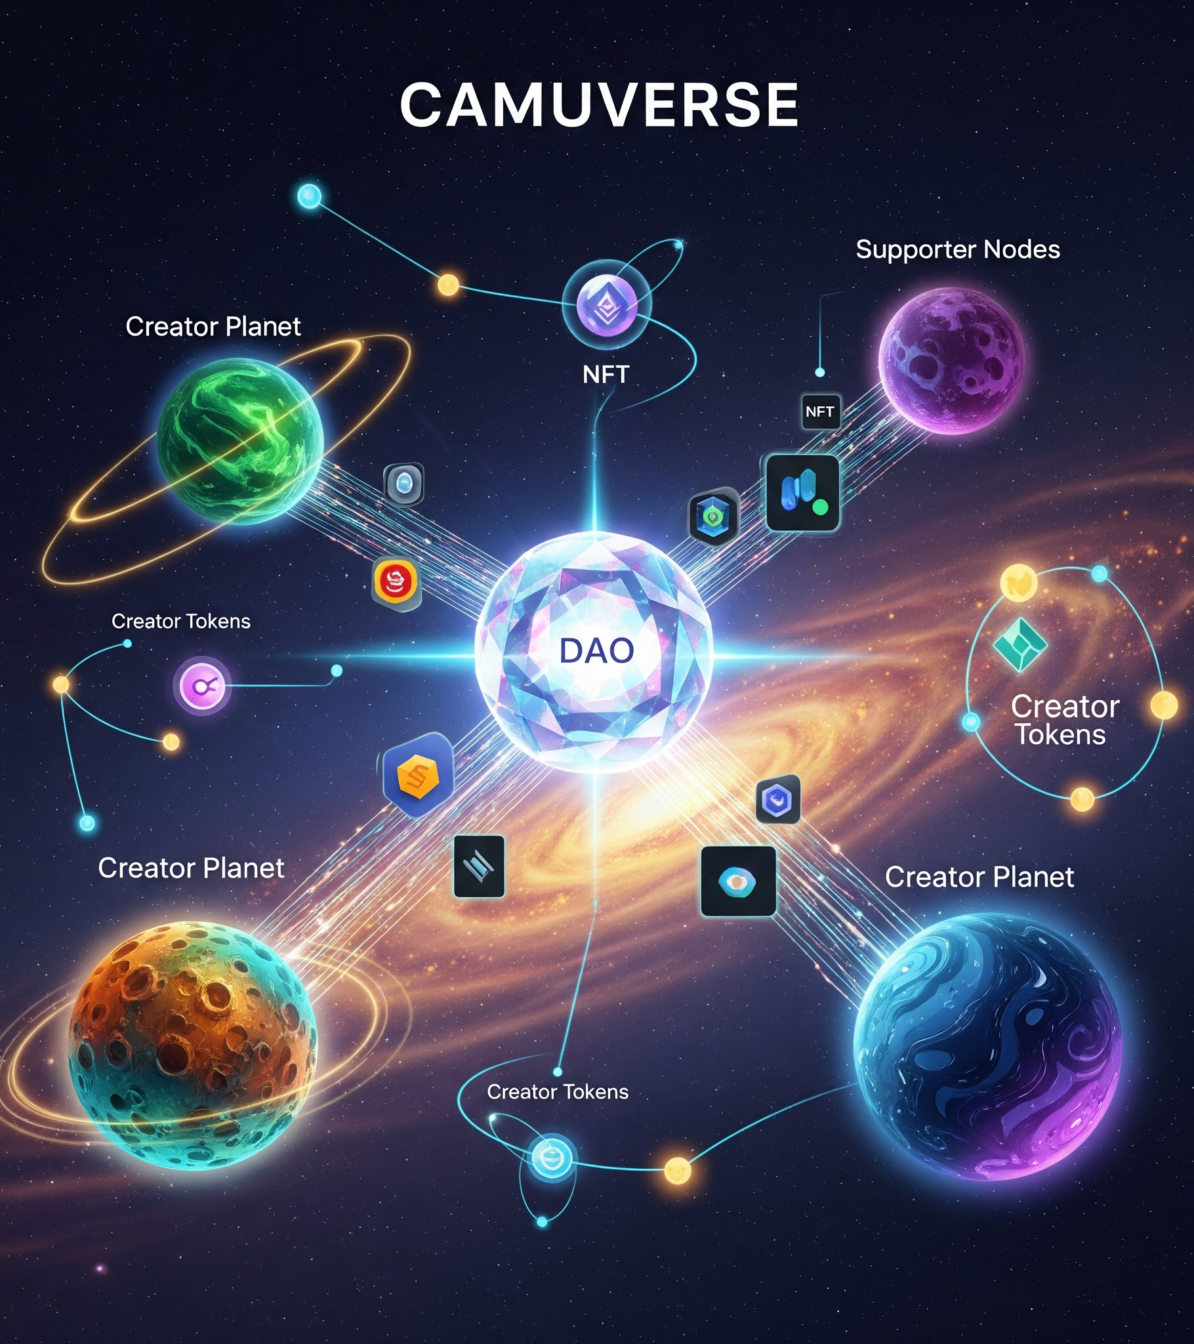
Cammunity Mission & Camuverse.io Vision
To create a decentralized and inclusive ecosystem, the “Camuverse,” where creators of all types can monetize their content, engage with their audience, and have a say in the platform’s development through DAO governance.
The camuverse introduces a paradigm shift in digital access and monetization, anchored in Creator Token Decentralized Subscriber Gating (CTDSG), where fan relationships, content privacy, and tiered benefits are programmable and owned.

Slide 4
Explore the Cammunity DAO Ecosystem
The ecosystem consists of:
CamuCoin,
CamuToken,
an open site,
and an NFT marketplace.
It provides a versatile environment for creators, DAO token holders, and general users, emphasizing mutual benefits and community-driven development.
Core Contracts Deployed On Base Mainnet Blockchain:
https://basescan.org/address/0xa5A750f3eF47fc35e5c1Af2c54C1182Abb392125#code

Slide 5
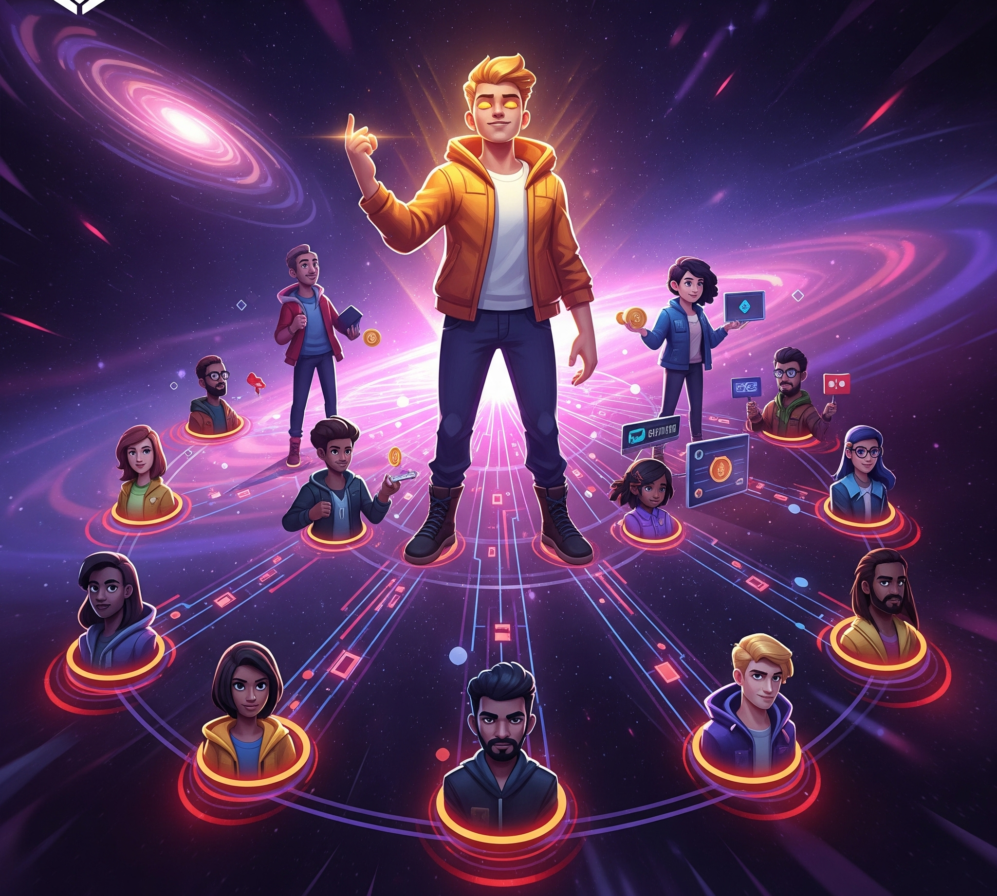
Monetize Content. Control Access. Govern Together.
DAO token holders have voting rights in governance decisions, influencing platform development, feature implementation, and community initiatives. They can earn rewards and have access to exclusive content and premium features.

Slide 6

Support What You Love. Shape What Comes Next.
Creators can monetize their content through various revenue streams like subscriptions, tips, and NFT sales. They have control over access to their content and can engage with their audience in a secure and supportive environment.

Slide 7

Flexible Access. Creator-Controlled Monetization.
Users have access to a diverse range of content and can support their favorite creators. They can participate in community activities, purchase NFTs, and experience high-quality, user-friendly services on the platform.

Slide 8
NFT Market: Own, Support, and Engage
The platform is open to all, with optional gated access for creators to manage content accessibility. It ensures a balanced ecosystem where freedom of expression and content diversity are valued.
Third-party Decentralized Identifiers (DiDs)* verification integration (Fractal ID / Polygon ID) planned for adult-only Creator Token Decentralized Subscriber Gating (CTDSG).
* Use of DiDs removes the risk associated with Personally Identifiable Information (PII) retention.

Slide 9
Traditional Subscriber Model vs. Creator Token Decentralized Subscriber Gating
Feature | Traditional Platform (e.g., Patreon, YouTube) | Camuverse Token-Gated Version
General Public Content | Public posts/videos accessible to anyone | NFTs viewable by anyone (open layer)
Members-Only Content | Followers or free subscribers | Verified Cammunity members
Paid Subscriber Content | Monthly paying subscribers (e.g., $5/month) | Ownership of creator-issued tokens (e.g., 1 CTKN = subscriber)
Exclusive Content for Verified Adults | Platforms often avoid hosting due to legal/PII risk | Gated to CamuVerify-approved members only
Tiered Subscription Perks | Different tiers ($5/$10/$25) with more perks | NFTs with metadata gated by specific token holdings
🎯 Decentralized equivalent of subscriber-only content
🪙 Creators can issue their own ERC721/1155 tokens as access passes
🔐 Viewers must hold the token + be CamuVerify-verified to access gated content
🧠 No centralized identity or subscription platform needed
🔧 Enforced on-chain via GatingRegistry.sol

Slide 10
Decentralized Governance in Action
The NFT marketplace enables the creation, listing, and trading of unique digital assets. It opens up new possibilities for content monetization and ownership, enhancing the value proposition for creators and collectors.

Slide 11
Tokenomics and Treasury: Designed for Sustainability
Community is at the core of Cammunity DAO LLC. Regular events, discussions, and collaborative initiatives foster a sense of belonging and active participation, driving the platform’s continuous growth and innovation.

Slide 12
Tokenomics Overview
CamuCoin (CAMC): Utility token used for content unlocks, tips, and transactions
1% transaction fee redirected to DAO Treasury
2% burn fee triggered after supply cap is reached
CamuToken (CAMT): Governance token with voting and access rights
DAO-controlled minting, with 15% monthly treasury withdrawal cap

Slide 13

Sustainability and Growth
Through decentralized governance, diverse revenue models, and community engagement, Cammunity DAO LLC aims to achieve long-term sustainability and growth, adapting to the evolving needs of the community and the digital content landscape.

Slide 14
How DAO Governance Works
Proposal Submission
Verified Members Vote (Camucoin)
Governance Token Holders Vote (CamuToken)
Smart Contract Execution
An example member proposal: Add a smart contract and website to handle phigital item sales

Slide 15
Genesis Creator Airdrop + Vesting System
400,000 CAMC pre-minted and stored in VestingWrapper.sol
Early creators receive up to 5,000 CAMC each via claim-based unlocks
Unlocking tied to Cammunity engagement/Camuverse presence
Protects token value while giving creators usable launch capital
Prevents dumping and encourages real participation in the platform
DAO treasury, LP fund, and founder wallets receive CAMC via initial minting

Slide 16
Influencer Airdrop Reward Unlocking
# | Criterion | Logic
1* | Verification (e.g., via CamuVerify / DID) | Establishes authenticity and protects the ecosystem from bots, sybil attacks, and abuse.
2 | Posting content/NFT | Shows creator intent and contribution to the platform — minimal friction, but real commitment.
3 | First CTDSG Token Issuance | Incentivizes creators to initiate decentralized subscriber models, which is core to Camuverse.
4 | Five CTDSG Tokens issued to unique wallets | Ensures traction: creator tokens are not just created but actually adopted. Prevents gaming with alt wallets.
5 | Voting on a proposal | Ensures DAO participation and aligns reward unlocking with governance engagement.
* Free Verification via Partial Early Unlock for Registration: Influencers use a portion of locked airdropped tokens to pay for CamuVerify verification.

Slide 17
Creator Subscription Token Pricing & Minting
Verified creators can deploy their own CTDSG (Creator Token) using the Camuverse Creator Factory.
They set a mint price (in ETH or token) for their subscription NFT.
Verified or public users can mint the token (based on content gate), gaining access to exclusive content or perks.
No intermediaries or platforms take a cut — creator earnings go directly to their wallet.

Slide 18
Proposal: CTDSG-Gated Live Streaming Dapp
🔍 Objective:
Empower verified creators to broadcast live, gated content using Creator Token Decentralized Subscriber Gating (CTDSG).
📦 Features:
🔒 CTDSG token-gated stream access
🧑‍🎤 Creator-controlled live sessions
💬 Real-time chat + tipping in CAMC
📅 Stream scheduling & analytics
💰 Funding Requested:
200,000 CAMC (includes dev bounty, infra, UX tooling)
📅 Milestones:
Q4 2025: MVP Launch (Access-Gated Streaming)
Q1 2026: Tipping + Viewer Analytics
Q2 2026: Decentralized Archiving
🟢 Outcome:
Boosts creator engagement, CAMC utility, and ecosystem stickiness

Slide 19
Proposal: Camuverse Microservices Roadmap
🔍 Objective:
Fund and launch modular backend infrastructure to scale DAO apps like the streaming Dapp, token marketplaces, and creator dashboards.
📦 Features:
🛠 Microservice Modules:
💰 Funding Requested:
300,000 CAMC (dev, integration, audit, SDK)
📅 Milestones:
Q4 2025: Identity & CTDSG API
🟢 Outcome:
Accelerates ecosystem scalability and Dapp development efficiency
Q1 2026: Creator Dashboard
Q2 2026: Full SDK Suite + Tipping Engine
Empower verified creators to broadcast live, gated content using Creator Token Decentralized Subscriber Gating (CTDSG).
🔐 Identity & KYC (via CamuVerify / DiD)
🎫 CTDSG Registry & Query APIs
📊 Creator Dashboards
🎁 Tipping & Support Layers
🧠 Proposal Drafting & Voting API
🧰 Frontend SDKs for Dapp teams

