Slide 1
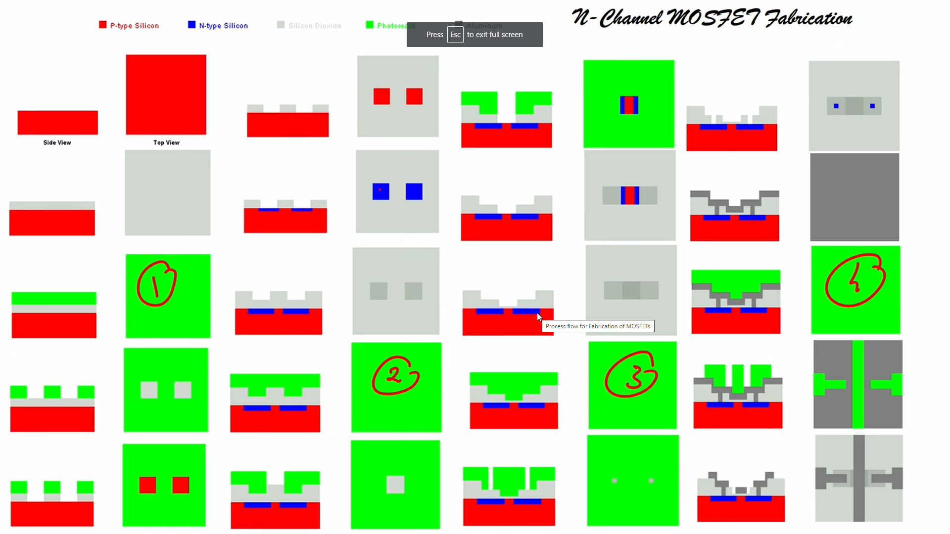
https://www.youtube.com/watch?v=88eYPWShO5c&t=2914s

Slide 2
