Slide 1
SMART SAFETY SYSTEM
An IoT based gas, flame and heat detector with remote control
Detects on the device. Reports to the cloud. Controlled from a phone.
Bahçeşehir University · Faculty of Engineering and Natural Sciences
Department of Computer Engineering · CMP3010 Embedded Systems Programming
Ege Gürtünca · 2202775
Notes:
Smart Safety System. Gas, flame and heat detection that keeps working without the internet, and can be watched and controlled from an Android app.

Slide 2
01 · MOTIVATION
The Problem & The Approach
It only beeps in that room
THE APPROACH
1
A normal detector makes a sound where it is installed. If nobody is home, nobody hears it.
All detection and the fan run on the Arduino.
The Arduino never waits for the network.
Wi-Fi only adds reporting and a few commands.
If the internet dies, the detector still works.
Smart ones are expensive and closed
2
They cost much more, depend on the maker's cloud, and cannot be repaired or extended.
No record of what happened
3
You cannot go back and see when the gas level rose or how long the alarm lasted.
Notes:
Ordinary detectors are local only. Smart ones are costly and closed. My design keeps the safety logic on the device and treats the cloud as an extra, not a dependency.

Slide 3
02 · WHAT IT DOES
Three Capabilities
1
2
3
Sense
React
Report & Control
Gas and smoke with an MQ-2
Flame with an infrared sensor
Temperature and humidity with a DHT11
12 V fan through a relay
Buzzer and red / green LEDs
Live values on a 16x2 LCD
Readings to a Flask server every 5 s
Charts and alarm log in an Android app
Fan, mute and thresholds set remotely
The alarm decision is made only on the Arduino, not in the app or on the server.
Notes:
Three groups: sensing, local reaction, and remote reporting with control. The important part is that the decision lives on the Arduino.

Slide 4
03 · HARDWARE
Components & Sensors
Arduino Uno
NodeMCU ESP8266
MQ-2
IR flame sensor
DHT11
Sensors, alarm, relay, LCD
Wi-Fi gateway, carries data only
LPG, methane and smoke
Open flame
Temperature and humidity
Relay + 12 V fan
Buzzer + 2 LEDs
16x2 I2C LCD
microSD module
8 x AA pack
Emergency ventilation
Audible and visual alarm
Local readout, two pins
Local log every 2 s
Separate 12 V for the fan
Most boards and sensors came from the lab stock. I bought the LCD, the fan, the battery pack, the LEDs, the buttons, the resistors and the jumper wires.
Notes:
Ten parts. The Arduino runs the safety logic, the NodeMCU is only a gateway. The fan runs on its own 12 V pack so it never loads the 5 V logic.

Slide 5
04 · ARCHITECTURE
System Design
Sensors
Arduino Uno
NodeMCU
Flask on Render
Android app and web
MQ-2, flame, DHT11
Decides the alarm. Drives fan, buzzer, LEDs, LCD and SD.
Wi-Fi and HTTPS. Carries data only.
Stores in Supabase. Answers with the command.
Live values, charts, alarm log, controls.
Data goes up
Commands come back down
Arduino to NodeMCU every second, NodeMCU to the server every five seconds as an 88 byte JSON message.
The server puts the command inside its answer to the same POST, so a command arrives within five seconds.
Notes:
Data flows left to right. Commands ride back on the response of the measurement POST, so there is no MQTT, no second endpoint and no extra polling loop.

Slide 6
05 · DETECTION LOGIC
When Does It Alarm?
Gas
Flame
Fast heating
Absolute heat
MQ-2 reading
≥ 400
IR reading
≤ 80
+5 °C within
60 seconds
Temperature
≥ 45 °C
Why two heat rules?
Humidity is a warning, not an alarm
A fire shows itself as a fast rise, not as a high number. An absolute limit alone gives false alarms in summer and reacts too late in winter, so the device keeps a 60 second window of samples and watches both.
Above 80 % or below 25 % the LCD alternates every two seconds between the readings and the warning. The fan, the buzzer and the relay are not touched. All thresholds can be changed from the phone.
Notes:
Four alarm conditions and one warning. Every threshold is adjustable from the app and stored in EEPROM.

Slide 7
06 · SAFETY DESIGN
Three Rules Kept in the Firmware
Remote control can only turn the fan ON
1
fanOn = alarm OR button OR remote
You cannot switch the fan off from the phone while there is a gas alarm.
Mute clears itself
2
server resets mute when alarm ends
Otherwise one press would silence the system forever.
Thresholds live in EEPROM
3
written only when a value changes
They survive a power cut, and the 100k write limit is respected.
All three are enforced on the Arduino, so a bug in the app or the server cannot break them.
Notes:
These three rules are the reason the system is a safety device and not a remote control. They are all in the firmware.

Slide 8
07 · WHAT WENT WRONG
Technical Challenges & Solutions
PROBLEM
SOLUTION
Commands arrived broken
SoftwareSerial cannot send and receive at the same time, so two commands stuck together.
Added an XOR checksum. A line that does not match is thrown away; the next one arrives in five seconds.
The Uno ran out of RAM
80 % used. The LCD stayed blank and the EEPROM values turned into garbage.
Wrapped every string in the F() macro so it stays in flash. RAM use dropped to 64 %.
One bad reading lost everything
When the DHT11 failed it sent nan, the JSON became invalid and the whole POST was rejected.
Values that are not numbers are sent as null, so gas and flame still reach the server.
A dead device looked safe
If the device stopped sending, the last reading stayed on screen and everything looked normal.
The server reports the age of the reading. Older than 60 seconds and the app warns instead of showing NORMAL.
Notes:
Four real problems. The last one matters most: a dead device that still looks safe is the most dangerous failure mode of a safety system.

Slide 9
08 · VERIFICATION
Testing & Verified Results
Specification | Target | How I tested it
Gas and flame detection speed | Under 1 second | Timestamps in the serial monitor
Local reaction to an alarm | Fan, buzzer and LED | Lighter near the flame sensor
Data reaching the server | Every 5 seconds | created_at values in the database
Command round trip | 5 seconds or less | Button press to CMD line in the log
Thresholds survive a power cut | Yes | Unplugged the board, read them at boot
Broken commands rejected | All of them | Five different corrupted lines
Noticing a silent device | 60 seconds or less | Record age reported by the server
Free RAM on the Arduino | Above 25 % | Compiler output after uploading
Every specification was checked on the built system, not on paper.
Notes:
Eight specifications, each with a target and the way I measured it.

Slide 10
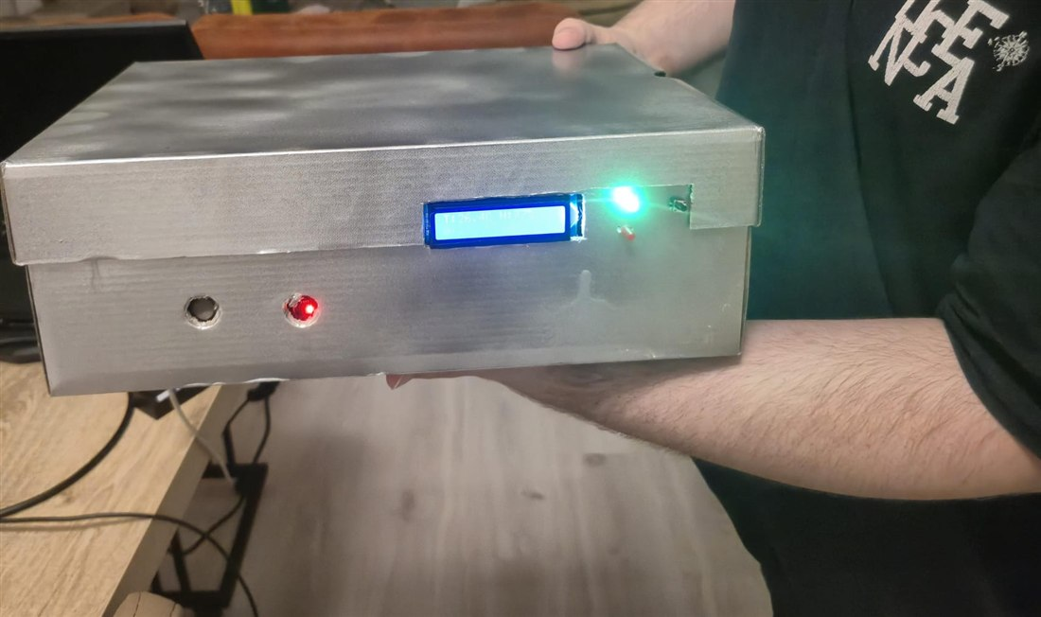
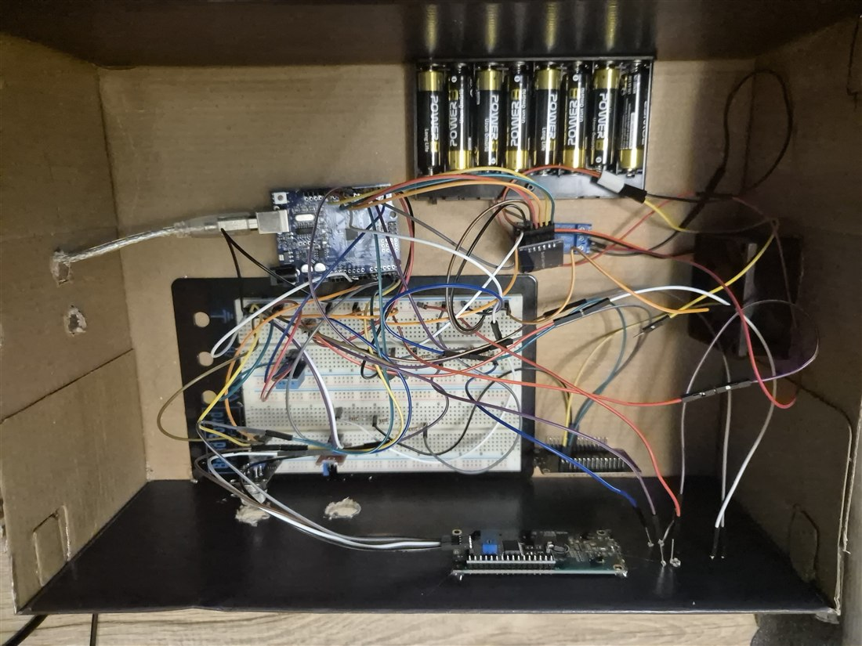
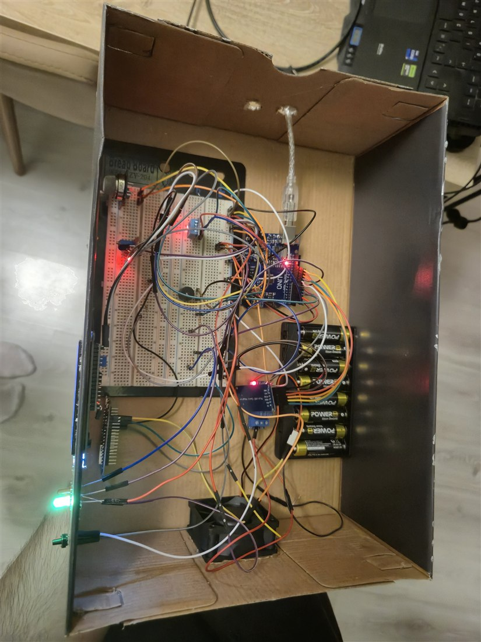
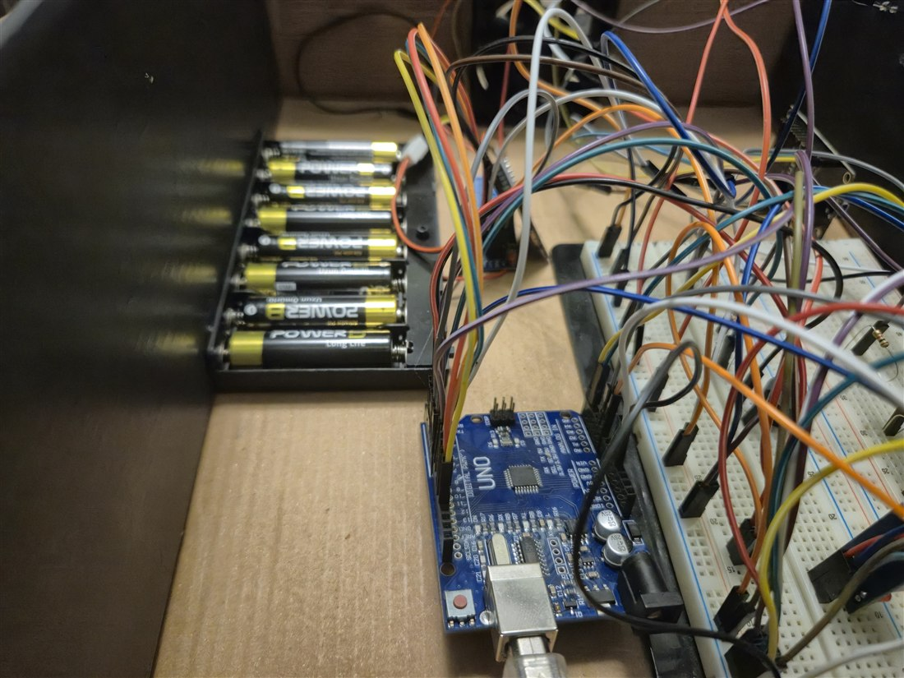
09 · PHOTOS
The Built System
Finished case, LCD showing live values
Inside: Arduino, breadboard, relay, NodeMCU
Running with the case open
Wiring and the 12 V battery pack
The case is a cardboard box covered in foil, with the LCD, the two LEDs and the button on the front and the fan on the side.
Notes:
The green LED means no alarm. The LCD alternates between the readings and the humidity warning when humidity is out of range.

Slide 11
10 · PROJECT PLAN
Timeline & Cost
3
Week 3
Proposal, design, ordering the parts
545.59 TL
4
Week 4
Sensors, Arduino and NodeMCU firmware, server
what I actually paid — the lab supplied the boards and the sensors
5
Week 5
Web page, Android app, command channel
6
≈ 1350 TL
Week 6
Testing, fixes and the report
to build the whole system from scratch
7
Week 7
Presentation
0 TL
server, database and notifications — every service on a free plan
The term started on 27 July 2026. I worked alone, so the work was split into stages instead of people.
Notes:
The project cost me 545 lira because the lab supplied the boards and sensors. Running it costs nothing.

Slide 12
11 · WHAT COMES NEXT
Future Work
Wi-Fi reconnect and a watchdog
Hysteresis on the relay
The NodeMCU does not reconnect by itself after the network drops, and neither board has a watchdog timer yet.
A reading sitting exactly on the threshold makes the fan switch on and off repeatedly.
Calibrating the MQ-2
A better sensor set
The gas threshold is a sensible default. It has not been calibrated against a known gas concentration.
A DHT22 measures up to 80 °C, which would make the heat alarm useful in a real fire.
The prototype works on a breadboard. It is not a certified detector and I would not tell anyone to use it instead of one.
Notes:
Known limits, stated honestly. The most important one is that the NodeMCU does not reconnect after a Wi-Fi drop.

Slide 13
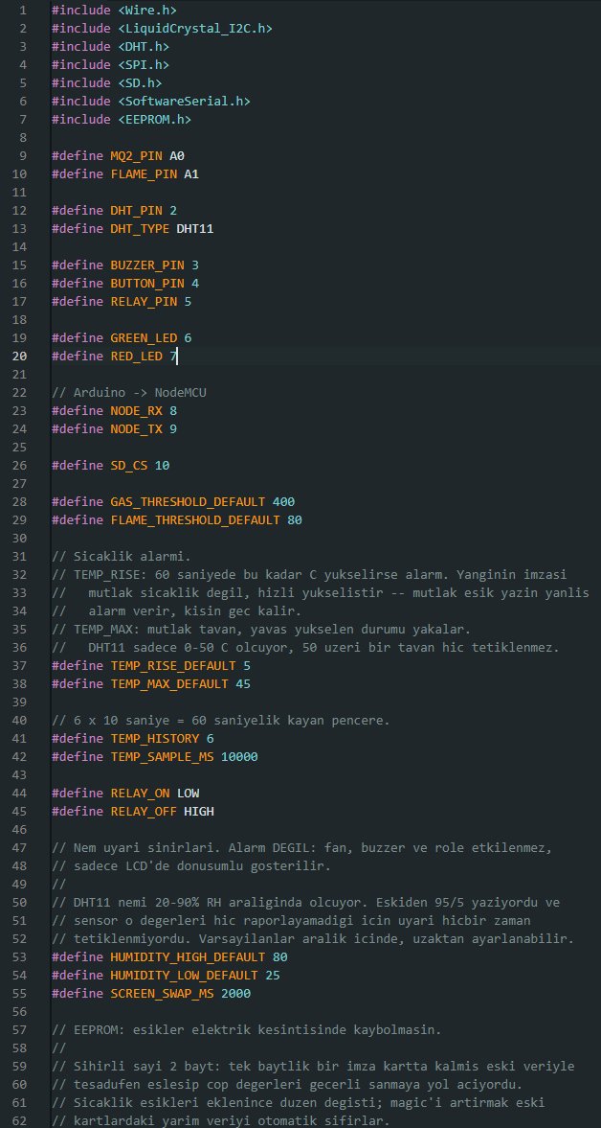
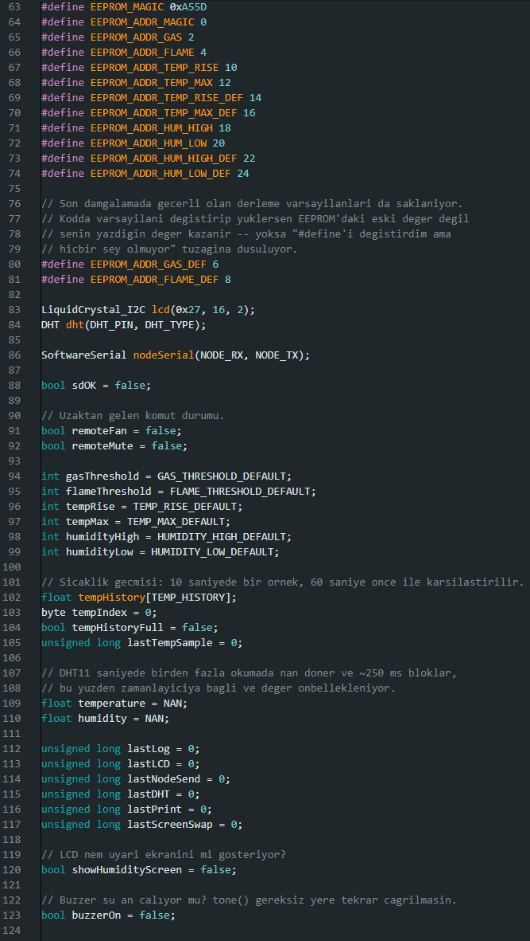
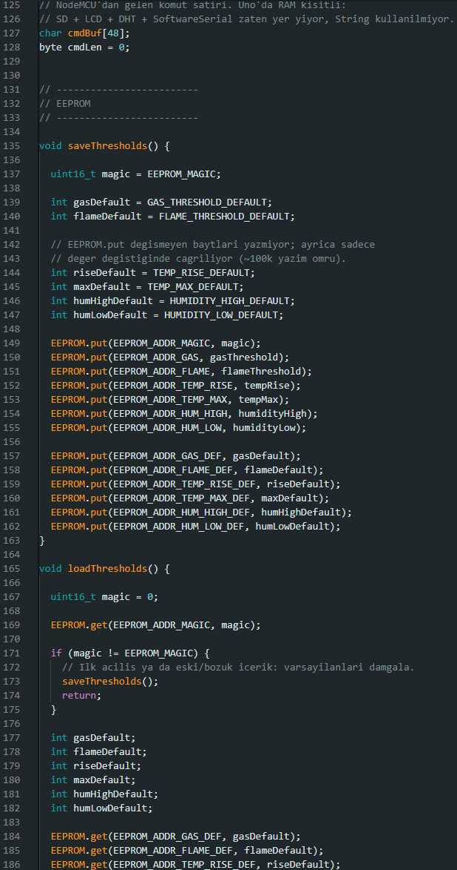
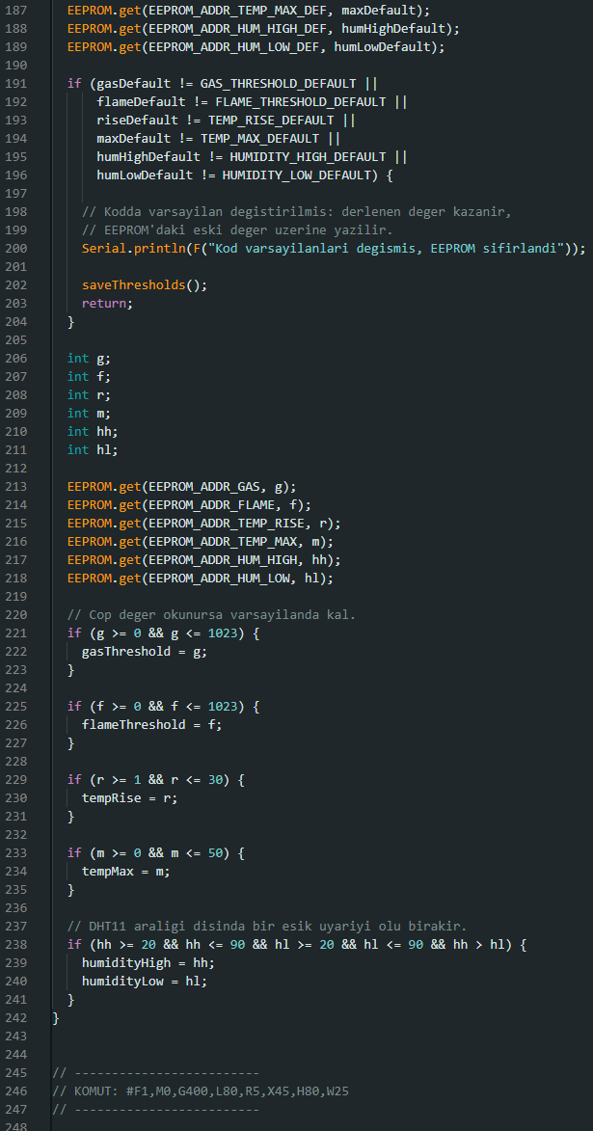
APPENDIX · SOURCE CODE
Arduino Firmware (1/3)
sketch_aug13a.ino
Notes:
Arduino Firmware, part 1 of 3.

Slide 14
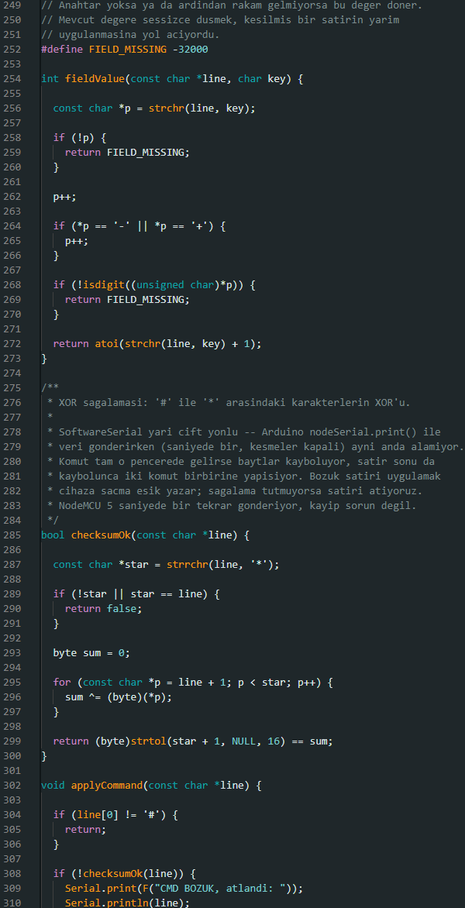
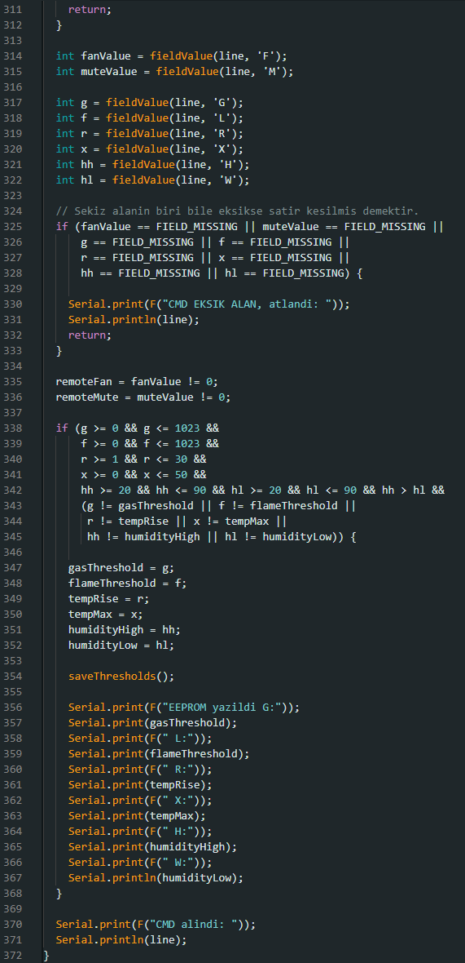
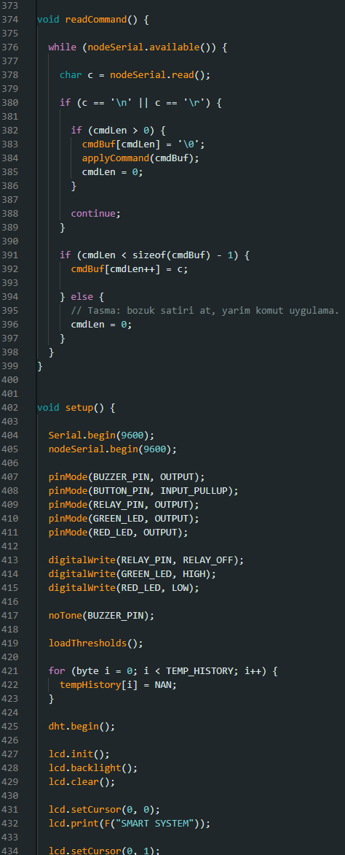
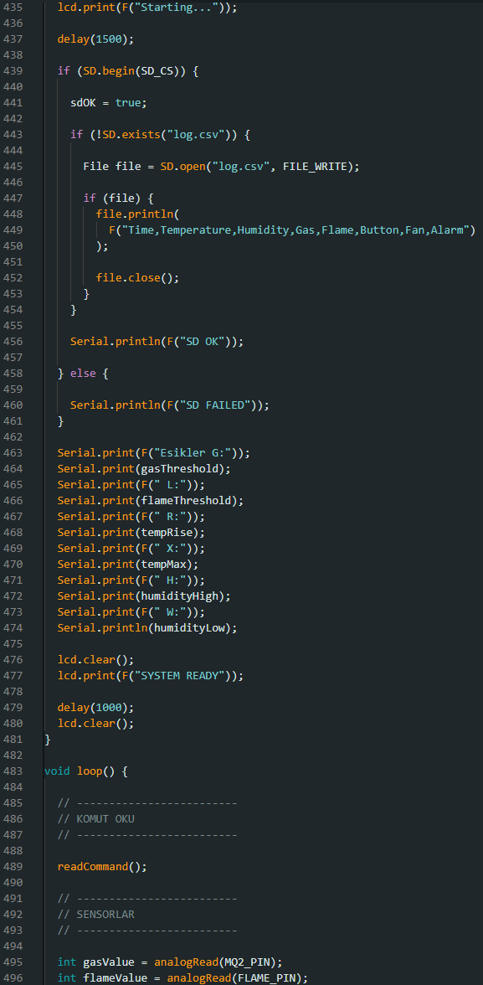
APPENDIX · SOURCE CODE
Arduino Firmware (2/3)
sketch_aug13a.ino
Notes:
Arduino Firmware, part 2 of 3.

Slide 15
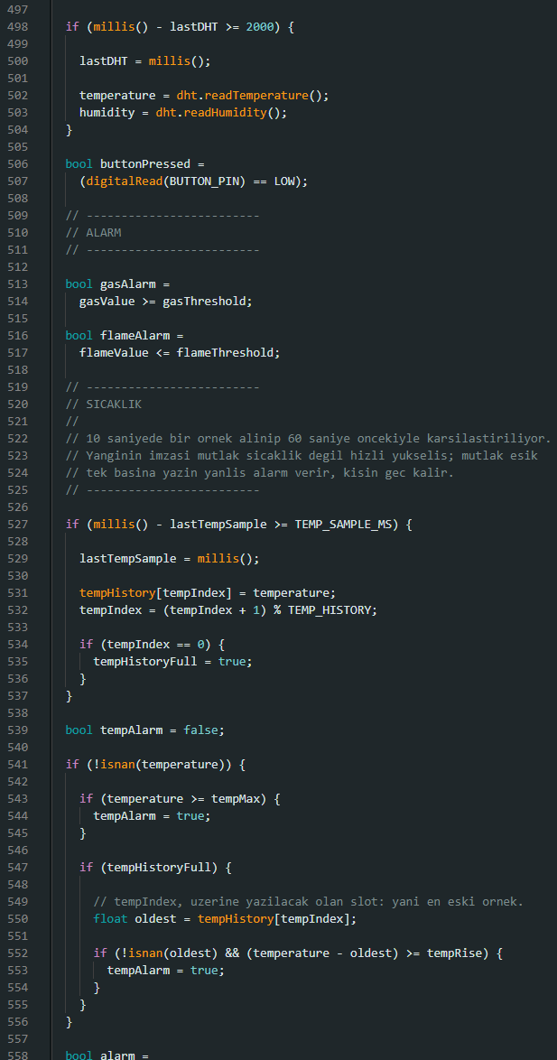
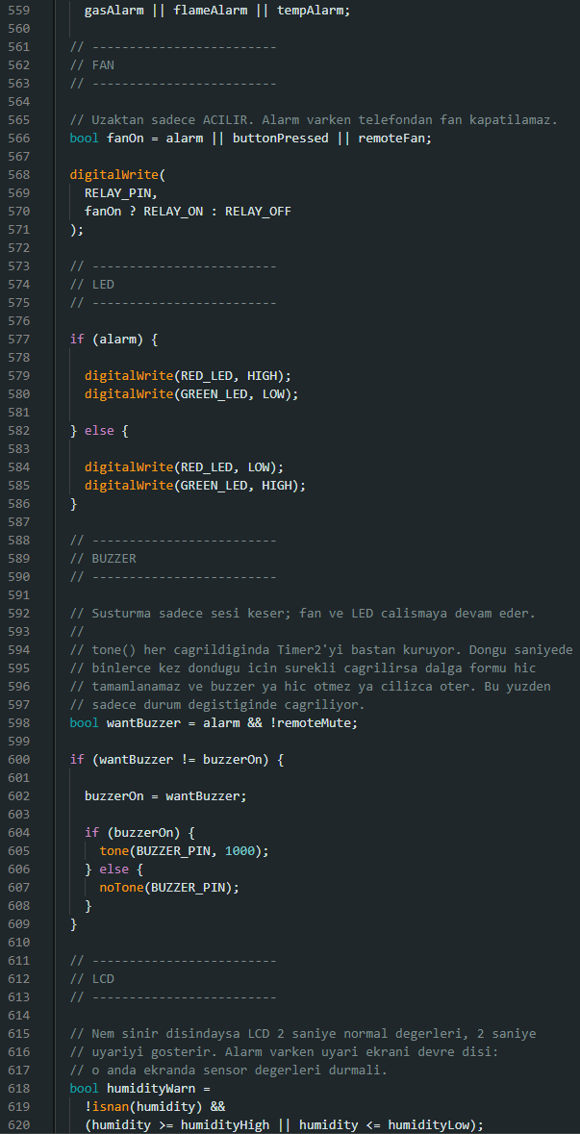
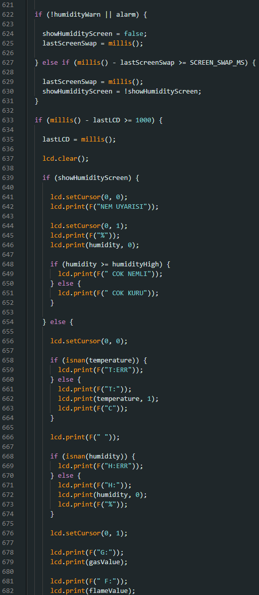
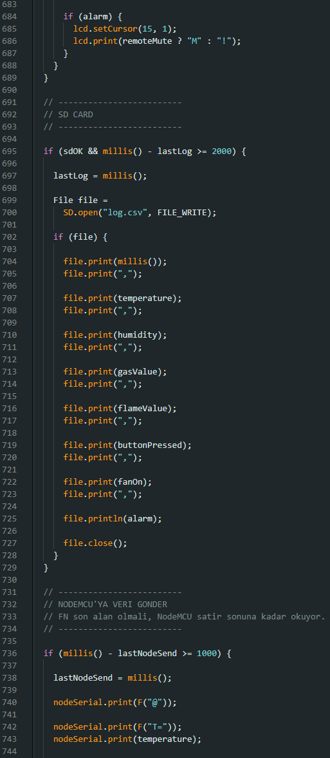
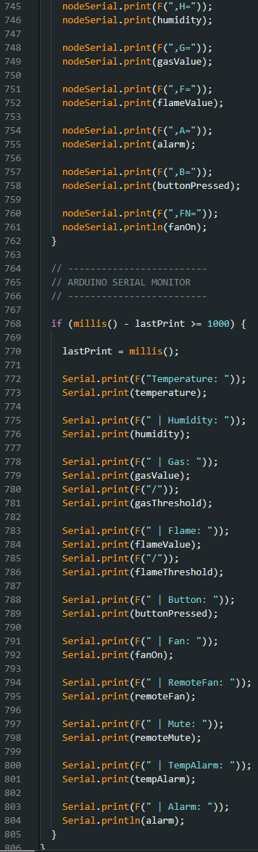
APPENDIX · SOURCE CODE
Arduino Firmware (3/3)
sketch_aug13a.ino
Notes:
Arduino Firmware, part 3 of 3.

Slide 16
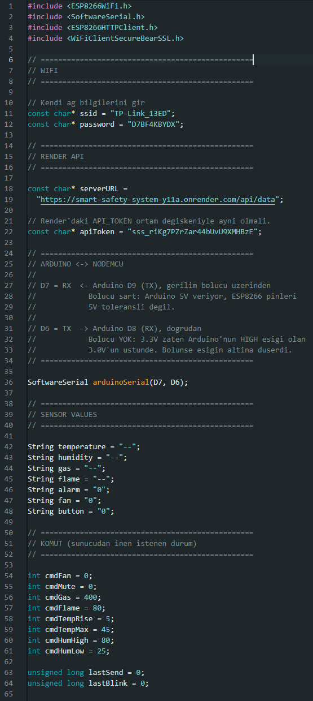
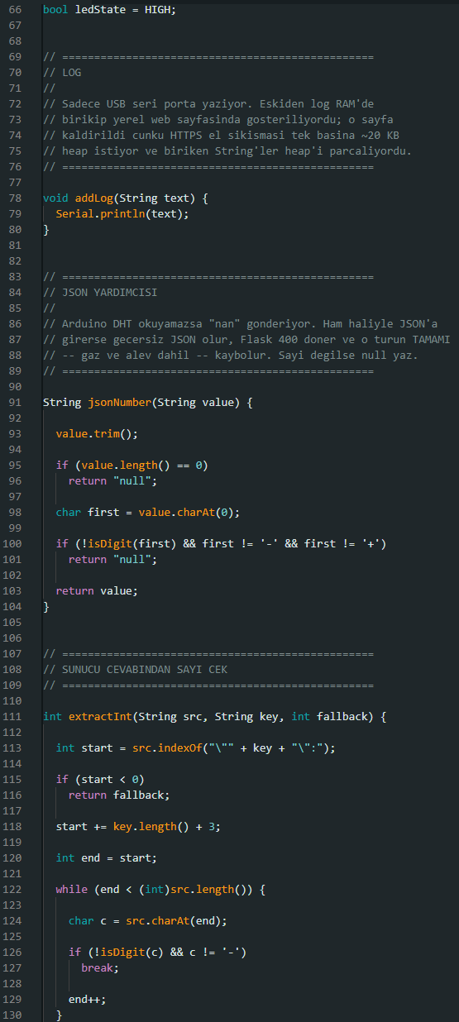
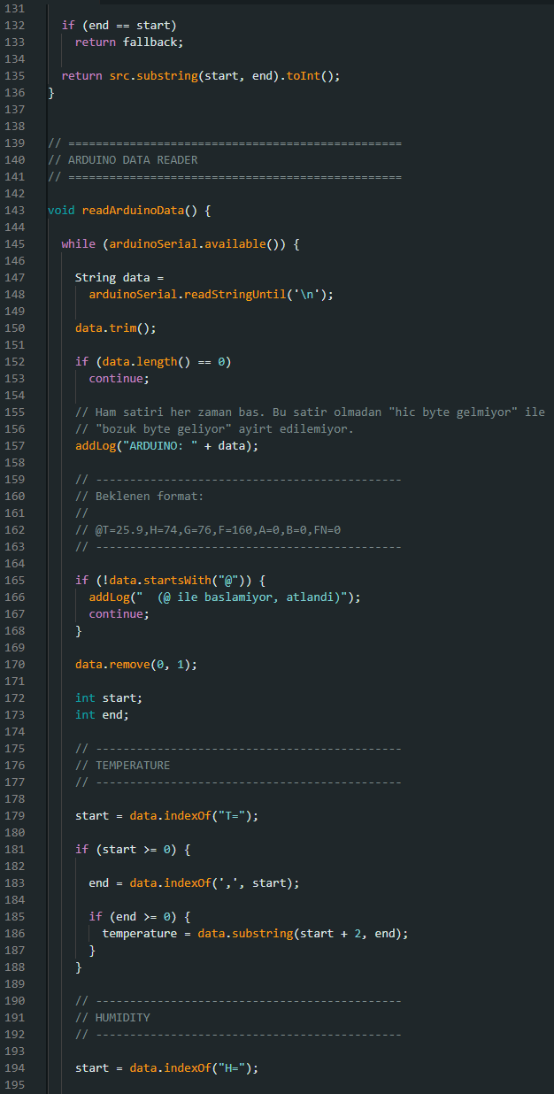
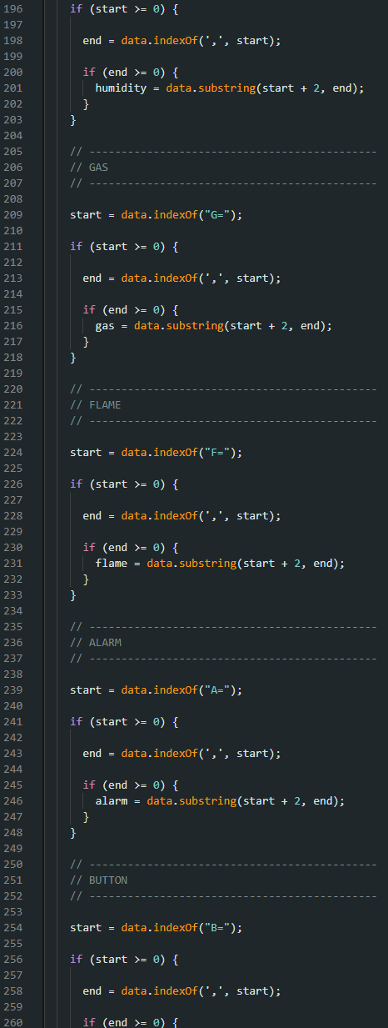
APPENDIX · SOURCE CODE
NodeMCU Firmware (1/3)
sketch_aug13b.ino
Notes:
NodeMCU Firmware, part 1 of 3.

Slide 17
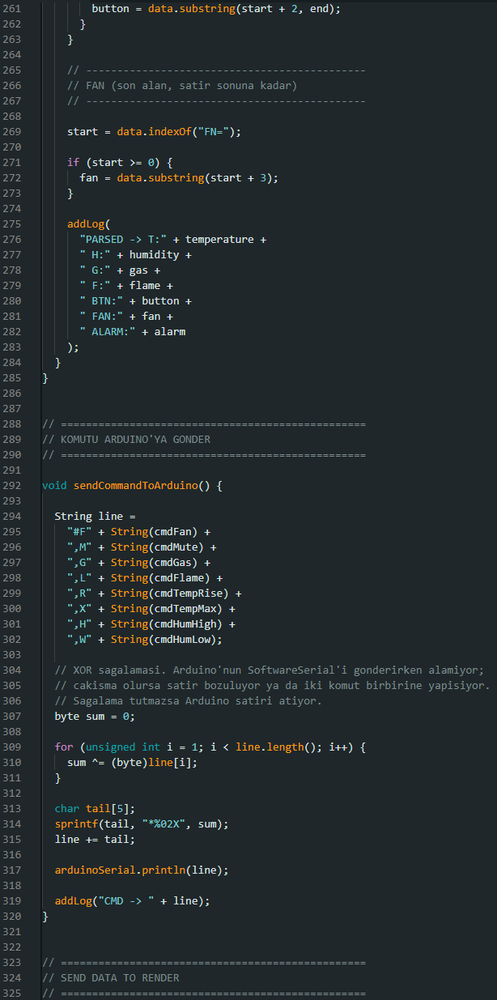
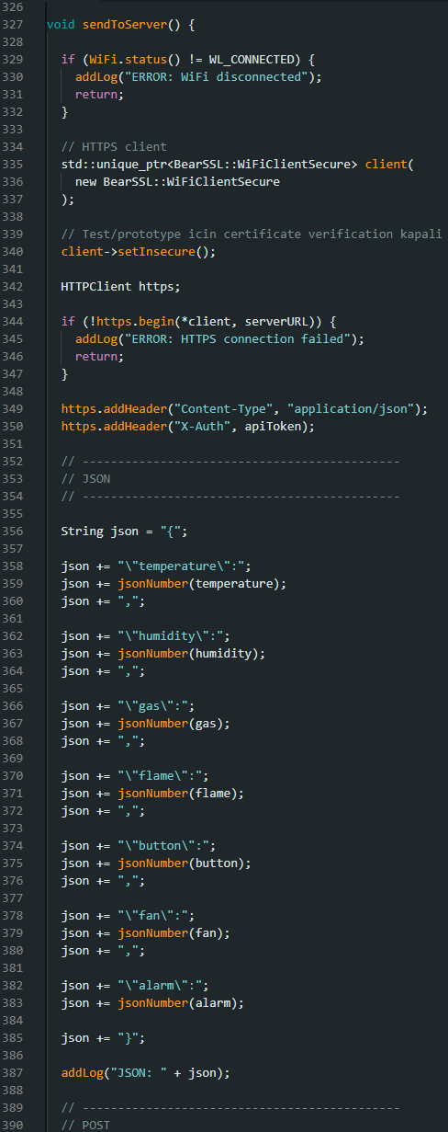
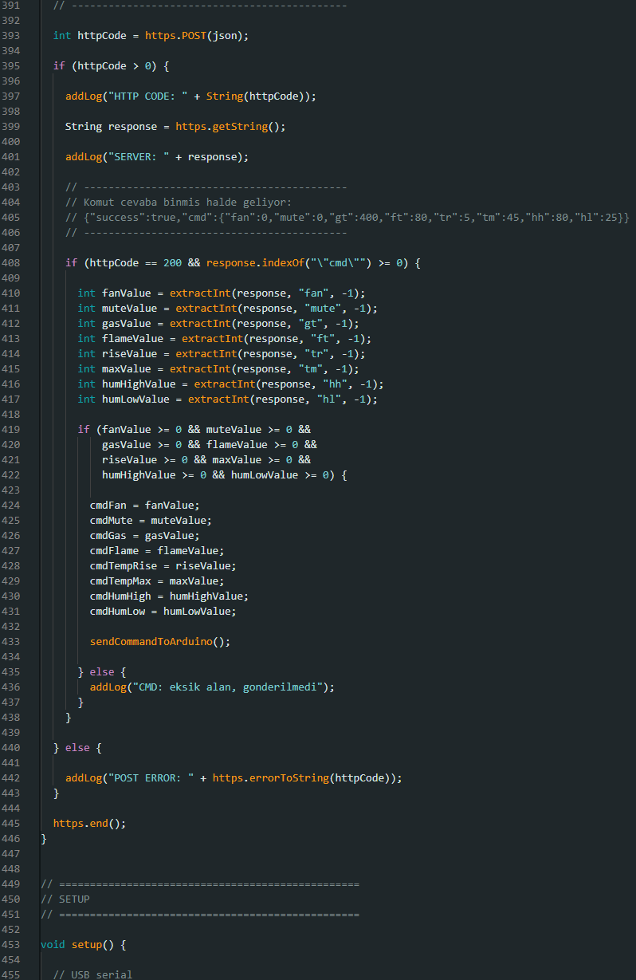
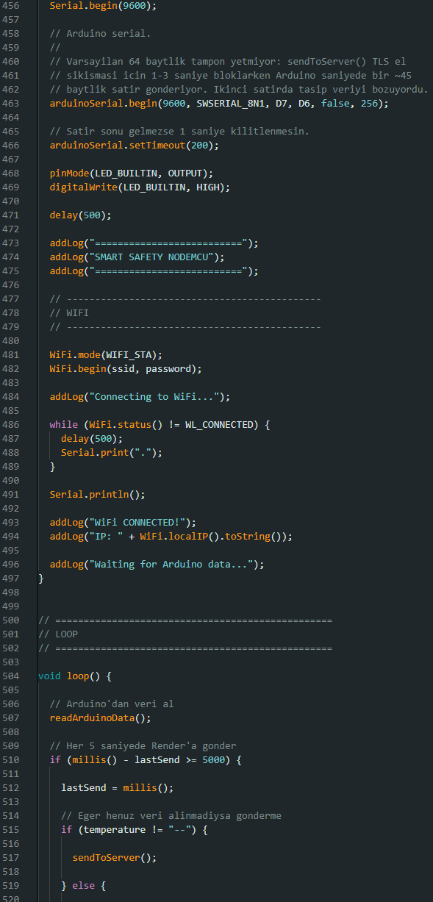
APPENDIX · SOURCE CODE
NodeMCU Firmware (2/3)
sketch_aug13b.ino
Notes:
NodeMCU Firmware, part 2 of 3.

Slide 18
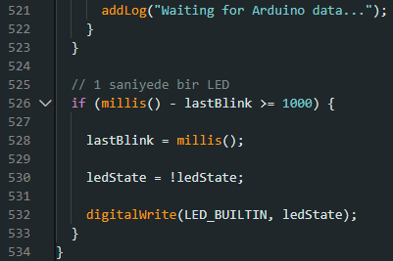
APPENDIX · SOURCE CODE
NodeMCU Firmware (3/3)
sketch_aug13b.ino
Notes:
NodeMCU Firmware, part 3 of 3.

Slide 19
References
Arduino
Arduino Uno Rev3 Documentation
docs.arduino.cc/hardware/uno-rev3
Hanwei Electronics
MQ-2 Semiconductor Sensor for Combustible Gas
pololu.com/file/download/MQ2.pdf
Aosong Electronics
DHT11 Humidity and Temperature Sensor
mouser.com/datasheet/2/758
Espressif Systems, 2023
ESP8266EX Datasheet, version 6.9
espressif.com · esp8266ex_datasheet_en.pdf
NFPA, 2022
NFPA 72 National Fire Alarm and Signaling Code
Rate of rise heat detectors
CEN, 2018
EN 50291-1 Detection of carbon monoxide in premises
Brussels
Thank you
Notes:
Thank you. Happy to answer questions.

