Slide 1

W2
YENI EKIP SYNC
VERSIYON KONTROL SISTEMI
GIT
SCRUM TRELLO REVIEW
YAZILIM GELİŞTİRME MODELİ
TEAM RESPONSIBILITY
SPRINT CLOSING

Slide 2
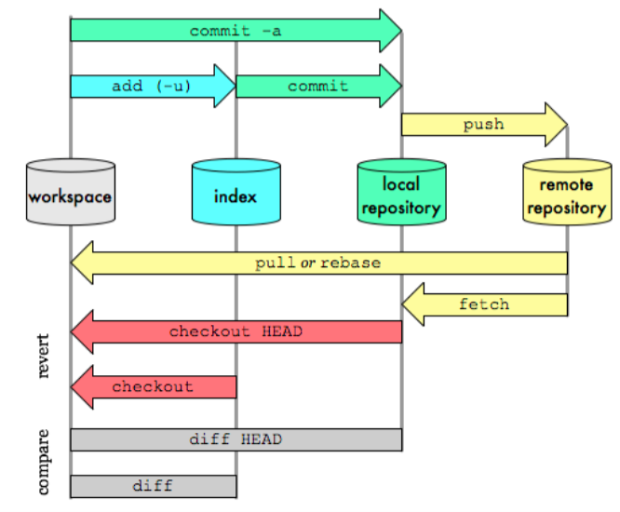

Slide 3
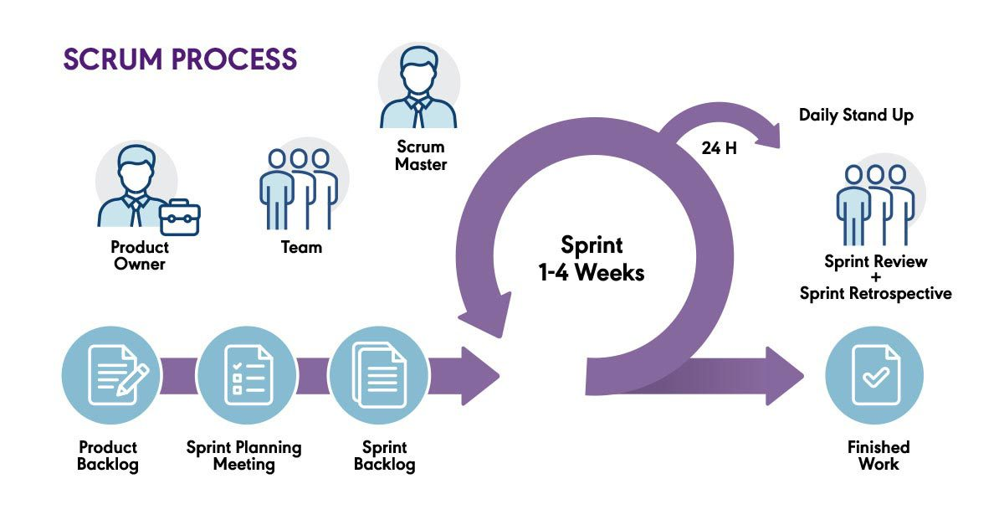

Slide 4
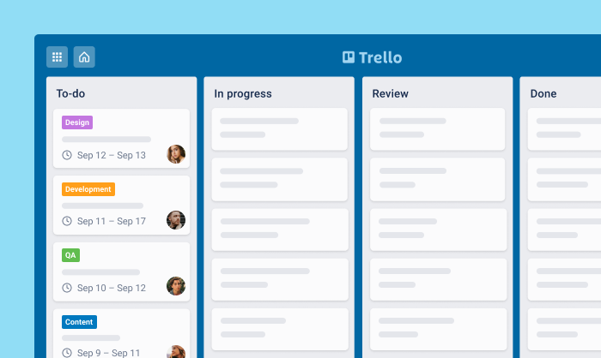

Slide 5
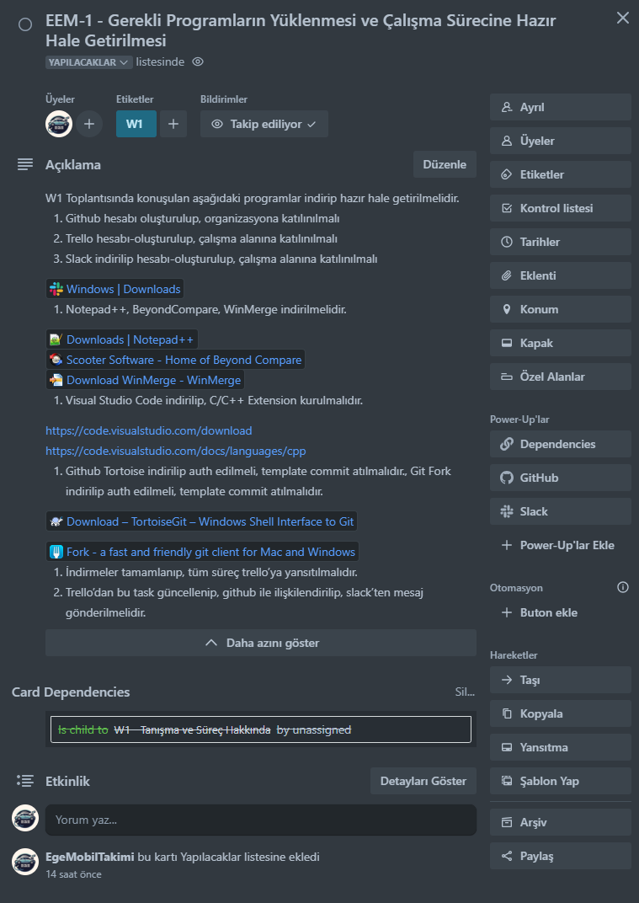
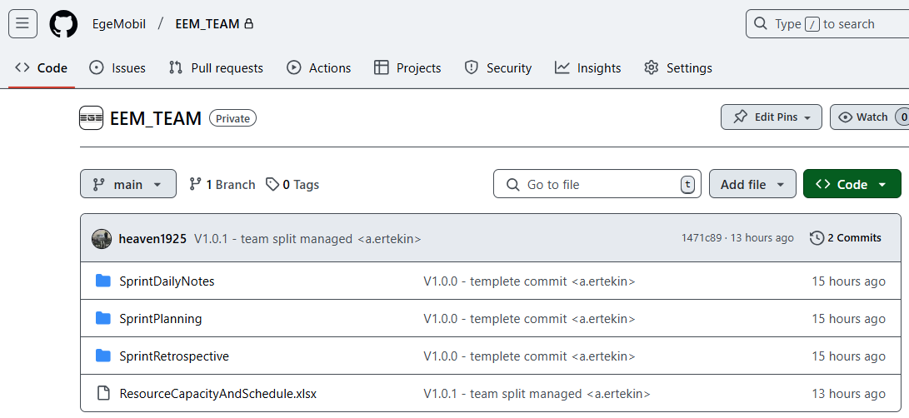
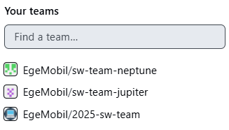
https://github.com/EgeMobil/EEM_TEAM
https://trello.com/c/hGCJ2xMu/3-eem-1-gerekli-programlar%C4%B1n-y%C3%BCklenmesi-ve-%C3%A7al%C4%B1%C5%9Fma-s%C3%BCrecine-haz%C4%B1r-hale-getirilmesi

Slide 6
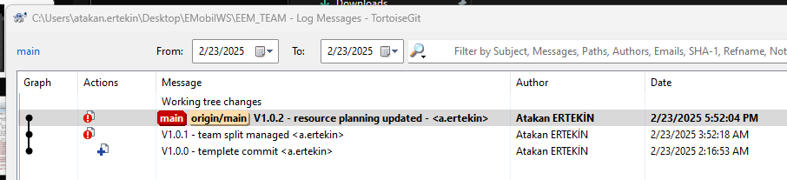

V<X>.<Y>.<Z> - commit açıklaması <<isimbasharif.soyisim>>

Slide 7
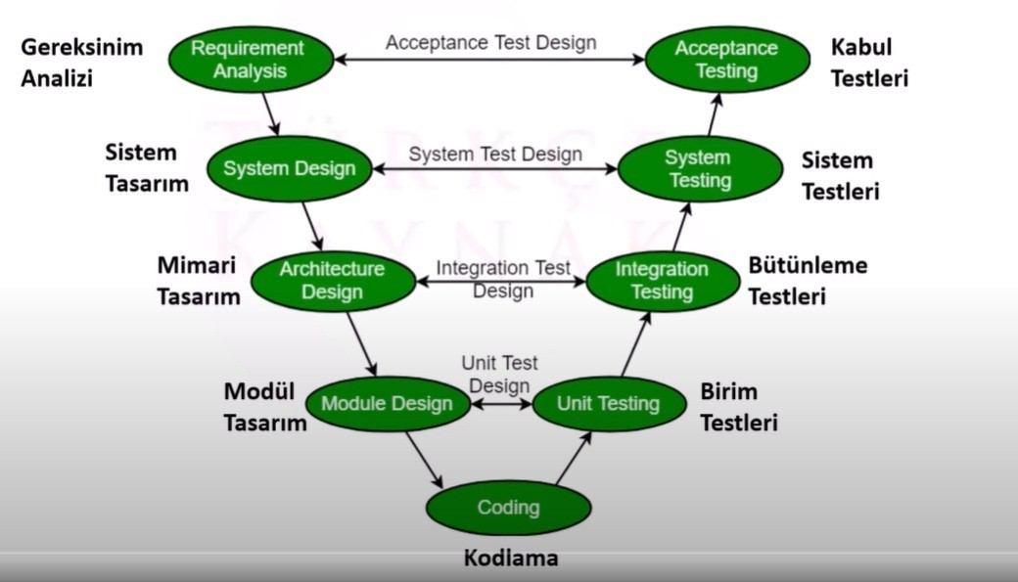

Slide 8
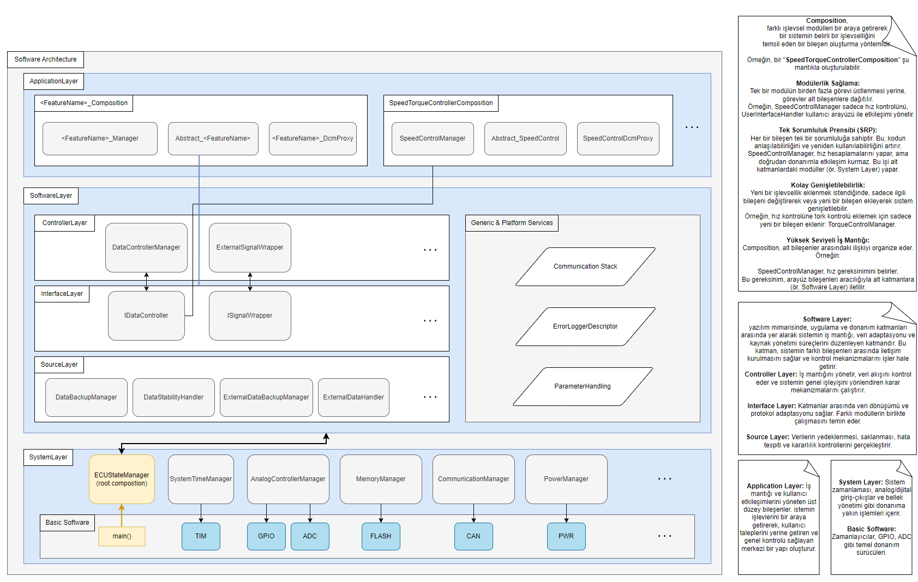

Slide 9
