Slide 1

Applied Domain-Driven Design Blue Prints for Java EE
Reza Rahman
Java EE/GlassFish Evangelist
Reza.Rahman@Oracle.com
@reza_rahman

Slide 2
Agenda
The Cargo Tracker Project
Domain-Driven Design (DDD)
DDD and Java EE

Slide 3
The Cargo Tracker Project
Blue Prints Reborn
J2EE popularized family of layered server-side architectures
  J2EE Blue Prints (aka “Java Pet Store”)
J2EE Blue Prints had profound impact, but not without it’s problems
  Many of the paradigms are alive and well even today!
  Encumbered by the immaturity of the technology/industry
Domain-Driven Design (DDD) emphasizes a return to the roots of Object Oriented Analysis and Design (OOAD)
Java EE’s lightweight programming model fits the DDD philosophy extremely well
  The Cargo Tracker project completes the circle

Slide 4
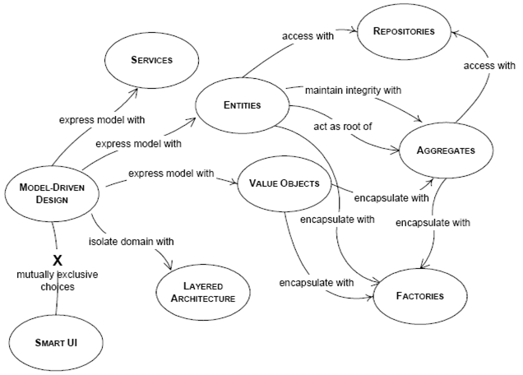
Domain-Driven Design
The Building Blocks

Slide 5
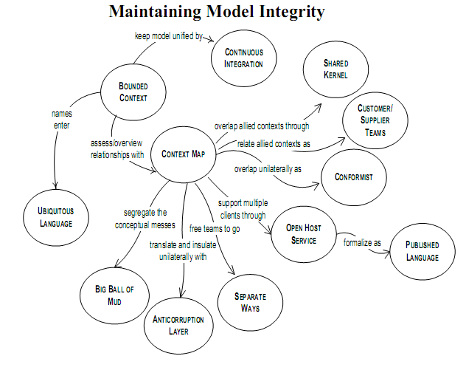
Strategic Domain-Driven Design

Slide 6
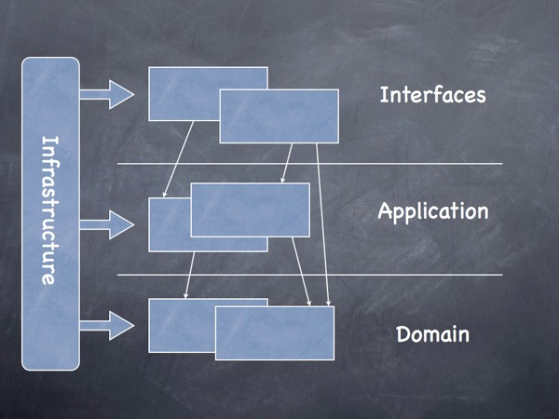
Layers
Separating the Concerns

Slide 7
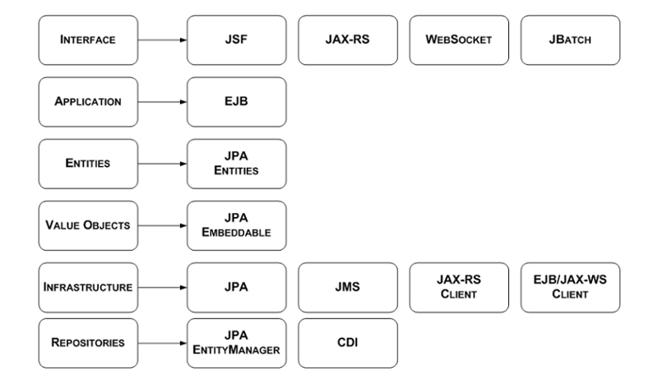
Mapping DDD to Java EE

Slide 8
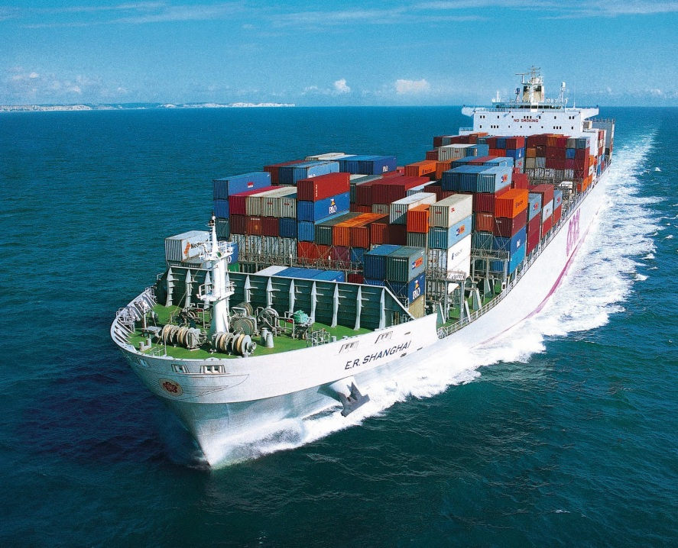

Java EE/DDD in Practice
http://cargotracker.java.net

Slide 9

Try it Out!
http://dlc.sun.com.edgesuite.net/glassfish/4.0.1/promoted/

Slide 10
Learn More
Cargo Tracker
  http://cargotracker.java.net
Getting Started with Domain-Driven Design
  http://refcardz.dzone.com/refcardz/getting-started-domain-driven
Domain-Driven Design Quickly
  http://www.infoq.com/minibooks/domain-driven-design-quickly
DDD Sample
  http://dddsample.sourceforge.net
Java EE 7 Tutorial
  http://docs.oracle.com/javaee/7/tutorial/doc/
The Aquarium
  http://blogs.oracle.com/theaquarium

