Slide 1
Domain Driven Design
Introduction

Slide 2
Domain Driven Design | Intro
Workshop
Domain Driven Design
Principles

Slide 3
Domain Driven Design | Workshops
 | Eindhoven | Rotterdam
April | Domain Driven Design Java Performance Tuning | Java Performance Tuning
Mei | Spring Framework Google Web Toolkit | Domain Driven Design Agile Techniques Stripes Framework Flex, Spring & BlazeDS
Juni | Agile Techniques jQuery Flex, Spring & BlazeDS | jQuery Spring Framework
…
September | Architectural Patterns Open Source ESBs | Java Power Tools Portlet Development Java Security
Oktober | Java Power Tools Portlet Development Java Security | Architectural Patterns Open Source ESBs

Slide 4


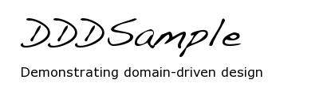
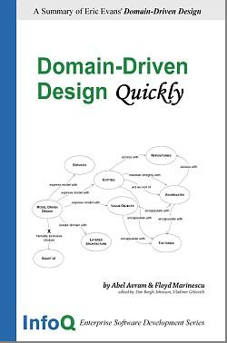
Domain Driven Design | Links
Domain Driven Design http://domaindrivendesign.org/
Domain Language http://domainlanguage.com/
DDD Sample http://dddsample.sourceforge.net/
Domain Driven Design Content on InfoQ http://www.infoq.com/domain-driven-design
Domain Driven Design Quickly http://www.infoq.com/minibooks/domain-driven-design-quickly
An Introduction to Domain Driven Design http://msdn.microsoft.com/en-us/magazine/dd419654.aspx

Slide 5
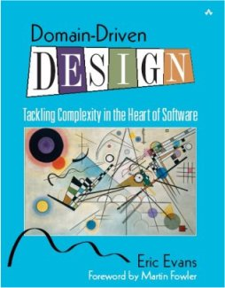
Domain Driven Design | Book
I: Putting the Model to Work
II: The Building Block of a
Model-Driven Design
(Tuesday)
III: Refactoring Toward Deeper Insight
(Thursday)
IV: Strategic Design

Slide 6
Domain Driven Design | Principles
Abstraction
Encapsulation
Information Hiding
Modularization
Separation of Concerns
Coupling and Cohesion
Sufficiency, Completeness and Primitiveness
Separation of Policy and Implementation
Separation of Interface and Implementation
Single Point of Reference
Divide-And-Conquer
From: Parnas, others.

Slide 7
Domain Driven Design | Principles
Values
Principles
Patterns
Meaning
Unity
Usability
Fitness
Flexibility
Maintainability
…
Continuous Learning
Knowledge Rich Design
Ubiquitous Language
Model-Driven Design
Separation of Concerns
Deep Models
Declarative Style
Layered Architecture
Ubiquitous Language
(Entities, Value Objects, Services, Modules, Aggregates, Factories, Specification)
Supple Design
(Intention-Revealing Interfaces, Side-Effect Free Functions, Assertions, Conceptual Contours, Standalone Classes, Closure of Operations)

Slide 8
Domain Driven Design
Assignment

Slide 9
Domain Driven Design | Assignment to Create a (Domain) Model of our World

Slide 10
Domain Driven Design | World
Ontology
Nouns & Verbs
Data Models
Entities, Relationships
Data, Queries
Object Models
Classes, Associations
Properties, Methods
Animal
Mammal
Fish
eats
Canine
Human
= rational animal
Detached, ‘objective’ engagement; method becomes a filter: “when all you have is a hammer, everything looks like a nail” (or SQL, table, respectively).

Slide 11
Domain Driven Design | World
Ubiquitous Language
- Unity (“being-with”)
- Intentionality (“towards-which”)
- Meaning (“for-the-sake-of-which”)
- Projection (“world-of-possibilities”)
Domain Model as Backbone
Bringing back the humans: End Users, Experts, Developers, Testers. Communicating.

Slide 12

Case | Domain
Online Developer Community
Working
Interacting
Community =
Communication +
Unity (JavaPosse)
Thinking
Learning

Slide 13
Domain | Interacting
Network
Messaging
Connecting
Skill
Profile
Member
Identity
Association
Group

Slide 14
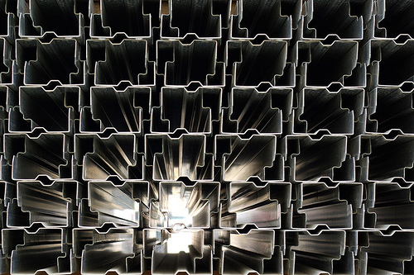
Network | Consultant Profile
Social Networking
Education
Career
Personal web sites
Blogs
We need to know who is ‘in’ the community. On the other hand we don’t want to demand too much effort. But there’s a bunch of information that is already there to fill in the gaps: Lara, social networking sites, personal web sites. This will constitute the basis of each consultant’s profile (on a permission basis).

Slide 15

Network | Expertise Location
Questions
Answers
Experts
Conversations
Real Help
I’ve got a problem with X, is there anybody who can help me? Sure, you can post it on the mailing list, and someone will eventually respond. But, mail threads are not like meaningful conversations (otherwise we wouldn’t put “hope this helps” at the bottom of the response).

Slide 16
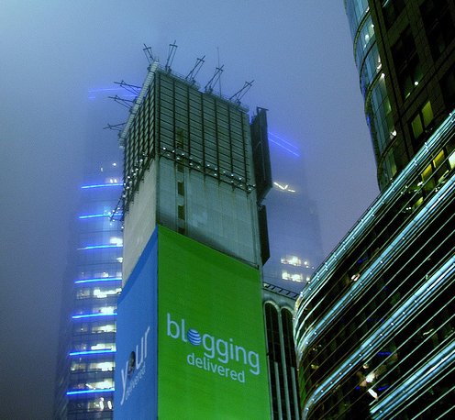
Network | (Micro-)blogging
Thoughts
Tweets
Topics
Tags
Your colleagues may have pretty funky ideas about stuff, and not only about what to have for breakfast. Perhaps you need a better way to find them.

Slide 17
Domain | Working
Projects
Job
Skill
Role
Assignment
Client
Qualification
Employee
Business
Company

Slide 18

Projects | Job Finder
Lara
Job postings
Skill profile
Notification
Sometimes less is more. Take Lara (the system), if you subscribe to Lara you’ll get a multitude of job postings – most of which being totally irrelevant. This feature will filter the most relevant job postings, given a consultants’ skill profile.

Slide 19
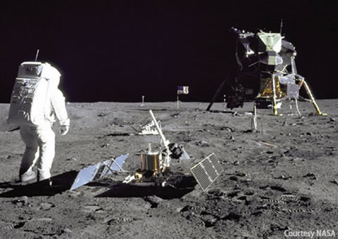
Projects | Project History
Retrospectives
Lessons learned
Technology Usage
Job Assignments
Learn from experience
Project records
No astronaut left the moon without some physical evidence of ‘being there’ (i.e. ‘rocks’). Likewise, no consultant will leave a project without digital evidence (i.e. experience). This experience shall be shared to others. What technologies were involved? What did we learn? How to prevent the same mistakes from happening?

Slide 20
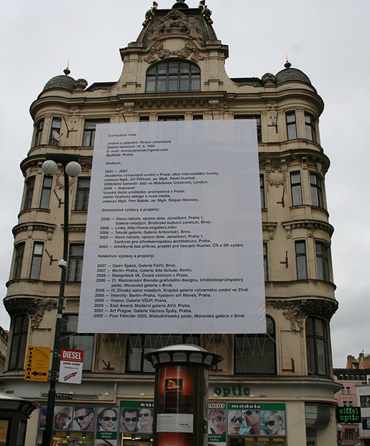
Projects | CV Generator
Roles and responsibilities
Technologies used
Recorded project brief
If we have recorded all projects to which our consultants have been assigned, we should be able to automatically generate an up-to-date CV (both Dutch and English) from past experience.

Slide 21
Domain | Thinking
Technology
Specification
Framework
Concern
Pattern
Mechanism
Skill
Implementation
Tool
Technique

Slide 22
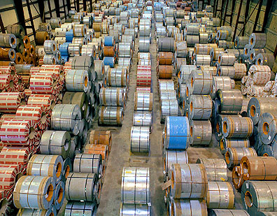
Technology | Software Trove
Mechanisms
Components
Libraries
Frameworks
Servers
Engines
Software systems involve many mechanisms in order to satisfy functional and non-functional requirements. In open source Java software alone there is an abundance of choice. This feature serves as a catalog for those mechanisms, along with the most popular implementation options.

Slide 23
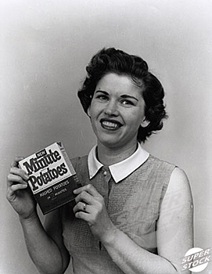
Technology | Design-o-Matic
‘Expert System’
Constraints
Rules
Solutions
Just add some water – and you’re done! But seriously, with just a packet full of rules and constraints, you’ll end up having just a few meaningful options, instead of a combinatorial explosion package.

Slide 24
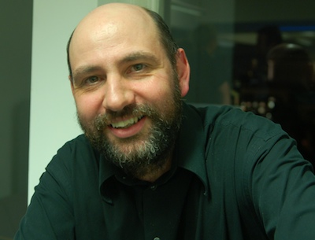
Technology | Guru Sightings
Martin Fowler
Martin Odersky
Robert C. Martin
(Uncle Bob)
Martin Heidegger
These are all gurus, and they’re all called Martin (one way or the other). At Logica we have novices, advanced beginners, competents, proficients, but hardly no experts – or gurus. Gurus earn a reputation, not particularly based on a name that was given to them at birth, but one given for what they can teach us about technology.

Slide 25
Domain | Learning
Resources
Article
Guru
How-To
Book
Skill
Author
Topic
Podcast
Speaker
Course
Talk

Slide 26

Resources | Digital Bookshelves
Professional literature
Textbooks
Software how-to’s
Cookbooks
Free books
Bibles
Consultants read books. Who is reading what? Preferred books reveal a consultants’ interests. Aggregated bookshelves assist in locating expertise. Collective reading behavior may signify change. Additional functions: buy books at best price, connect lenders and borrowers.

Slide 27

Resources | Online Courseware
Free vendor training
Conference tapes
How-to podcasts iTunes University lectures
Skillsoft training
There’s a whole bunch of stuff online. And it’s free. You just need to know where to find it. The online community will disclose relevant courses, trainings, lectures, seminars, talks, and other multimedia content.

Slide 28
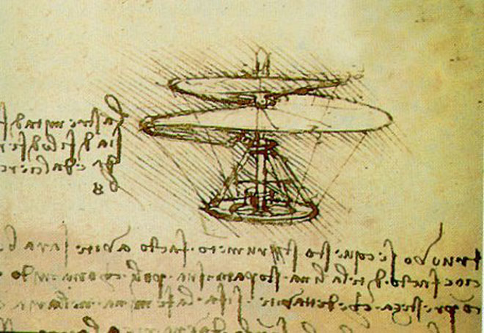
Resources | Knowledge Fragments
Recipes
Case Studies
Principles
Patterns
…
Different people need different types of knowledge in order to acquire skills. Novices want recipes, the do’s and don’ts; advanced beginners mimic cases; competent professionals require principles and maxims; proficient colleagues thrive on patterns. Experts need … what?

Slide 29
Domain Driven Design | Example
Mechanism
<< Entity >>
Standard
Technique
SDO
Platform
Concern
<< Entity >>
<< Aggregate Root >>
Implementation
E.g. Concern: Data Access, Mechanism: Persistence, Technique: Object-Relational Mapping, Standard: JPA, Implementation: Hibernate (or NHibernate for .NET)

Slide 30
Domain Driven Design | Example
Value Object e.g. Implementation.Release
Factory e.g. ImplementationFactory
Repository e.g. TechnologyTripletStoreRepository
Service e.g. SolutionService

Slide 31
Domain. Driven. Done.

