Slide 1
PackageManagerService
IntentResolver
Intent
mResolvePrioritySorter排序
ActivityIntentResolver
queryIntentActivitiesInternals
ServiceIntentResolver
List<ResolveInfo> query
IntentFilter(s)
ProviderIntentResolver
chooseBestActivity
List<ResolveInfo> query
先检查
再比对
Settings
findPreferredActivity
最佳
ResolveInfo
List<PreferredActivity> prefs
UserId
intent
PreferredIntentResolver （s）
PreferredIntentResolver
queryIntent
ResolveInfo
IntentFilter
ProviderInfo
ServiceInfo
ActivityInfo

Slide 2
@Override public ResolveInfo resolveIntent(Intent intent, String resolvedType, int flags, int userId) { return resolveIntentInternal(intent, resolvedType, flags, userId, false,Binder.getCallingUid()); }
private ResolveInfo resolveIntentInternal(Intent intent, String resolvedType, int flags, int userId, boolean resolveForStart, int filterCallingUid) {
…… final List<ResolveInfo> query = queryIntentActivitiesInternal(intent, resolvedType, flags, filterCallingUid, userId, resolveForStart, true /*allowDynamicSplits*/); …… final ResolveInfo bestChoice = chooseBestActivity(intent, resolvedType, flags, query, userId); return bestChoice; }
private @NonNull List<ResolveInfo> queryIntentActivitiesInternal(Intent intent, String resolvedType, int flags, int filterCallingUid, int userId, boolean resolveForStart, boolean allowDynamicSplits) {
………
List<ResolveInfo> result; result = filterIfNotSystemUser(mActivities.queryIntent( intent, resolvedType, flags, userId), userId);
…… Collections.sort(result, mResolvePrioritySorter); return …
}
ActivityIntentResolver
1、获取并排序
ResolveInfo findPreferredActivity(Intent intent, String resolvedType, int flags, List<ResolveInfo> query, int priority, boolean always, boolean removeMatches, boolean debug, int userId) {
ResolveInfo pri = findPersistentPreferredActivityLP(intent, resolvedType, flags, query, debug, userId); PreferredIntentResolver pir = mSettings.mPreferredActivities.get(userId); List<PreferredActivity> prefs = pir != null ? pir.queryIntent(intent, resolvedType, (flags & PackageManager.MATCH_DEFAULT_ONLY) != 0, userId) : null; if (prefs != null && prefs.size() > 0) { boolean changed = false; try { int match = 0; final int N = query.size(); for (int j=0; j<N; j++) {// 让 match = 最大的值 } final int M = prefs.size(); // 遍历 List<PreferredActivity> prefs for (int i=0; i<M; i++) { final PreferredActivity pa = prefs.get(i); // 第1步：检查 match 已经是最大的值，不等跳过 // 第2步：检查 mPref.mAlways 类型 // 第3步：获取对应的 ActivityInfo // 第4步：ActivityInfo 检查 ， // 第5步：遍历、比对 for (int j=0; j<N; j++) {final ResolveInfo ri = query.get(j); //第6步：遍历比对packageName、Name等。。。 return ri; } } } finally {。。。。 } } } 。。。 }
private static final Comparator<ResolveInfo> mResolvePrioritySorter = new Comparator<ResolveInfo>() { public int compare(ResolveInfo r1, ResolveInfo r2) {
。。。。。 r1.priority; r1.preferredOrder; r1.isDefault ? -1 : 1; r1.system ? -1 : 1; r1.activityInfo.packageName.compareTo(r2.activityInfo.packageName); r1.serviceInfo.packageName.compareTo(r2.serviceInfo.packageName); r1.providerInfo.packageName.compareTo(r2.providerInfo.packageName);
。。。。。 } };
2、获取最佳
private ResolveInfo chooseBestActivity(Intent intent, String resolvedType, int flags, List<ResolveInfo> query, int userId) {
。。。。。 ResolveInfo ri = findPreferredActivity(intent, resolvedType, flags, query, r0.priority, true, false, debug, userId); if (ri != null) { return ri; }
。。。。。 return ri; } } return null; }

Slide 3
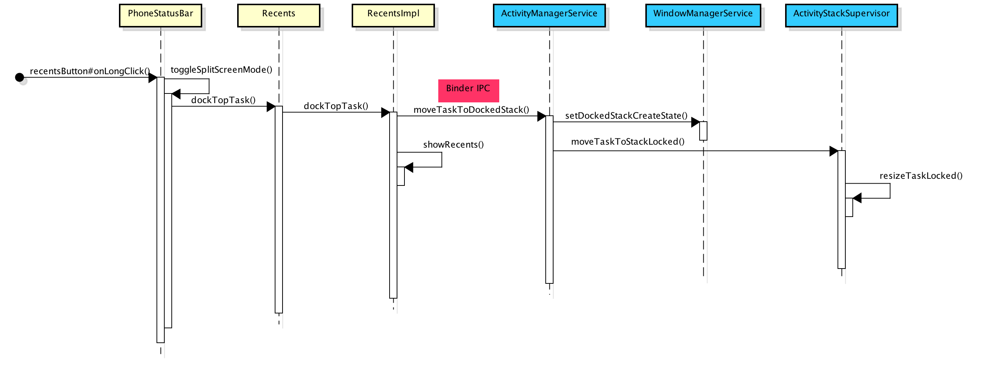

Slide 4
为什么一旦将Activity移动到Pinned Stack上，该窗口就能一直在最上层显示呢？这就是由Z-Order控制的，Z-Order决定了窗口的上下关系。 Android N中新增了一个类WindowLayersController来专门负责Z-Order的计算。在计算Z-Order的时候，有几类窗口会进行特殊处理，处于Pinned Stack上的窗口便是其中之一。

Slide 5
系统中可能会包含这么几个Stack
Activity
Activity
Activity
Task
Activity
【Id：3】Docked Stack
【Id：4】Pinned Stack
【Id：0】Home Stack
【Id：1】FullScren Stack
【Id：2】 Freeform Stack
系统中可能会包含这么几个Stack
ActivityStackSupervisor

