Slide 1
POLICY STATE
IntentResolver
ANIMATOR STATE
SESSIONS
List<ResolveInfo> query
DISPLAY CONTENTS
TOKENS
List<ResolveInfo> query
WINDOWS
先检查
再比对
最佳
ResolveInfo
List<PreferredActivity> prefs
UserId
intent
PreferredIntentResolver
ResolveInfo
IntentFilter
ProviderInfo
ServiceInfo
ActivityInfo

Slide 2
AMS
WMS
SurfaceClient
剧本
胶片
投影仪

Slide 3
AMS
WMS
SurfaceClient
剧本
胶片
投影仪

Slide 4
WindowManagerService
WindowStateAnimator
WindowManagerService
Animator
PhoneWindowManager
ActivityManagerService
SurfaceFlinger
Surface
IntentResolver
IntentResolver
WindowManagerPolicy
IntentResolver
PhoneManagerService
WindowAnimator
Watchdog
Display
InputManagerService
DisplayContent
WindowState
DisplayManager
ResolveInfo
IntentFilter
ProviderInfo
WindowToken
ServiceInfo
Session
ActivityInfo

Slide 5
AMS
App
WMS
SurfaceFlinger
Sureface
SurefaceControl
Sureface
Layer
SharedBufferBuffer
SharedBufferClient
Layer
SurfaceComposerClient
Layer
Layer
Layer
ISurface
Layer
SharedClient
FrameBuffer
HAL
Gralloc
HWComposer
Display

Slide 6
WindowStateAnimator
WindowManagerService
WindowManagerPolicy
WindowManagerService
PhoneWindowManager
ActivityManagerService
SurfaceFlinger
Surface
PhoneManagerService
IntentResolver
IntentResolver
WindowManagerPolicy
IntentResolver
WindowAnimator
Watchdog
Display
InputManagerService
DisplayContent
WindowState
DisplayManager
ResolveInfo
IntentFilter
ProviderInfo
WindowToken
ServiceInfo
Session
ActivityInfo

Slide 7
App
Sureface
WindowStateAnimator
Layer
ActivityManagerService
SharedBufferClient
Layer
Layer
PhoneWindowManager
WindowManagerService
SurfaceFlinger
Surface
SurefaceControl
IntentResolver
SurfaceComposerClient
WindowManagerPolicy
ISurface
SurfaceFlinger
Sureface
Layer
DisplayContent
SharedBufferBuffer
Layer
Layer
DisplayManager
SharedClient
FrameBuffer
HAL
Gralloc
HWComposer
Display

Slide 8
AMS
App
WindowManagerService
SurfaceFlinger
Sureface
SurefaceControl
Sureface
Layer
SharedBufferBuffer
SharedBufferClient
Layer
SurfaceComposerClient
Layer
Layer
Layer
ISurface
Layer
SharedClient
FrameBuffer
HAL
Gralloc
HWComposer
Display
IntentResolver
WindowStateAnimator
WindowManagerPolicy
ActivityManagerService
SurfaceFlinger
DisplayContent
Surface
PhoneWindowManager
DisplayManager

Slide 9
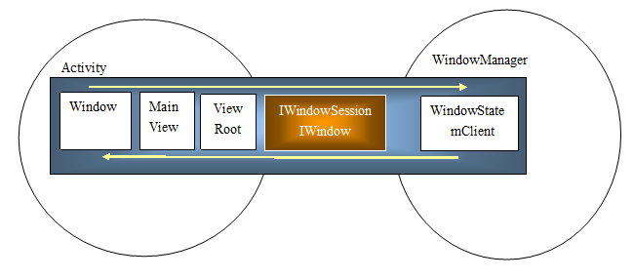
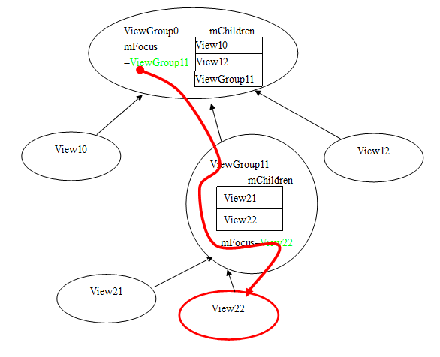
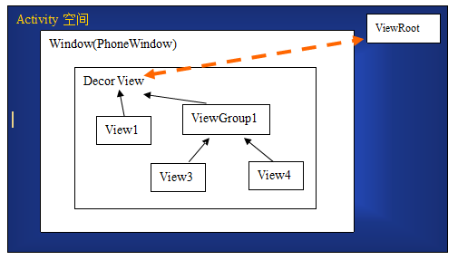
所谓的Foucs Path就是我们的KeyEvent传递的路线。一般的我们的KeyEvent在主循环中主View通过View的焦点记录关系传递到焦点View上。例如下图，View22是焦点，我们从最顶层的View通过mFcous的关系链找到最后所形成的路径就是Focus Path。

Slide 10
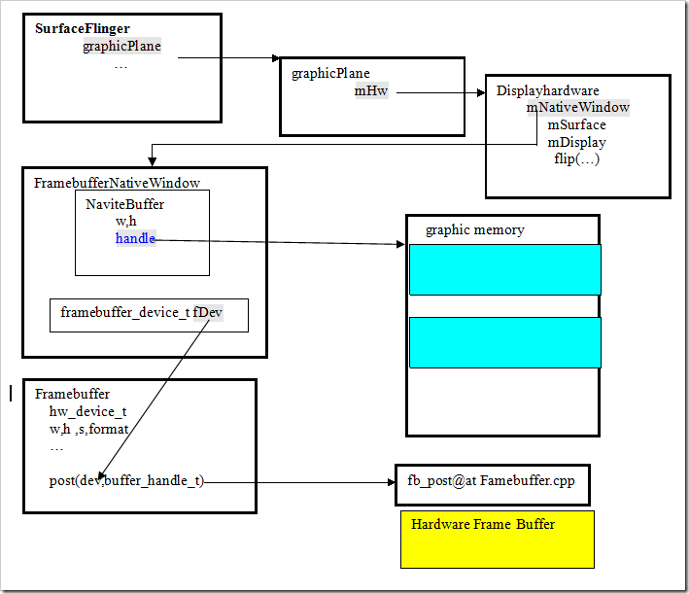
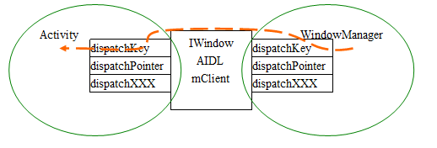
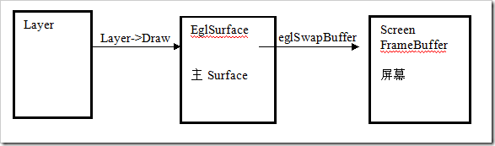
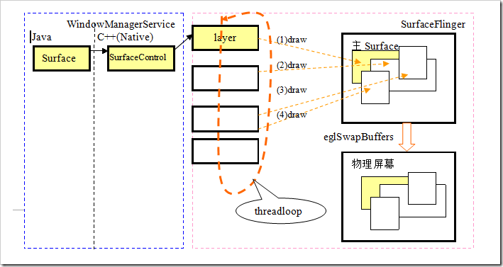

Slide 11
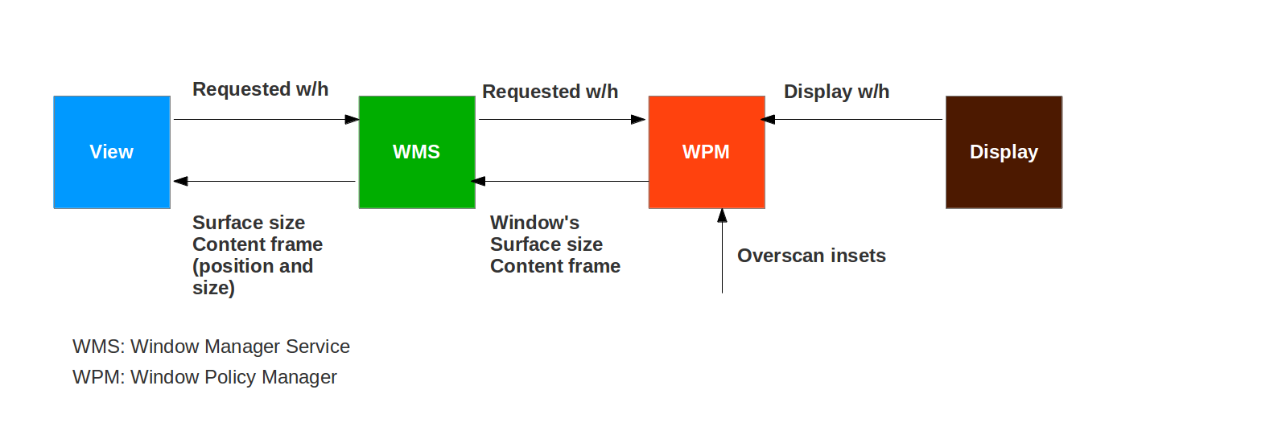

Slide 12
@Override public ResolveInfo resolveIntent(Intent intent, String resolvedType, int flags, int userId) { return resolveIntentInternal(intent, resolvedType, flags, userId, false,Binder.getCallingUid()); }
private ResolveInfo resolveIntentInternal(Intent intent, String resolvedType, int flags, int userId, boolean resolveForStart, int filterCallingUid) {
…… final List<ResolveInfo> query = queryIntentActivitiesInternal(intent, resolvedType, flags, filterCallingUid, userId, resolveForStart, true /*allowDynamicSplits*/); …… final ResolveInfo bestChoice = chooseBestActivity(intent, resolvedType, flags, query, userId); return bestChoice; }
private @NonNull List<ResolveInfo> queryIntentActivitiesInternal(Intent intent, String resolvedType, int flags, int filterCallingUid, int userId, boolean resolveForStart, boolean allowDynamicSplits) {
………
List<ResolveInfo> result; result = filterIfNotSystemUser(mActivities.queryIntent( intent, resolvedType, flags, userId), userId);
…… Collections.sort(result, mResolvePrioritySorter); return …
}
ActivityIntentResolver
1、获取并排序
ResolveInfo findPreferredActivity(Intent intent, String resolvedType, int flags, List<ResolveInfo> query, int priority, boolean always, boolean removeMatches, boolean debug, int userId) {
ResolveInfo pri = findPersistentPreferredActivityLP(intent, resolvedType, flags, query, debug, userId); PreferredIntentResolver pir = mSettings.mPreferredActivities.get(userId); List<PreferredActivity> prefs = pir != null ? pir.queryIntent(intent, resolvedType, (flags & PackageManager.MATCH_DEFAULT_ONLY) != 0, userId) : null; if (prefs != null && prefs.size() > 0) { boolean changed = false; try { int match = 0; final int N = query.size(); for (int j=0; j<N; j++) {// 让 match = 最大的值 } final int M = prefs.size(); // 遍历 List<PreferredActivity> prefs for (int i=0; i<M; i++) { final PreferredActivity pa = prefs.get(i); // 第1步：检查 match 已经是最大的值，不等跳过 // 第2步：检查 mPref.mAlways 类型 // 第3步：获取对应的 ActivityInfo // 第4步：ActivityInfo 检查 ， // 第5步：遍历、比对 for (int j=0; j<N; j++) {final ResolveInfo ri = query.get(j); //第6步：遍历比对packageName、Name等。。。 return ri; } } } finally {。。。。 } } } 。。。 }
private static final Comparator<ResolveInfo> mResolvePrioritySorter = new Comparator<ResolveInfo>() { public int compare(ResolveInfo r1, ResolveInfo r2) {
。。。。。 r1.priority; r1.preferredOrder; r1.isDefault ? -1 : 1; r1.system ? -1 : 1; r1.activityInfo.packageName.compareTo(r2.activityInfo.packageName); r1.serviceInfo.packageName.compareTo(r2.serviceInfo.packageName); r1.providerInfo.packageName.compareTo(r2.providerInfo.packageName);
。。。。。 } };
2、获取最佳
private ResolveInfo chooseBestActivity(Intent intent, String resolvedType, int flags, List<ResolveInfo> query, int userId) {
。。。。。 ResolveInfo ri = findPreferredActivity(intent, resolvedType, flags, query, r0.priority, true, false, debug, userId); if (ri != null) { return ri; }
。。。。。 return ri; } } return null; }

Slide 13
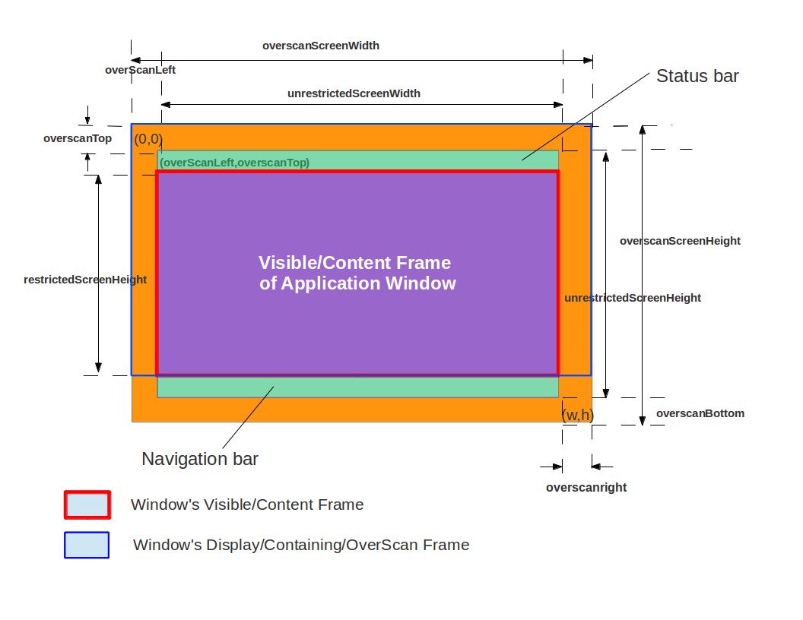
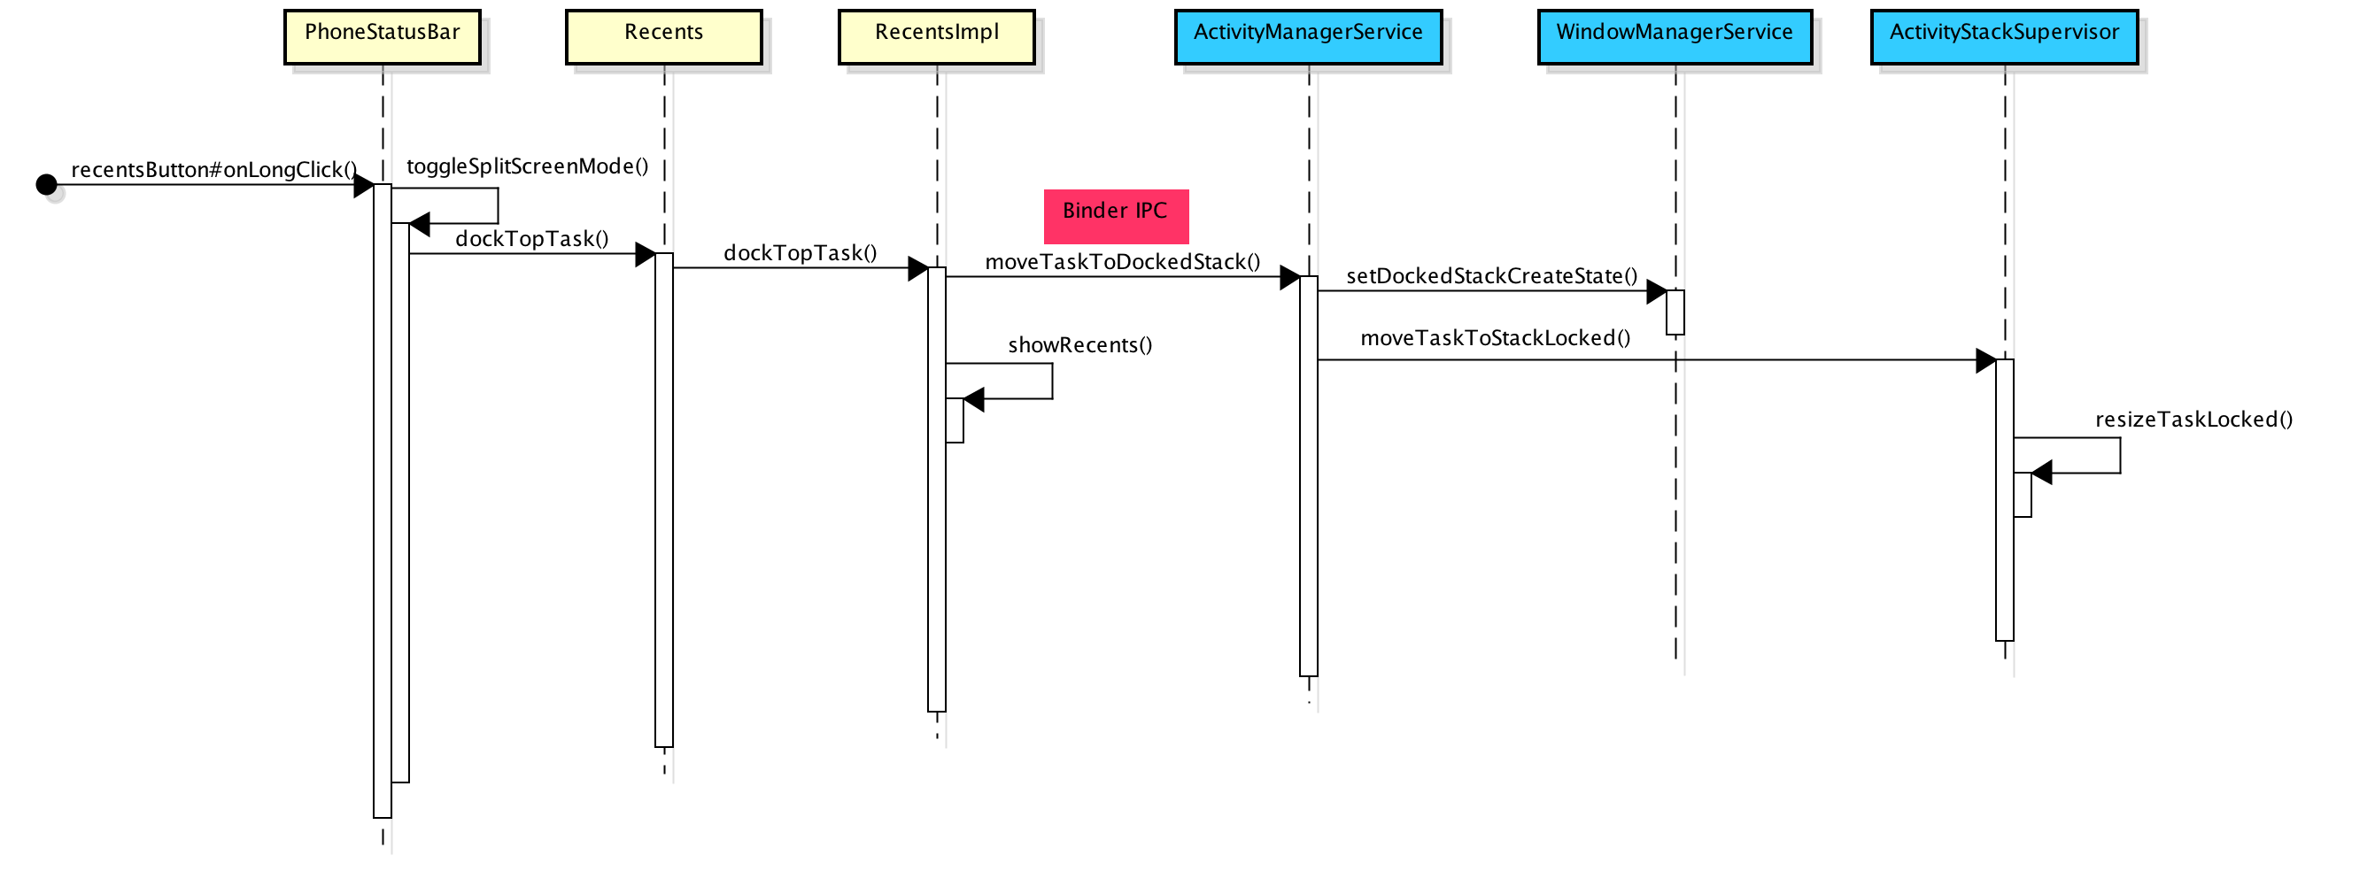

Slide 14
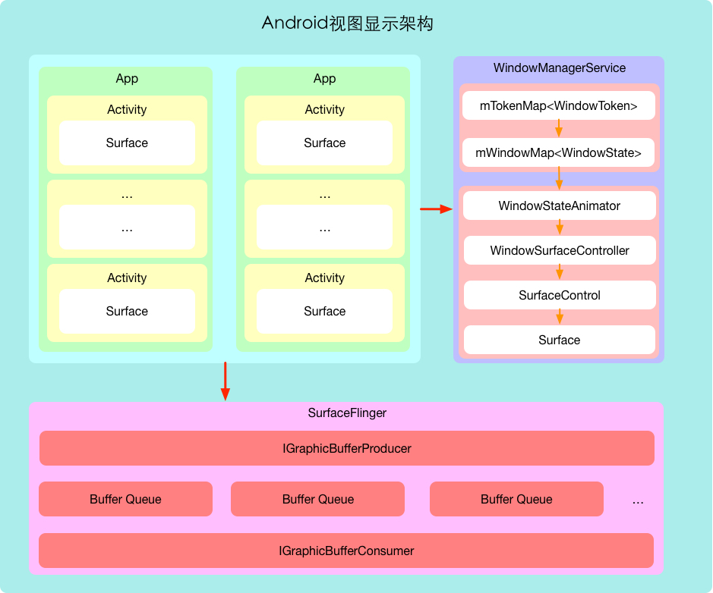

Slide 15
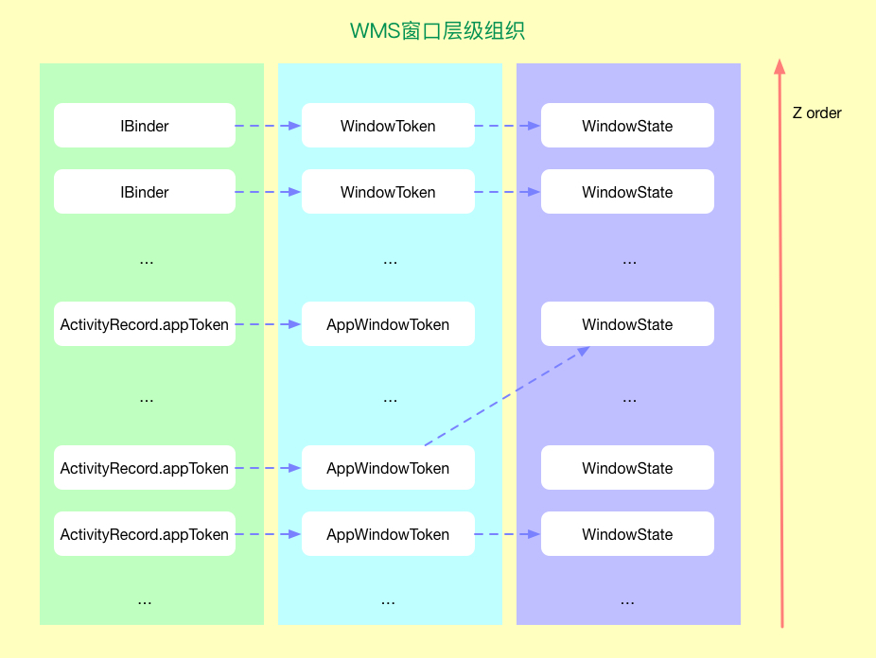

Slide 16
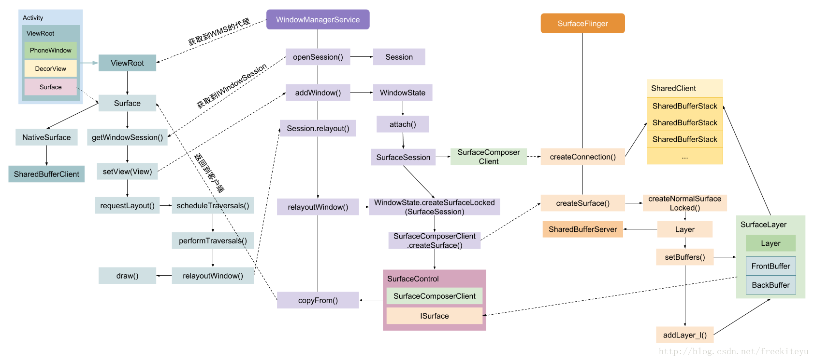

Slide 17
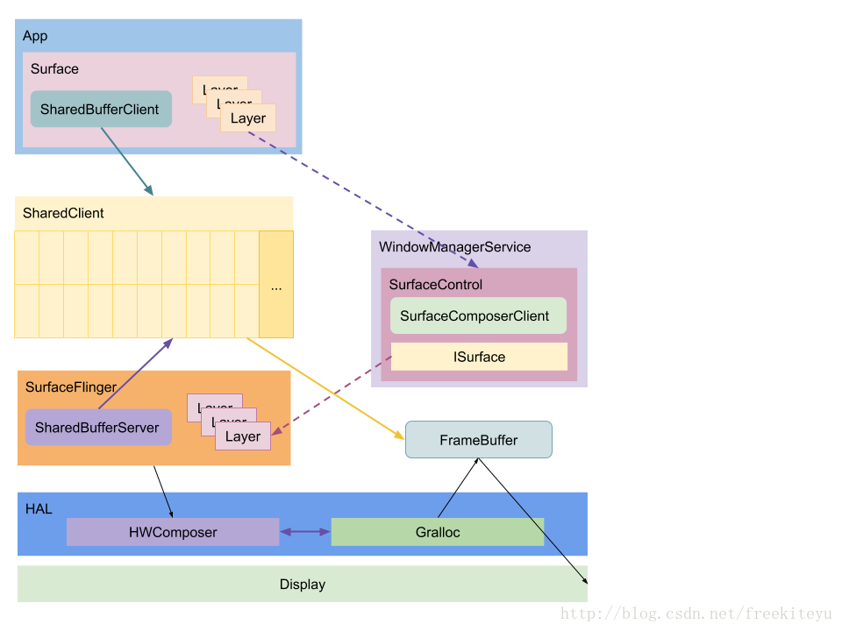

Slide 18
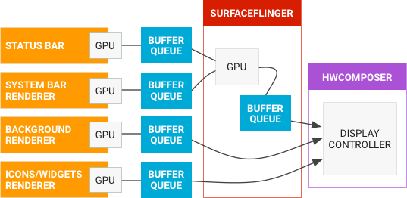
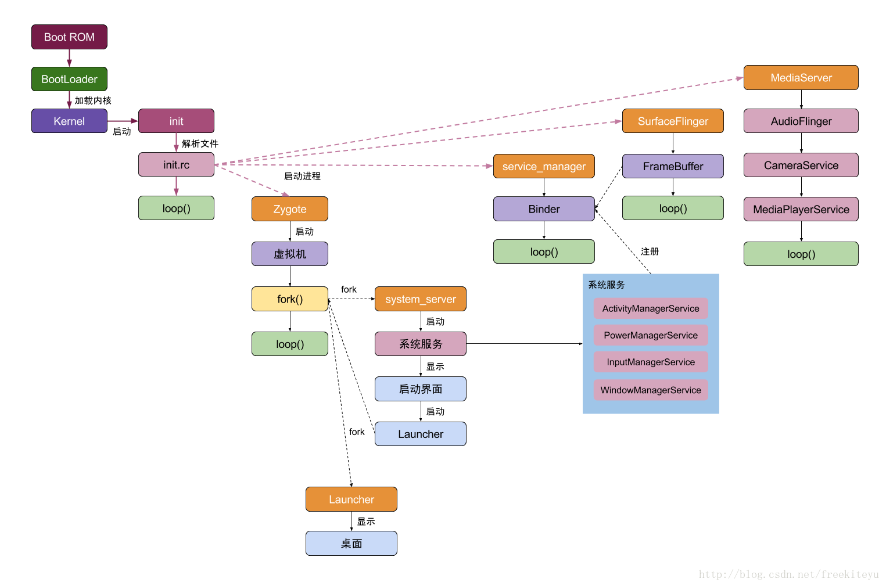
为什么一旦将Activity移动到Pinned Stack上，该窗口就能一直在最上层显示呢？这就是由Z-Order控制的，Z-Order决定了窗口的上下关系。 Android N中新增了一个类WindowLayersController来专门负责Z-Order的计算。在计算Z-Order的时候，有几类窗口会进行特殊处理，处于Pinned Stack上的窗口便是其中之一。

Slide 19
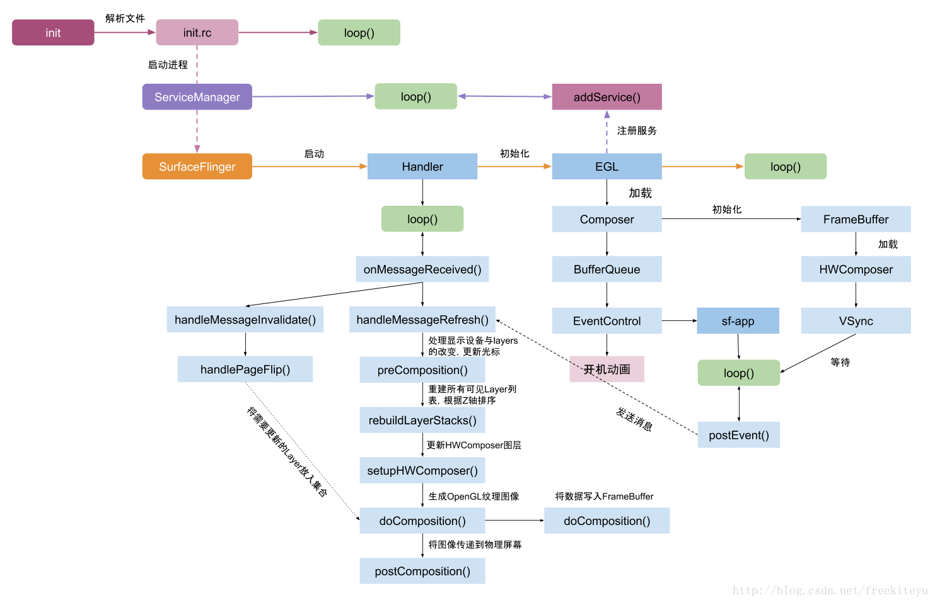

Slide 21
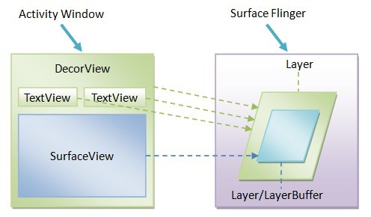
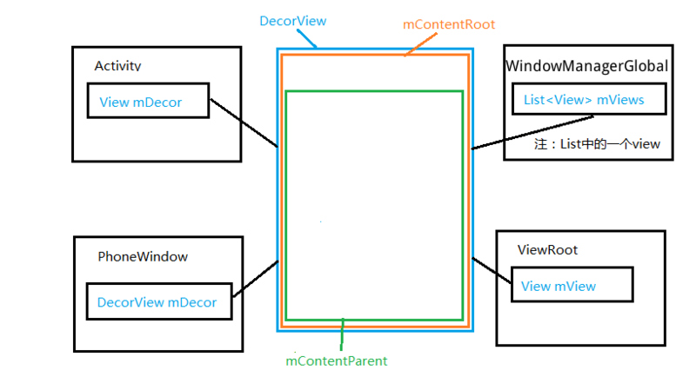

Slide 22
Animation: Animation抽象类，里面最重要的一个接口就是applyTranformation, 它的输入是当前的一个描述进度的浮点数(0.0 ~ 1.0)， 输出是一个Transformation类对象，这个对象里有两个重要的成员变量，mAlpha 和 mMatrix, 前者表示下一个动画点的透明度(用于灰度渐变效果），后者则是一个变形矩阵，通过它可以生成各种各样的变形效果。Android提供了很多Animation的具体实现，比如RotationAnimation, AlphaAnimation 等等，用户也可以实现自己的Animation类，只需要重载applyTransform 这个接口。注意，Animation类只生成绘制动画所需的参数（alpha 或 matrix)，不负责完成绘制工作。完成这个工作的是Animator.
Animator： 控制动画的‘人’， 它通常通过向定时器Choreographer 注册一个Runnable对象来实现定时触发，在回调函数里它要做两件事情：1. 从Animation那里获取新的Transform， 2. 将Transform里的值更新底层参数，为接下来的重绘做准备。动画可以发生在Window上，也可以发生在某个具体的View。前者的动画会通过SurfaceControl直接在某个Surface上进行操作(会在SurfaceFlinger里详细描述），比如设置Alpha值。后者则通过OpenGL完成（生成我们前面提过的DisplayList).
WindowStateAnimator, WindowAnimator, AppWindowAnimator: 针对不同对象的Animator. WindowAnimator, 负责整个屏幕的动画，比如说转屏，它提供Runnable实现。WindowStateAnimator, 负责ViewRoot，即某一个窗口的动画。AppWindowAnimator, 负责应用启动和退出时候的动画。这几个Animator都会提供一个函数，stepAnimationLocked(), 它会完成一个动画动作的一系列工作，从计算Transformation到更新Surface的Matrix.

Slide 23
系统中可能会包含这么几个Stack
Activity
Activity
Activity
Task
Activity
【Id：3】Docked Stack
【Id：4】Pinned Stack
【Id：0】Home Stack
【Id：1】FullScren Stack
【Id：2】 Freeform Stack
系统中可能会包含这么几个Stack
ActivityStackSupervisor

