Slide 1
RayTracing Project
Egemen Inal
&
Umut Cem Kayaalti

Slide 2
Project Description
Our goal was to see the impact of light reflection counts effect on render time and image quality.
In order to observe this effect, we created a small 3D scene with both reflective and non-reflective spheres, a surface and 3 light sources. We initialize spheres with different reflective, diffusion and specular properties.
We measured the time to render a single image and changed the number of bounces to see the quality and time difference

Slide 3
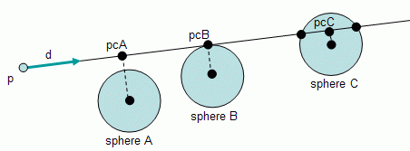
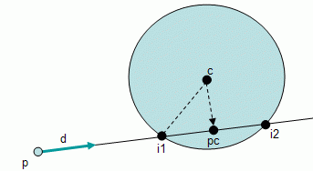
Logic
Intersection of the rayline can be calculated with Pythagorean theorem
For each different senarios.

Slide 4
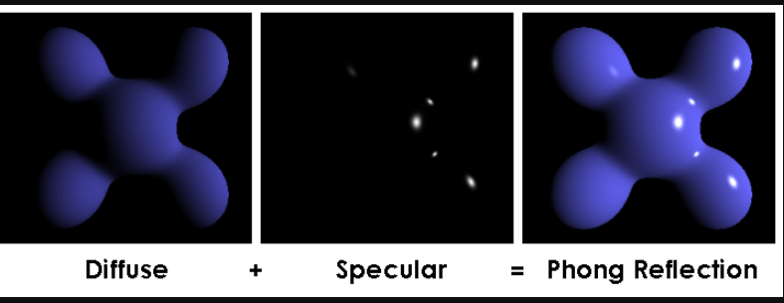

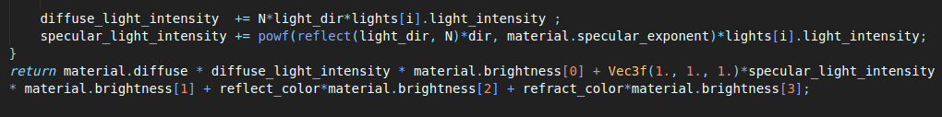
Phong reflection model

Slide 5
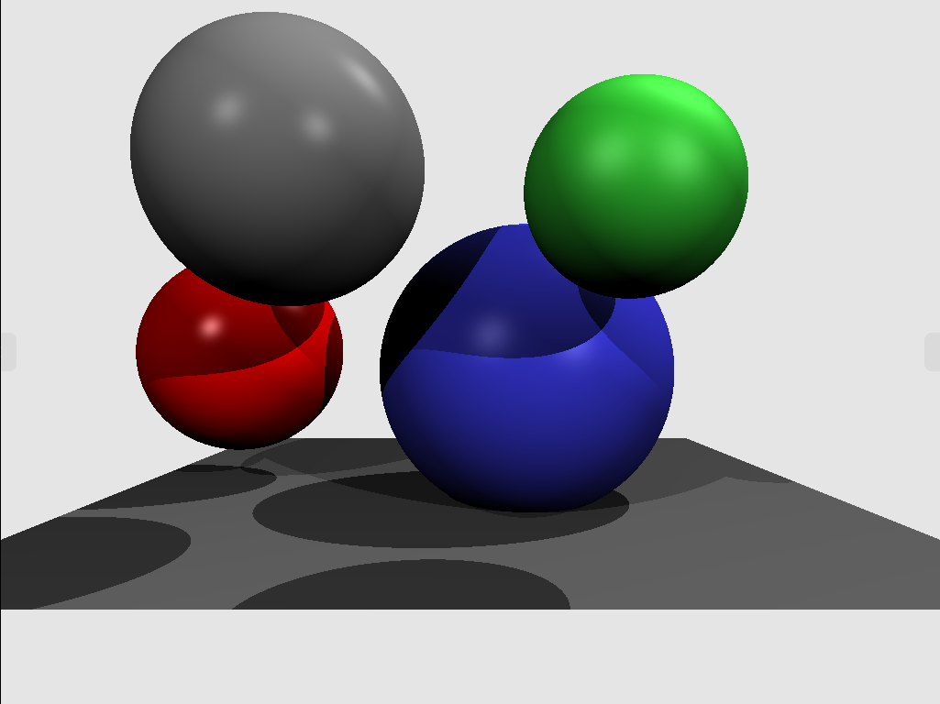

Slide 6


Reflect and Refract
Using this formula, we calculate the reflection direction and threat that as another light ray.
For the refractions we use the Snell’s Law. We calculate the angle and then we use the surfaces refraction indexes to determine the exit angle of the light

Slide 7
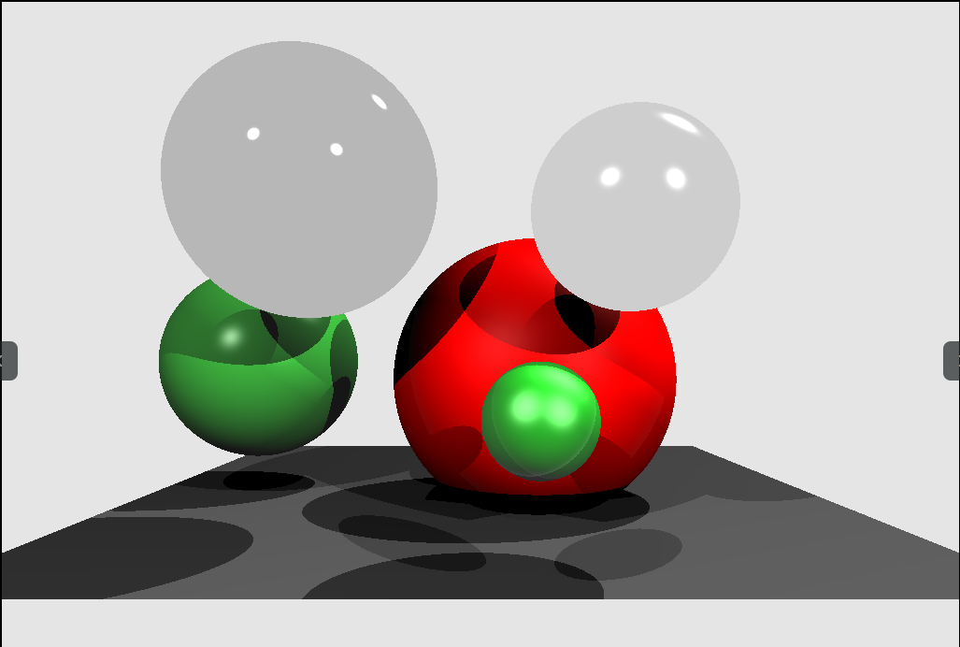
Number of bounces 0 Time = 0.159505

Slide 8
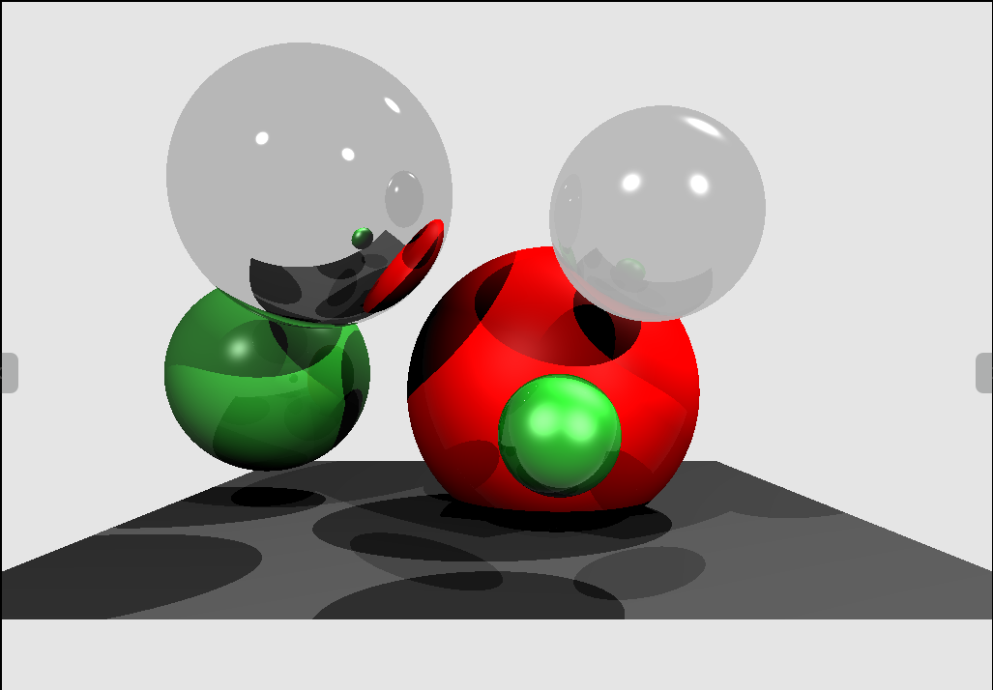
Number of bounces 1 Time = 0.266186

Slide 9
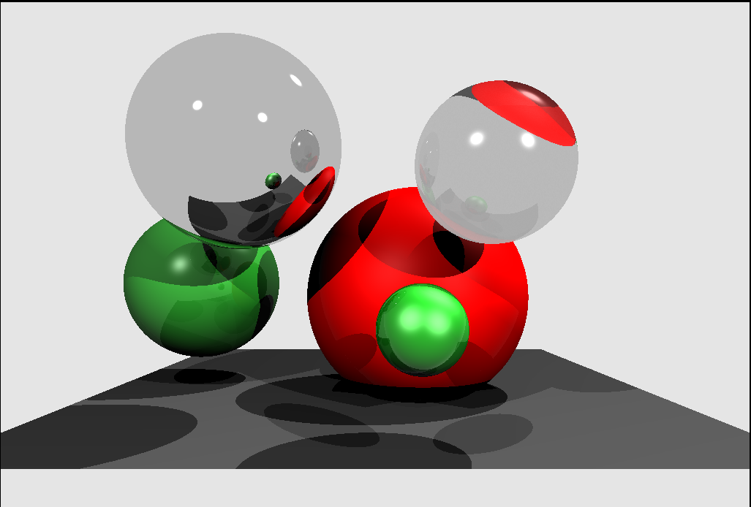
Number of bounces 2 Time = 0.379451(s)

Slide 10
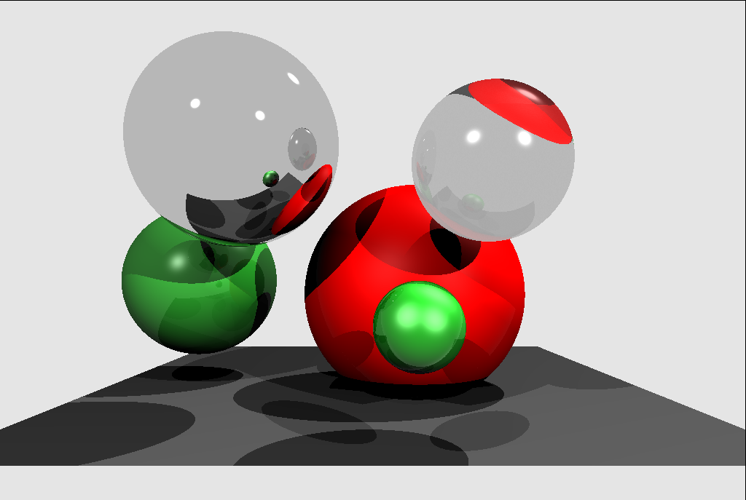
Number of bounces 3 Time =0.506021(s)

