Slide 1
Hourly Traffic Volume Forecasting
Springboard Data Science Career Track – Capstone Three
Forecasting hourly traffic using time-series models

Slide 2
Problem Statement
Urban traffic congestion creates operational, economic, and safety challenges.
Traffic management teams need reliable short-term forecasts to allocate resources.
The goal is to forecast hourly traffic volume up to 7 days ahead.
Success metric: accurate out-of-sample prediction using RMSE.

Slide 3
Dataset Overview
Metro Interstate Traffic Volume dataset.
Hourly traffic counts collected over multiple years.
Includes weather variables and holiday indicators.
Target variable: traffic_volume.

Slide 4
Data Wrangling – Issues
Duplicate hourly timestamps.
Missing hours.
Mixed numeric and categorical features.

Slide 5
Data Wrangling – Solutions
Duplicate timestamps were identified and aggregated to one row per hour.
Missing hourly intervals were explicitly introduced to ensure continuity.
Time index was restructured to a complete hourly sequence.
Holiday missing values were treated as non-holiday periods.

Slide 6
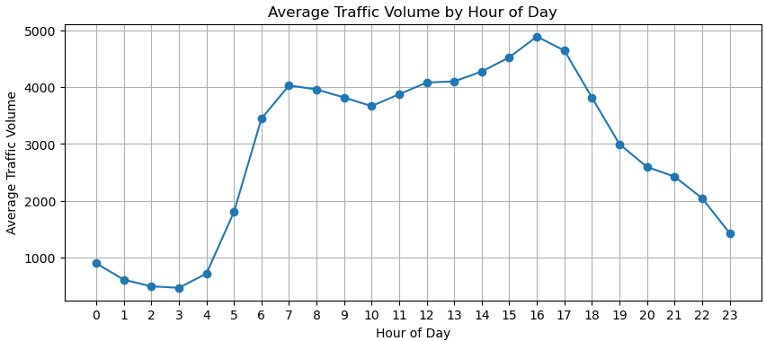
Exploratory Data Analysis
Strong daily seasonality with clear morning and evening peaks.

Slide 7
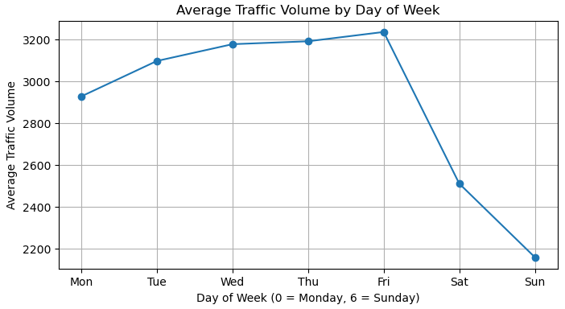
Exploratory Data Analysis
Consistent weekly pattern: higher weekday traffic, lower weekends.

Slide 8
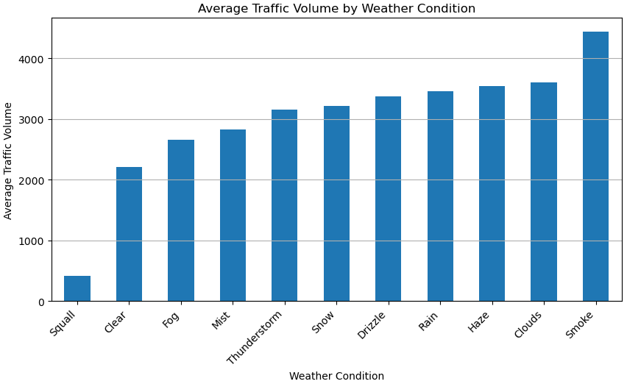
EDA – Weather & Holidays
Weather and holidays affect traffic.
Effects are secondary to seasonality.
Do not override core patterns.

Slide 9
Preprocessing & Feature Engineering 1/2
Ensured evenly spaced hourly time series required for time-series models.
Created binary holiday indicators.
Prepared light and full exogenous feature sets for SARIMAX models.

Slide 10
Preprocessing & Feature Engineering 2/2
Engineered a binary holiday indicator.
Selected compact weather features (temperature, rain, snow, cloud cover).
Excluded high-cardinality weather descriptions to reduce noise.
Key takeaway:
preprocessing ensured a clean, continuous time series, while feature engineering captured external signals without overriding core temporal patterns.

Slide 11
Modeling Strategy
Progressive approach: baseline → SARIMA → SARIMAX.
Goal: test whether added complexity improves accuracy.
Models evaluated using consistent time-based split.

Slide 12
Models Implemented
Seasonal Naive Baseline (same hour, one week earlier).
SARIMA without seasonality.
SARIMA with daily seasonality.
SARIMAX with full exogenous features (no seasonality).
SARIMAX with daily seasonality and light exogenous features.

Slide 13
Model Performance (RMSE)
Seasonal Naive Baseline: RMSE ≈ 646 (best).
SARIMA (No Seasonality): RMSE ≈ 3858 (worst).
SARIMA (Daily Seasonality): RMSE ≈ 983.
SARIMAX (Full Exogenous, No Seasonality): RMSE ≈ 2015.
SARIMAX (Daily Seasonality + Light Exogenous): RMSE ≈ 958.

Slide 14
Final Model Selection
The seasonal naive baseline achieved the lowest RMSE.
More complex models did not improve accuracy.
Seasonality alone explains most traffic behavior.
The baseline model was selected as the final model.

Slide 15
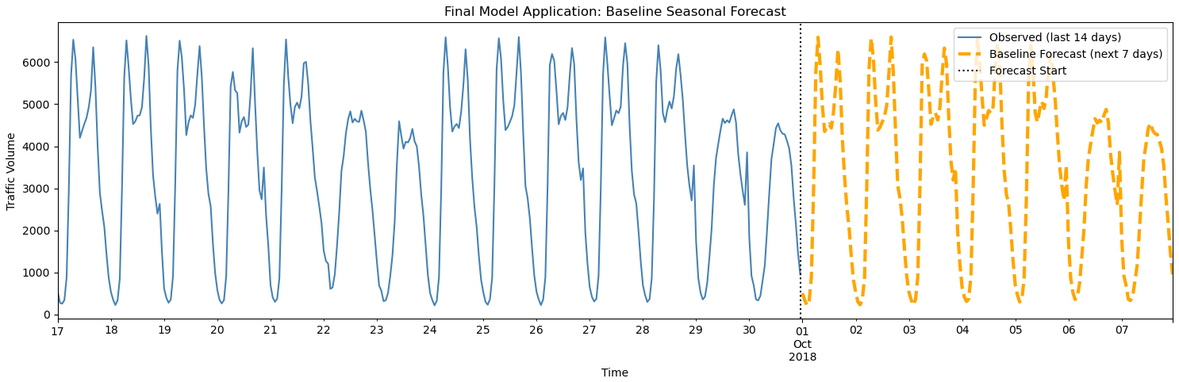
Final Model Application
Generated a real 7-day hourly forecast beyond the dataset.
Forecast preserves daily and weekly patterns.
No artificial trend or instability introduced.
Results are interpretable and operationally reliable.

Slide 16
Business Recommendations
Use the seasonal baseline model for short-term traffic planning.
Schedule staffing and congestion mitigation around predictable peak hours.
Use weather and holidays as monitoring signals, not core forecast drivers.

Slide 17
Limitations & Future Work
Baseline model assumes stable seasonal patterns.
Does not adapt to structural changes or rare events.
Future work could explore event-based modeling.
Integration with real-time data could improve responsiveness.

