Slide 1
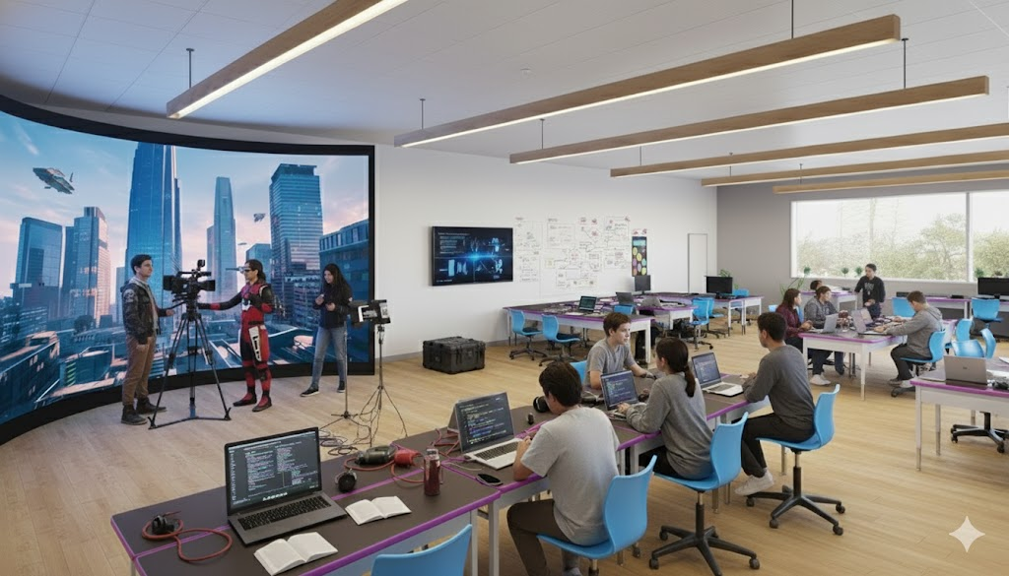
CORE HUB
Creative • Operations • Reality Engine

Slide 2
CORE HUB
Future-Ready Learning in Action
Bishop Diego High School

Slide 3
Executive Summary
The CORE Hub is Bishop Diego's bold response to the AI-native economy
A 3-zone production studio teaching Virtual Production, AI/ML, XR, and Digital Entrepreneurship
An LED Virtual Production Wall as the centerpiece - cutting-edge technology used in Hollywood
Students gain hands-on experience with industry-standard tools and workflows
Prepares students for high-growth careers in tech, media, and creative industries
Makes Bishop Diego the premier Catholic high school for future-ready education

Slide 4
Why Now? The Strategic Imperative
AI & Automation: Traditional jobs are being transformed - students need new skills
The Creator Economy: Content creation, digital marketing, and virtual production are booming
Competitive Advantage: Differentiate BDHS in Santa Barbara's competitive education market
Future-Proof Curriculum: Prepare students for careers that don't yet exist
Industry Demand: Tech and media companies desperately need skilled talent
Mission Alignment: Integrates faith-based values with cutting-edge innovation

Slide 5
Five 4-Year Learning Tracks
1. AI & Data Science - Build and question AI models with ethical frameworks
2. Interactive Experience & UI/UX - Design human-centered digital experiences
3. Virtual Production & Storytelling - Master LED wall cinematography
4. Digital Entrepreneurship & Marketing - Launch real companies and brands
5. Immersive World-Building & XR - Create 3D worlds for VR, AR, and LED walls

Slide 6
AI & Data Science
Cultivate dual mastery of building AI models and the human-centric thinking to question them
CAREER PATHS:
• AI/ML Specialist
• Data Scientist
• AI Prompt Engineer
• AI Ethicist
PROGRAM HIGHLIGHTS:
• Python & Machine Learning
• Neural Networks
• Data Ethics
• Portfolio Capstone

Slide 7
Interactive Experience & UI/UX
Master human-computer interaction, blending empathy, psychology, visual design, and logic
CAREER PATHS:
• UX/UI Designer
• Immersive Experience Designer
• Creative Technologist
PROGRAM HIGHLIGHTS:
• Design Thinking
• User Research
• Prototyping
• Interactive Design

Slide 8
Virtual Production & Storytelling
Master next-generation storytelling with LED wall virtual production and real-time rendering
CAREER PATHS:
• Virtual Production Specialist
• Video Producer
• Content Creator
• Audio Engineer
PROGRAM HIGHLIGHTS:
• Virtual Cinematography
• LED Wall Production
• Unreal Engine
• Audio Production

Slide 9
Digital Entrepreneurship & Marketing
Learn to build brands, analyze data, find audiences, and create companies in the digital economy
CAREER PATHS:
• Digital Marketing Strategist
• SEO Specialist
• Social Media Manager
• Founder
PROGRAM HIGHLIGHTS:
• Digital Marketing
• SEO & Analytics
• Brand Building
• Startup Creation

Slide 10
Immersive World-Building & XR
Fuse art and code to build 3D interactive worlds for LED walls, VR headsets, and beyond
CAREER PATHS:
• XR Developer
• VR/AR Designer
• 3D Modeler
• Game Developer
PROGRAM HIGHLIGHTS:
• Unity & Unreal
• 3D Modeling
• VR/AR Development
• Interactive Experiences

Slide 11
4-Year Curriculum Structure
9th Grade: Foundations of Media & Technology
• Introduction to all five tracks
• Basic digital literacy and creative tools
10th Grade: Track Selection & Core Skills
• Students choose their specialization track
• Develop foundational skills in chosen area
11th Grade: Advanced Specialization
• Industry-standard software and workflows
• Real-world project experience
12th Grade: Capstone Portfolio Project
• Professional portfolio piece
• Presentation to industry professionals

Slide 12
The 3-Zone Facility
Zone 1: Virtual Production Studio (THE CORE)
• LED Virtual Production Wall for in-camera VFX
• Professional camera, lighting & audio equipment
Zone 2: Deep Tech Lab (THE ENGINE)
• High-performance computing for AI & 3D development
• VR/AR testing stations
Zone 3: Collab & Design Studio (THE HUB)
• Wall-to-wall whiteboards for design thinking
• Flexible furniture for collaboration
Studio-first design: flexible, reconfigurable, interdisciplinary

Slide 13
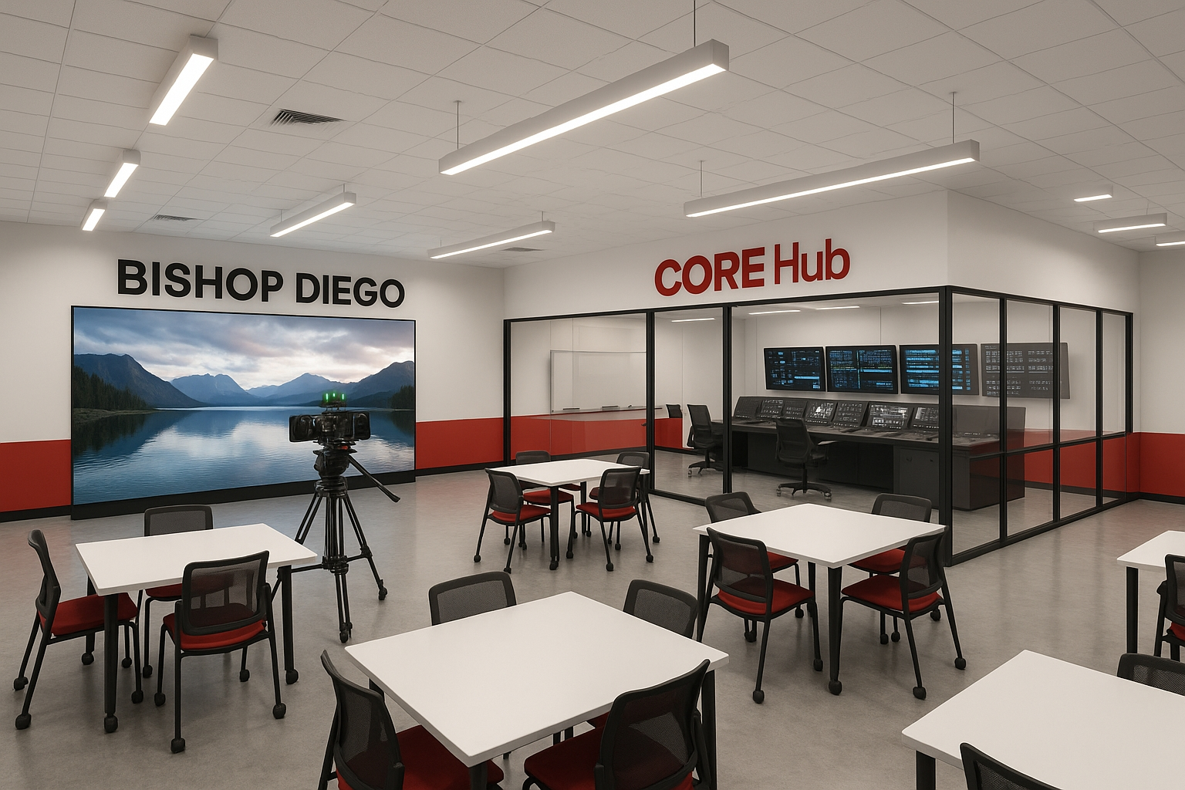
Zone 1: Virtual Production Studio
The CORE - LED Wall enables in-camera visual effects with realistic lighting

Slide 14
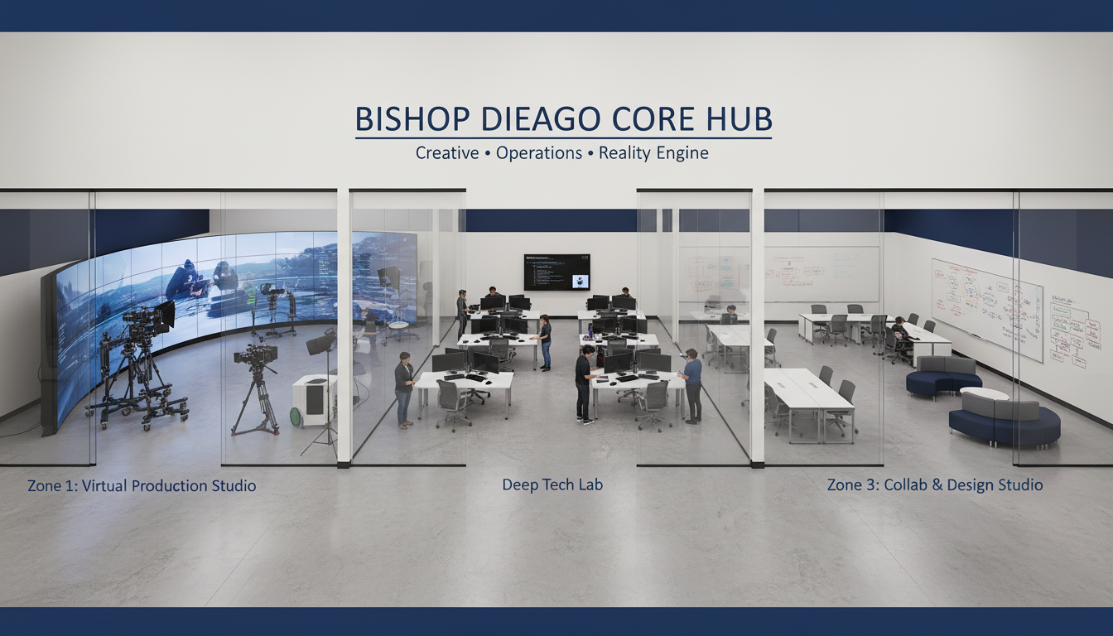
Zone 2: Deep Tech Lab
The ENGINE - High-computational power zone for AI and 3D development

Slide 15
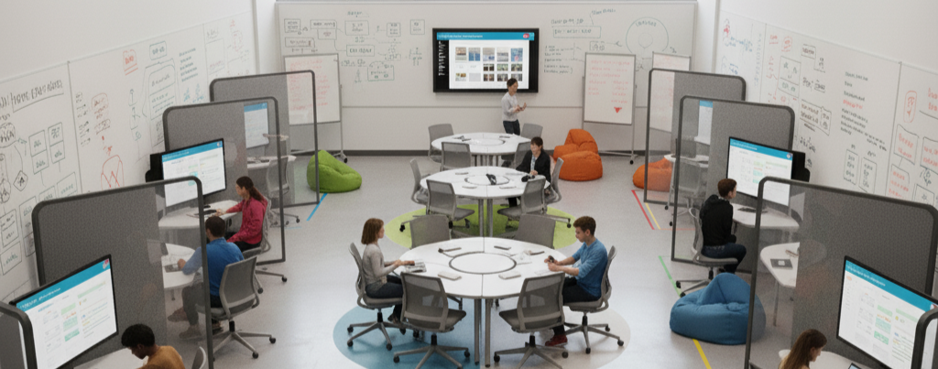
Zone 3: Collab & Design Studio
The HUB - Human-centric workspace for UI/UX and entrepreneurship

Slide 16
The LED Wall: Game-Changing Technology
Not just a display - a real-time production tool driven by game engines
Unlike green screens:
• In-camera visual effects with realistic lighting and reflections
• Actors see the environment they're performing in
• No post-production green screen keying required
Industry Standard:
• Used in The Mandalorian, House of the Dragon, and major films
• Teaches complete virtual production pipeline
• Prepares students for Hollywood-level workflows
This is the "leapfrog" technology that sets us apart

Slide 17
Career Outcomes & Pathways
High-Growth Industries:
• AI & Machine Learning - 40% projected growth
• Digital Marketing - $600B+ industry
• Virtual Production - Used in 75% of major productions
• XR Development - $300B+ metaverse economy
Portfolio-Ready Graduates:
• Professional capstone projects
• Industry-standard tool proficiency
• Real-world client experience
College & Career Readiness:
• Stand out in college applications
• Direct pathways to tech careers
• Entrepreneurial mindset development

Slide 18
Investment Overview
PHASE 1: Core Infrastructure
• Virtual Production Studio with LED Wall: $120,000
• Deep Tech Lab Computing Equipment: $50,000
• Collab Studio Furniture & Whiteboards: $15,000
Total Phase 1: $185,000
PHASE 2: Expansion & Enhancement
• Additional camera & audio gear: $25,000
• VR/AR development kits: $20,000
• Software licenses & cloud services: $15,000
Total Phase 2: $60,000
TOTAL INVESTMENT: $245,000

Slide 19
Detailed Budget Breakdown
VIRTUAL PRODUCTION STUDIO:
• LED Wall System: $80,000
• Camera Package: $25,000
• Lighting Kit: $10,000
• Audio Equipment: $5,000
DEEP TECH LAB:
• GPU Workstations (5x): $30,000
• VR Headsets (10x): $15,000
• 3D Printers: $5,000
COLLAB STUDIO:
• Modular Furniture: $10,000
• Whiteboard Walls: $3,000
• Large Displays: $2,000
SOFTWARE & SUPPORT:
• Adobe Creative Cloud: $5,000/yr
• Unity/Unreal Licenses: $3,000/yr
• Cloud Rendering: $4,000/yr
• Faculty Training: $8,000

Slide 20
Return on Investment
Student Outcomes:
• Industry-certified graduates with professional portfolios
• Competitive advantage in college admissions
• Direct career pathways to high-paying industries
Institutional Benefits:
• Premier differentiation in competitive education market
• Attraction tool for prospective families
• Increased enrollment and retention
• National recognition as innovation leader
Community Impact:
• Partnership opportunities with local businesses
• Student services (video production, web design) for community
• Elevates Bishop Diego's regional profile

Slide 21
The Time is Now
The CORE Hub positions Bishop Diego at the forefront of education innovation
We're not just teaching technology - we're preparing students to:
• Create meaningful work in an AI-powered economy
• Lead with ethics and human-centered values
• Build the future while staying grounded in faith
This is more than a facility - it's a commitment to:
• Every student's future readiness
• Bishop Diego's competitive excellence
• Catholic education's relevance in the modern world
Join us in building the future of learning.

Slide 22
CORE HUB
Where Innovation Meets Education
Bishop Diego High School
www.bdhscorehub.pages.dev

