Slide 1

SOPHOMORE • GRADE 10
Verbal Villains & Empathy
Equips students to recognize and replace communication patterns that block empathy ("Verbal Villains"). The module introduces and practices the "1, 2, 3's of Empathy"—Mirroring, Validation, and Empathy—to foster deeper connection and understanding.
CASEL FOCUS
Social Awareness & Relationship Skills
CST LENS
Call to Community

Slide 2

Communication Experiential Activity
Split students into A’s and B’s giving each groups different communication instructions.
A’s will share about a cool experience they had in the past.
B’s will listen to the story and follow the teacher’s secret directions

Slide 3
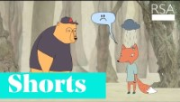

Slide 4

Verbal Villains
Reinforce disconnection and aloneness
Invalidate someone's experience
Makes someone hide a part of themselves from you

Slide 5

Your friend tells you: “This holiday has been really difficult for me. I’m not close with my family. I think I’ll just spend the holiday alone.”
Logical Larry: “The cure for loneliness is to spend more time with friends.”
Detective Debbie: “Has it always been like this? How long has it been since you had a close relationship with them? Have you tried giving them a phone call yet?”
Positive Polly: “You have so many people who love you and care about you. This is going to be the best year yet. You’re amazing!”

Slide 6
Your friend tells you: “This holiday has been really difficult for me. I’m not close with my family. I think I’ll just spend the holiday alone.”
Back Then Bob: “You’re not the only one who has had it bad. Back when I was your age, I felt horrible during the holidays. I really struggled to make it through, but I made it through back then. I just needed to have a little grit.”
Fix-it Felix: “If you want to have a good holiday, here’s what you need to do. First, decide what tradition you want to start this year. After you have done that, the next thing you should do is…”

Slide 7
Your friend tells you: “This holiday has been really difficult for me. I’m not close with my family. I think I’ll just spend the holiday alone.”
Fortune-Telling Fiona: “If you spend the holiday alone, you will always have horrible holidays.”
Blaming Billy: “If you’re not close with your family, well, it is probably something you’re doing. What have you done so far to connect with them?”

Slide 8
Your friend tells you: “This holiday has been really difficult for me. I’m not close with my family. I think I’ll just spend the holiday alone.”
Redirection Ricky: “I know what will get your mind off of that. I’m about to head to the movies, do you want to come with me?”
Wise Winona: “There is a light at the end of the tunnel. God will work it out for you. He is always good.”
Magic Mickey: “It’s not really that bad. You’ll feel better tomorrow, I’m sure.”

Slide 9
Verbal Villains Exercise
Which verbal villain do you default to the most? (Choose 1)
Which one do you hate to receive from others? (Choose 1)
What would an empathetic response be to your friend?

Slide 10

1, 2, 3’s of Empathy
Create deep levels of connection
Provide safety
Help people connect to what is real
Invite all parts of a person into relationship
Validate reality

Slide 11
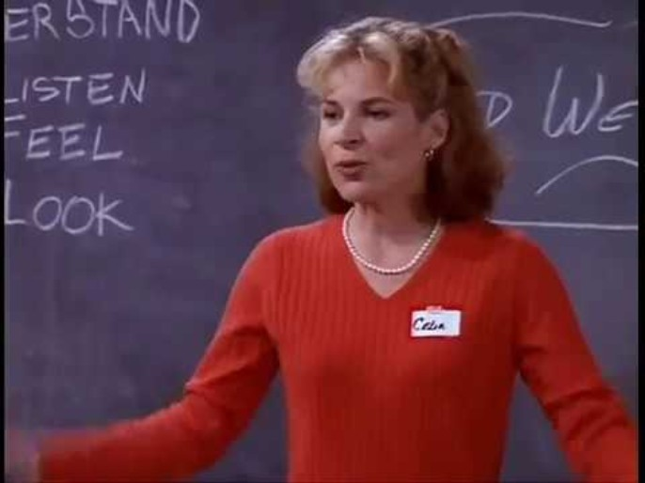

Slide 12
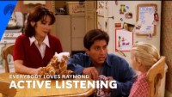

Slide 13

Step 1: Mirroring
Reflecting back the important ideas, emotions, or concepts that someone is telling you
Keeps the conversation about the other person and doesn’t turn the conversation back to you.

Slide 14

Step 2: Validation
You make sense and what makes sense to me is….
Validation is the act of helping someone feel heard or understood.
You can validate someone even if you disagree with them.

Slide 15
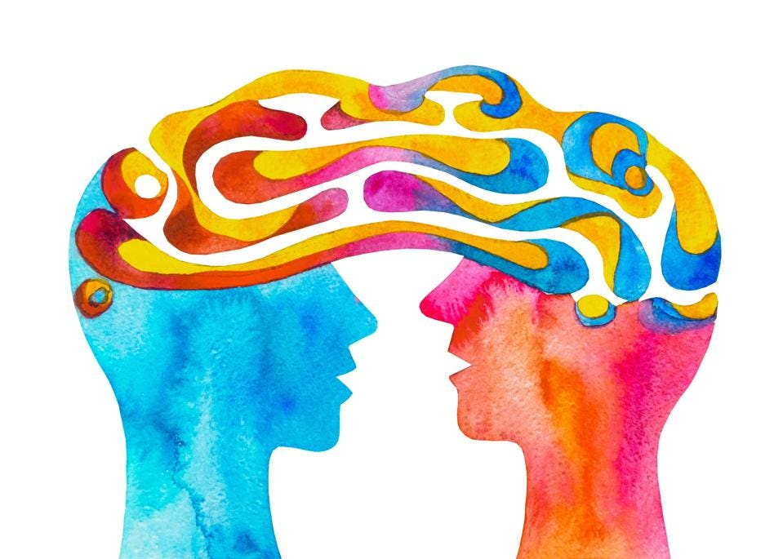
Step 3: Empathy
“I imagine that feels…Did I get that?”
You are able to identify the emotions that another person is feeling and communicate about them.

Slide 16
The 1, 2, 3’s of Empathy
Mirror
“I am hearing you say… is there more?“
Validate
“You make sense… What makes sense to me is…”
Empathize
“I imagine you might be feeling…is that what you’re feeling?”

Slide 17
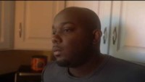

Notes:
Husband and Wife
Politics

Slide 18
The 1, 2, 3’s of Empathy Modeling
Mirror
“I am hearing you say… is there more?“
Validate
“You make sense… What makes sense to me is…”
Empathize
“I imagine you might be feeling…is that what you’re feeling?”

Slide 19
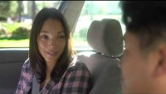

Slide 20

What is available for Bishop Students?
As a personal counselor, I am available to meet with you to help you process difficult to process life circumstances.
Feel free to come to my office, or to email me if you desire to meet with me one on one.
Mr. Eggman: AEggman@bishopdiego.org.
•
•
•
•

Slide 21
Questions?

