Slide 1
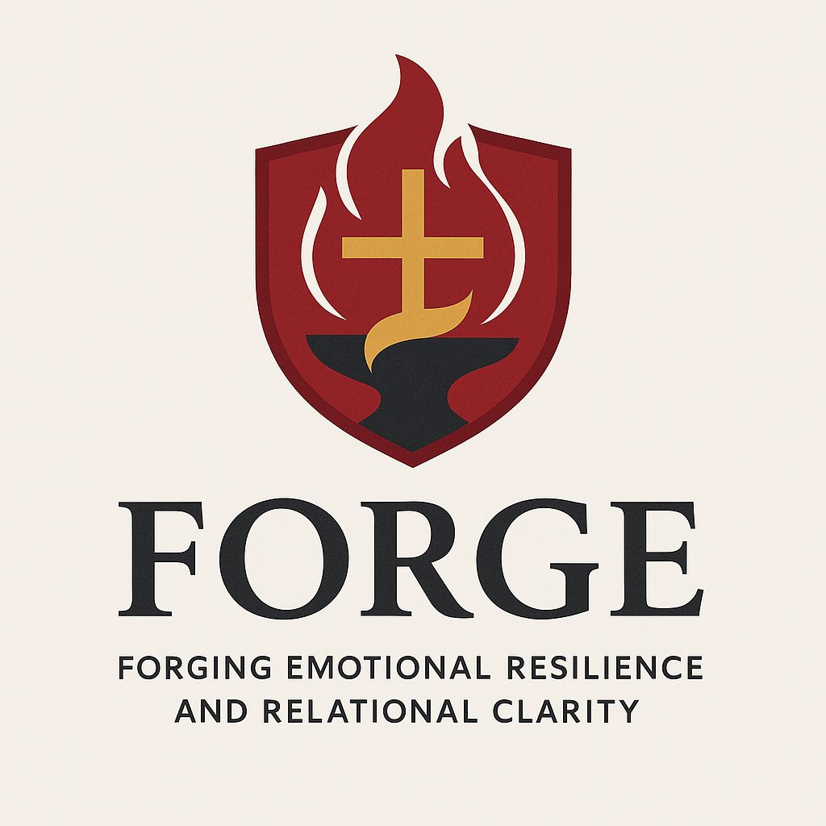
A Christ-Centered SEL & Leadership Formation Program
Bishop Diego High School • Grades 9-12

Slide 2
SENIOR • GRADE 12
Healthy Character I: Boundaries
Defines character as the capacity to face reality and introduces the Character Structure of Separation—the ability to be distinct from others and say "no". Students learn to establish healthy boundaries by taking responsibility for their own emotions, choices, and limits.
CASEL FOCUS
Relationship Skills & Responsible Decision-Making
CST LENS
Rights & Responsibilities

Slide 3
Overview
Session Goals
What are character structures?
Why do boundaries matter?
How can we grow resilience and clarity?
"Forging Emotional Resilience and Relational Clarity"
Grade 12 | FORGE
FORGE

Slide 4
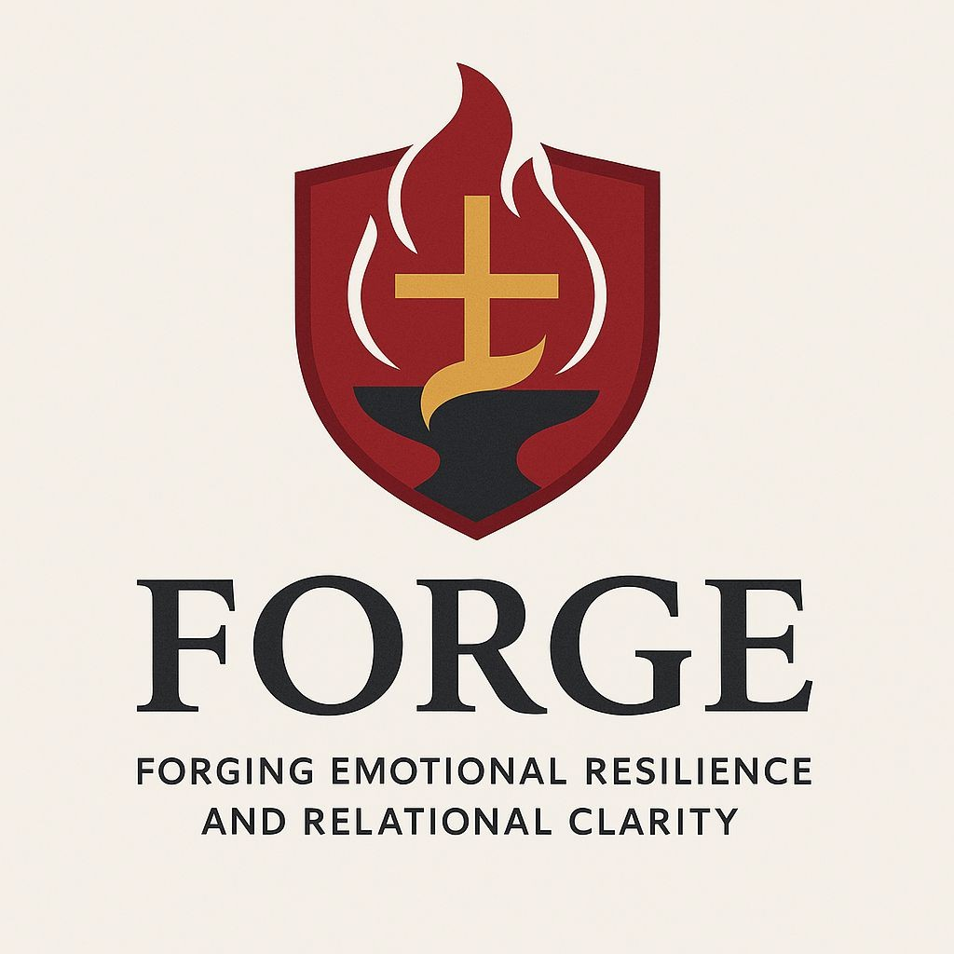
Case Study: Tami
Tami came to me because she kept having panic attacks that seemed to come out of the blue. As we talked together, we discovered that Tami works very hard to always make others happy and feels bad when others get upset with her. She has a really hard time saying no to others when they ask her to do things for them as she worries about letting others down. She loves to be there for others when they need her, but she doesn’t want to burden others when she is struggling.
•
•
•
•

Slide 5
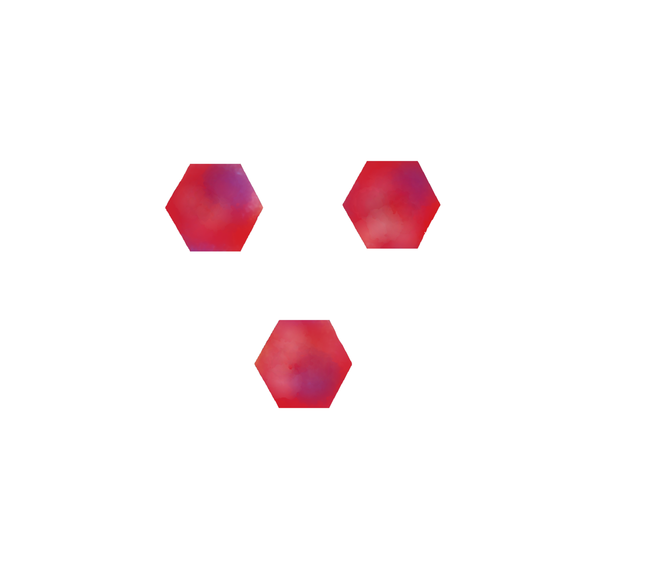
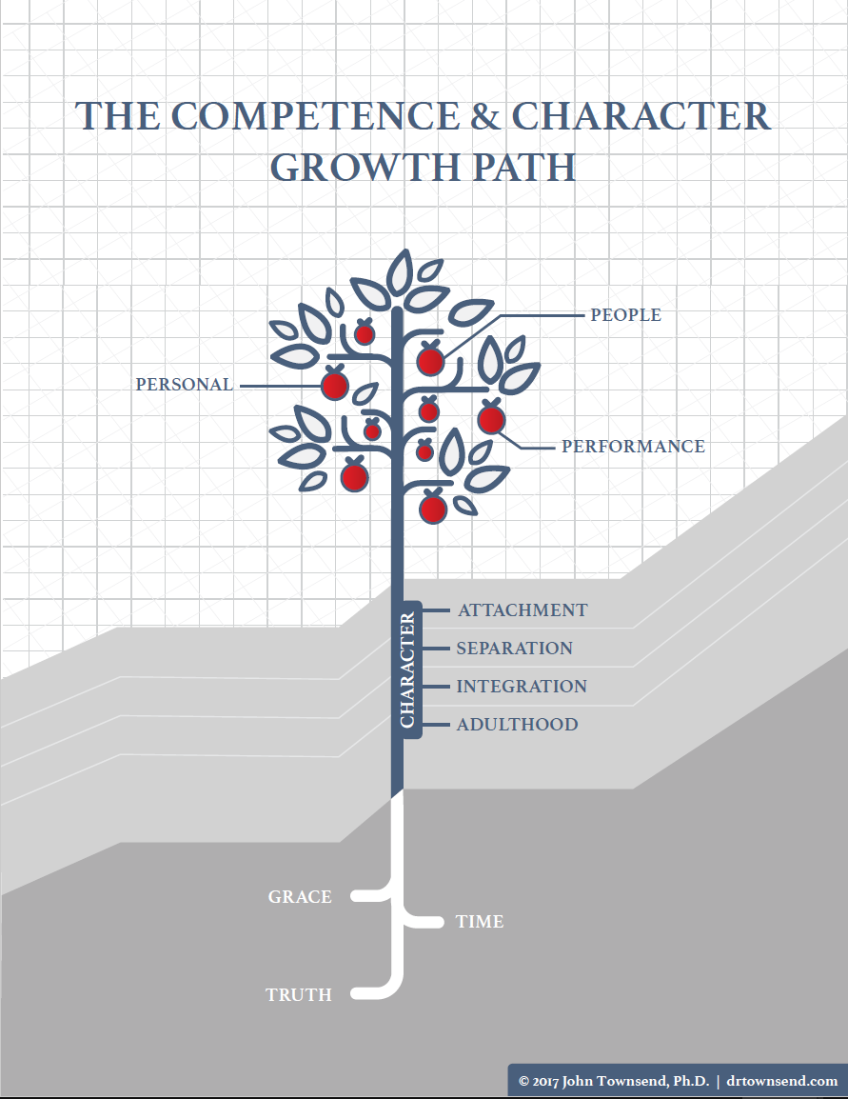

Slide 6

Define Character
“That set of capacities needed to face and feel the demands of reality”
–John Townsend

Slide 7

Why should we learn about the four Character Structures?
To know what is healthy behaviors and what is unhealthy
To define what is character strength and what is deficiency

Slide 8

Character Structure of Separation
The ability to be different from others, say “yes” and “no,” maintain boundaries, maintain internal freedom and to emotionally regulate anger

Slide 9
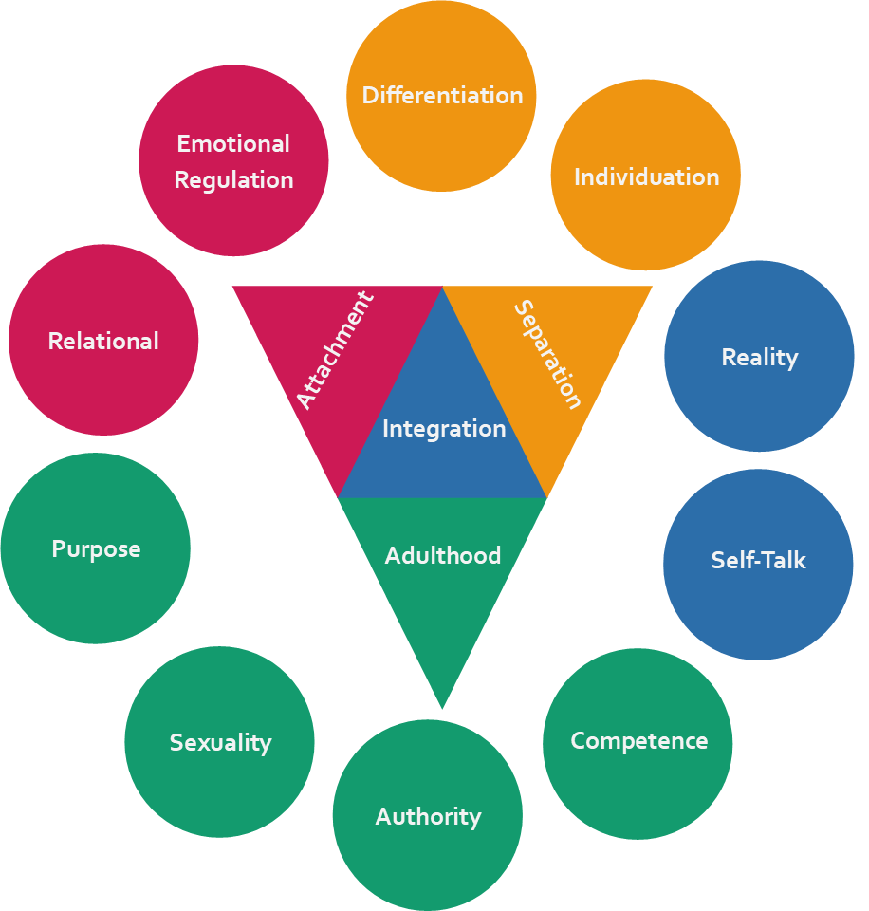
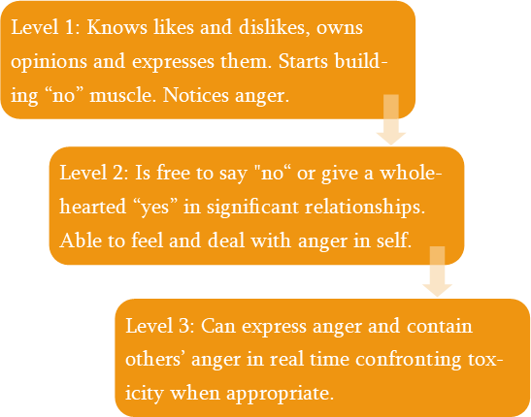
Character Structure of Separation

Slide 10

Defining Boundaries
The ability to be 100% responsible over what is yours to own.
What is yours to take 100% responsibility over?
Your emotions, attitudes, thoughts, beliefs, behaviors, choices, values, desires, resources, limits, giftings, love.

Slide 11
Defining Boundaries
The ability to be 100% responsible over what is yours to own.
What is yours to take 100% responsibility over?
Your emotions
Your attitudes
Your thoughts
Your beliefs
Your behaviors
Your choices
Your values
Your desires
Your resources
Your limits
Your giftings
Your love
Grade 12 | FORGE
FORGE

Slide 12


Slide 13

Discussion Questions
1.) Why does Dr. Cloud say that the son doesn’t have any problems, but that the father has a lot of problems?
2.) What boundary problems does the father have?

Slide 14
Enabling
F/S
Father & Son Example
The father is being over responsible and thus the son doesn't need to take responsibility in different aspects of his life.
The father enables his son's lifestyle, by continuing to give him access to money and resources when the son is taking no responsibility for his actions.
The father keeps rescuing the son from the consequences of his irresponsibility.
The son has no incentive to change as he has a great life.
Key Insight
When we take responsibility for others' actions and shield them from consequences, we prevent them from developing their own character structure and boundaries.
Grade 12 | FORGE
FORGE

Slide 15

Examples of Boundaries
Touch “Do you want a hug?” “I don’t want a hug right now”
Words “I like…” “I don’t like…”
Geographical distance “If you speak to me in that tone again, I am going to leave the room.”

Slide 16
Examples of Boundaries
Time “I don’t want to talk about that now, let’s talk about it tomorrow.”
Relationships “I want to hang out.” “I don’t want to hang out.”
Consequences “If you do ______, I will______”

Slide 17
Case Study: Tami
As Tami and I worked together, we discovered her boundary confusion. She didn’t know what she needed to take responsibility for and what she needed to allow others to take responsibility for. She learned that she is only responsible for her own emotional responses, and I helped her to learn to be okay when others disapproved of her choices or behaviors. I helped Tami to learn to say “no” or “I don’t want to” and not feel “bad” doing so. As a result of our working together, the panic attacks stopped.

Slide 18
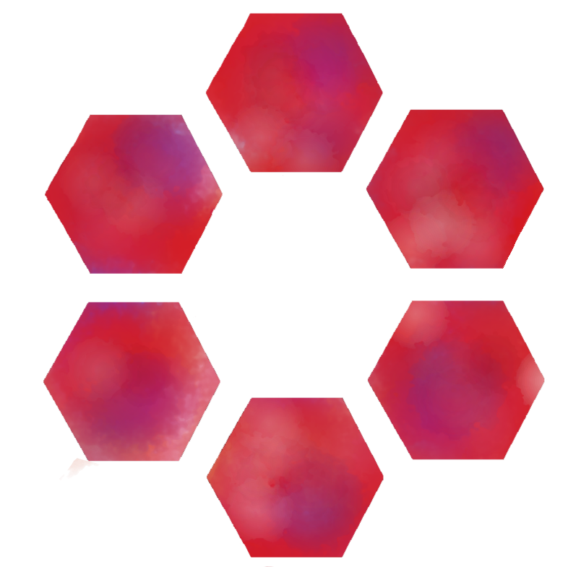
Summary of Boundary Problems
 | Can’t Say | Can’t Hear
NO | Boundaryless The Compliant Feels guilty and controlled | Boundary Busting The Controller Guilts others into compliance

Slide 19
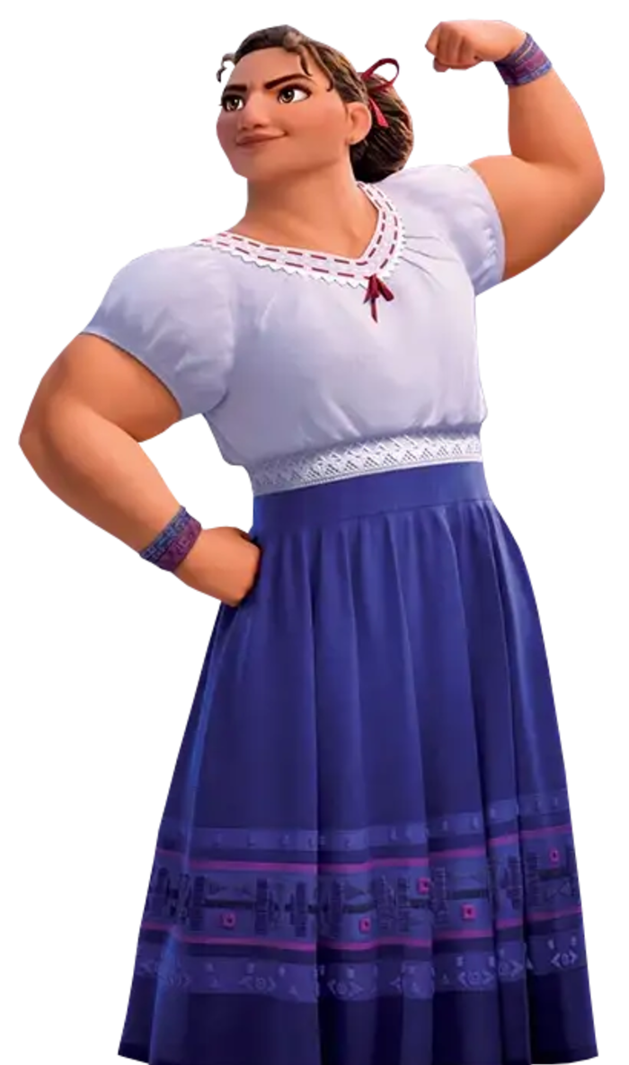
Video Activity
Watch: A clip from Enchanto
Write down three observations/lyrics from the video that describe Luisa’s character structure of boundary deficiency.
Is Luisa Boundaryless or Boundary Busting?

Slide 20


Slide 21
Video Activity
Share your observations or lyrics from the video that describe Luisa’s character structure of separation deficiency in a group of three or four.
What other movies character’s can you think of that are deficient in the character structure of separation in boundaries?

Slide 22
Why We Struggle With No
Developmental Challenges
Example: Internal anger, externally people pleasing
Age 2 – developmental task: learn to say "no"
If parental figures didn't respect our "no," we grow up unable to say it
Consequences
Pleasing others outwardly while resenting inwardly
Disconnection from anger and related body sensations
Directing anger inward with "should" statements
We can never say "yes" wholeheartedly if we can't first learn to say "no"
Grade 12 | FORGE
FORGE

Slide 23
Discussion: Saying No
?
1
How or when do you struggle to say no to people when you want to?
Self
Reflection
2
What happens inside of you when you say yes but want to say no?
3
Do you sometimes struggle to hear no when others say no to you?
4
Are there people in your life that try to change your no into a yes? How does that feel?
Grade 12 | FORGE
FORGE

Slide 24

Characterological Hiding Patterns
We disconnect from our thoughts, emotions, and sensations when they are too overwhelming for us to feel and deal alone.
For protection, we adopt hiding patterns.
Hiding patterns freeze our character development at the point when we adopted them.
Feeling and dealing in relationship allows our character development to resume.
Notes:
Example: Internal anger, externally people pleasing.
Age 2 – developmental task, learn to say “no.” But if we had a parental figure who didn’t like our “no” or didn’t hear our “no” we grow up with an inability to say “no.” We seek to please people, but on the inside we hate doing it. It’s “unspiritual” to say “no.” Thus, we are disconnected from the emotion anger and its related body sensations. Now, when we feel anger, we direct the anger inwards and we speak to ourselves in “should”s. You “Should” serve. The anger, the part of us that says “no” is now alone. The developmental task of learning to say “no” is now on pause. We can never say “yes” wholeheartedly if we can’t first learn to say “no.”
This situation might look like…For example: Someone asks you to help them out with something at church. They ask you to come early to help serve donuts and coffee for the church breakfast gathering. Inside, you are thinking, “I am already helping out with some things, and I was hoping to just have a quiet morning before church… I don’t really want to do this, but how can I say no to serving God in this way?” You agree to do it, but inside, you are seething. You begin to cut off your relationship with the person who asked you for help because you don’t want them to ask you to do anything else.

Slide 25
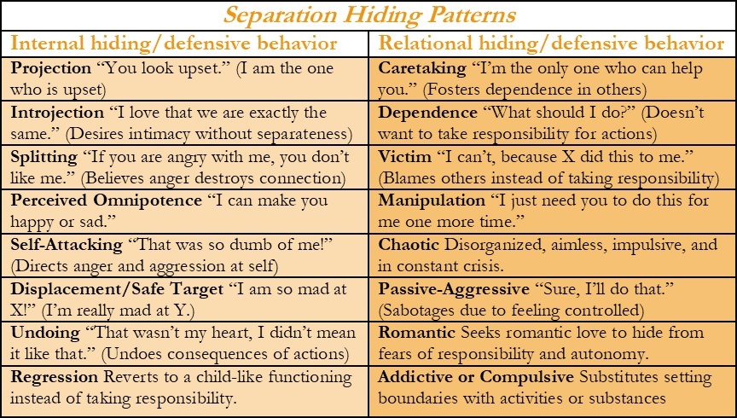

Slide 26
What is available for Bishop Students?
As a personal counselor, I am available to meet with you to help you process difficult to process life circumstances.
Feel free to come to my office, or to email me if you desire to meet with me one on one.
Mr. Eggman: AEggman@bishopdiego.org.
•
•
•
•

Slide 27
Questions?

