Slide 1

A Christ-Centered SEL & Leadership Formation Program
Bishop Diego High School • Grades 9-12

Slide 2
FRESHMAN • GRADE 9
The Time-Traveling Emotional Brain
Explains how the emotional brain connects present sensory experiences to the past, creating emotional "triggers". Students explore the concepts of being "flooded" by past emotions and how unresolved "core memories" can impact present behavior and well-being.
CASEL FOCUS
Self-Awareness & Social Awareness
CST LENS
Healing Community

Slide 3


The Brain Time Travels Activity
Various smells have been handed out. Go around smelling the various objects until a memory enters your mind that is connected to a smell. What is the memory? What emotions, body sensations, and thoughts are you aware of that is connected to this smell?

Slide 4
I Just “Triggered” You
Your “emotional” brain connects experiences where you see, hear, smell, taste, or touch in the present with those you heard, saw, smelled, tasted, or touched in the past.
Your “triggered” when you start feeling emotions connected to the past in the present.
This can be both positive or negative

Slide 5

Being “Flooded”
Being “flooded” is the concept that the emotions rooted in past experience are too overwhelming to feel and deal with.
What ever emotions that you have been unable to feel and deal with in the past will continue to “flood” you when something in your environment “triggers” you.
Notes:
Example: Internal anger, externally people pleasing.
Age 2 – developmental task, learn to say “no.” But if we had a parental figure who didn’t like our “no” or didn’t hear our “no” we grow up with an inability to say “no.” We seek to please people, but on the inside we hate doing it. It’s “unspiritual” to say “no.” Thus, we are disconnected from the emotion anger and its related body sensations. Now, when we feel anger, we direct the anger inwards and we speak to ourselves in “should”s. You “Should” serve. The anger, the part of us that says “no” is now alone. The developmental task of learning to say “no” is now on pause. We can never say “yes” wholeheartedly if we can’t first learn to say “no.”
This situation might look like…For example: Someone asks you to help them out with something at church. They ask you to come early to help serve donuts and coffee for the church breakfast gathering. Inside, you are thinking, “I am already helping out with some things, and I was hoping to just have a quiet morning before church… I don’t really want to do this, but how can I say no to serving God in this way?” You agree to do it, but inside, you are seething. You begin to cut off your relationship with the person who asked you for help because you don’t want them to ask you to do anything else.

Slide 6
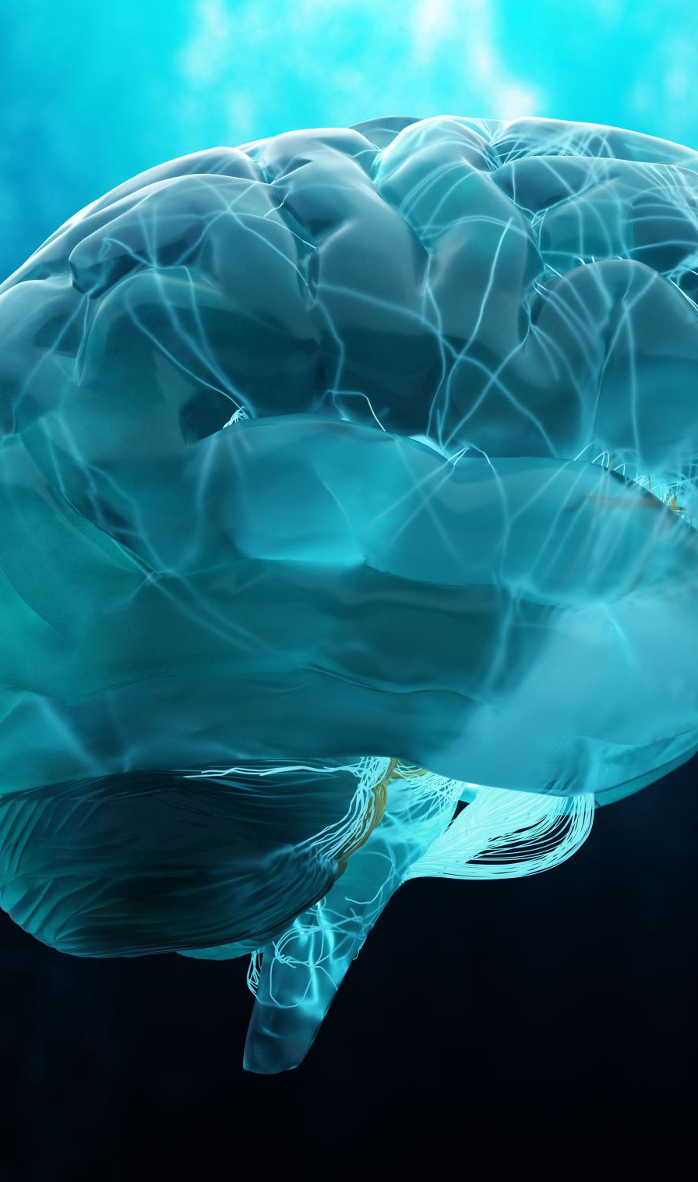
“Core Memories” are stored in the emotional brain
A “core memory” is a highly emotionally charged experience that occurred in the past and has the potential to be “triggered” by something happening in the present.
Components of “core memories”:
Emotions with their correlating body sensations
Embodied beliefs
Notes:
Why—making disciples = great commission. This group is about making disciples. Learning how to make disciples and being discipled. But the problem is the current way we make disciples is failing. Stories-attachment deficiency—go to room and pray. Boundary deficiency—be more loving (they are caregivers). Harsh critical internal judge—told to stop it. We need a change model that works so that we can make disciples.
What—Change model kingdom family. Two-brain system, growing in relationship with others and with God. Knowing what is healthy and what is not healthy.
How—Grace, Truth, and Time not fixing saving or solving, empathy, experiencing Jesus, the incarnational stance
What if—What if we could have a spiritual family where we have a system that actually enacts growth, discipleship, hearts go out with compassion, lost attracted to us because we love one another, what if we could get our relational nutrients at church

Slide 7


Slide 8
The Importance of Feeling and Dealing
When something negative happens in our life, we feel a lot of emotions.
If we are unable to feel and deal in relationship with those intense emotions, those emotion get stuck in our emotional brain ready to be “triggered.”
When our present experience reminds our brain of the past, those overwhelming emotions linked in the past will then “flood” our present
Notes:
(Luke 13:6-9)

Slide 9


Notes:
(Luke 13:6-9)

Slide 10

Activity: Inside Out Video Clip
#1 Why did Riley breakdown at school?
#2 What do you believe is the deepest root cause of Riley’s emotional struggles?
#3 What does Riley need to break the cycle of being “flooded“?
Notes:
Example: Internal anger, externally people pleasing.
Age 2 – developmental task, learn to say “no.” But if we had a parental figure who didn’t like our “no” or didn’t hear our “no” we grow up with an inability to say “no.” We seek to please people, but on the inside we hate doing it. It’s “unspiritual” to say “no.” Thus, we are disconnected from the emotion anger and its related body sensations. Now, when we feel anger, we direct the anger inwards and we speak to ourselves in “should”s. You “Should” serve. The anger, the part of us that says “no” is now alone. The developmental task of learning to say “no” is now on pause. We can never say “yes” wholeheartedly if we can’t first learn to say “no.”
This situation might look like…For example: Someone asks you to help them out with something at church. They ask you to come early to help serve donuts and coffee for the church breakfast gathering. Inside, you are thinking, “I am already helping out with some things, and I was hoping to just have a quiet morning before church… I don’t really want to do this, but how can I say no to serving God in this way?” You agree to do it, but inside, you are seething. You begin to cut off your relationship with the person who asked you for help because you don’t want them to ask you to do anything else.

Slide 11

The Solution
Solution = Feeling and dealing in relationship with those experiences which was previously too overwhelming
Notes:
(Luke 13:6-9)

Slide 12

Steps for Transformational Change
•
Step 1: An empathetic, safe relationship with someone who is not overwhelmed by you being “triggered”
Step 2: Have a new experience feeling and dealing in relationship with that which was previously too overwhelming
•
•
•

Slide 13


Slide 14
Activity: Solution: Inside Out Video Clip
#1 Why was a half-joy, half-sadness core memory created?
#2 How does this correlate with Riley feeling and dealing with the move from Minnesota?
#2 Why was it important for Riley to feel the sadness associated with leaving Minnesota?
#3 How will Riley be different in the future when her memories associated with Minnesota are triggered?
Notes:
Example: Internal anger, externally people pleasing.
Age 2 – developmental task, learn to say “no.” But if we had a parental figure who didn’t like our “no” or didn’t hear our “no” we grow up with an inability to say “no.” We seek to please people, but on the inside we hate doing it. It’s “unspiritual” to say “no.” Thus, we are disconnected from the emotion anger and its related body sensations. Now, when we feel anger, we direct the anger inwards and we speak to ourselves in “should”s. You “Should” serve. The anger, the part of us that says “no” is now alone. The developmental task of learning to say “no” is now on pause. We can never say “yes” wholeheartedly if we can’t first learn to say “no.”
This situation might look like…For example: Someone asks you to help them out with something at church. They ask you to come early to help serve donuts and coffee for the church breakfast gathering. Inside, you are thinking, “I am already helping out with some things, and I was hoping to just have a quiet morning before church… I don’t really want to do this, but how can I say no to serving God in this way?” You agree to do it, but inside, you are seething. You begin to cut off your relationship with the person who asked you for help because you don’t want them to ask you to do anything else.

Slide 15
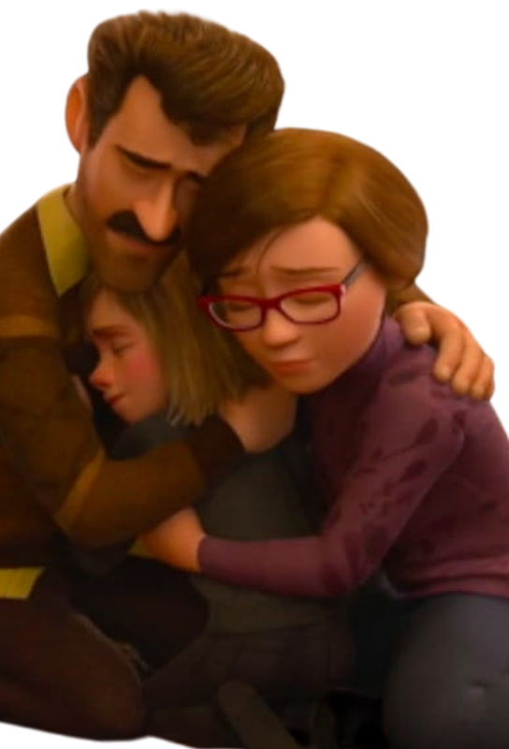
Who can we go to for these transformational experiences?
#1 Family
#2 Friends
#3 Church Family
#4 Teachers / Coaches
#5 Counselors (I invite you to see me, email me aeggman@bishopdiego.org)
Notes:
Example: Internal anger, externally people pleasing.
Age 2 – developmental task, learn to say “no.” But if we had a parental figure who didn’t like our “no” or didn’t hear our “no” we grow up with an inability to say “no.” We seek to please people, but on the inside we hate doing it. It’s “unspiritual” to say “no.” Thus, we are disconnected from the emotion anger and its related body sensations. Now, when we feel anger, we direct the anger inwards and we speak to ourselves in “should”s. You “Should” serve. The anger, the part of us that says “no” is now alone. The developmental task of learning to say “no” is now on pause. We can never say “yes” wholeheartedly if we can’t first learn to say “no.”
This situation might look like…For example: Someone asks you to help them out with something at church. They ask you to come early to help serve donuts and coffee for the church breakfast gathering. Inside, you are thinking, “I am already helping out with some things, and I was hoping to just have a quiet morning before church… I don’t really want to do this, but how can I say no to serving God in this way?” You agree to do it, but inside, you are seething. You begin to cut off your relationship with the person who asked you for help because you don’t want them to ask you to do anything else.

Slide 16
Case Study: The Football Signing Ceremony
Johnny’s father was an NFL player, but his relationship with his father was strained. His father was often absorbed in work, and he never said “I love you” to his son. Johnny worked day after day, year after year to please his father by being a good football player. Johnny did so well he was invited to sign at his dream University. On his signing ceremony he was ecstatic and wanted to share this experience with his father. Unfortunately, his father never came to the ceremony, because he was busy working like usual.
Notes:
Example: Internal anger, externally people pleasing.
Age 2 – developmental task, learn to say “no.” But if we had a parental figure who didn’t like our “no” or didn’t hear our “no” we grow up with an inability to say “no.” We seek to please people, but on the inside we hate doing it. It’s “unspiritual” to say “no.” Thus, we are disconnected from the emotion anger and its related body sensations. Now, when we feel anger, we direct the anger inwards and we speak to ourselves in “should”s. You “Should” serve. The anger, the part of us that says “no” is now alone. The developmental task of learning to say “no” is now on pause. We can never say “yes” wholeheartedly if we can’t first learn to say “no.”
This situation might look like…For example: Someone asks you to help them out with something at church. They ask you to come early to help serve donuts and coffee for the church breakfast gathering. Inside, you are thinking, “I am already helping out with some things, and I was hoping to just have a quiet morning before church… I don’t really want to do this, but how can I say no to serving God in this way?” You agree to do it, but inside, you are seething. You begin to cut off your relationship with the person who asked you for help because you don’t want them to ask you to do anything else.

Slide 17
Case Study: The Football Signing Ceremony
Johnny’s father was an NFL player, but his relationship with his father was strained. His father was often absorbed in work, and he never said “I love you” to his son. Johnny worked day after day, year after year to please his father by being a good football player. Johnny did so well he was invited to sign at his dream University. On his signing ceremony, he was ecstatic and wanted to share this experience with his father. Unfortunately, his father never came to the ceremony, because he was busy working like usual.
What emotion(s) will Johnny have a difficult time feeling and dealing with?
What core memory and associated belief might Johnny internalize as result?
How might this affect Johnny in the future?
Notes:
Example: Internal anger, externally people pleasing.
Age 2 – developmental task, learn to say “no.” But if we had a parental figure who didn’t like our “no” or didn’t hear our “no” we grow up with an inability to say “no.” We seek to please people, but on the inside we hate doing it. It’s “unspiritual” to say “no.” Thus, we are disconnected from the emotion anger and its related body sensations. Now, when we feel anger, we direct the anger inwards and we speak to ourselves in “should”s. You “Should” serve. The anger, the part of us that says “no” is now alone. The developmental task of learning to say “no” is now on pause. We can never say “yes” wholeheartedly if we can’t first learn to say “no.”
This situation might look like…For example: Someone asks you to help them out with something at church. They ask you to come early to help serve donuts and coffee for the church breakfast gathering. Inside, you are thinking, “I am already helping out with some things, and I was hoping to just have a quiet morning before church… I don’t really want to do this, but how can I say no to serving God in this way?” You agree to do it, but inside, you are seething. You begin to cut off your relationship with the person who asked you for help because you don’t want them to ask you to do anything else.

Slide 18
Example: The Football Signing Ceremony
Johnny, a successful CEO of a widely successful organization, ended up seeing me as an Executive Coaching Client due to often feeling depressed. As we explored the roots of what was causing the depressive emotions, we discovered that when he experienced great victories in his life, instead of feeling joy and pride he felt shame and aloneness. As he shared the football signing ceremony event with me, I helped him feel and deal with the joy and pride of his big signing event. After feeling and dealing with the pride and joy associated with the football signing ceremony, the depressive emotions went away, and he was able to feel positive in the future when he made accomplishments.

Slide 19

Group work
Think of a movie or book where the main character is given a tragic backstory. How does that tragic backstory affect the main character of the film or book? Does the character ever overcome this effect? If so, how?

Slide 20
What is available for Bishop Students?
As a personal counselor, I am available to meet with you to help you process difficult to process life circumstances.
Feel free to come to my office, or to email me if you desire to meet with me one on one.
Mr. Eggman: AEggman@bishopdiego.org.
•
•
•
•

Slide 21
Questions?

