Slide 1
Sleep Data Analysis
by Egnesh Louie S

Slide 2
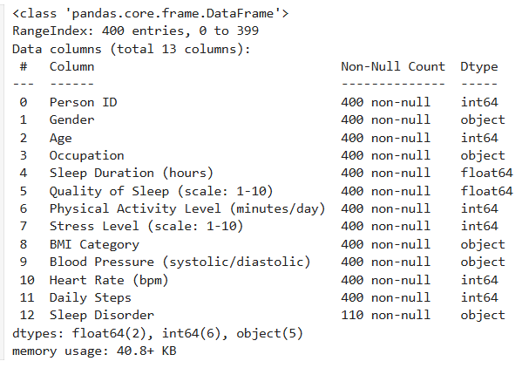
Dataset Overview
Total Records: 400
Features: 13
Key Columns:
Demographics: Gender, Age, Occupation
Sleep Metrics: Duration, Quality, Disorder
Health Metrics: Stress, BMI, Activity, Heart Rate
Missing Values: Present in activity, stress,
blood pressure, heart rate, and steps

Slide 3
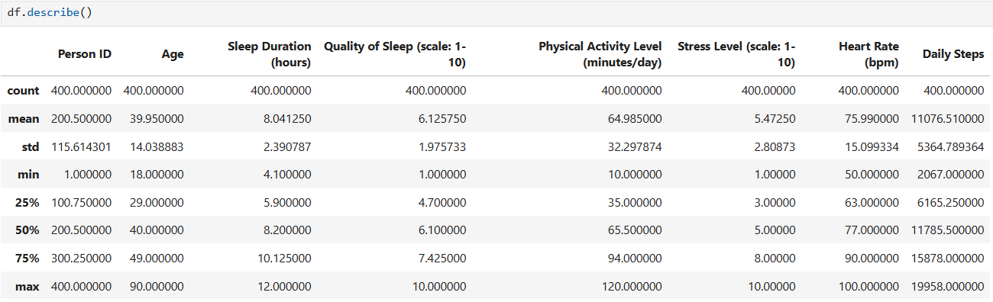
Statistical Summary

Slide 4
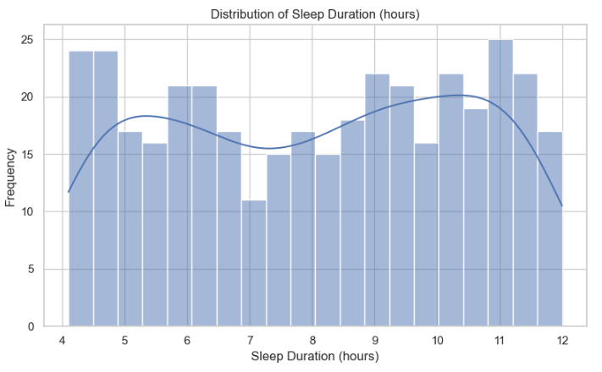
Distribution of Sleep Duration
How Long Do People Sleep? Chart: Histogram of Sleep Duration (hours)
Most individuals sleep between 6 and 9 hours
Very few sleep <5 or >10 hours
Peak around 7–8 hours, aligning with health recommendations

Slide 5
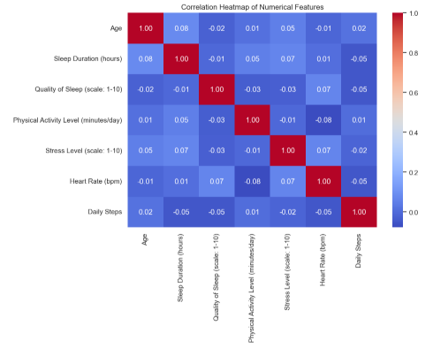
Correlation Between Features
What Factors Are Related? Chart: Heatmap of numerical feature correlations
Positive Correlation: Sleep Quality ↔ Sleep Duration & Physical Activity
Negative Correlation: Sleep Quality ↔ Stress Level
Daily Steps ↔ Physical Activity show expected correlation

Slide 6
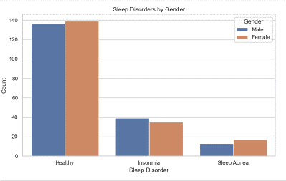
Sleep Disorders by Gender
Are Sleep Disorders Gendered? Chart: Countplot of Sleep Disorder by Gender
Both males and females are affected
Slight differences in distribution by gender, worth further analysis

Slide 7
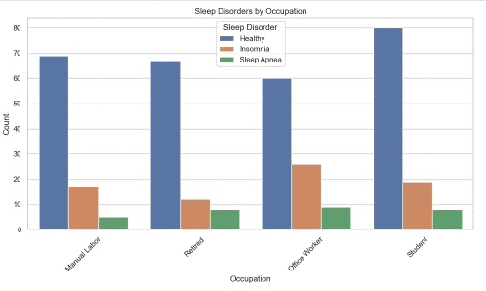
Sleep Disorders by Occupation
Which Jobs Are More Affected? Chart: Countplot of Occupation vs Sleep Disorder
Office Workers and Healthcare Workers have more reported disorders
Retired individuals also show notable counts of insomnia or apnea

Slide 8
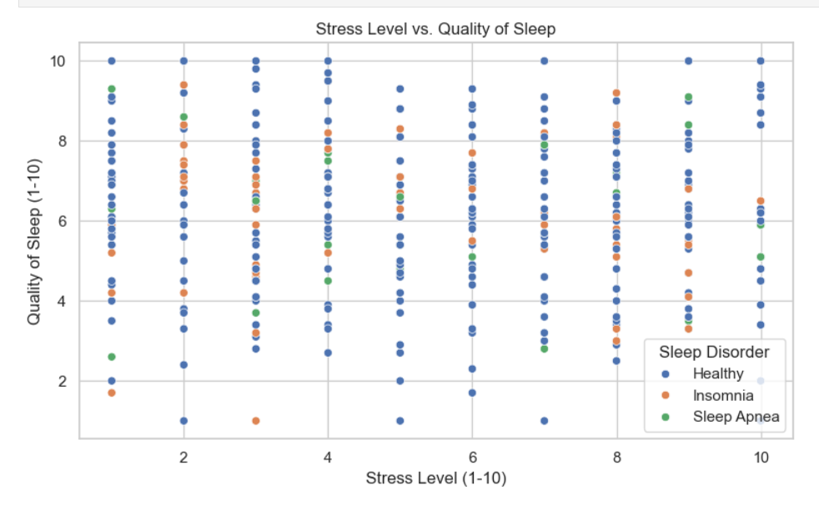
Stress vs. Sleep Quality
Impact of Stress on Sleep Quality Chart: Scatterplot of Stress Level vs Quality of Sleep
Clear negative trend: Higher stress → Lower sleep quality
Healthy individuals cluster in low-stress, high-quality zone

Slide 9
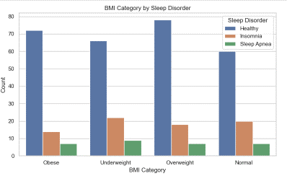
BMI and Sleep Disorders
Is BMI Linked to Sleep Issues? Chart: Countplot of BMI Category by Sleep Disorder
Obese category shows more instances of sleep apnea
Underweight and overweight categories also show variation by disorder

Slide 10
Conclusion
Sleep quality is influenced by duration, activity, and stress
Occupation and BMI are related to sleep disorders
Stress management and physical activity improve sleep outcomes
Sleep disorders require targeted interventions for specific groups

