Slide 1
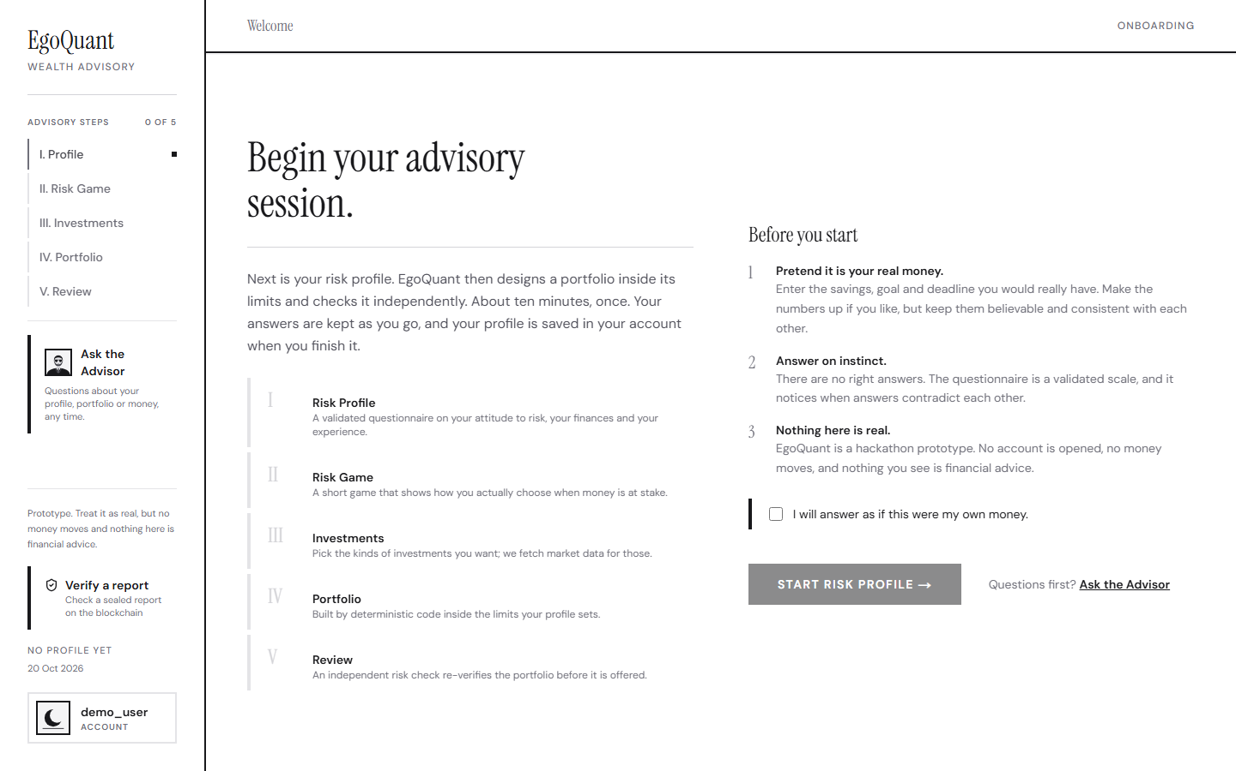
EgoQuant
Your portfolio should understand you
A behavioural approach to wealth advisory: a wealth-advisory agent you can check
2026 Shenzhen FinTechathon · WeBank International Track · Topic B: Wealth Advisory Agent
Team EgoQuant · NYU Abu Dhabi · 20 October 2026
Live: www.egoquant.app
Notes:
Good afternoon. EgoQuant is a wealth-advisory agent built on one rule: every number that matters comes from deterministic, tested code, and the AI only explains. In ten minutes I will show the journey an investor takes, the safety design behind it, what we measured, and what we did not build. Everything I say names a file, a test or a measured number in our documents.

Slide 2
The problem a retail investor has
Most apps show a portfolio and ask for trust. Three things the investor cannot do today:
1
2
3
Judge fit
See why
Prove later
Is this portfolio suitable for my finances and for how I really behave under loss?
Which rule set this limit, where does this number come from, and who checked it?
Can I show afterwards, unchanged, what I was told?
EgoQuant makes three promises in return: Fit, Proof, Trace.
Notes:
A retail investor cannot judge whether a portfolio is suitable, cannot see why it looks the way it does, and cannot prove later what they were told. EgoQuant answers each of these with a promise: Fit, the portfolio is suitable for this person; Proof, every number has a reason, a source and an independent check; Trace, what we advised can be shown unchanged later.

Slide 3
The one rule that organises the system
Numbers that matter come from deterministic, tested code. AI only explains. An independent Risk Engine has the final word.
1
2
3
Code decides
AI explains
One labelled exception
Scores, the risk category, every limit, the portfolio weights, approvals and trade verdicts. No language model can write to any of them.
The advisor explains the engine's facts, can run two whitelisted tools (what-if, check one trade), and every number in its answer is checked against the engine.
The news briefing's tone label for a headline and a fund comes from a model. It never sets a number the person acts on.
The Risk Engine re-computes every limit from the weights alone and fails closed on anything unknown.
Notes:
This is the rule behind everything you will see. Scores, categories, limits, weights, approvals and trade verdicts are code. The language model explains results it is given; it can run the real engine through two whitelisted tools, but it cannot invent a number, because every number it says is checked against the engine's facts. The one exception, the news-tone label, is labelled as such and never touches a number. And an independent Risk Engine re-checks the finished portfolio from scratch and fails closed.

Slide 4
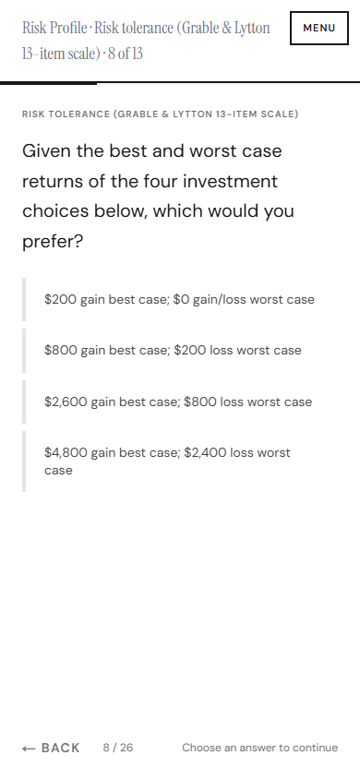
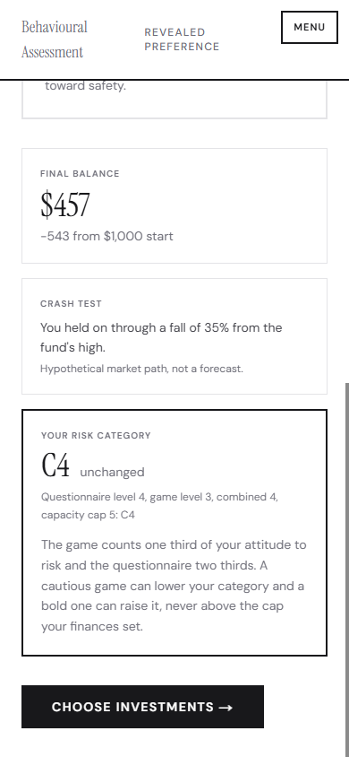
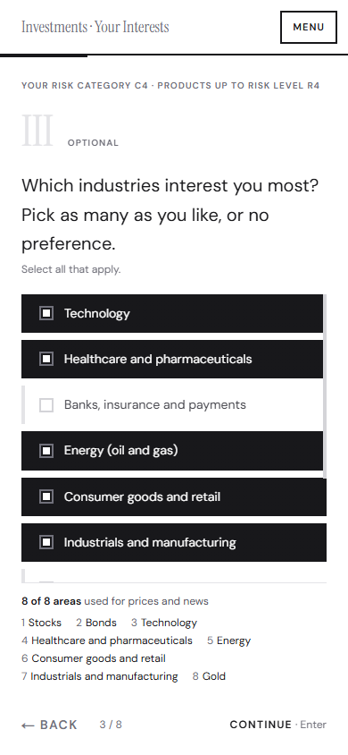
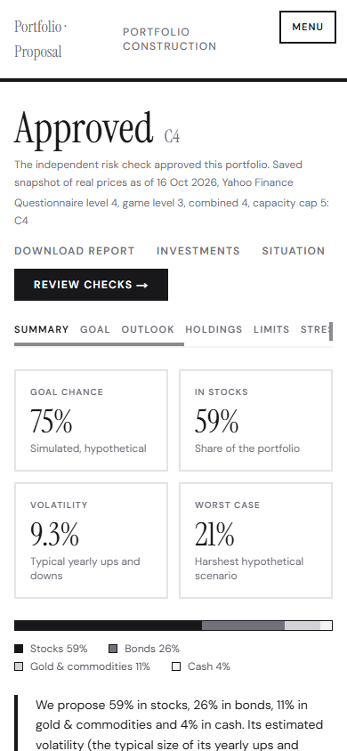
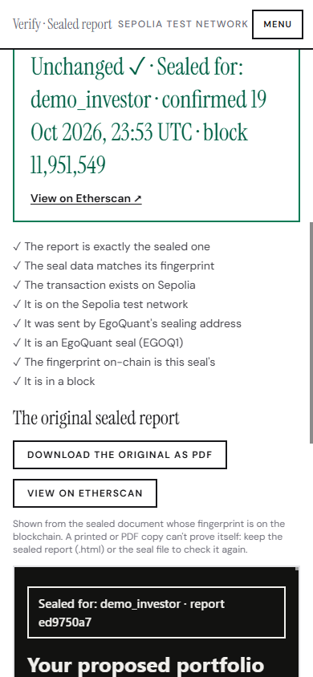
The journey: about ten minutes, five steps
I. Profile
II. Risk Game
III. Investments
IV. Portfolio
V. Review and seal
25 questions; two published scales quoted verbatim; a fixed program scores them
Seven rounds and a crash test: how the person behaves, not only what they say
Only what the category allows can be ticked; greyed-out options say why
Approved by the Risk Engine; the goal chance as N in 100 simulated futures
The independent checks, then Confirm and seal, then Verify a report
Notes:
The journey takes about ten minutes. A validated questionnaire gives the risk category and its limits. A short Risk Game adds behaviour. The investor picks what they would like to hold, and only what their category allows can be ticked, with the reason shown for everything else. The portfolio is built on real prices and approved by the Risk Engine, with the chance of reaching the goal shown as N in 100 simulated futures. Finally the plan is reviewed, confirmed and sealed, and anyone can verify the sealed report later. LIVE DEMO (30 seconds, no sign-in): open www.egoquant.app/verify, press Use the demo report (Unchanged, Sealed for demo_investor, block 11,951,549), then Try a tampered copy (Does not match). If asked for an operation log: the dated deploy-check file in the evidence folder (71 of 71 checks on the live service, 20 Oct) and the fourteen-investor run log (30 builds, 26 trade checks, 14 what-ifs, 0 rule failures).

Slide 5
Suitability by design: the lower of willing and able
Category C1 (most careful) to C5 = the LOWER of capacity (what the finances allow) and attitude to risk
Attitude = two thirds questionnaire + one third Risk Game; a bold game can never pass the capacity cap
"I could not accept any loss" always gives C1
Attitude: Grable and Lytton's 13-item scale, verbatim. Knowledge: Lusardi and Mitchell's Big Three; it restricts complex products, never the category
Capacity averages horizon, savings, share of wealth and income; money that must come back and a short horizon are hard caps
Product risk levels R1 to R5: a Cn client may hold up to Rn
Category | Product level | Stocks | Crypto | Loss limit in a severe fall
C1 | R1 | 0% | 0% | 5%
C2 | R2 | 0% | 0% | 10%
C3 | R3 | 40% | 0% | 20%
C4 | R4 | 70% | 0% | 35%
C5 | R5 | 90% | 5% | 45%
Provisional placeholders in one configuration file; a bank replaces them with its approved table. Every report carries a DRAFT LIMITS banner.
Notes:
Suitability asks for the more cautious of willing and able, so the category is the lower of the two. Attitude is measured with Grable and Lytton's published scale, quoted word for word, blended two thirds with one third from the Risk Game. Knowledge, from Lusardi and Mitchell's Big Three, gates complex products but never changes the category. Capacity averages four answers, with two hard caps: money that must come back, and a short horizon. The numbers behind each category are our provisional placeholders, kept in one file so a bank can replace them, and every report says so.

Slide 6
Six specialised parts, one independent check
Questionnaire + Risk Game
category C1 to C5, numeric limits (deterministic code)
↓
Agent C · market intelligence
allowed universe per category and platform; real prices (committed snapshot of 292 tickers, about 19 years); data provenance
→
Agent A · quant
about 100 candidate portfolios (20 risk points x 5 styles) inside every hard limit; goal simulation on 10,000 futures
←
Agent B · behavioural twin
IBKR trade history, crash test; returns limits that can ONLY tighten
↓
Agent D · news briefing
headlines per holding, read-only; the one labelled AI tone label
Risk Engine · final word
re-computes every limit from the weights alone; unknown product = fail closed; only an approved portfolio is shown
Advisor (OpenAI)
explains sealed facts; tools: what-if, check one trade; number grounding, redaction, compliance guard
Next.js on Vercel → FastAPI on Railway → Supabase (Auth + Postgres with Row-Level Security) · OpenAI (explanations only) · Sepolia test chain (fingerprints only)
Notes:
Why several agents rather than one prompt? Separation of duties. Each part does one job in deterministic, tested code: market data, portfolio construction, behaviour, and the final check. Agent C builds the allowed universe and prices it with real data. Agent A builds about a hundred candidates inside every hard limit and simulates the goal. Agent B reads real behaviour and can only tighten. The Risk Engine does not trust the optimiser: it re-computes everything and fails closed. The news briefing and the advisor sit beside the numbers and never change them.

Slide 7
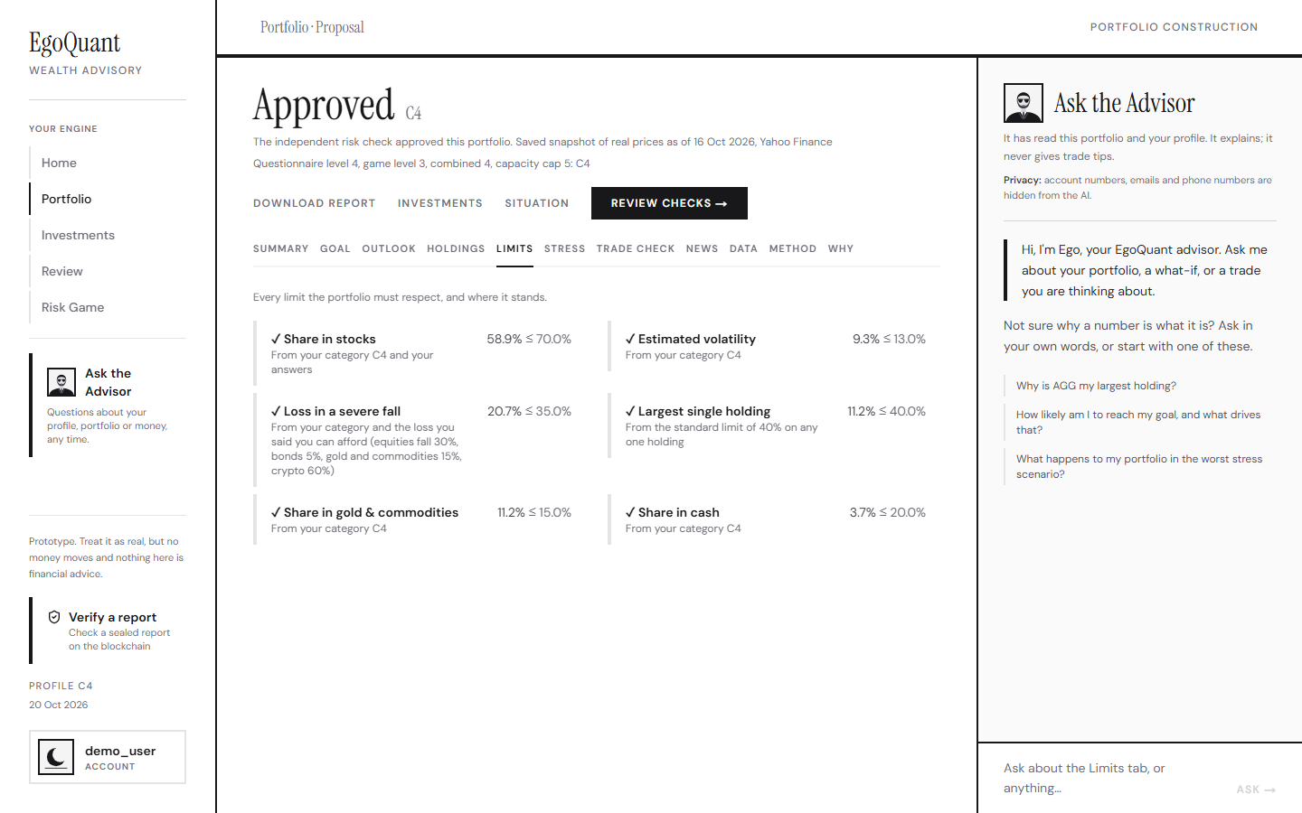
Behaviour counts, and can only make it safer
The Risk Game gives every person a behavioural signal; it counts one third of the attitude to risk and never pushes past the capacity cap
A real Interactive Brokers history (read-only upload or one-off Flex token; nothing stored) is stronger evidence and tightens only
Demo: the balanced investor, category C3. Without a history: 23% stocks, 87 of 100 simulated futures reach the goal
With an invented history that sold half its stocks in two market falls: the loss limit moves from 20% to 8.8%, stocks from 23% to 8%, the goal chance to 86 of 100; the Limits tab shows the line and the report says why
The eager beginner: C5 by the questionnaire, C4 after a cautious game; crypto stays closed because the knowledge questions were not answered correctly
The Limits tab (screenshot: a different example, category C4): every limit with its source, including the behavioural limit from the person's own trades
Notes:
What people say and what they do differ. The Risk Game gives everyone a behavioural signal, bounded to one third of the attitude and never past the capacity cap. A real trade history is stronger evidence and can only tighten. In the demo, an invented account that sold in two market falls moves the loss limit from twenty to under nine percent and the stock share from twenty-three to eight percent, and the Limits tab shows exactly where that line came from.

Slide 8
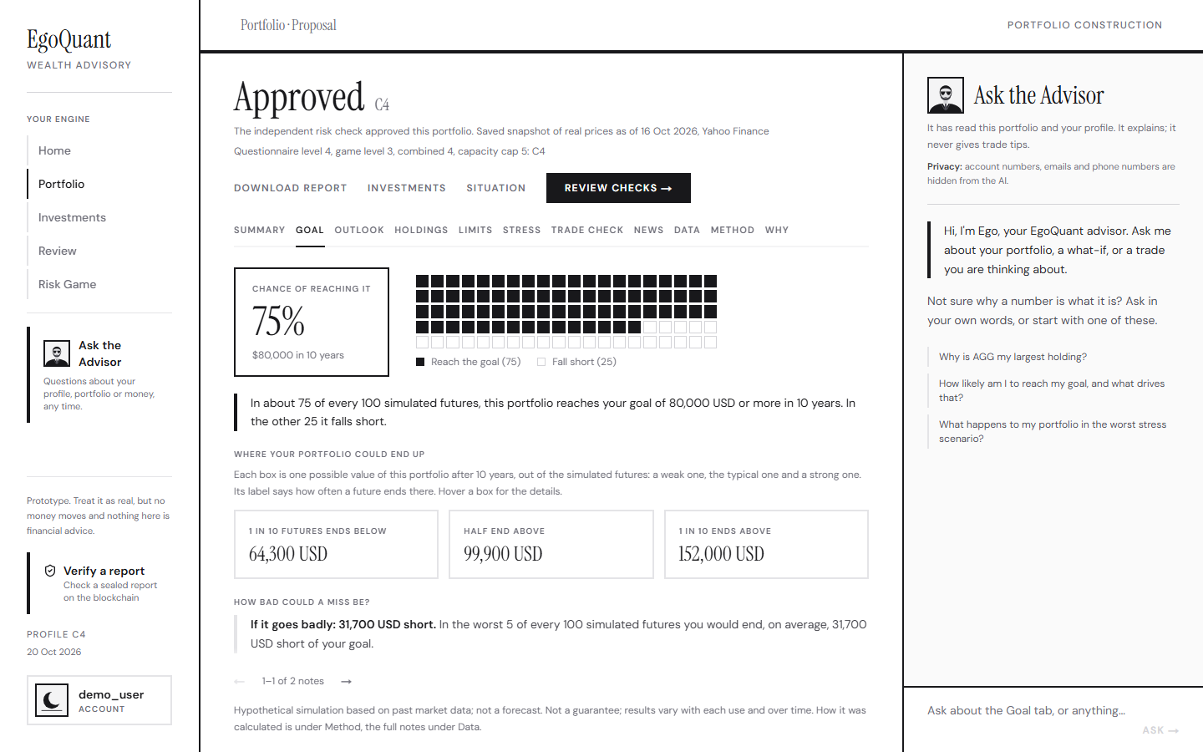
A goal simulation that is honest about history
The chance of reaching the goal is shown as "N in 100 simulated futures", never as a forecast
10,000 futures, the same for every candidate; month-long blocks of real daily returns, so crashes and rebounds stay clustered
Regime-aware sampler: a four-state Hidden Markov model fitted offline, loaded as a hash-checked file, with a fall-back and a kill switch
Two bias corrections: bonds and cash get today's rate, not their past average; stocks keep every real move but get the average their market sensitivity earned
Our own calibration backtest (rolling start dates, refitted on earlier data only): Brier score better than the plain bootstrap by 0.007 at five years and 0.011 at ten; on the later dates the gain is within the noise, and realised outcomes can differ from the simulated chance by tens of points. Hence "simulated", never "probable"
The Goal tab: the chance as 100 boxes, where the portfolio could end up, how bad a miss could be
Notes:
To say how likely a goal is, we replay the past: ten thousand futures stitched from real months of market history, with a regime model deciding which kind of month comes next so that crises last as long as they did. Two corrections keep history's luck out: today's interest rates for bonds and cash, and a hindsight correction for stocks. We ran a calibration backtest on our own method. It beats the plain bootstrap over all dates, but the gain on later dates is within the noise, and realised outcomes can differ from the simulated chance by tens of points. That is why the product says simulated and never probable.

Slide 9
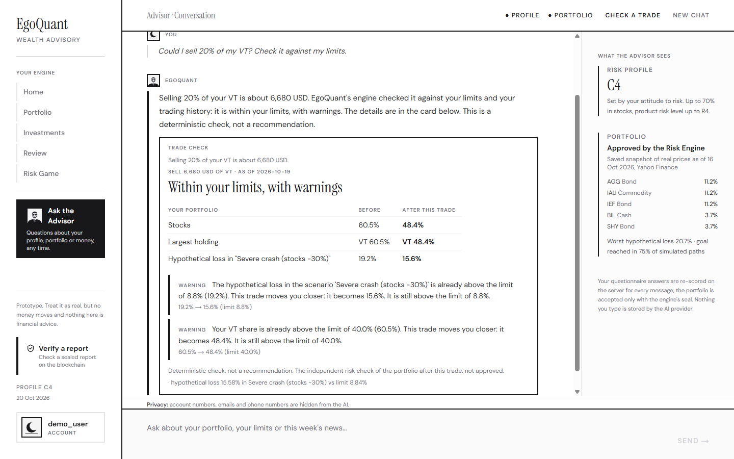
The advisor can run the engine but cannot decide
Two whitelisted tools: run a what-if (the real engine on a validated scenario) and check one trade (the deterministic trade check on the saved history); no field for a limit, a category or an identity; at most two calls per message
Number grounding: every percentage, "N in 100", amount and multiplier must come from the engine's facts or the user's own words, otherwise the reply is regenerated once, then replaced by a safe fallback
Redaction gateway: names, e-mails, phone numbers and account ids become placeholders before any model call; requests use store=false
Compliance guard: 36 patterns (English and Chinese) withhold anything that reads like a trade instruction, a price target, a guarantee or a forecast
Live red-teams against the real model (raw results in eval/results): earlier prompts 19/19, 19/19, 21/21, 24/24. On 20 Oct the red-team of the final advisor found a real defect in the trade tool (the model filled two size fields, so no trade check completed: a safe failure), fixed within the hour as advisor-v11; the re-run passed 41 of 42 cases (the one flag is a false alarm of our own check) and the trade explanation 51 of 51
A trade question in the chat: the verdict card under the reply is the real engine's check
Notes:
The advisor is fenced in. It can run the real engine through two whitelisted tools, but it has no write path to any score, limit or verdict. Every number it says must come from the engine's facts or the user's own words, or the reply is regenerated and then replaced by a safe fallback. Personal data is replaced by placeholders before any model call, and a compliance guard withholds anything that reads like a trade instruction or a forecast. We ran the live red-team on the final version today: 41 of 42 cases and 51 of 51 trade explanations pass. The first run found a real bug in the chat's trade tool, which we fixed within the hour and re-ran; the one remaining flag is a false alarm of our own check.

Slide 10
Security and compliance: what we built and what we measured
3,554
71 of 71
0
28
automatic tests, offline; last complete run 3,538 of 3,540 passed, 1 failed (a timing test of the news page), 1 skipped; 14 added since ran green
read-only deploy checks passed on the live service (20 Oct)
known vulnerabilities in the 56 pinned packages (pip-audit, 20 Oct)
known gaps listed openly with owners, next to a threat table T1 to T19
One person can never read another's data: every database call runs as the signed-in user under Row-Level Security on all 12 tables, the backend filters again, and there is no all-powerful key (the account store refuses to start with one); the RLS proof passed on the real project
Less data, kept shorter: broker credentials never asked for, tokens used once, uploaded files parsed in memory, every row expires after 180 days, "delete my data" erases every table (a test fails if one is forgotten)
Hostile input: strict schemas, no echo of what was sent, 80 + 33 + 129 hostile and extreme cases with no server error; size and rate limits; security headers and a content-security policy; secrets scanned on every push
Fails safely: a slow price feed switches the whole build to a labelled snapshot; the engine works without the AI; kill switches for every optional part
Notes:
Security is thirty percent of the score, so here is what we measured. Three and a half thousand automatic tests, 3,554 on the submitted version, with hostile-input suites, property sweeps and mutation checks where we broke the code on purpose to see the tests fail. A read-only deploy check passes seventy-one of seventy-one on the live service. The dependency audit found nothing. And we list twenty-eight known gaps with owners, next to a threat table, because a limit that is written down can be defended. Users are isolated by Row-Level Security with no privileged key anywhere; data is minimal, expires, and can be erased completely.

Slide 11
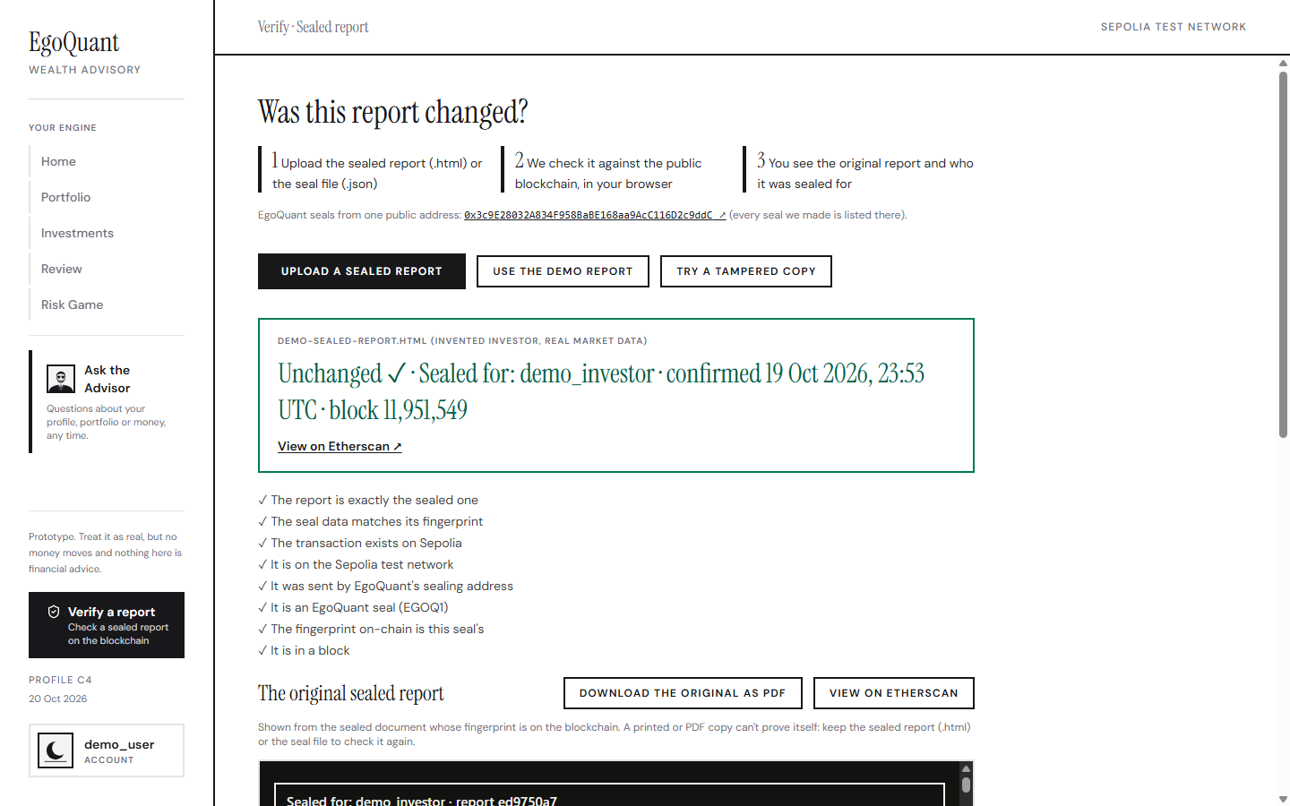
Tamper-evident advice: the on-chain seal
When a signed-in investor confirms an approved plan, the exact report is rendered once, marked "Sealed for: <username>", and a record of the advice is built
Only a fingerprint goes on chain: EGOQ1 + SHA-256(salt ‖ record), 37 bytes in a 0-ETH transaction on Ethereum Sepolia (test network); nothing personal leaves the database
Verify a report (no account needed) recomputes the fingerprint in the browser and reads the chain: "Unchanged ✓" or "Does not match ✗"; one changed character fails
Real transactions: the Verify page's demo report (block 11,951,549); a live signed-in seal on 20 Oct (block 11,954,258); sealing address 0x3c9E…9ddC; the evidence list names every seal with its Etherscan link
What it proves: this exact report existed, unchanged, no later than that block, for that username. What it does not: that the advice was right. Older seals still verify; "delete my data" removes the record and its salt. Roadmap: the same format on FISCO BCOS
Verify a report: a real sealed report checked against the live chain, every check passed
Notes:
Trust needs a trace. When a plan is confirmed, we fingerprint the exact report the person saw, together with a record of the advice, and publish only that fingerprint on a public test chain. Anyone can later check the downloaded report on the Verify page without an account: change one number and it fails. These are real transactions; the block numbers are on the slide and every seal is listed with its link. We are precise about what it proves, that this report existed unchanged for this person, and what it does not: that the advice was right. The same format would move to a consortium chain such as FISCO BCOS.

Slide 12
Honest limits, and what we would do next
What it is not, and where it is weak
Roadmap, in order
A licensed or regulated service: the category limits are placeholders, nothing has been reviewed by a regulator
The Risk Game has no psychometric validation; its effect is bounded and it has kill switches
The simulation replays about 19 years of history; it is not a probability
Prices: a Yahoo Finance snapshot accepted for the competition only; the live site runs on saved real prices
English only; Interactive Brokers only; the blockchain is a test network
No third-party penetration test; the newest advisor prompt not yet live red-teamed
Institutional calibration of the category table; periodic suitability review
Validate the Risk Game on a real sample; make the result of record non-replayable
Licensed market data, FX and tax awareness
The same salted fingerprint on FISCO BCOS, with a countersigning authority
Chinese-language advice with its own reviewed guard; more brokers
Third-party penetration test, monitoring, a per-user AI spending cap
Notes:
We say what is not done. EgoQuant is a prototype, not a regulated service; its limits are placeholders. The Risk Game is not psychometrically validated, so it is bounded. The simulation is not a probability. The data is a snapshot accepted for the competition only. It is English only, one broker only, on a test network, and without an external penetration test. The roadmap follows directly: institutional calibration, validation of the game, licensed data, a consortium chain, Chinese-language advice and assurance.

Slide 13
Try it yourself
Live site: www.egoquant.app · API and interactive docs: web-production-59960.up.railway.app/docs
Two minutes, no account: Verify a report → Use the demo report → Try a tampered copy
Ten minutes with the demo account: profile, Risk Game, investments, portfolio, trade check, confirm and seal, verify
Documents 01 to 09 (summary, security and compliance, methods, testing and evidence, user guide, limitations, judges' questions, API reference, on-chain seal); code at the tag submission-20oct in both repositories
Every limit is a proposal, every simulation is hypothetical, and every claim names a file, a test or a measured number. Thank you.
Notes:
You can try everything yourself. Two minutes without an account on the Verify page, ten minutes with the demo account through the whole journey. Nine documents and the tagged code carry the evidence. Every limit in EgoQuant is a proposal, every simulation is hypothetical, and every claim names a file, a test or a measured number. Thank you.

