Slide 1
SSH Honeypot Project with Cowrie
Kali Linux Honeypot Deployment and Monitoring

Slide 2
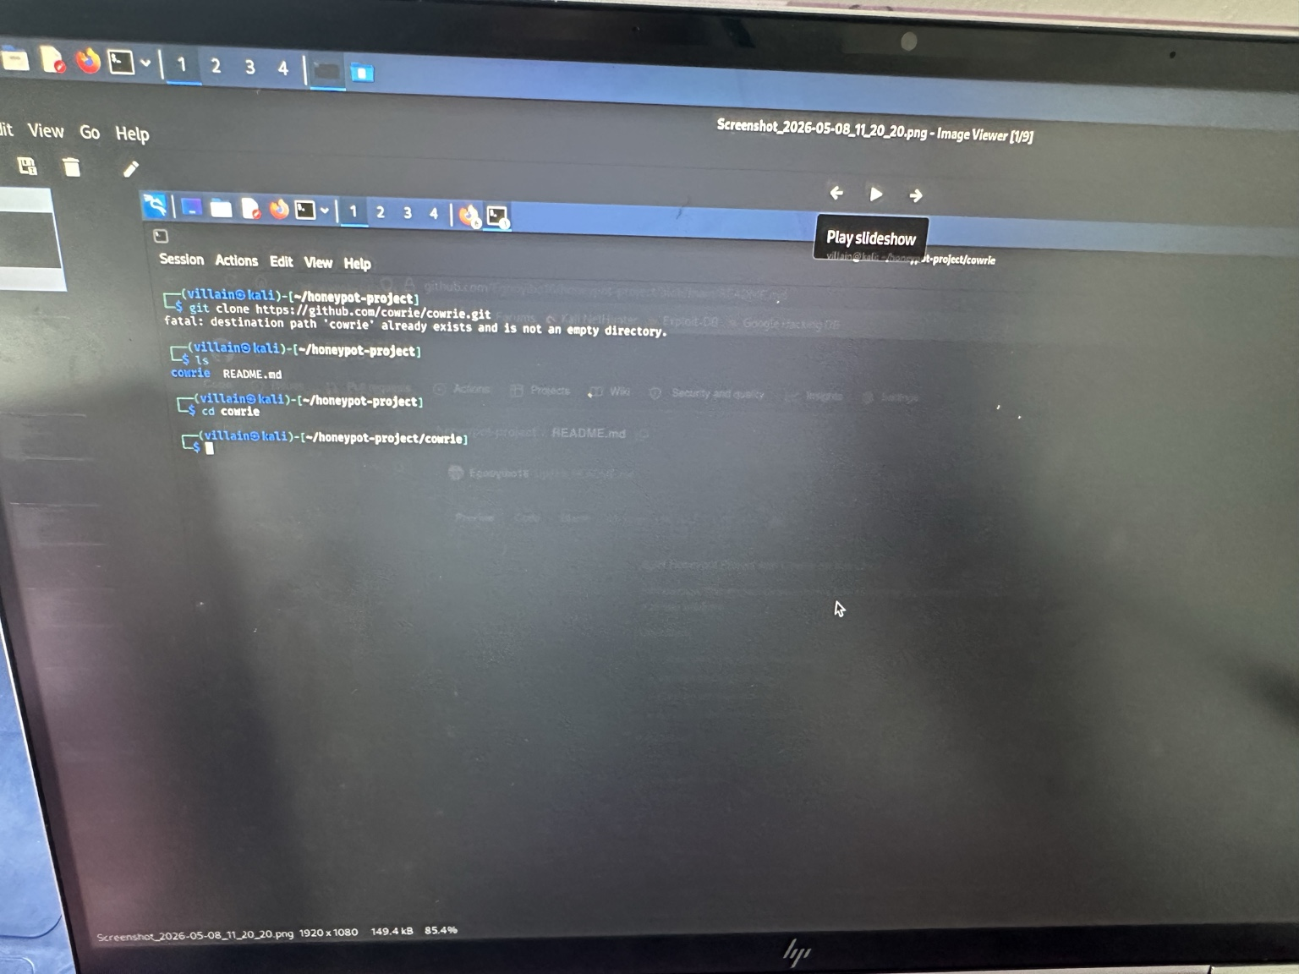
Project Setup
Cloning the Cowrie repository and navigating into the project directory.

Slide 3
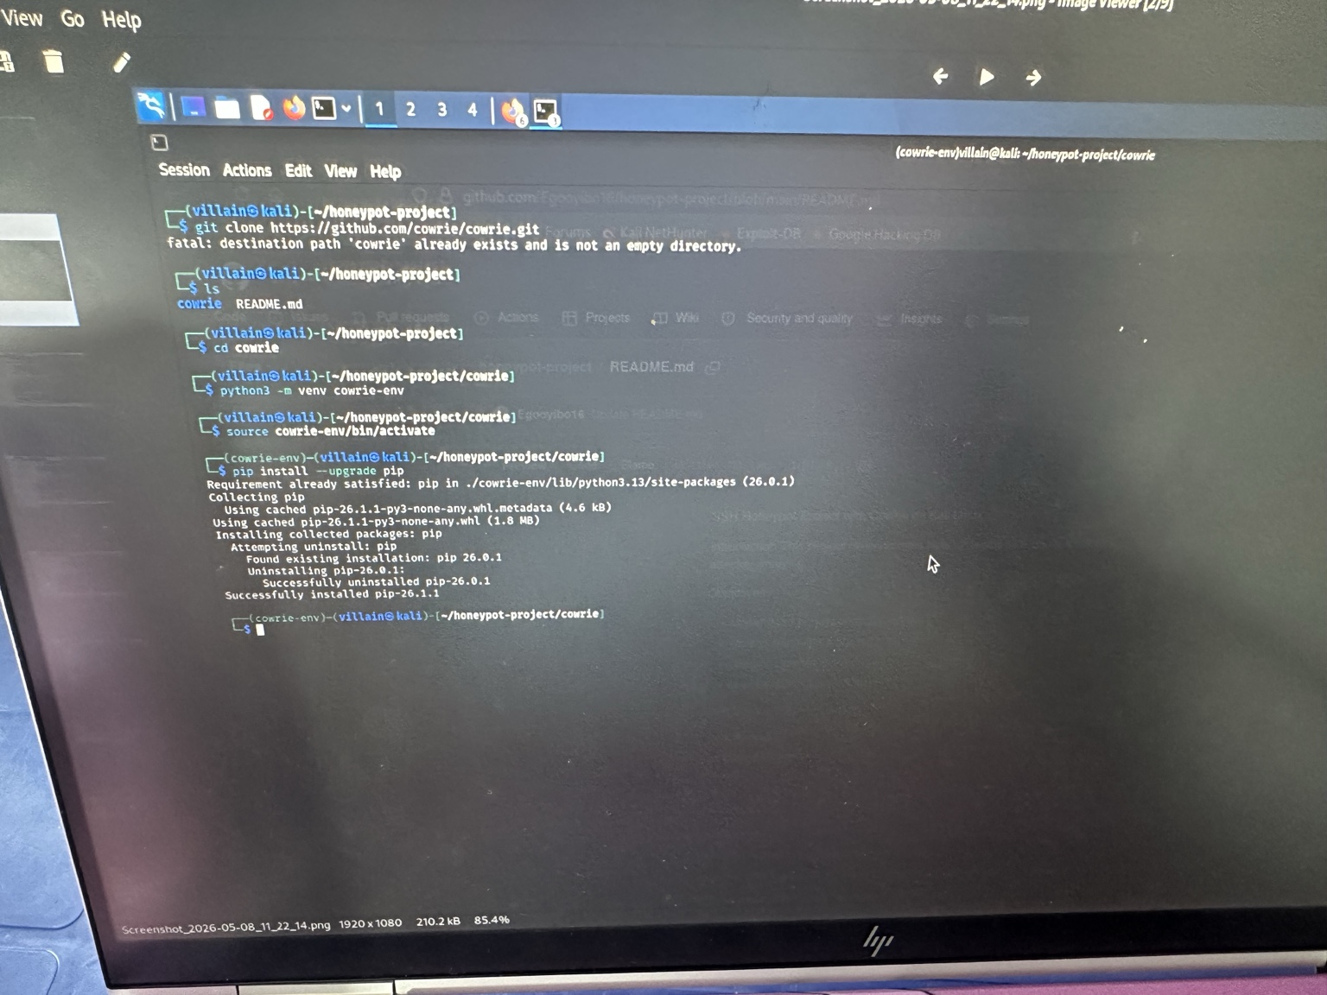
Virtual Environment Configuration
Creating and activating the Python virtual environment.

Slide 4
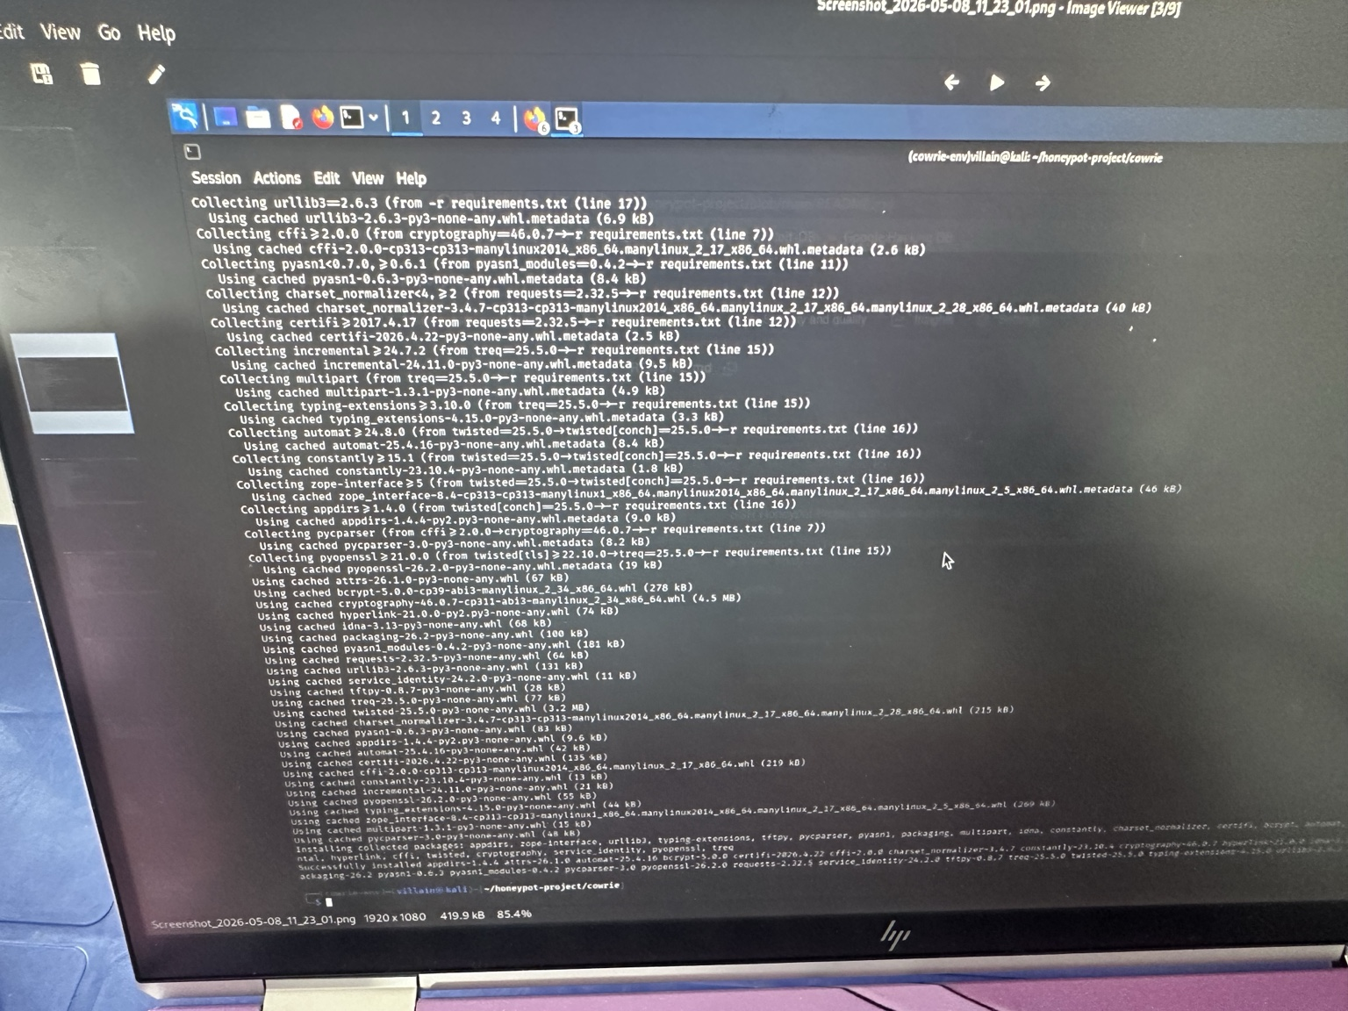
Dependency Installation
Installing Cowrie dependencies and configuring the honeypot.

Slide 5
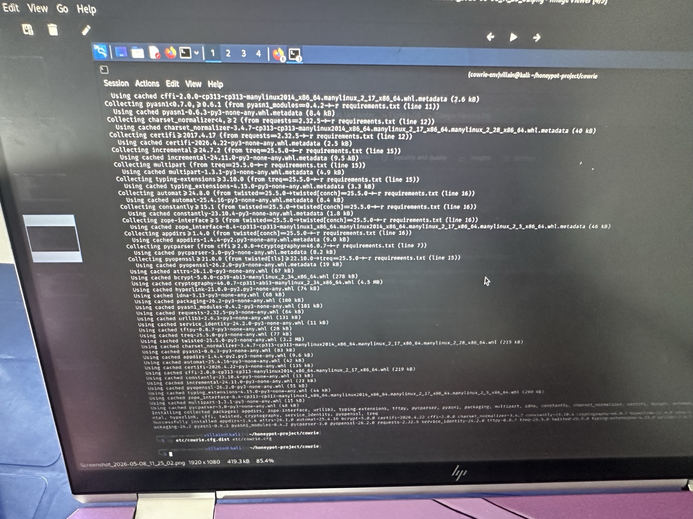
Starting Cowrie Honeypot
Launching the Cowrie SSH honeypot successfully.

Slide 6
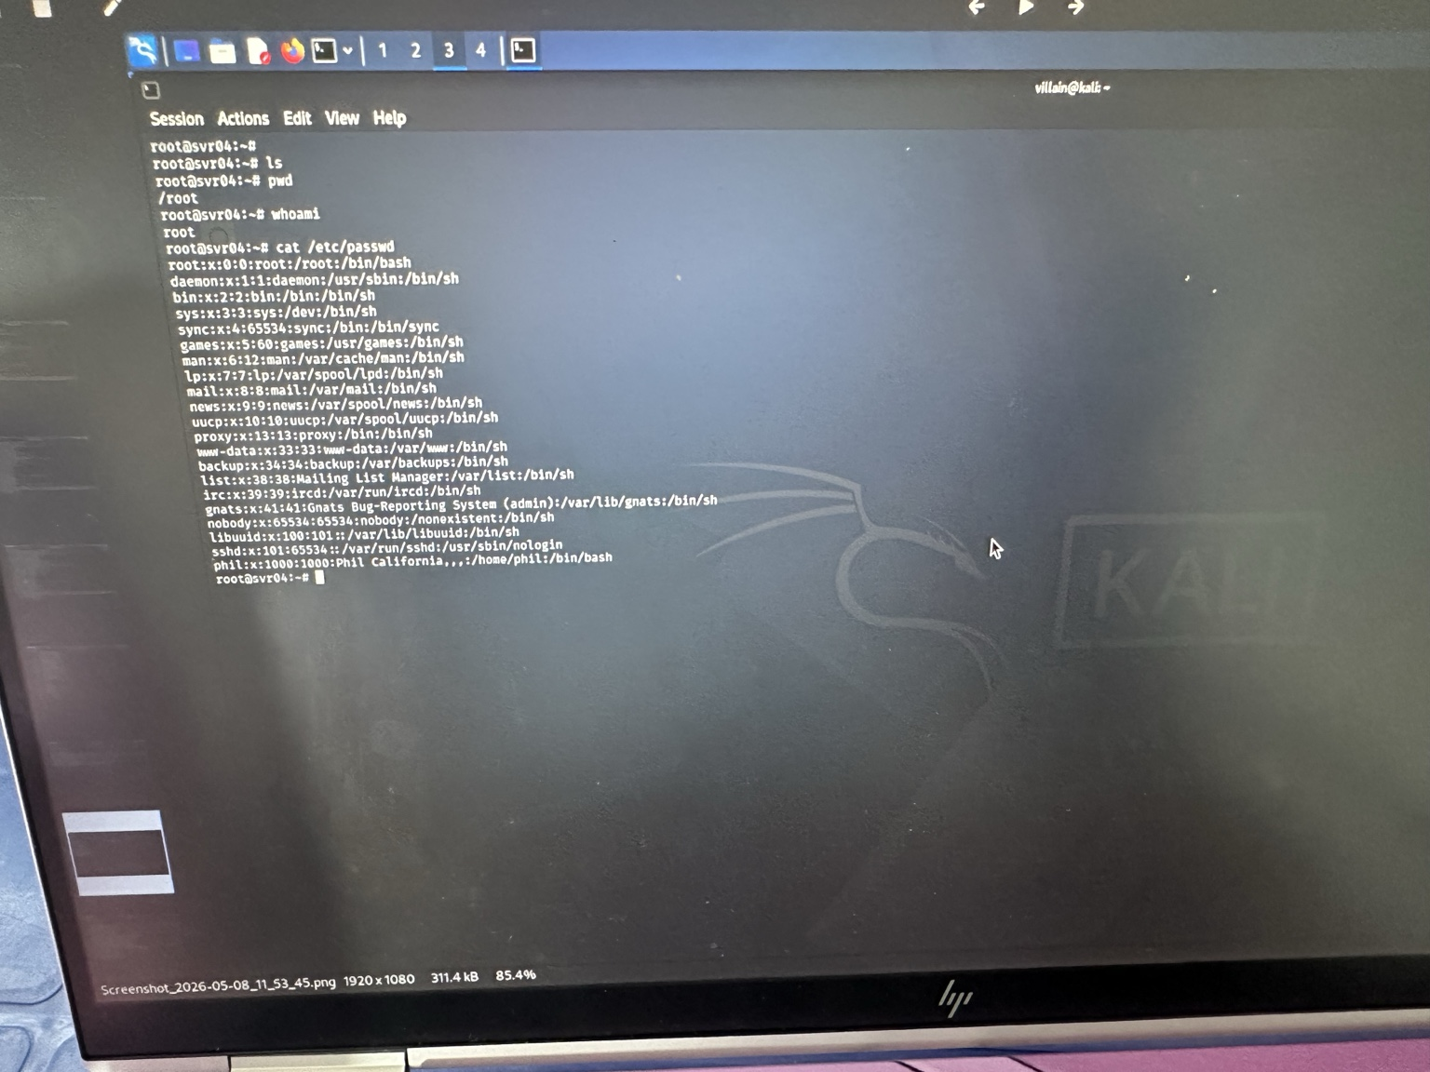
Simulated Attacker Interaction
Testing the honeypot with simulated attacker commands.

Slide 7
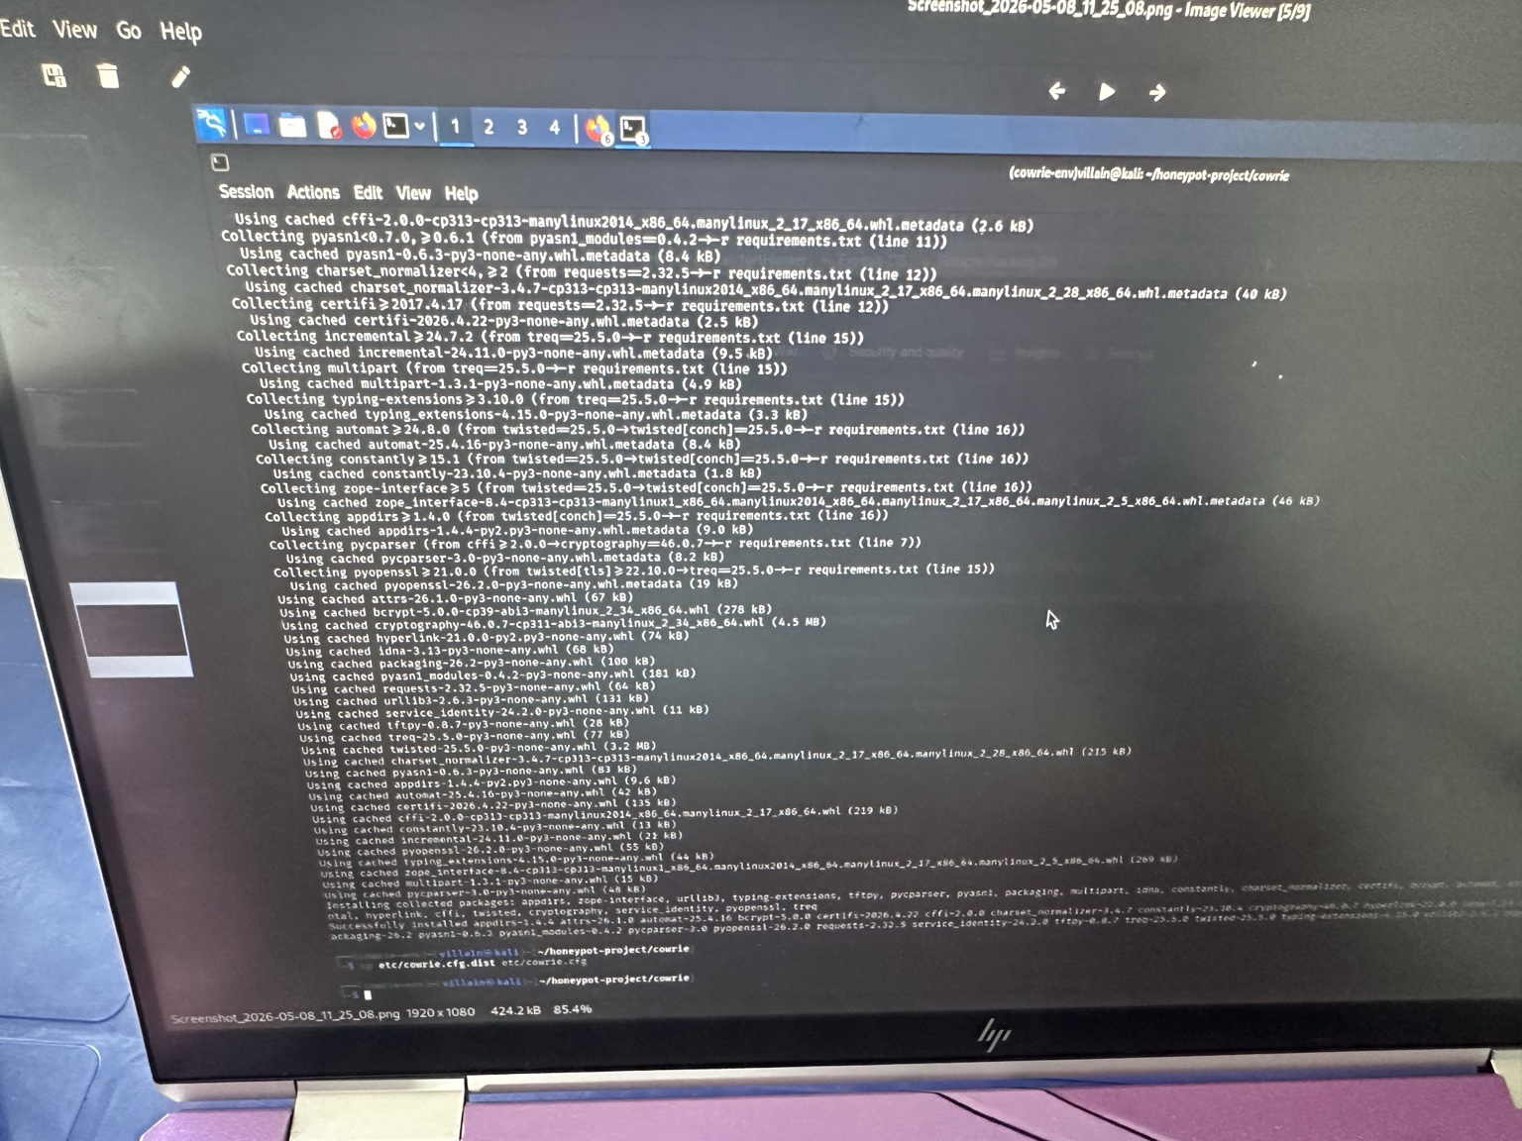
Captured SSH Session Logs
Viewing captured SSH logs and attacker activity.

Slide 8
Conclusion
This project demonstrated the deployment of a Cowrie SSH honeypot on Kali Linux, including setup, configuration, attacker interaction simulation, and log monitoring for cybersecurity analysis.

