Slide 1


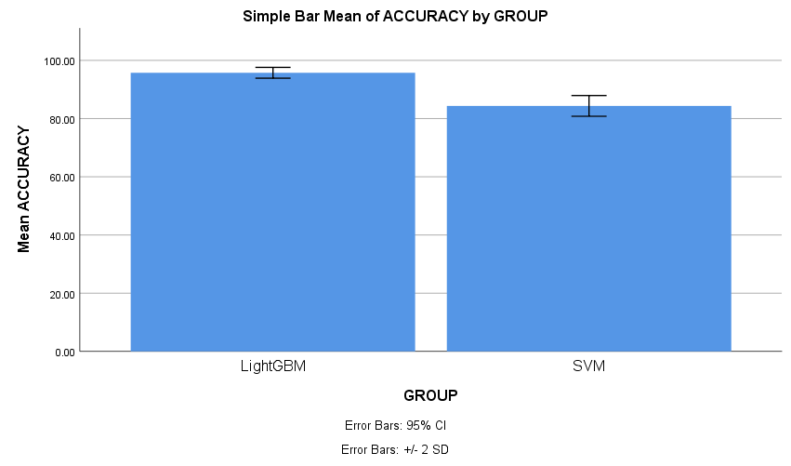
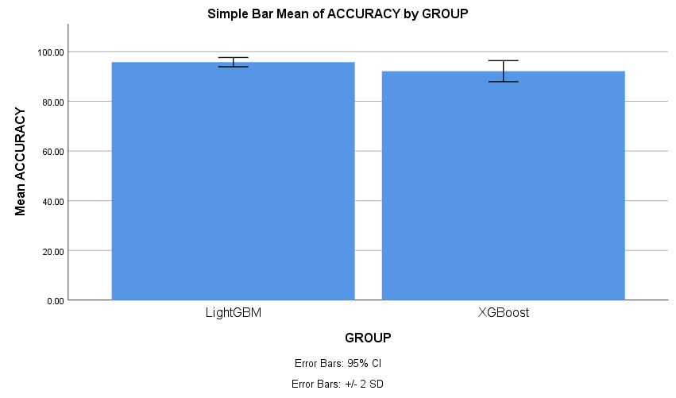
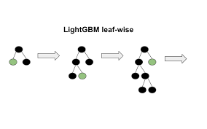
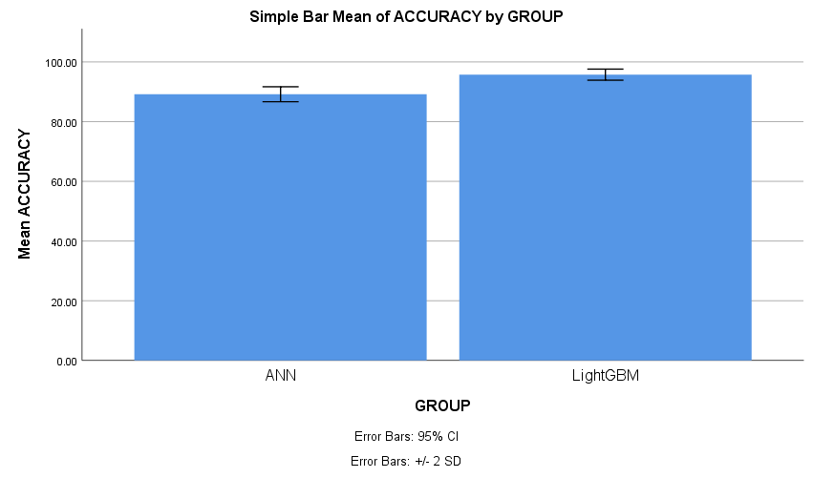


Register No: 192221074
Students Name: E.Gopi
Guided By Dr.C.Anitha
Robust Wireless Network Security: Detecting Evil Twin Attacks in Real Time Using LightGBM Over Support Vector Machine (SVM) with Improved Accuracy
Robust Wireless Network Security: Detecting Evil Twin Attacks in Real Time Using LightGBM Over XGBoost with Improved Accuracy
Wireless networks are highly vulnerable to various cyberattacks due to their open and shared nature, making security a major concern.
Evil Twin Attacks mimic legitimate Wi-Fi access points to trick users into connecting, allowing attackers to intercept sensitive data.
Traditional machine learning models like Support Vector Machine (SVM) often face limitations in accuracy and speed for real-time detection.
LightGBM (Light Gradient Boosting Machine) is a powerful ensemble model known for high speed and efficiency in classification tasks.
This study proposes a hybrid approach using LightGBM over SVM to enhance real-time detection of Evil Twin Attacks with improved accuracy and lower latency.
INTRODUCTION
INTRODUCTION
Evil Twin Attacks exploit trusted SSIDs, making them difficult to detect with traditional methods.
XGBoost, though powerful, can suffer from longer training times and may not scale efficiently with large feature sets.
LightGBM uses leaf-wise tree growth, resulting in better accuracy and faster processing than XGBoost.
Modern intrusion detection systems benefit from algorithms that balance speed and performance, especially in real-time scenarios.
This study evaluates whether LightGBM offers measurable improvement over XGBoost in accurately detecting Evil Twin Attacks.
MATERIALS AND METHODS
MATERIALS AND METHODS
Text here
Data Collection
Data pre-processing
Splitting the Data
Train Data
70%
Data Collection
Data pre-processing
Feature Selection and Extraction
Evaluation
Test Data
30%
LightGBM/SVM Classifier
High Prediction Accuracy
High Prediction Accuracy
Post-Processing/Control
Deployment
Comparison of XGBoost and LightGBM
Fig 1: LightGBM and SVM
ccc
RESULTS
Table 1: Group Stastical Analysis of LightGBM and SVM
RESULTS
Table 1: Group Stastical Analysis of LightGBM and XGBoost
Group Statistics
 | GROUP | N | Mean | Std. Deviation | Std. Error Mean
ACCURACY | LightGBM | 10 | 95.7250 | 0.92947 | 0.29392
 | SVM | 10 | 84.3560 | 1.78532 | 0.56457
Group Statistics
 | GROUP | N | Mean | Std. Deviation | Std. Error Mean
ACCURACY | LightGBM | 10 | 95.7250 | 0.92947 | 0.29392
 | XGBoost | 10 | 92.1100 | 2.12216 | 0.67109
The accuracy rate of the Support Vector Machine (SVM) algorithm is 84.35%, while LightGBM achieves an accuracy of 95.72%.
Comparison Analysis: The results show a significant difference in accuracy between LightGBM and SVM algorithms for detecting Evil Twin Attacks
Based on the T-test statistical analysis SPSS, a significance value of p = 0.001 (independent sample T-test, p < 0.05) was obtained, indicating a statistically significant difference between the two groups.
These results demonstrate that LightGBM outperforms SVM, achieving higher accuracy in the real-time detection of Evil Twin Attacks.
Fig 1: LightGBM and XGBoost
DISCUSSION AND CONCLUSION
The comparative study between LightGBM and XGBoost demonstrates that LightGBM delivers superior accuracy (95.72%) compared to XGBoost’s (92.11%) in detecting Evil Twin Attacks.
Using IBM SPSS, an independent sample T-test was conducted to compare the mean accuracy scores of LightGBM and XGBoost algorithm
Future enhancements can explore integrating LightGBM with edge computing devices or combining it with other anomaly detection techniques for more comprehensive wireless security.
These results demonstrate that LightGBM outperforms XGBoost , achieving higher accuracy in the real-time detection of Evil Twin Attacks.
DISCUSSION AND CONCLUSION
Banakh, R., Piskozub, A., & Opirskyy, I. (2023). DEVISING A METHOD FOR DETECTING “EVIL TWIN” ATTACKS ON IEEE 802.11 NETWORKS (WI-FI) WITH KNN CLASSIFICATION MODEL. Eastern-European Journal of Enterprise Technologies, 123(9).
Seo, J., Cho, C., & Won, Y. (2020). Enhancing the reliability of Wi-Fi network using evil twin AP detection method based on machine learning. Journal of Information Processing Systems, 541-56.
Asaduzzaman, M., Majib, M. S., & Rahman, M. M. (2020, June). Wi-fi frame classification and feature selection analysis in detecting evil twin attack. In 2020 IEEE TENSYMP) (pp. 1704-1707). IEEE.
Shrivastava, P., Jamal, M. S., & Kataoka, K. (2020). EvilScout: Detection and mitigation of evil twin attack in SDN enabled WiFi. IEEE Transactions on Network and Service Management, 17(1), 89-102.
Kamble, A., & Kshirsagar, D. (2023, September). Feature Selection in Wireless Intrusion Detection System for Evil Twin Attack Detection. In 2023 3rd International Conference on Innovative Sustainable Computational Technologies (CISCT) (pp. 1-5). IEEE.
Ahadi, S. A. A. (2020, December). Overview on public wi-fi security threat evil twin attack detection. In 2020 IEEE International Conference on Advent Trends in Multidisciplinary Research and Innovation (ICATMRI) (pp. 1-6). IEEE.
Yang, C., Song, Y., & Gu, G. (2012). Active user-side evil twin access point detection using statistical techniques. IEEE Transactions on Information Forensics and Security, 7(5), 1638-1651.
Hsu, F. H., Wu, M. H., Hwang, Y. L., Lee, C. H., Wang, C. S., & Chang, T. C. (2022). WPFD: Active user-side detection of evil twins. Applied Sciences, 12(16), 8088.
BIBLIOGRAPHY
BIBLIOGRAPHY
Robust Wireless Network Security: Detecting Evil Twin Attacks in Real Time Using LightGBM Over Artificial Neural Networks (ANN) with Improved Accuracy
Robust Wireless Network Security: Detecting Evil Twin Attacks in Real Time Using LightGBM Over Random Forest with Improved Accuracy
The growth of public Wi-Fi and IoT devices has increased the surface area for wireless network vulnerabilities, especially Evil Twin Attacks.
Evil Twin Attacks are deceptive by nature, making them difficult to detect using static or rule-based security mechanisms.
Artificial Neural Networks (ANN) mimic the human brain to recognize complex patterns but often require large datasets and long training times.
ANN models can overfit on smaller datasets, reducing their effectiveness in real-time detection scenarios
This study aims to evaluate whether LightGBM can offer a more efficient and scalable solution than ANN in detecting Evil Twin Attacks in real time.
Evil Twin Attacks are stealthy threats in wireless networks that trick users into connecting to fake access points.
Random Forest is known for robustness but becomes slower and less efficient as data complexity increases.
LightGBM uses a leaf-wise growth strategy, enabling faster decision-making compared to depth-wise tree growth in Random Forest.
In real-time environments, model speed and memory usage are critical — LightGBM requires less memory and training time.
This study evaluates the efficiency of LightGBM compared to Random Forest to identify the most effective defense against Evil Twin Attacks.
INTRODUCTION
INTRODUCTION
MATERIALS AND METHODS
MATERIALS AND METHODS
Data Collection
Data pre-processing
Feature Selection and Extraction
Evaluation
Data
Collection
Data pre-processing
Splitting the Data
Train Data
70%
High Prediction Accuracy
Post-Processing/Control
Deployment
Comparison of ANN and LightGBM
Test Data
30%
LightGBM/ Random Forest Classifier
High Prediction Accuracy
RESULTS
Group Statistics
 | GROUP | N | Mean | Std. Deviation | Std. Error Mean
ACCURACY | LightGBM | 10 | 95.7250 | 0.92947 | 0.29392
 | ANN | 10 | 89.1730 | 1.25364 | 0.39643
RESULTS
Group Statistics
 | GROUP | N | Mean | Std. Deviation | Std. Error Mean
ACCURACY | LightGBM | 10 | 95.7250 | 0.92947 | 0.29392
 | RandomFT | 10 | 86.2280 | 1.43826 | 0.45482
Fig 1: LightGBM and ANN
Table 1: Group Stastical Analysis of LightGBM and ANN
Fig 1: LightGBM and RandomFT
Table 1: Group Stastical Analysis of LightGBM and RandomFT
The experimental comparison revealed that LightGBM achieved a higher accuracy of 95.72%, while Artificial Neural Networks (ANN) reached 89.17% in detecting Evil Twin Attacks.
While ANN is effective for complex pattern recognition, it requires more training time, is prone to overfitting on smaller datasets, and lacks the speed needed for real-time detection.
LightGBM’s leaf-wise boosting approach contributes to its superior performance by handling large feature spaces efficiently and minimizing training time.
For the above results shows that when the LightGBM is used rather than other Artificial Neural Networks (ANN) algorithms, the accuracy received is more detecting Evil Twin Attacks.
The comparison between LightGBM (95.72%) and Random Forest (86.22%) in detecting Evil Twin Attacks showed a significant performance gap, with LightGBM achieving higher accuracy.
Random Forest, though robust, becomes slower as the number of trees increases and may struggle with larger datasets or real-time detection requirements.
Based on the T-test statistical analysis, a significance value of p = 0.001 (independent sample T-test, p < 0.05) was obtained, indicating a statistically significant difference between the two groups.
For the above results shows that when the LightGBM is used rather than other Random Forest algorithms, the accuracy received is more detecting Evil Twin Attacks.
DISCUSSION AND CONCLUSION
DISCUSSION AND CONCLUSION
Rofoo, F. F. H., Galety, M. G., Arulkumar, N., & Maaroof, R. (2022). DPETAs: Detection and Prevention of Evil Twin Attacks on Wi-Fi Networks 2021 (pp. 559-568) Singapore: Springer Singapore.
Visoottiviseth, V., Sakarin, P., Thongwilai, J., & Choobanjong, T. (2020, November). Signature-based and behavior-based attack detection with machine learning for home IoT devices. In 2020 IEEE REGION 10 CONFERENCE (TENCON) (pp. 829-834). IEEE.
Ahadi, S. A. A., Baray, E., Rakesh, N., & Varshney, S. (2022, March). Public Wi-Fi security threat evil twin attack detection based on signal variant and hop count. In AIP Conference Proceedings (Vol. 2424, No. 1). AIP Publishing.
Li, T., Hong, Z., & Yu, L. (2020, October). Machine learning-based intrusion detection for iot devices smart home. In 2020 IEEE 16th international conference control & automation (ICCA) (pp. 277-82).
Harsha, S., Nazim, K. S., Balaji, S., & Rao, V. V. (2019). Improving Wi-Fi Security against Evil Twin attack using light weight machine learning application. Compusoft, 8(3), 3075-3078.
Jain, V., Laxmi, V., Gaur, M. S., & Mosbah, M. (2019). ETGuard: detecting D2D attacks using wireless evil twins. Computers & Security, 83, 389-405.
Nanayakkara, J. D. A. S. K., Bandara, M. M. P. R. M., Mawjood, M. S., Perera, R. A. P. M., Yapa, K., & Siriwardana, D. (2024, December). Enhanced Detection of Evil Twin Attacks in Public Wi-Fi Networks Using Machine Learning Algorithms. In 2024 9th International Conference on Information Technology Research (ICITR) (pp. 1-6). IEEE.
Banakh, R., Nyemkova, E., Justice, C., Piskozub, A., & Lakh, Y. (2024). Data Mining Approach for Evil Twin Attack Identification in Wi-Fi Networks. Data, 9(10), 119.
BIBLIOGRAPHY
BIBLIOGRAPHY

