Slide 1

Ecoworld
H
T
M
L
the future is in our hands

Slide 2
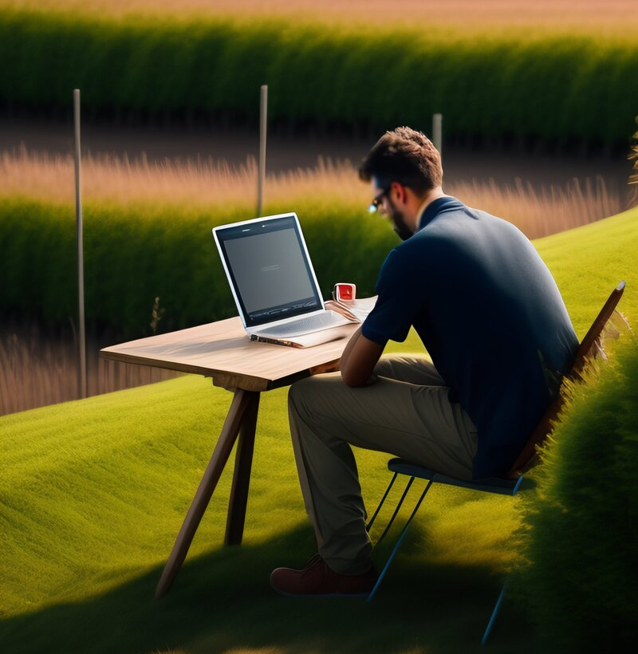
Table of contents
Our team
Plan for the website
Used softwares

Slide 3




Our Team
Nicolay zheliazkov
Egor grebennikov
STEFAN RADEV
Daniela stoilova
DESIGNER
SCRUM TRAINER
DEVELOPER
DEVELOPER

Slide 4
PLAN FOR THE WEBSITE
HOME
ABOUT US
CONTACTS
PROJECTS

Slide 5





USED SOFTWARES

Slide 6
Let’s jump into the website!

