Slide 1
CalCalc
Calorie Calculator
NG Courses project

Slide 2

CalCalc is a simple website for people who want to keep healthy!
Calorie Calculator allows you:
Tracking your Calories and Goals
Getting info of your eaten dish (Calories, Proteins, Fats and Carbohydrates)

Slide 3
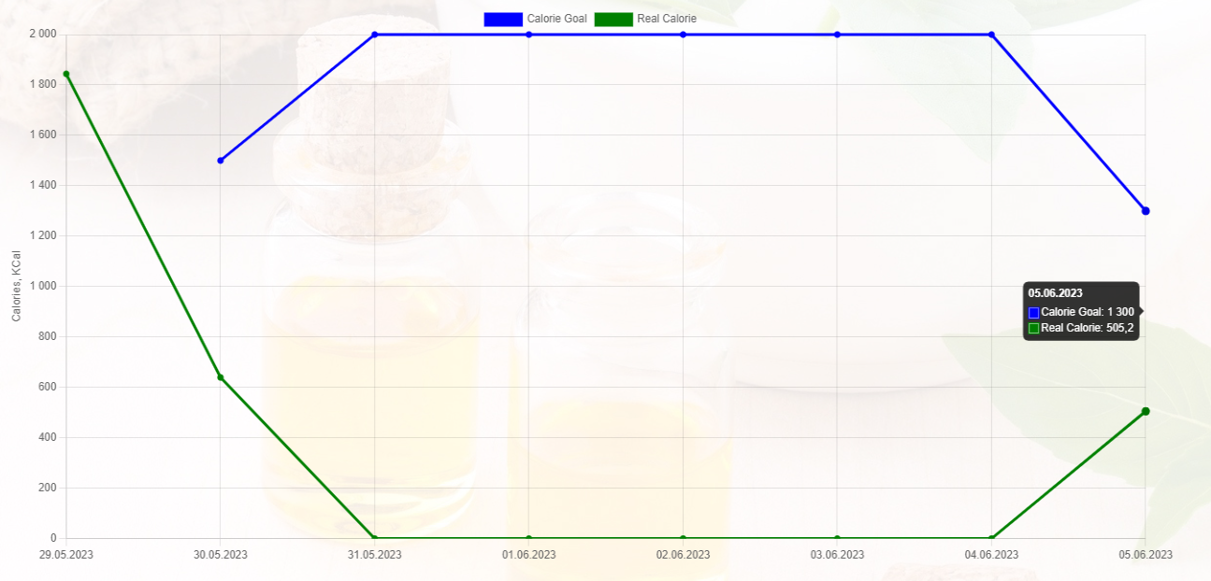
Tracking
Simple, Informative and Clear Chart for tracking your Calories and Goals

Slide 4
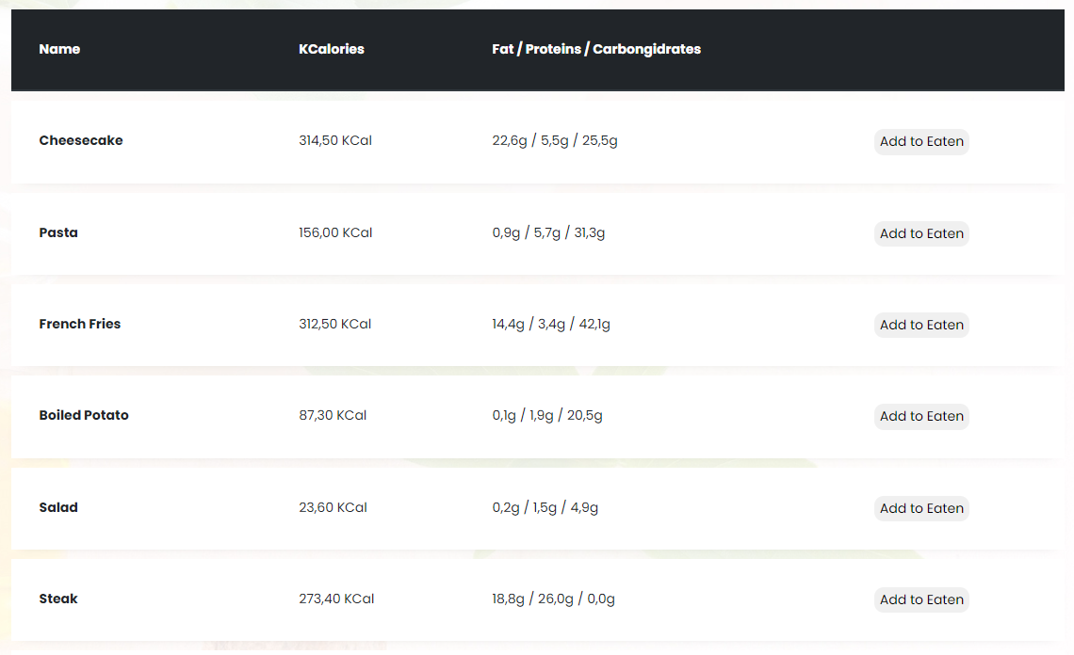
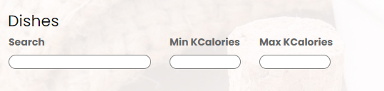
Getting Information
Displaying Information in nice Table with a large number of different dishes and with simple-intuitive real-time search
Pic. 1 Table
Pic. 2 Search

Slide 5
Demand
This program can be so useful for people that want to keep healthy but can`t know how many calories are in each eaten dish and can`t remember their results.
Nowadays, there is a significant number of such people, so there should be high demand for the program.

Slide 6
Author: Egor Podvalkov
Mentor: Danyil Mykytenko
Courses: NewGeneration

