Slide 1


MIT
Massachusetts Institute of Technology

Slide 2
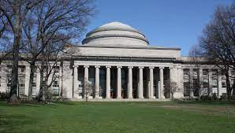
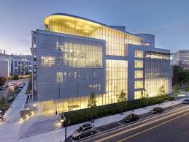
LOCATION
Massachusetts Institute of Technology is a university and research center located in Cambridge, Massachusetts, USA.

Slide 3
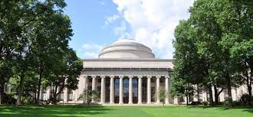
Famous people
Among the well-known graduates of this university are both politicians and scientists. Here is some list:
Virgillio Barco - President of Colombia
Ben Bernanke - Chairman of the United States Federal Reserve
David Miliband - British Foreign Secretary
George Schultz - U.S. Secretary of State
Jose Figueres Ferrer - President of Costa Rica

Slide 4
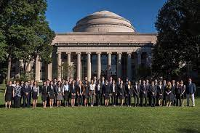
The educational process at
The Bachelor's degree at MIT is characterized by a fairly large set of specializations:
54 main and 58 additional.
All programs are implemented in full-time format (4 years) and lead to an SB - Bachelor of Science degree.
To successfully complete the training, the student, first of all, must master the basic program - General Institute Requirements (GIRs). This includes the following elements: Requirement (6 subjects in the field of exact and natural sciences - chemistry, physics, mathematics, biology);
HASS Requirement (8 subjects in the field of social sciences and humanities and arts); REST Requirement (2 subjects from the Restricted Electives in Science and Technology list); Laboratory Requirement (laboratory sessions with a volume of 12 credits);

Slide 5
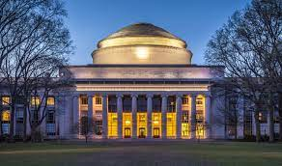
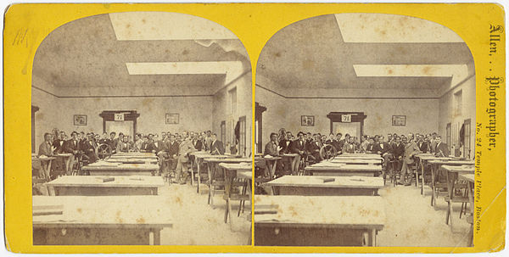
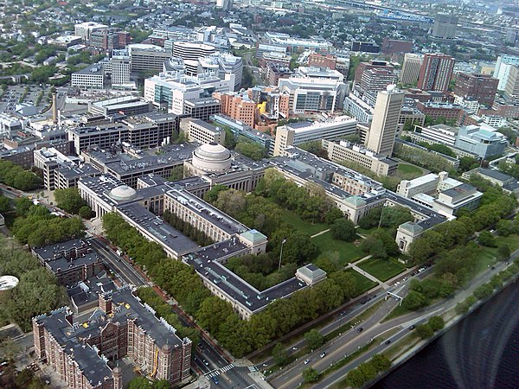
history
In 1861, the Commonwealth of Massachusetts approved the charter of William Burton Rogers to establish the "Massachusetts Institute of Technology and the Boston Natural Science Society.”
Construction of the first MIT building in the Back Bay area was completed in 1866 and was known as "Boston Techno" until the campus sprouted across the Charles River to Cambridge in 1916.
By 1916, MIT finally moved to new stately buildings, made in the neoclassical style, and remains there to this day. The new campus implied some changes in the stagnant curriculum

Slide 6
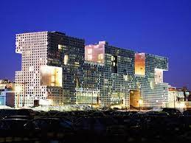
Accommodation for students
MIT guarantees a four-year dormitory for all students. The assigned team leader and superintendent play a dual role in helping and screening students for medical or psychological problems. Students are allowed to select a dorm and floor prior to arriving on campus; as a result, various communities emerge among the living.
While the large number of hostels provides a variety of housing options, the hostels on and east of Massachusetts Avenue are stereotypically more countercultural. Older dorms, such as Bexley Hall and the East Campus, have limited design flexibility.

Slide 7
Positions and reputation
MIT is ranked number 2 among the top 200 universities in the world according to The Times (2004-2005): number 1 in technology and engineering and number 2 in science.
The National Research Council ranked the institute number 1 for reputation and number 4 for citations and awards in a 1995 study of US universities. The Lombardi University Performance Measurement Program has consistently ranked MIT among the top 5 national universities since 2000 - since the beginning of the program.

