Slide 1
Connecting Human-Robot Interaction and Data Visualization:
Szafir and Szafir
CS 279r with Elena Glassman and Priyan Vaithilingam

Slide 2
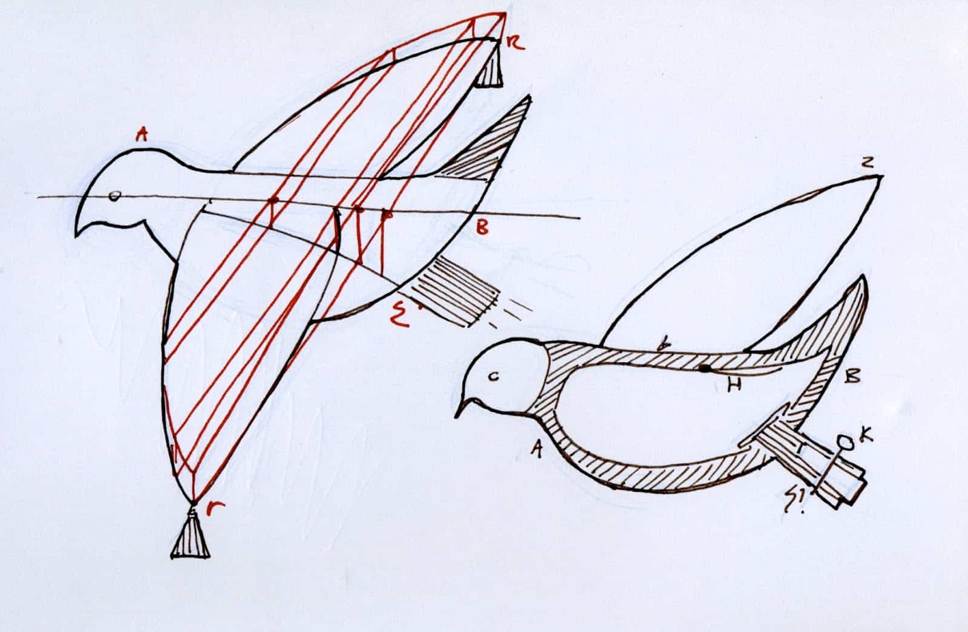
A History of Robots
Archytas of Tarentum’s mechanical wooden dove (350 BC)

Slide 3
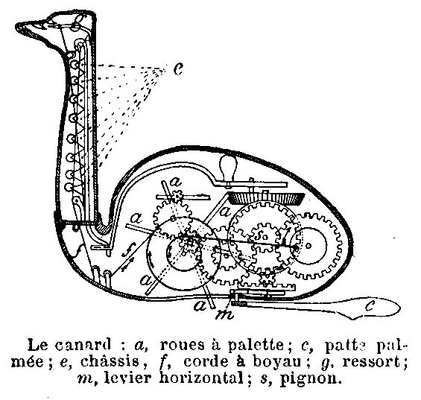
A History of Robots
Archytas of Tarentum’s mechanical wooden dove (350 BC)
Jacques de Vaucanson’s automata (1738)

Slide 4
A History of Robots
Archytas of Tarentum’s mechanical wooden dove (350 BC)
Jacques de Vaucanson’s automata (1738)
Historically, robot deployments have required significant human oversight and direct intervention
  Human-Robot interfaces focused on supporting human supervision and teleoperation.

Slide 5
Why is HRI important?
Robot capabilities are advancing.
  Robots are getting better at domain-specific tasks
    mapping archaeological sites
    inspecting building integrity
  Humans can focus less on directing low-level aspects of robot operation.
Visualization lets humans develop insights from data. It is fluid and should let humans make quick and natural decisions.

Slide 6
Need Thesis
Who?
  Robot Interface Designers
Goal?
  Create systems that let humans who work with robots focus on higher-level considerations like overall mission objectives instead of on low-level direct supervision through visualization
Obstacles?
  HCI principles alone are insufficient for robotics
  Almost no overlap between Human-robot interaction research and visualization research

Slide 7
Approach Thesis
Who?
  Robot Interface Designers
Goal?
  Create systems that let humans who work with robots focus on higher-level considerations like overall mission objectives instead of on low-level direct supervision through visualization
Approaches?
  Consider VIS and HRI principles
  Call for collaboration between VIS and HRI experts
  Use Szafir and Szafir’s new framework

Slide 8
Research – no overlap between HRI and VIS?
IEEE VIS conferences from 1990 to 2019 using term “robot”
  One paper by one of the co-authors.
IEEE Transactions on Visualization and Computer Graphics
  Three papers
“Robot data has not been actively investigated in VIS research.”
“Little work has considered principled methods for how these interfaces may visualize data to specifically help user analysis and decision making”.

Slide 9
HRI and VIS
“There is a considerable potential for natural synergies between HRI, which develops interfaces that enable humans to effectively direct and/or supervise robots while also making use of the data such robots collect, and information visualization, which focuses on designing interfaces that allow people to build targeted knowledge through data”.

Slide 10
VIS Definitions
Data analysis:
  process of exploring and making sense of measurable artifacts
Insights:
  Specific, meaningful conclusions drawn from data
Tasks:
  The specific information people look to draw from data
Field robotics:
  Robotics in an unstructured, dynamic environment

Slide 11
Discussion Question
The authors wrote that their objective was “to explore how research in visualization interface design for robotics, recognizing that one of the fundamental activities for human-robot teams is to collect and analyze data”.
Did they succeed?

Slide 12
Existing HRI frameworks
Coactive design
GEDIS framework
  for evaluating robot interfaces
Video game-based frameworks
  for characterizing interaction design

Slide 13
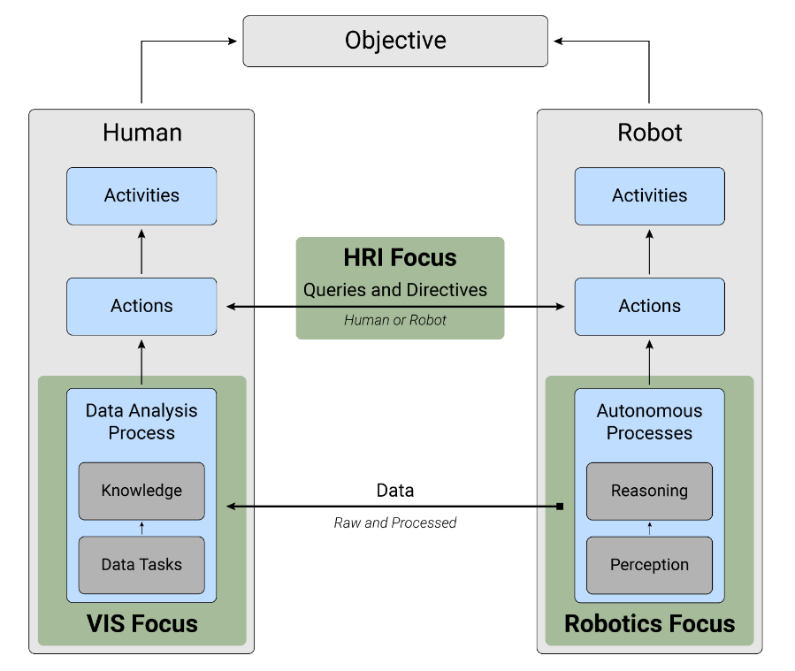
Szafir and Szafir’s Framework

Slide 14
Szafir and Szafir’s Framework
Data flow between humans and robots at the Action level:
(1) a human might query for data
(2) a human might direct the robot to act in some way
(3) a robot might query a human to take advantage of human perception
(4) a robot might take advantage of human decision-making processes

Slide 15
Szafir and Szafir’s Framework
Data flow between humans and robots from the robot Autonomous Processes to the Robot interface for the human Data Analysis Process to use.
The human can then generate new knowledge and insights, leading to more effective Human Actions towards the team Objective.

Slide 16
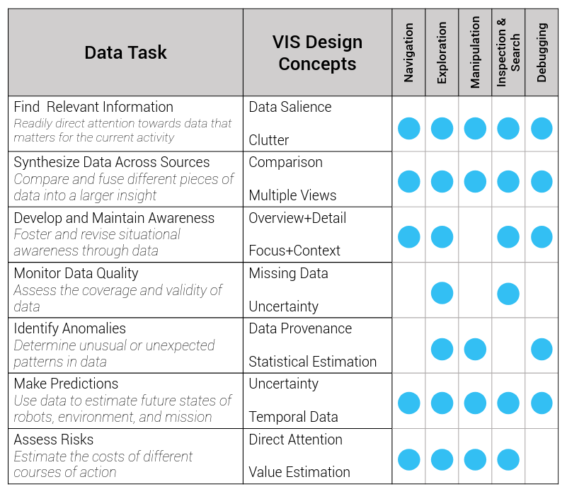
Human-robot interaction data tasks
What are data tasks?
  Szafir and Szafir surveyed 38 papers across HRI and field robotics

Slide 17
Human-robot interaction data tasks
What are HRI activities?
  Environment Navigation and exploration
  Manipulation
  Inspection and Search
  Debugging and Recovering from Error

Slide 18
Human-robot interaction data tasks
Why visualization?
  Visualization offers quantified design insight into how to best encode data for tasks such as …
    Estimating individual values
    Assessing trends
    Inferring correlation

Slide 19
Discussion question
What if the authors considered purely social human-robot interactions, that lack any overarching team objectives or where there is no mediating technology that could support visual data communication?

Slide 20
Thanks!
This slide design is licensed under a Creative Commons Attribution-ShareAlike 3.0 Unported License.
It makes use of the works of Mateus Machado Luna.

