Slide 1
firemisc
Cloud Contact Center Platform
Mobility Information Social Cloud

Slide 2
Vision
Digital telecommunication company availing the following services
IP-PBX ( Digital Phone) for corporate and mass.
Contact center / help desk .

Slide 3
Mission
Migrate Contact Center technology to Middle East region by rolling out the first contact center software made in Egypt.
Enable Small / Medium communications through cloud contact center and cloud PBX based solution ( VOIP Calls)
Introduce the first digital telecommunication company with cloud based PBX hosted in ME ( VOIP Phone) for corporate and retail

Slide 4
Problem definition
Lake of communication in Small / Medium markets
Cost of PBX and Contact Center technologies for SM Business
Agents / Resources Availability
Cost
Resources
Communication

Slide 5
Communications
Company
Agent
Customer
firemisc is connecting 3 parties
Companies ( Through PBX and Contact Center)
Customers ( Through Click to call)
Agent

Slide 6
Product Map
Contact Center functions
IP PBX
Social Channels
WhatsApp Business
Voice Recorder
WFM

Slide 7
Design
firemisc architecture

Slide 8












Specifications
Functional
Design
Multi tenancy platform
Cloud based app
1
1
Cross agents platform
Web Interface
2
2
Voice / Video Channels
Mobile Interface
3
3
Social / Digital Channels
3rd Party Integration
4
4
IVR / Bots
Role based app
5
5

Slide 9
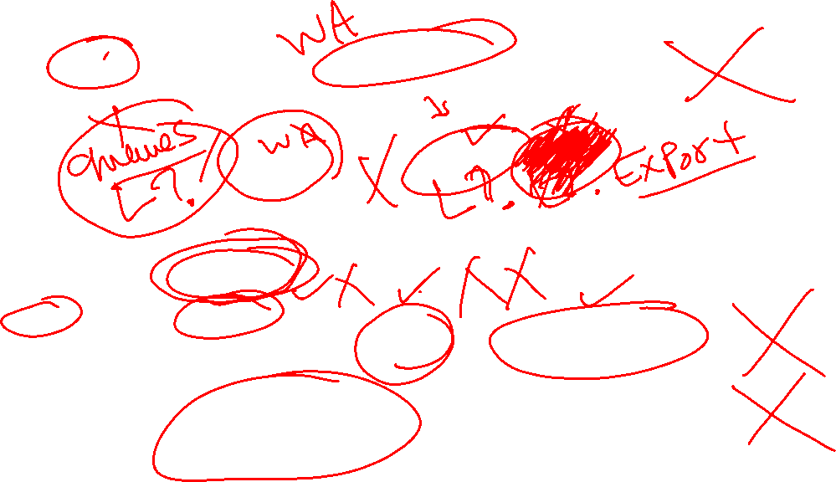
High Level Components
Frontend
ODI
Operator Digital Interface
Administrator
Users / Skills / Types / Workflows
Phone
Operator Phone
User
Interactions / To-do / Dashboard / Reports
Backend
User APIs Profile / Todo / Interactions / Queue / Reports / Dashboard
ODI
ODI Manager
Router
Interaction Router
Logger
Data Logger
Tenant Admin APIs
Users / skills / types/ workflows
PI
PBX Interface
Big Data
Mongo DB - Casandra
PBX
Asterisk

Slide 10

Realtime communication
Frontend
ODI
Operator Digital Interface
Administrator
Users / Skills / Types / Workflows
Phone
Operator Phone
User
Interactions / To-do / Dashboard / Reports
Operator Connects to ODI for Status tracking and interactions routing
Phone is registering on SIP Server Direct
Backend
User APIs Profile / Todo / Interactions / Queue / Reports / Dashboard
ODI
ODI Manager
Router
Interaction Router
Logger
Data Logger
Tenant Admin APIs
Users / skills / types/ workflows
PI
PBX Interface
Big Data
Mongo DB - Casandra
PBX
Asterisk

Slide 11

Workflow - Login
Start
Login Email or New
New Account
Is Verified
Verify Account
Fill Account Form
Is Suspend
Contact us
Fill Account Form
Send Email
Is Not Archived
Verification Email
Restore Account
Check Email
Dashboard
Is Type?
Welcome
Verify Account

Slide 12
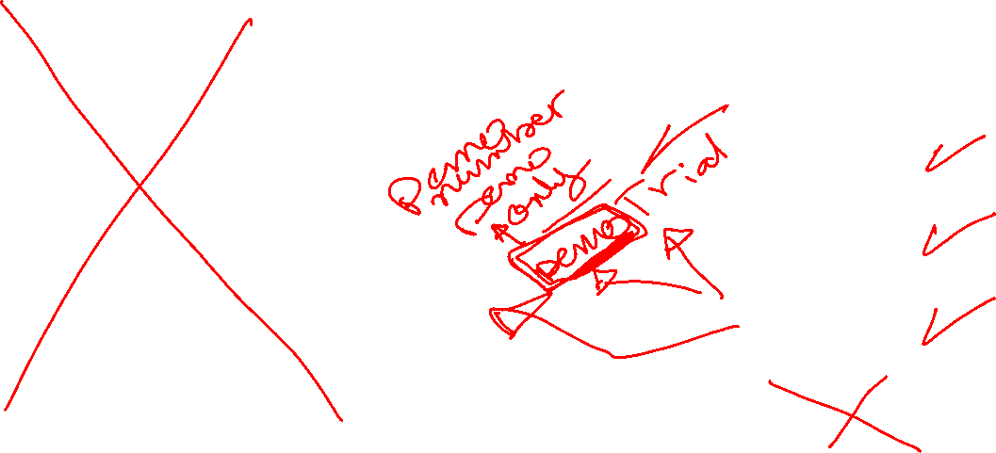
Welcome Workflow
Welcome
User or Company
User Wizard
Yes
User Chosen?
No
Tenant Wizard
User Info
Tenant Info
Pick Extension
Skill groups Info
Main
Apply Tenant Job
Users Info
Select / Hire User
Post Job

Slide 13
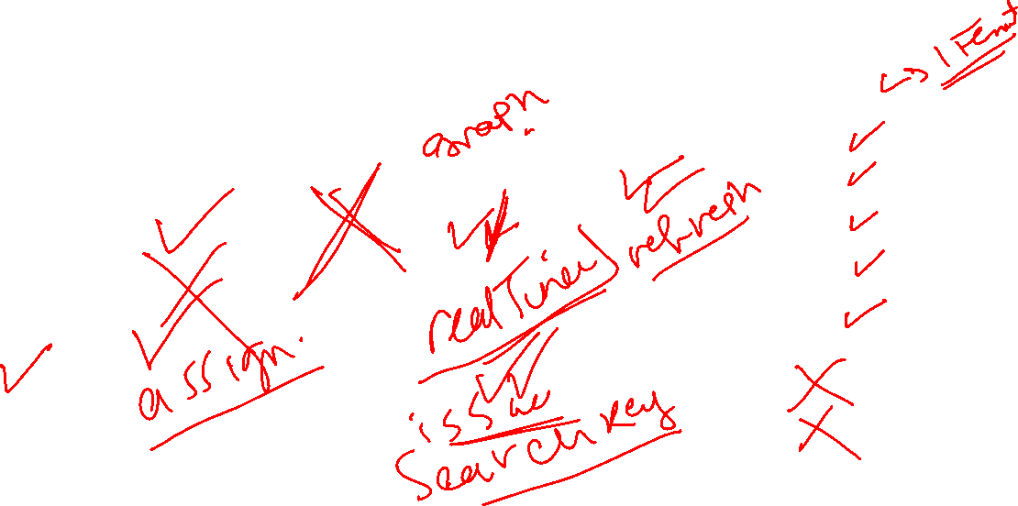
Main workflow
Administrator
Main
Tenants
Queues
Types
History
Skill groups
Reports
Users
To do
Workflows
Dashboard
Tasks
Logs
Setting

Slide 14
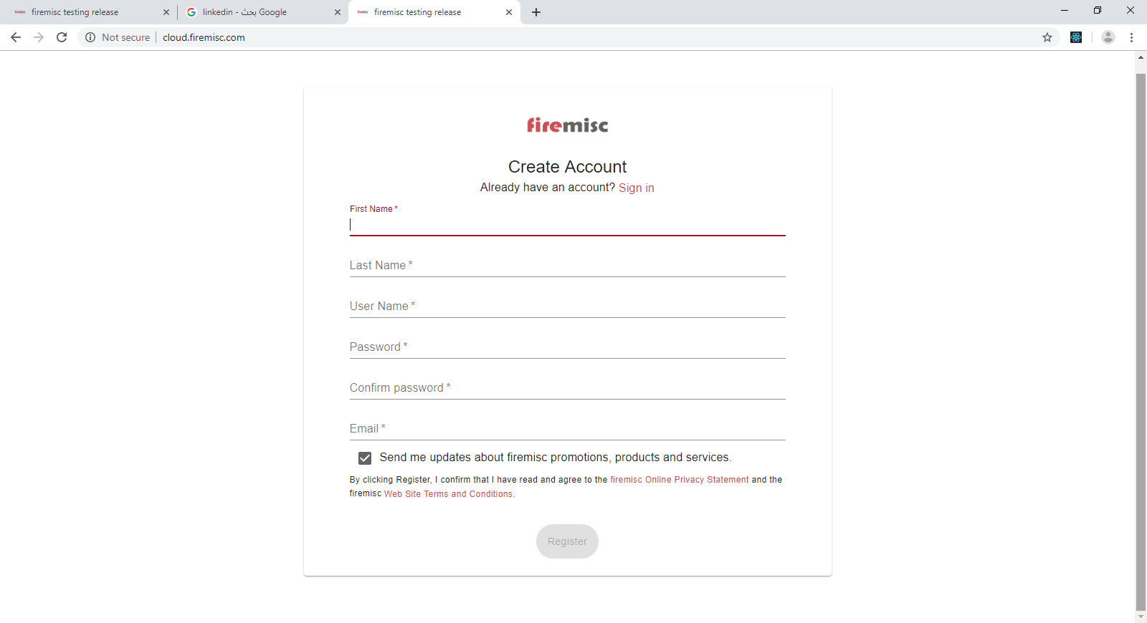
Register

Slide 15
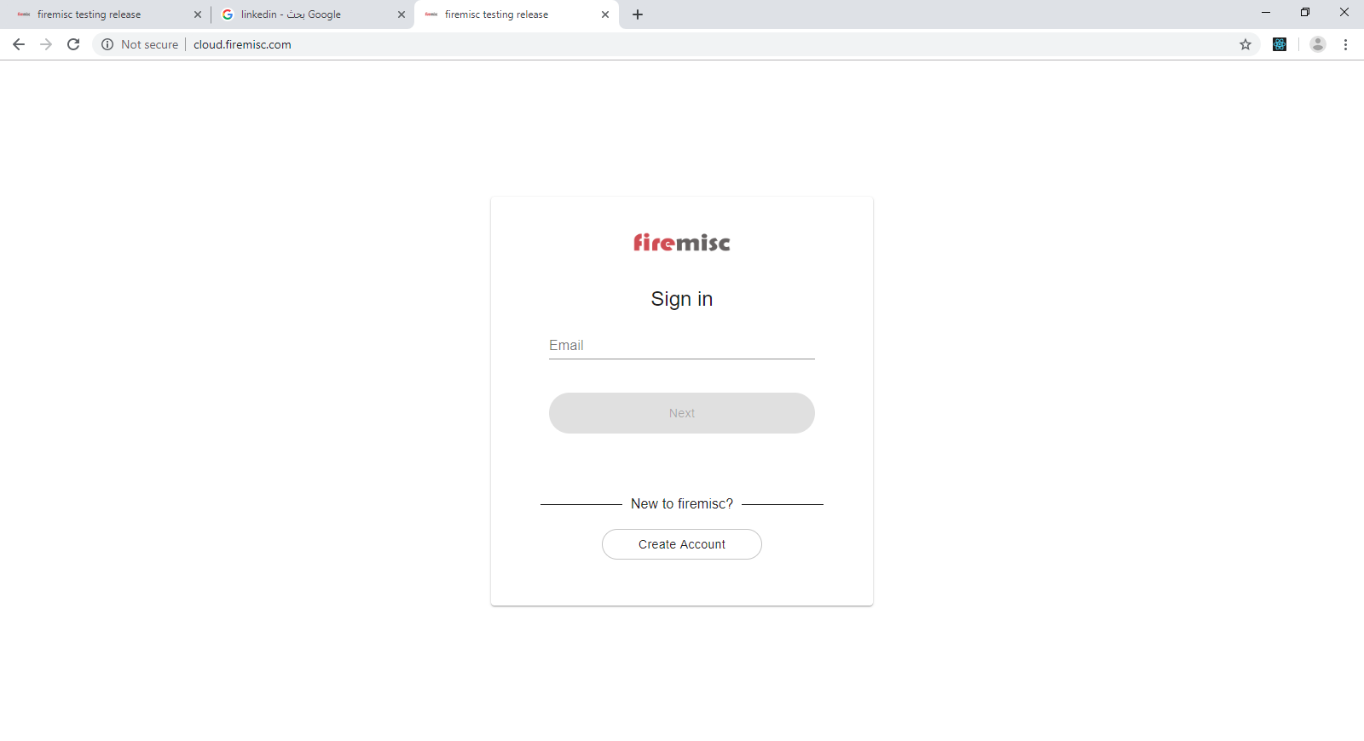
Login

Slide 16
















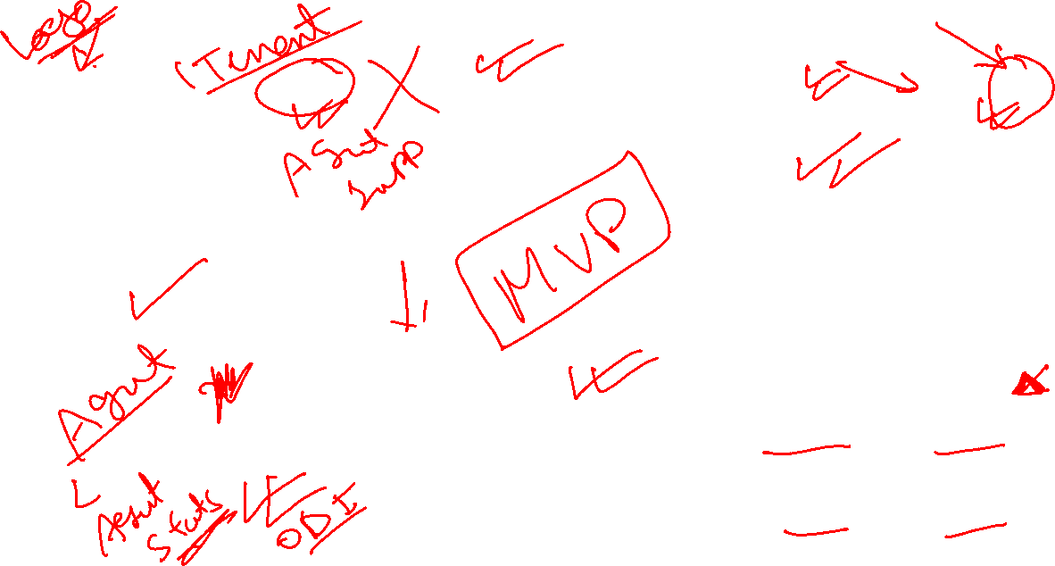
Dashboard
Bank ABC
Dashboard
1000
Ready
User A
!
My work
To do
Customer A
I need to subscribe into banking services
Cheque Request
2019-09-15 New
Check customer X request for cheque book
C
Customer Y (maref@firemisc.com)
Please send me last water bills.
M
Send follow up
2019-09-15 New
Send follow up email to my manager to check about my vacation
Customer B (+201011222666)
Call from +201011222666
C
Send email
2019-09-15 New
Send email to customer x regarding last order
Customer Z (+201002892777)
How to issue a new credit card
Team status
Logged Out
4
10
Ready
Customers
Not Ready
2
42% Calls
65% WB
15
15
Sales
Billing
Queues
34% FB
78% Email

Slide 17







Queue
Bank ABC
Queues
1000
Ready
User A
!
f
Total Queue
Comments
Posts
Direct Msg
24
3
-
Tweets
Mentions
Hashtags
2
7
50
Inbound
Outbound
8
25
Comments
Mentions
Direct Msg
5
20
-
321
Sales
Billing
Complaints
12
6
9
Sales
Billing
Complaints
40
1
18
Sales
Billing
Complaints
18
8
5
Sales
Billing
Complaints
17
5
3
Sales
153
@
B
Billing
28
119
5
45
Comments
Mentions
10
-
Complaints
Sales
Billing
Complaints
11
8
100
Sales
Billing
Complaints
5
-
-
Sales
Billing
Complaints
40
-
5
Sales
Billing
Complaints
10
-
-
140

Slide 18

To do
Bank ABC
To do
1000
Ready
User A
!
To do
C
Cheque Request
2019-09-15 New
Check customer X request for cheque book
M
Send follow up
2019-09-15 New
Send follow up email to my manager to check about my vacation
C
Send email
2019-09-15 New
Send email to customer x regarding last order

Slide 19


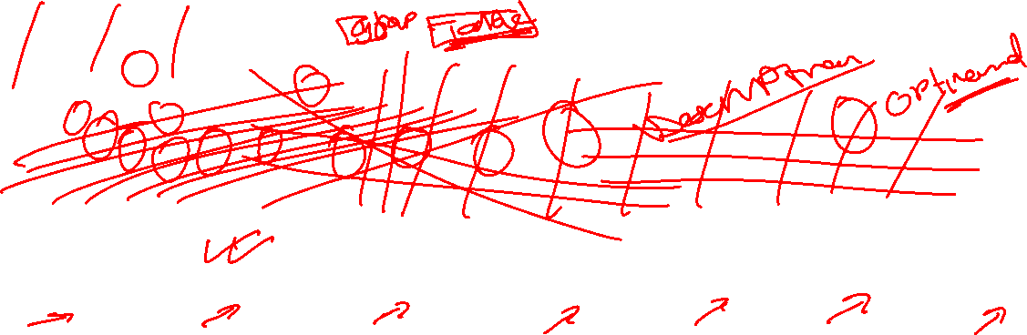
History
Bank ABC
History
1000
Ready
User A
!
5
2
5
3
15 interactions
Today
Week
Month
Year
Handle Time
08:00:00
10:00:00
12:00:00
14:00:00
16:00:00
18:00:00
20:00:00
22:00:00
00:00:00
Time
Completed work
Search
Type | Name | From | To | Handle Time | Skill-group | Time
 | Customer A | Customer A | Bank ABC | 00:02:21 | Sales | 10:05:02
 | Customer Y | maref@firemisc.com | support@bank.com | 00:32:14 | Complaint | 12:07:59
 | Customer B | +201011222666 | 1000 | 00:05:10 | Sales | 16:04:37
 | Customer Z | +201011222666 | +1729443212 | 00:12:25 | Sales | 22:46:42

Slide 20






Reports
Bank ABC
Reports
1000
Ready
User A
!
Overall Sentiment
Type | Count | SLA
 | 5 | 98%
 | 2 | 60%
 | 5 | 90%
 | 3 | 95%
 | 15 | 85%
Type | Count | SLA
 | 27 | 95%
 | 12 | 58%
 | 21 | 89%
 | 27 | 93%
 | 87 | 83%
Type | Count | SLA
 | 52 | 90%
 | 18 | 70%
 | 96 | 87%
 | 60 | 91%
 | 226 | 84%
Today Sentiment
Login time | 07:58:21
Ready time | 07:01:08
Not Ready time | 00:57:03
Handling time | 04:20:11
NPS | 9
CSAT
Avg Login time | 08:10:00
Avg Ready time | 06:42:15
Avg Not Ready time | 00:50:10
Avg Handling time | 05:30:08
NPS | 7.6
CSAT
Avg Login time | 08:02:03
Avg Ready time | 06:35:24
Avg Not Ready time | 00:55:43
Avg Handling time | 05:12:07
NPS | 8.1
CSAT
NPS
8.2
NPS

Slide 21
Functional Design
Firemisc contact center functional specifications

Slide 22










Components Diagram
Channels
Adaptors
WhatsApp
Facebook
Youtube
Instagram
LinkedIn
WebRTC
Voice
Email
Chat
SMS
firemisc APIs
Interaction API (HOST/tenants/:tenantId/interactions)
Router
Logger
Backend
Workflow Engine
ODI (IO)
Logger functions
Mongo DB
My Interactions
My Team
My Skillgroups
My Queues
Me
My work (My Interactions)
firemisc website
WhatsApp
Facebook
Youtube
Instagram
LinkedIn
WebRTC
Voice
Email
Chat
SMS
Frontend
Dashboard
Todo
Queue
History
Reports

Slide 23
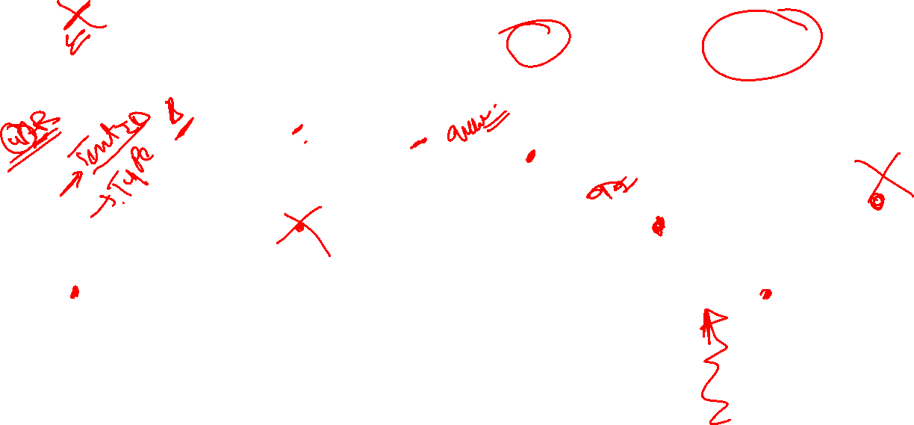
Sequence of social post engagement
Adaptor
APIs
Workflow
3rd Party
LAA
APIs
My Work
User
0
1
2
3
4
5
6
8
7
7
9
Backend APIs & Engine
Frontend

Slide 24

Sequence of social post engagement
Adaptor receive Facebook post via webhook
Engine will offer interaction to user through ODI
0
5
Adaptor submit interaction with type id to APIs
Agent accept interaction and details rendered then reply
1
6
API will invoke workflow associated
Frontend will save interaction through APIs
Frontend will send response to mediator APIs.
2
7
Workflow will execute till Queue
APIs will trigger workflow to continue
3
8
Engine will find LAA in the target skillgroup
Mediator send response via facebook graph APIs
4
9

Slide 25
Deployment
Cloud deployment
Hybrid deployment

Slide 26
Cloud based model
firemisc Nodes
Docker Manager
WebApp Node A
WebApp Node B
WebApp Node C
WebApp Node D
WebApp Node E
WebApp Node F
APIs Node A
APIs Node B
APIs Node C
APIs Node D
APIs Node E
APIs Node F
FB Node A
FB Node B
WA Node A
WA Node B
PBX Node A
PBX Node B
Database Nodes
Docker Manager
Node A
Node B
Node C
Node D
Node E
Node F
Storage Manager

Slide 27

Facebook
Twitter
WhatsApp
STC
Hook
API
Hook
API
Hook
API
Router
Adaptors Docker Manager
IP-PBX Nodes
FB Adaptors
TW Adaptors
WA Adaptors
PBX A
PBX B
PBX C
Node A
Node B
Node A
Node B
Node A
Node B
Public
Local
APIs Nodes
DB Nodes
Contact Center Docker Manager
Node A
Node B
Node C
Node D
Node E
Node A
Node B
Node C
Node D
Node E
Website Nodes
Node A
Node B
Node C
Node D
Node E
Node F
Node G
Node H
Node I
Node J

Slide 28
Integration
Channels
firemisc contact center platform
Adaptors Nodes
WhatsApp
Facebook
Youtube
Instagram
LinkedIn
WebRTC
Voice
Email
Chat
SMS
firemisc-backend nodes
firemisc-storage nodes
firemisc-frontend nodes

Slide 29
Node Capacity Planning
Node | Concurrent | Hardware
Voice Adaptor | 100 Users | VM ( 1 Core , 4 GB RAM ) – Linux / Windows
Facebook Adaptor | - | VM ( 1 Core , 4 GB RAM ) – Linux / Windows
Twitter Adaptor | - | VM ( 1 Core , 4 GB RAM ) – Linux / Windows
WhatsApp Adaptor | - | VM ( 1 Core , 4 GB RAM ) – Linux / Windows
General Social Adaptor | - | VM ( 1 Core , 4 GB RAM ) – Linux / Windows
Firemisc APIs (backend) | 500 Users | VM ( 2 Core , 8 GB RAM ) – Linux
Firemisc Website (frontend) | 500 Users | VM ( 1 Core , 4 GB RAM ) – Linux
Firemisc Storage (Database Hot) | - | VM ( 2 Core , 4 GB RAM ) – Linux
Firemisc Storage (Database Cold) | 100 Users | VM ( 2 Core , 8 GB RAM ) – Linux

Slide 30
Hardware Requirements
Docker Manager
VM (1 Core , 4 GB)
Social Adaptors
VM (1 Core , 4 GB)
APIs
VM (2 Core , 8 GB)
Website
VM (1 Core , 4 GB)
Storage
VM (2 Core , 8 GB)
Voice PBX
VM (1 Core , 4 GB)
All in one
VM (4 Core , 16 GB) / VM (2 Core , 8 GB)

Slide 31


Deployment Options
Option A (Hybrid)
Hybrid model is based on using one of the major cloud provider to host the service
All Components will be deployed on cloud except Voice PBX will be hosted locally
Option B (Private Cloud)
On premises model based on private cloud hosted locally.
All Components will be deployed on private cloud.

Slide 32
Time line
Implementation time line

Slide 33
Cost
Project cost

Slide 34
Cost
Project cost

