Slide 1
…and now for something completely different...
- Capture the flag

Slide 2

There’s a pool up on the roof…

Slide 3
Motivation
Learning how things are broken is a good way to … not break them
Fun and challenging
Often have to write code, with no examples and on the fly to solve problems
No help from Google or StackOverflow
Areas you might not have been exposed to
Topics: binary analysis, protocol analysis, reverse engineering, cryptography. One CTF challenge: recover root password of hacked mySQL server

Slide 4
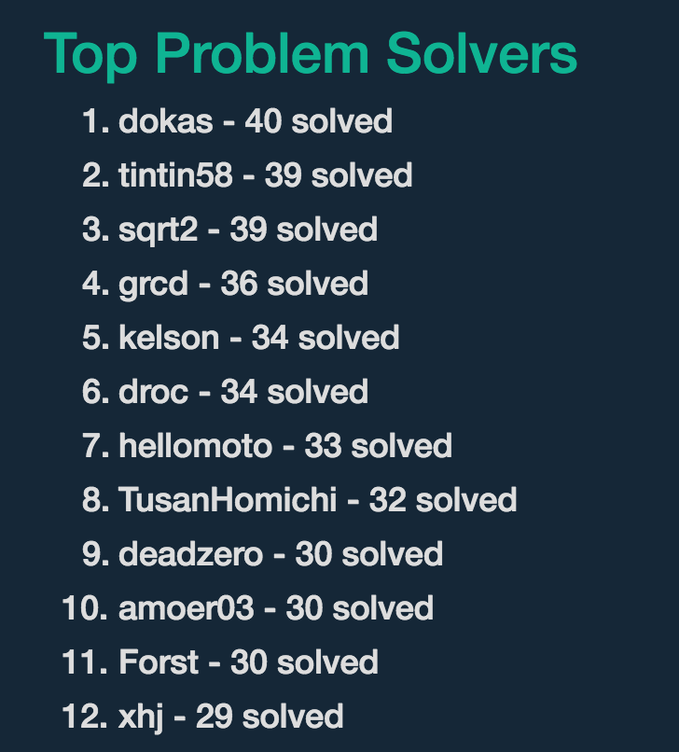
Jeopardy
The game is simple: find a flag (okay it’s really a string) that you input. If its correct, you win a flag.
It’s a lot like a debug log ☺

Slide 5
Example / Lesson
Micah Lee’s GPG challenge: https://usable-crypto.ctf.micahflee.com/
HOPE CTF
Fire up your terminal: gpg --gen-key
Test
Repeat
https://twitter.com/bcrypt/status/765621538863271936

Slide 6
Lesson
Always verify full fingerprints. Don’t roll your own crypto schemes

Slide 7
Password Cracking
https://id0-rsa.pub/problem/38/
Put these in a file hashes.out
John the ripper is good but can we … make go fast?

Slide 8
Password Cracking
https://id0-rsa.pub/problem/38/
Put these in a file hashes.out
John the ripper is good but can we … make go fast?
/usr/bin/john hashes.out –wordlist=/usr/share/dict/american-english
watch –n 60 ‘cat ~/.john/john.pot’

Slide 9
Lesson
Use complex passwords
Use a password manager
Salt your hashes!

Slide 10
Crypto challenge
Can SOC solve a crypto challenge with unknown inputs.
AES
No IV
(straight ECB, no chaser)
https://id0-rsa.pub/problem/30/
What do we know about unixtime? date +%s

Slide 11
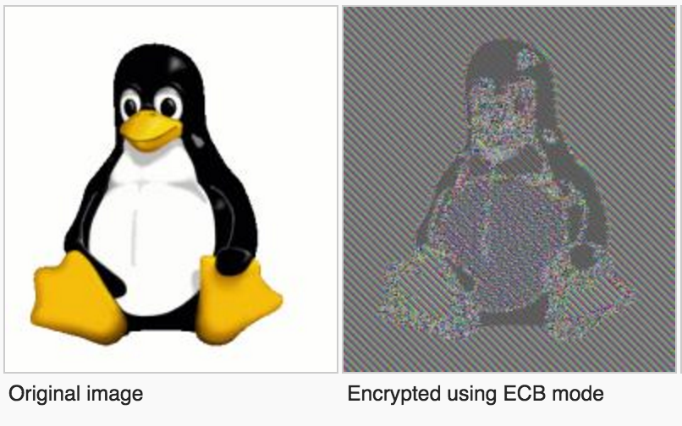
A reminder about AES
Electronic Code Book encodes the same input with the same output

Slide 12
Python Solution
pdb is your friend!
import binascii
from hashlib import md5
from Crypto.Cipher import AES
ciphertext = binascii.unhexlify('a99210d796a1e37503febf65c329c1b2')
def genkey():
for i in range(1453603087,1454603087):
keyfile= md5(str(i)).digest()
decrypt(keyfile)

Slide 13
Python Solution
def decrypt(i):
decobj = AES.new(i, AES.MODE_ECB)
plaintext = decobj.decrypt(ciphertext)
What do we know about ciphertext ?
Decoding them with wrong key gives us gibberish.

Slide 14
Python Solution
def decrypt(i):
decobj = AES.new(i, AES.MODE_ECB)
plaintext = decobj.decrypt(ciphertext)
plaintext=plaintext.decode('ascii')
print plaintext

Slide 15
Python Solution
def decrypt(i):
decobj = AES.new(i, AES.MODE_ECB)
plaintext = decobj.decrypt(ciphertext)
try:
plaintext=plaintext.decode('ascii')
print plaintext
except ValueError:
pass

Slide 16
Lesson
Initialize your inputs (strong IV)
Use CBC mode!

Slide 17
Something different?
https://id0-rsa.pub/problem/16/
Rainbow tables, write some code. Not too dissimilar to previous example
Elliptic Curve Key Recovery
A two minute overview on Keys
K <- k
H <- h
Small primes to large output
X^2=Y^2+3x+41058363725152142129326129780047268409114441015993725554835256314039467401291

Slide 18
Pick safe p, q, d, or….
https://id0-rsa.pub/problem/10/
MOV attack
DJB + Tanja Lange 31C3 https://www.youtube.com/watch?v=l6jTFxQaUJA
Okay enough of that…

Slide 19

Breaking crypto for lulz and profit
ECDSA and nonce-reuse. In cryptography, a nonce is a “number used once”
Who uses ECDSA
Who reuses nonce?
Sony
AES-GCM - Major financial institutions, credit card processors, Fortune 500 companies…

Slide 20
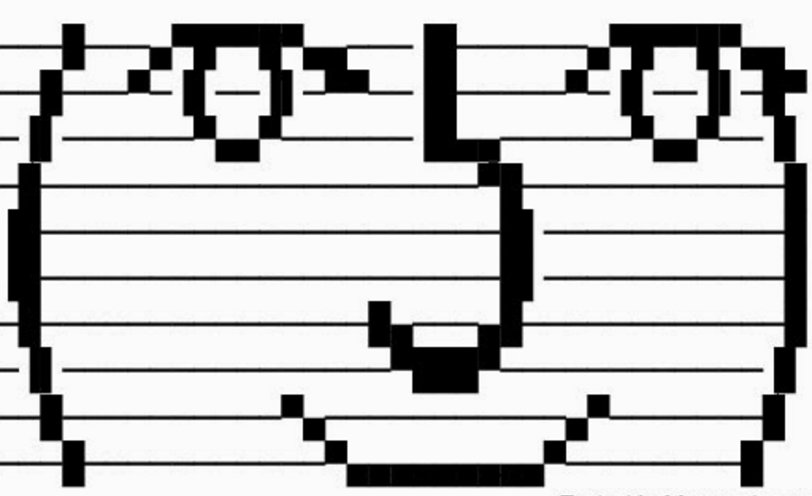
Other tools
IDA pro for Joe Burnitz
xxd for n00bs like me
Wireshark
Kali Linux FTW
Often times you have to share a server for your opponents.
wall wall walll

Slide 21
That’s it

