Slide 1

Arabic Word-Level Autocomplete System
This project presents an Arabic word-level autocomplete system using deep learning. Built for Dr. Islam Gamal Project, it assists users by predicting the next word accurately. The system leverages LSTM to capture language patterns and enhance typing speed in Arabic.
AA
by Ahmad Ashraf

Slide 2
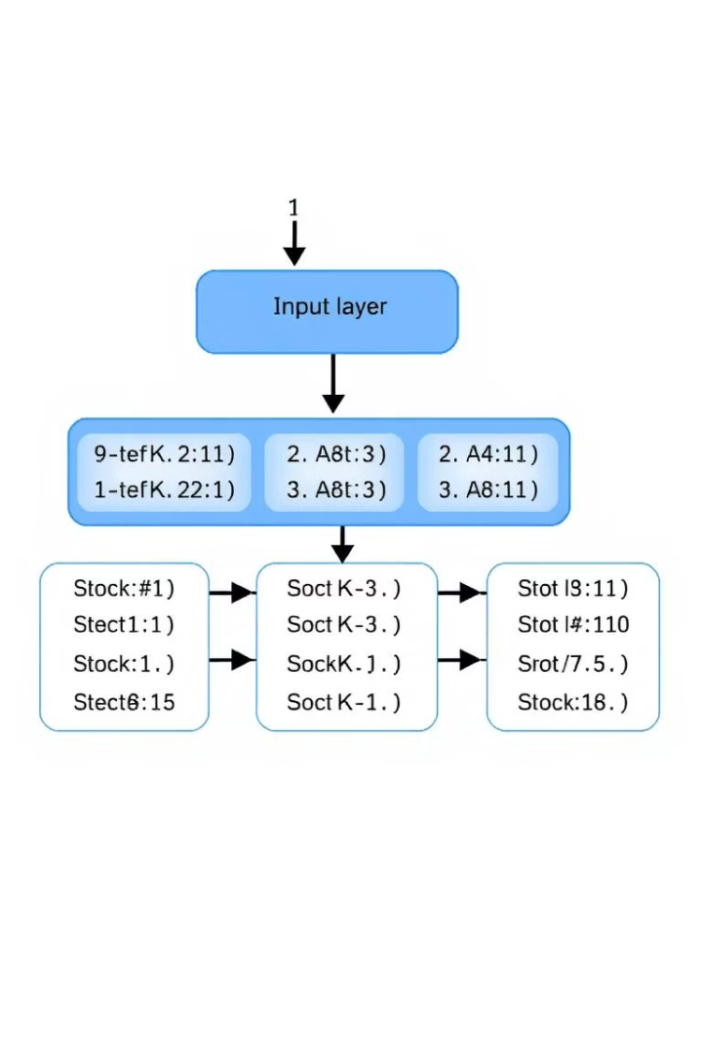
Model Architecture & Parameters
Architecture
LSTM-based model focused on word-level prediction.
Parameters
Embedding dimension: 128
2 LSTM layers with (256,128) units each
Activation function: SoftMax
Optimizer: Adam with default learning rate
Loss: Categorical cross-entropy

Slide 3
Dataset Information
Source & Size
Preprocessing
Arabic OSCAR dataset
Tokenization of text
Padding sequences for consistency
Vocabulary built including word frequency

Slide 4
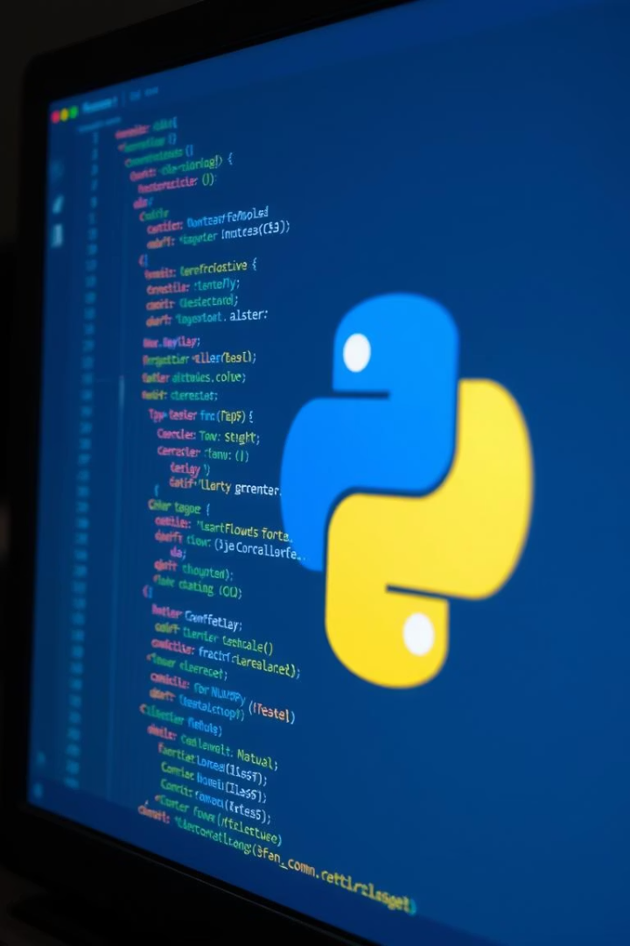
Implementation Details
Tensors & Arrays
Text Processing
TensorFlow for model building, NumPy for data handling
Regular expressions for cleaning, collections.Counter for word counts
Environment
Developed on Kaggle for GPU acceleration

Slide 5
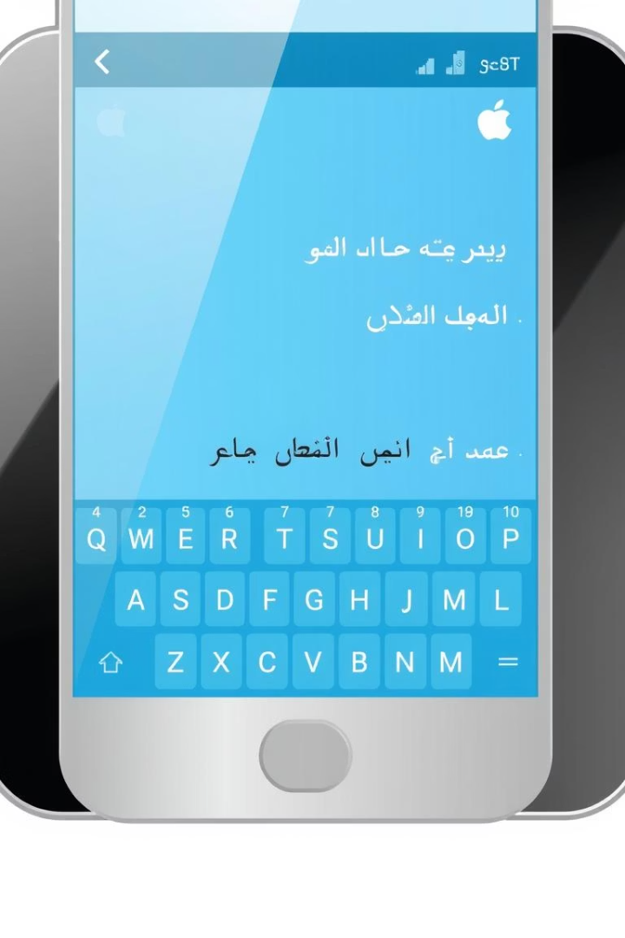




System Workflow
User Input
Enter one Arabic word
Model Prediction
LSTM predicts most probable next words
Output
Display high prob. predicted word
Evaluation
Measured with accuracy and perplexity

Slide 6
Performance Evaluation
Metrics
Sample Prediction
Accuracy: 70%
عليكم
Model predict:
User input: “السلام"
Training Time: 2 hours on Kaggle GPU
عليك

Slide 7
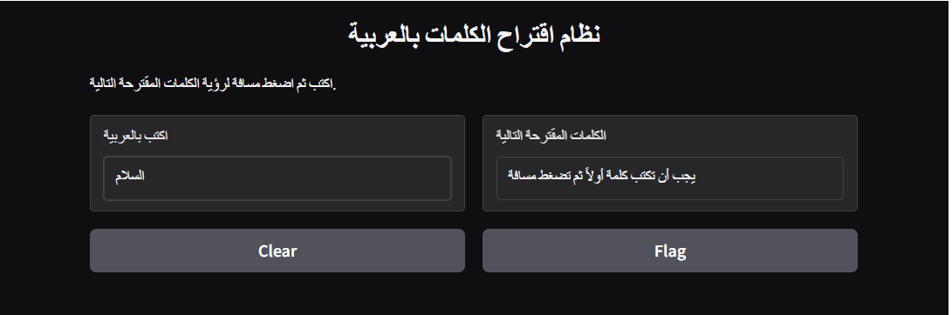
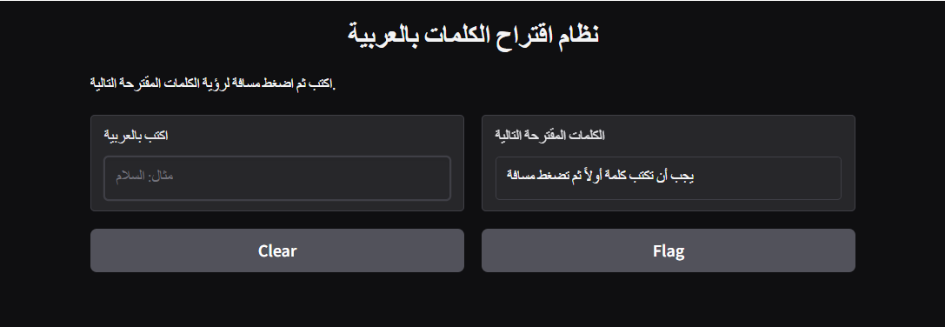
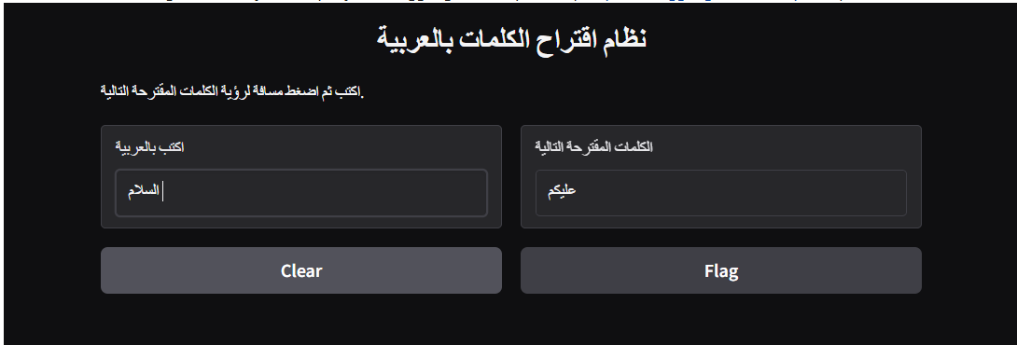
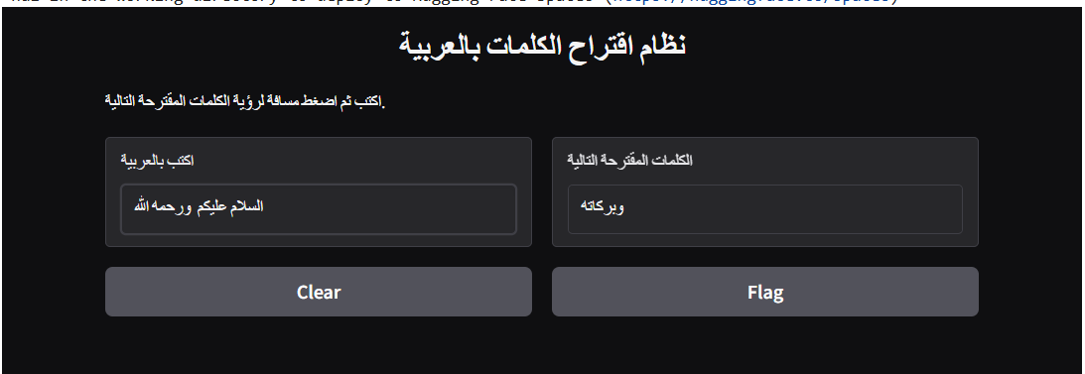
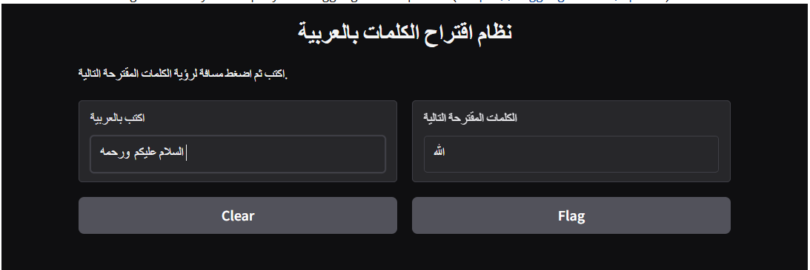
2
1
3
5
4

Slide 8
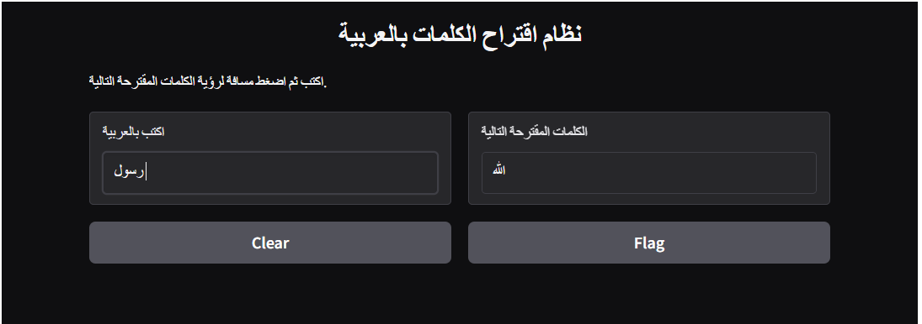
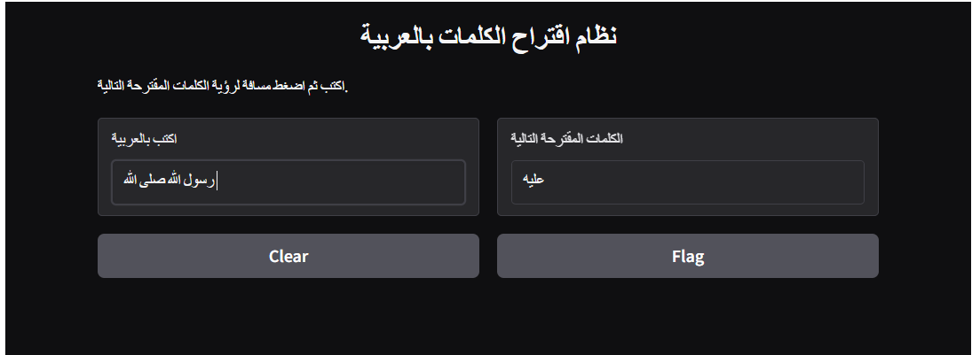

Slide 9

Model Limitations
OOV Words
Model struggles with unseen words, causing prediction gaps.
Context Limitations
The model just predict for last word and ignore the syntax
Data Bias
Quality of training data directly impacts model fairness.
Computational Cost
High resource usage for large vocabulary sizes.

Slide 10
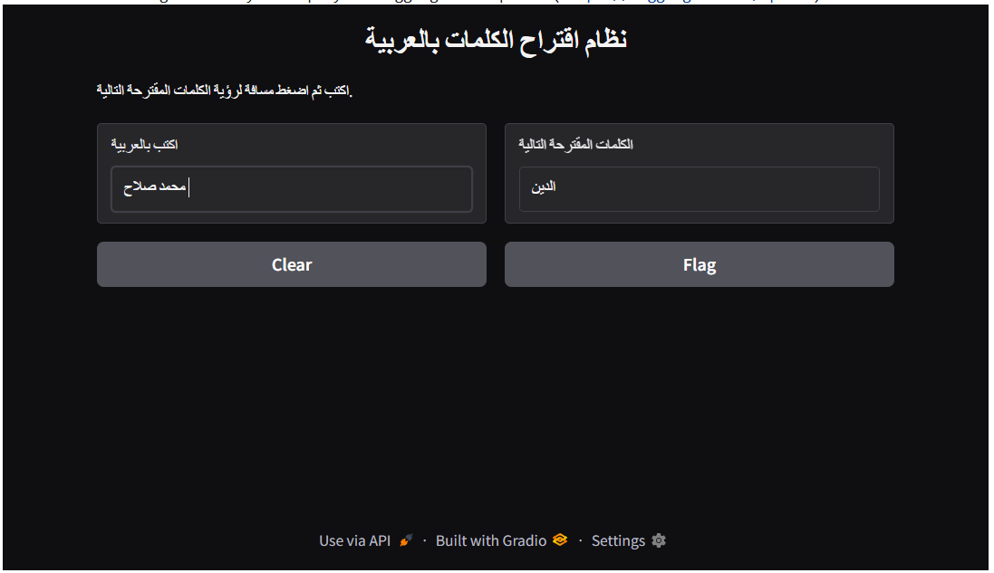

Slide 11
Conclusion and Future Work
Summary
Future Enhancements
Team
LSTM model successfully predicts next words for Arabic text input.
Add attention mechanisms
Ahmed Ashraf: 20220009
Aboubakr Ahmed: 20220003
Ahmed Alaa Elhousseny: 20220026
Ahmed Alaa Fathy: 20220027
Ahmed Qassem: 20220041
Expand dataset diversity
Use character-level embeddings for OOV
Explore transformer-based architectures

