Slide 1
Capstone Project - The Battle of Neighbourhoods
Insert the SubTitle of Your Presentation

Slide 2
Business Problem
Washington D.C is the capital of USA, which means that it is the capital of the World! Many people around the world visits this city yearly. This city contains many cultures around the world, it is known as the city of politics, business and deal making.
It is a strategic place to have a restaurant because they are need to do important businesses, restaurants gets a lot of visitors every two years because of the elections, it is a great opportunity during these elections to gain new customers. In addition, restaurants in D.C have less strict laws compared to other states in the US .
D.C contains a large metro area population, in 2021 there are around 5, 378, 00 people who live there, and it will not stop growing! In fact, every year there is an increase by around 1.1% to the population of D.C.
When someone owns a restaurant in D.C, there are some things to look for to have a better opportunity (Problems to solve):
Which areas are not expensive for a restaurant owner: land area and renting cost for example?
Which areas lack restaurants?
Which area have the largest population?

Slide 3
Data
1) Foursquare API:
Restaurants neighbourhoods in Washington D.C are explored using Foursquare API.
2) Washington D.C :
Location of restaurants (latitude and longitude) are used to explore neighbourhoods of Washington D.C.
Sources:
a)CSV
https://opendata.arcgis.com/datasets/071aa9b40a1a4b38a938f8f5058068a8_18.csv.
B) Webpage to webScrape: https://en.wikipedia.org/wiki/Neighborhoods_in_Washington,_D.C.

Slide 4
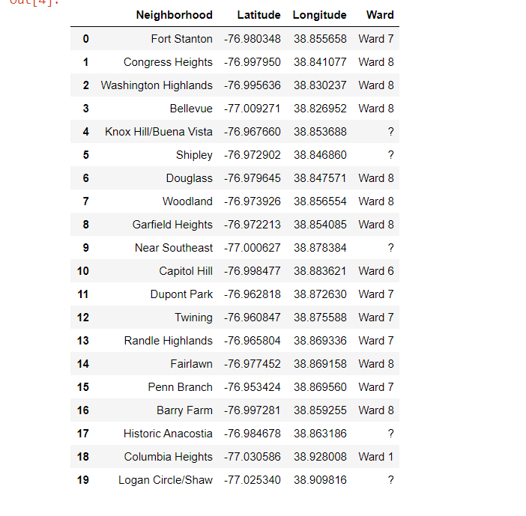
Methodology
Data about Washington D.C is extracted from a csv file that contains the name of the neighbourhoods and their corresponding longitudes and latitudes.
From a Wikipedia webpage, data is extracted using web scraping which contains the list of Wards of different neighbourhoods.
3) Data extracted from the Wikipedia page is merged with the table that contains the data of the csv file

Slide 5
Methodology
5) Many cells do not contain any data, so their rows have been deleted.
6) After the table have been cleaned, number of the total neighbourhoods have been displayed, by finding out the number of rows of the table.

Slide 6
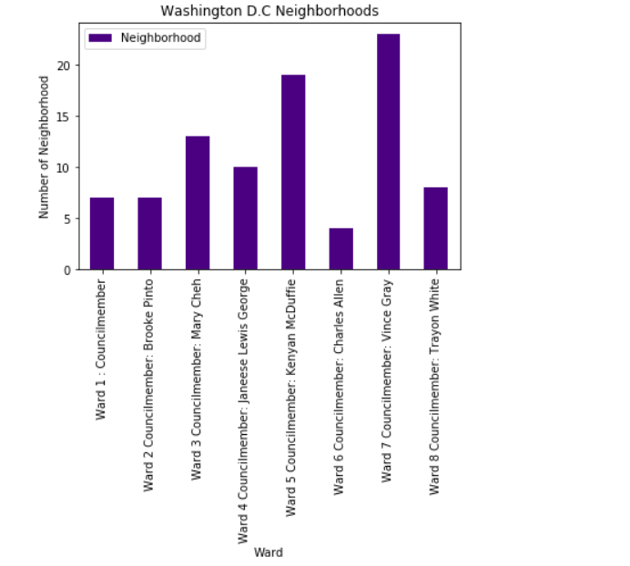
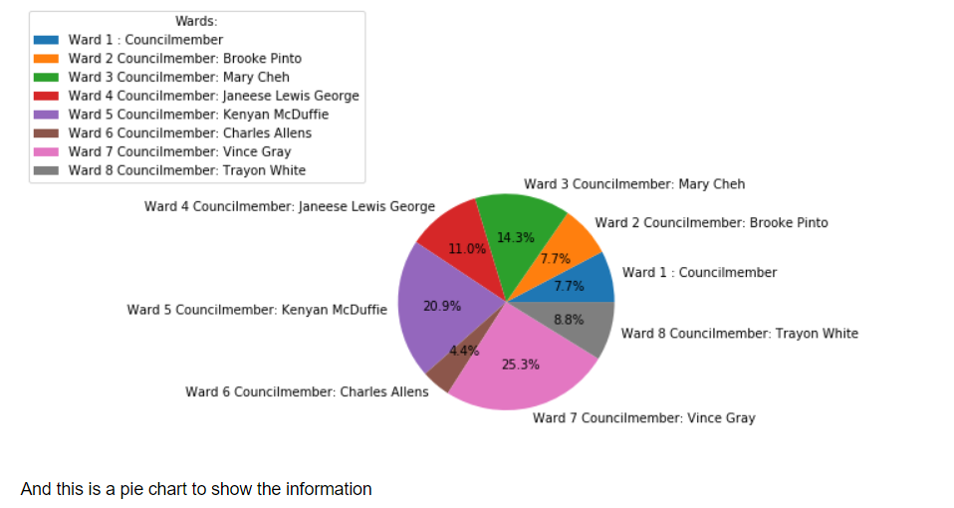
Methodology
7) Data is visualized using a bar-chart and pie-chart

