Slide 1
System Analysis And Design
Mrs Sumaya Albera
Sumia.albera@omu.edu.ly

Slide 2
What is a system?
A system is asset of interrelated components that work together to accomplish a purpose.
Basically, there are three major components in every system, are :( input, processing and output)
The objective of the system demand that some output is produced as a result of processing the suitable inputs.

Slide 3
Constraints of a System
A system must have some structure and behavior which is designed to achieve a predefined objective.
Interconnectivity and interdependence must exist among the system components.
The objectives of the organization have a higher priority than the objectives of its subsystems.

Slide 4
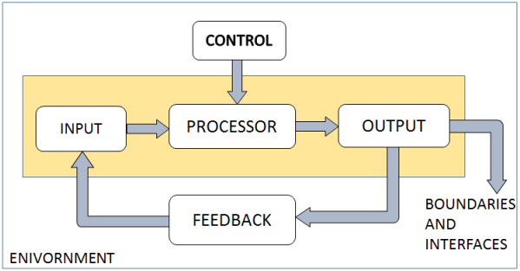
Elements of a System

Slide 5
Elements of a System
Outputs and Inputs :
  The main aim of a system is to produce an output which is useful for its user.
  Inputs are the data that enters into the system for processing.
  Output is the outcome of processing.

Slide 6
Elements of a System
Processor(s):
  The processor is the element of a system that involves the actual transformation of input into output.
  It is the operational component of a system. Processors may modify the input either totally or partially, depending on the output specification.
  As the output specifications change, so does the processing. In some cases, input is also modified to enable the processor for handling the transformation.

Slide 7
Elements of a System
Control :
  The control element guides the system.
  It is the decision–making subsystem that controls the pattern of activities governing input, processing, and output.
  The behavior of a computer System is controlled by the Operating System and software. In order to keep system in balance, what and how much input is needed is determined by Output Specifications.

Slide 8
Elements of a System
Feedback
  Feedback provides the control in a dynamic system
  .
  Positive feedback is routine in nature that encourages the performance of the system.
  Negative feedback is informational in nature that provides the controller with information for action.

Slide 9
Elements of a System
Environment
  The environment is the “supersystem” within which an organization operates.
  It is the source of external elements that strike on the system.
  It determines how a system must function. For example, vendors and competitors of organization’s environment, may provide constraints that affect the actual performance of the business.

Slide 10
Elements of a System
Boundaries and Interface :
  A system should be defined by its boundaries. Boundaries are the limits that identify its components, processes, and interrelationship when it interfaces with another system.
  Each system has boundaries that determine its sphere of influence and control.
  The knowledge of the boundaries of a given system is crucial in determining the nature of its interface with other systems for successful design.

Slide 11
What are System Analysis and System Design?
System Analysis is the study of a business
problem domain to recommend Improvements and specify the business requirements for the solution.
System Design is the specification or construction of a technical, computer based solution for the
business requirements identified in a system analysis.

Slide 12
THE SYSTEMS ANALYST
A business professional who uses analysis and design techniques to solve business problems using information technology.
The systems analyst is a key person analyzing the business, identifying opportunities for improvement, and designing information systems to implement these ideas. It is important to understand and develop through practice the skills needed to successfully design and implement new information systems.

Slide 13
What Does a Systems Analyst Do?
Identify the problem.
Analyze and understand the problem.
Identify solution requirements or expectations.
Identify alternative solutions and decide a course of action.
Design and implement the “best” solution.
Evaluate the results. If the problem is not solved,
return to Step 1 or 2 as appropriate.

Slide 14
Systems Analyst Skills:
The analyst’s skills can be divided down into six major categories: technical, business, analytical, interpersonal, management, and ethical.
Analysts must have the technical skills to understand the organization’s existing technical environment.
Business skills are required to understand how IT can be applied to business situations and to ensure that the IT delivers real business value.

Slide 15
Systems Analyst Skills:
Analysts are continuous problem solvers at both the project and the organizational level, and they put their analytical skills to the test regularly.
Often, analysts need to communicate with users, business managers and with programmers. They must be able to give presentations to large and small groups and to write reports. So, they need to have strong interpersonal abilities.

Slide 16
Systems Analyst Skills:
analysts must deal fairly, honestly, and ethically with other project team members, managers, and system users.

