Slide 1
System Analysis and Design
Mrs Sumaya Albera
Sumia.albera@omu.edu.ly

Slide 2
System Development Methodology
A methodology is a formalized approach to implementing the SDLC (i.e., it is a list of steps and deliverables).
There are many ways to categorize methodologies. One way is by looking at whether they focus on business processes or the data that support the business.

Slide 3
System Development Methodology
A process - centered methodology emphasizes process models as the core of the system concept. For example, process-centered methodologies would focus first on defining the processes (e.g., assemble sandwich ingredients).

Slide 4
System Development Methodology
Data-centered methodologies emphasize data models as the core of the system concept. In data centered methodologies would focus first on defining the contents of the storage areas (e.g., refrigerator) and how the contents were organized

Slide 5
System Development Methodology
Object-oriented methodologies attempt to balance the focus between process and data by incorporating both into one model.

Slide 6
1. Structured Design
Structured design methodologies adopt a formal step-by-step approach to the SDLC that moves logically from one phase to the next.
Numerous process-centered and data-centered methodologies follow the basic approach of the two structured design categories outlined next, as: Waterfall Development and Parallel Development

Slide 7
1.1 Waterfall Development
With waterfall development–based methodologies, the analysts and users proceed in sequence from one phase to the next.
The key deliverables for each phase are typically very long and are presented to the project sponsor for approval , Once the sponsor approves the work that was conducted for a phase, the phase ends and the next one begins .

Slide 8
1.1 Waterfall Development
This methodology is referred to as waterfall development because it moves forward from phase to phase in the same manner as a waterfall.

Slide 9
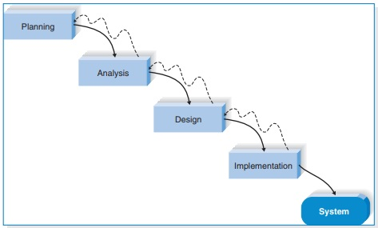
1.1 Waterfall Development

Slide 10
1.1 Waterfall Development
The two key advantages of the waterfall approach are:
  it an identifies system requirement long before programming begins
  it minimizes changes to the requirements as the project proceeds.

Slide 11
1.1 Waterfall Development
The two key disadvantages are:
  the design must be completely specified before programming begins
  a long time elapses between the completion of the system proposal in the analysis phase and the delivery of the system

Slide 12
1.2. Parallel Development:
It attempts to address the problem of long delays between the analysis phase and the delivery of the system.
Instead of doing design and implementation in sequence, it performs a general design for the whole system and then divides the project into a series of distinct subprojects that can be designed and implemented in parallel.

Slide 13
1.2. Parallel Development:
Once all subprojects are complete, there is a final integration of the separate pieces, then the system is delivered.
The advantage of this methodology is
  it can reduce the schedule time to deliver a system; thus, there is less chance of changes in the business environment causing rework

Slide 14
1.2. Parallel Development:
The disadvantage of this Methodology is :
  Sometimes the subprojects are not completely independent; design decisions made in one subproject may affect another, and the end of the project may require significant integration efforts.

Slide 15
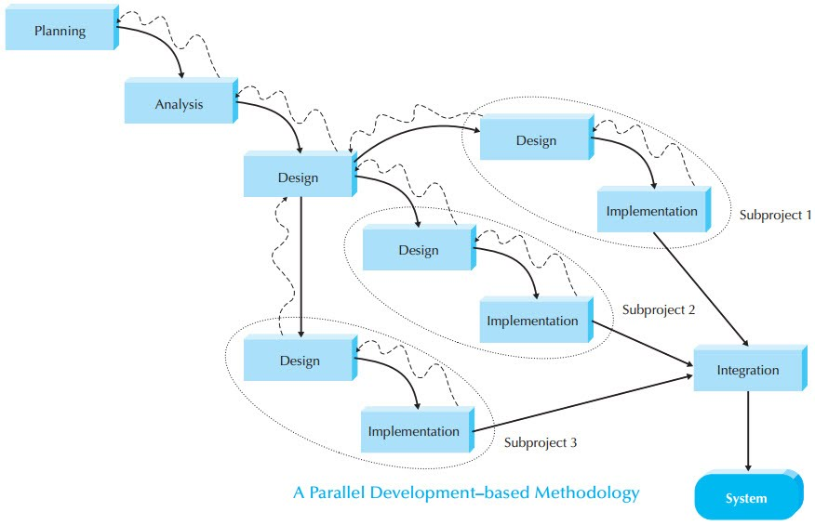
1.2. Parallel Development:

Slide 16
2. Rapid Application Development (RAD)
RAD-based methodologies attempt to address both weaknesses of structured design methodologies by adjusting the SDLC phases to get some part of the system developed quickly and into the hands of the users.
The users can better understand the system and suggest revisions that bring the system closer to what is needed.

Slide 17
2.1 Phased Development
phased development–based methodology breaks an overall system into a series of versions, which are developed sequentially.
The analysis phase identifies the overall system concept, and the project team, users, and system sponsor then categorize the requirements into a series of versions.

Slide 18
2.1 Phased Development
The most important and fundamental requirements are bundled into the first version of the system.
The analysis phase then leads into design and implementation but only with the set of requirements identified for version 1.

Slide 19
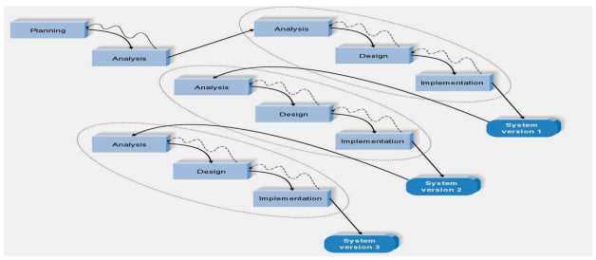
2.1 Phased Development

Slide 20
2.2 Prototyping
A prototyping-based methodology performs the analysis, design, and implementation phases concurrently, and all three phases are performed repeatedly in a cycle until the system is completed.
The basics of analysis and design are performed, and work immediately begins on a system prototype, program that provides a minimal amount of features.

Slide 21
2.2 Prototyping
The first prototype is usually the first part of the system that is used. This is shown to the users and the project sponsor, who provide comments.
These comments are used to reanalyze, redesign, and re-implement a second prototype, which provides a few more features.

Slide 22
2.2 Prototyping
This process continues in a cycle until the analysts, users, and sponsor agree that the prototype provides enough functionality to be installed and used in the organization.
Advantage: Provides a system for the users to interact with, even if it is not initially ready for use.
Disadvantage: Often the prototype undergoes such significant changes that many initial design decisions prove to be poor ones

Slide 23
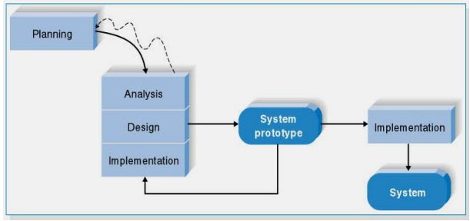
2.2 Prototyping

Slide 24
3. Agile Development
These programming-centric methodologies have few rules and practices.
They focus on streamlining the SDLC by eliminating much of the modeling and documentation overhead and the time spent on those tasks.
Instead, projects emphasize simple, iterative application development.

Slide 25
3. Agile Development
Examples of agile development methodologies include extreme programming, Scrum, and the Dynamic Systems Development Method (DSDM).
The agile development approach, typically is used in conjunction with object-oriented methodologies

Slide 26
3.1. Extreme Programming
Extreme programming (XP) is founded on four core values: communication, simplicity, feedback, and courage.
These four values provide a foundation that XP developers use to create any system,
First, the developers must provide rapid feedback to the end users on a continuous basis.

Slide 27
3.1. Extreme Programming
Second, XP requires developers to follow this principle (Keep It Simple and Stupid).
Third, developers must make incremental changes to grow the system, and they must not only accept change, they must embrace change.
Fourth, developers must have a quality-first mentality.

Slide 28
3.1. Extreme Programming
Three of the key principles that XP uses to create successful systems are:
  continuous testing,
  simple coding performed by pairs of developers,
  close interactions with end users to build systems very quickly.

Slide 29
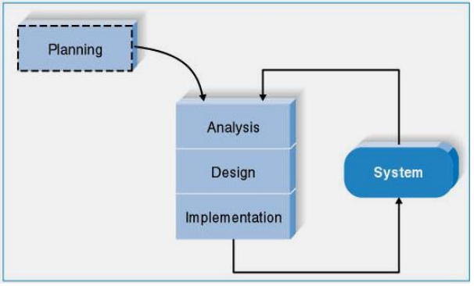
3.1. Extreme Programming

Slide 30
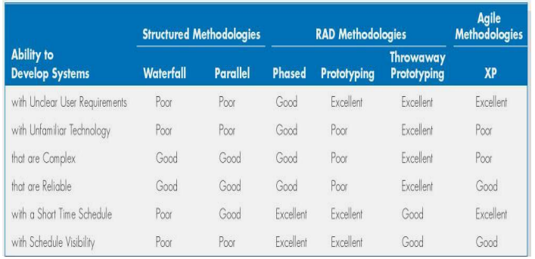
Selecting the Appropriate Development Methodology:

Slide 31
Selecting the Appropriate Development Methodology:
Clarity of user Requirements:
RAD methodologies are usually more appropriate when user requirements are unclear as they provide prototypes for users to interact with early in the SDLC.

Slide 32
Selecting the Appropriate Development Methodology:
Familiarity with Technology:
If the system is designed without some familiarity with the base technology, risks increase because the tools may not be capable of doing what is needed.

Slide 33
Selecting the Appropriate Development Methodology:
System complexity:
Complex systems require careful and detailed analysis and design. Project teams who follow phased development-based methodologies tend to devote less attention to the analysis of the complete problem domain than they might if they were using other methodologies.

Slide 34
Selecting the Appropriate Development Methodology:
System Reliability:
System reliability is usually an important factor in system development. Prototyping-based methodologies are generally not a good choice as they lack careful analysis and design phase

Slide 35
Selecting the Appropriate Development Methodology:
Short Time Schedules:
RAD-based methodologies are well suited for projects with short time schedules as they increase speed. Waterfall-based methodologies are the worst choice when time is essential as they do not allow for easy schedule changes.

Slide 36
Selecting the Appropriate Development Methodology:
Schedule Visibility:
RAD-based methodologies move many of the critical design decisions earlier in the project; consequently, this helps project managers recognize and address risk factors and keep expectations high

