Slide 1
System Analysis And Design
Mrs Sumaya Albera
Sumia.albera@omu.edu.ly

Slide 2
Requirement Determination:
Defining a Requirement : A requirement is simply a statement of what the system must do or what characteristic it must have.
During analysis, requirements are written from the perspective of the business person, and they focus on the ―what of the system do?
Because they focus on the needs of the business user, they are usually called business requirements (and sometimes user requirements).

Slide 3
Requirement Determination:
In design, business requirements evolve to become more technical, and they describe how the system will be implemented.
Requirements in design are written from the developer’s perspective, and they are usually called system requirements.

Slide 4
Creating a Requirements Definition:
The requirements definition is a document that lists the new system’s capabilities.
Creating a Requirements Definition:
  is an iterative and ongoing process whereby the analyst collects information with requirements-gathering techniques

Slide 5
Creating a Requirements Definition:
Analyzes the information to identify appropriate business requirements for the system, and adds the requirements to the requirements definition report.
The requirements definition is kept up to date so that the project team and business users can refer to it and get a clear understanding of the new system.

Slide 6
To Create a requirement Definition:
The project team first determines the kinds of functional and nonfunctional requirements that they will collect about the system.(These become the main sections of the document.)
The analysts use a variety of requirements gathering techniques (e.g., interviews, observation) to collect information, and they list the business requirements that were identified from that information.

Slide 7
To Create a requirement Definition: (cont.)
3. The analysts work with the entire project team and the business users to verify, change, and complete the list and to help prioritize the importance of the requirements that were identified.

Slide 8
Requirements Analysis
The basic process of analysis is divided into three steps:
  understanding the as-is system,
  identifying improvements,
  developing requirements for the to-be system

Slide 9
Requirements-Gathering Techniques
Interview
Joint Application Development (JAD)
Questionnaires
Document Analysis
Observation

Slide 10
1. Interview:
An interview is the most commonly used requirements-gathering technique;
In general, interviews are conducted one-on-one (one interviewer and one interviewee);
There are 5 basic steps to the interview process: selecting interviewees, designing interview questions, preparing for the interview, conducting the interview, and post interview follow-up.

Slide 11
1.1. selecting interviewees
The analyst should prepare an interview schedule that lists who will be interviewed, when, and for what purpose.
The interviewees are chosen based on the analyst’s information needs, with help from the project sponsor, key business users, and other team members to identify those who can best provide essential requirements information..

Slide 12
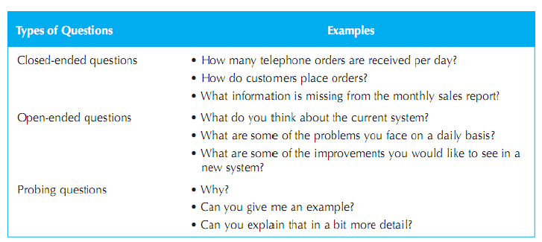
1.2. Designing Interview Questions:

Slide 13
1.2. Designing Interview Questions (cont.):
The top-down approach is an appropriate strategy for most interviews ;
Starting with general questions helps both the interviewee and the interviewer — the interviewee gets familiar with the topic, and the interviewer gains a basic understanding before asking detailed questions

Slide 15
1.3.Preparing for the Interview:
The interviewer needs a structured plan with well-ordered questions, should predict possible responses for effective follow-up, and smoothly transition between related topics.

Slide 16
1.4. Conducting the Interview
The interviewer’s first goal is to build trust and rapport with the interviewee so he/ she feels comfortable sharing honest information.
The interviewer should act professionally and remain neutral. The interview begins with an explanation of its purpose and the reason for selecting the interviewee, followed by the planned questions.

Slide 17
1.5. Post interview Follow-up:
The analyst needs to prepare an interview report that describes the information from the interview.
The interview report should be written within forty-eight hours of the interview, because the longer the interviewer waits, the more likely he or she is to forget information.

Slide 18
2. Joint Application Development (JAD)
Joint Application Design (JAD) is a structured technique for gathering system requirements through collaboration among the project team, users, and management.
Developed by IBM in the late 1970s,
JAD involves 10–20 users meeting under the guidance of a skilled facilitator to identify system needs effectively.

Slide 19
2. Joint Application Development (JAD)(cont.):
The facilitator is a person who sets the meeting agenda and guides the discussion but does not join in the discussion as a participant
The facilitator must be an expert in both group process techniques and systems analysis and design techniques.
Often the scribes will use computers and CASE tools to record information as the JAD session proceeds.

Slide 20
JAD (cont.):
Selecting Participants :
is done in the same basic way as selecting interview participants.
2. Designing a JAD Session :
can run from as little as half a day to several weeks, depending upon the size and scope of the project.
3. Preparing for a JAD Session As with interviewing, it is important to prepare the analysts and participants for a JAD session. Because the sessions can go beyond the depth of a typical interview and are usually conducted off-site;

Slide 21
JAD (cont.):
4. Conducting a JAD Session
Most JAD sessions try to follow a formal agenda, and most have formal ground rules that deﬁne appropriate behavior
5. Post-JAD Follow-up:
The post session report is essentially the same as the interview report. Because the JAD sessions are longer and provide more information, it usually takes a week or two after the JAD session before the report is complete

Slide 22
3. Questionnaires
A questionnaire is a set of written questions used to obtain information from individuals. Questionnaires are often used when there is a large number of people from whom information and opinions are needed;

Slide 23
3. Questionnaires (cont.):

Slide 24
3. Questionnaires:
Selecting Participants: The ﬁrst step is to identify the individuals to whom the questionnaire will be sent;
Designing a Questionnaire: Creating clear and well-designed questions is essential in questionnaires since respondents cannot ask for immediate clarification if they find a question confusing.
Administering the Questionnaire The key issue in administering the questionnaire is getting participants to complete the questionnaire and send it back.

Slide 25
3. Questionnaires:
Questionnaire Follow-up :
It is helpful to process the returned questionnaires and develop a questionnaire report soon after the questionnaire deadline. This ensures that the analysis process proceeds in a timely fashion and that respondent who requested copies of the results receive them promptly.

Slide 26
4. Document Analysis
Project teams often use document analysis to understand the as-is system.
Under ideal circumstances, the project team that developed the existing system will have produced documentation, which was then updated by all subsequent projects.
In this case, the project team can start by reviewing the documentation and examining the system itself.

Slide 27
5. Observation:
Observation, the act of watching processes being performed, is a powerful tool for gathering information about the as-is system because it enables the analyst to see the reality of a situation, rather than listening to others describe it in interviews or JAD.

Slide 28
