Slide 1
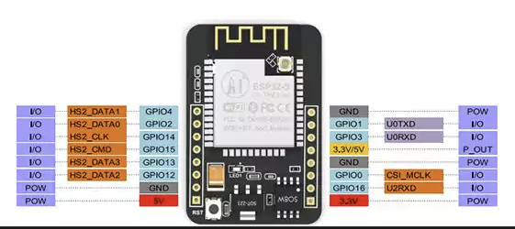
GND, black wire from USB plug
Data in from LED strip
5V from LED strip
GND from LED strip
5V red wire from USB plug

