Slide 1

01
SYP
Share Your Playlist
Connect with others, share your playlists and find new songs that you like!
Large-Scale and Multi-Structured Databases | Project Discussion

Slide 2
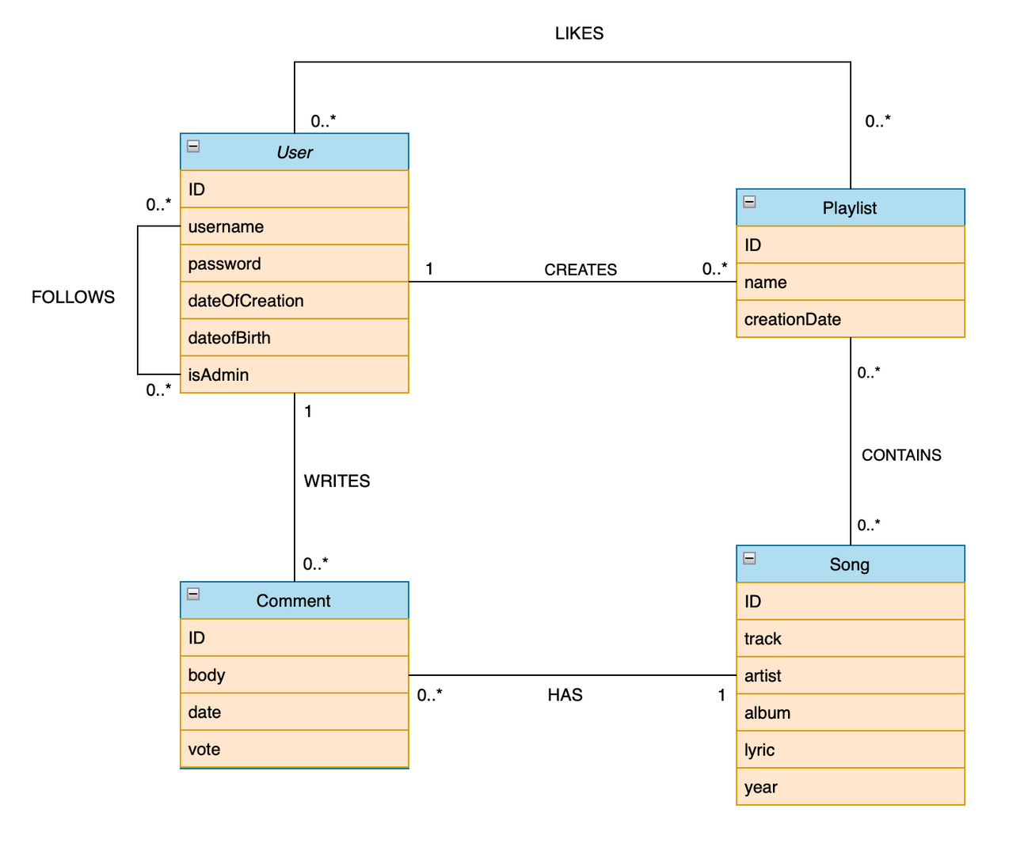
02
Class Diagram
Large-Scale and Multi-Structured Databases | Project Discussion

Slide 3
03
Dataset Description
Source:
Kaggle (Spotify playlists)
Data scraping from Genius (users, comments and song's information)
Random generated data (comment's vote, user's password, birth date and creation date)
Description: The dataset is composed taking the Kaggle’s dataset (spotify playlist) which contains user that created a playlist, playlist name, song in the playlist. To this dataset we add the users (that will use the social), comments of them and the information of a specific song. At the end, we add the random generated informations.
Volume: ~300 MB
Variety: Kaggle_db (file csv) + Scraping from Genius + Random generation of votes
Large-Scale and Multi-Structured Databases | Project Discussion

Slide 4
04
The application must provide a great quality of service (QoS) in terms of high availability, low latency and tolerance to failure.
The user’s usernames must be unique.
The application shall be user-friendly, since a user shall interact with an intuitive graphical interface.
The code shall be readable and easy to maintain.
Non-Functional Requirements
Large-Scale and Multi-Structured Databases | Project Discussion

Slide 5
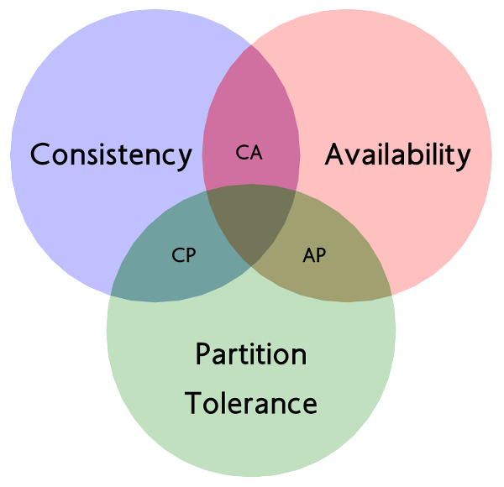
05
AP APPROACH
CAP theorem
READ-HEAVY
LOW LATENCY
HIGH AVAILABILITY
EVENTUAL CONSISTENCY
WRITE CONCERN
Write concern parameter w = 2
READ PREFERENCE
Read Preference parameter readPreference = nearest
Large-Scale and Multi-Structured Databases | Project Discussion

Slide 6
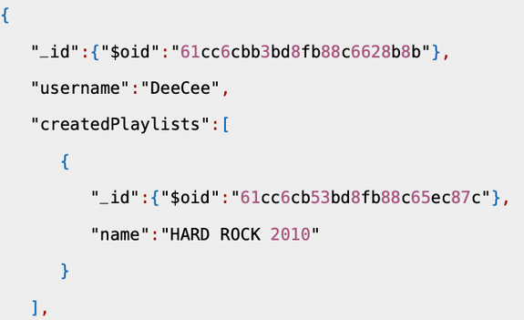
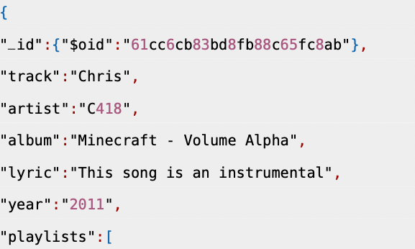
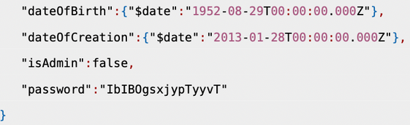
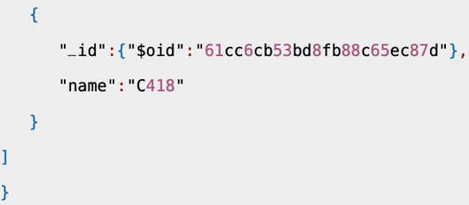
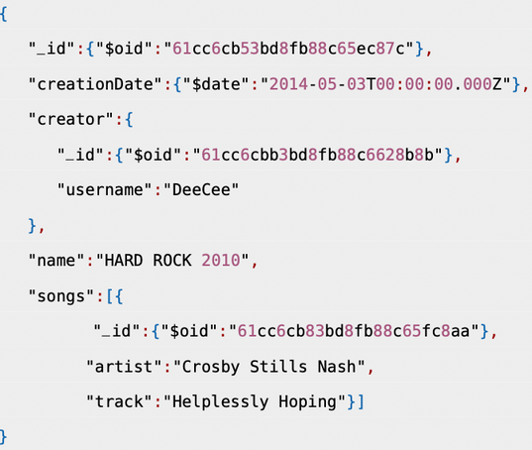

06
User collection
Songs collection
MongoDB
Design
Playlist collection
Large-Scale and Multi-Structured Databases | Project Discussion

Slide 7
07
ANALYTICS, STATISTCS AND SUGGESTIONS
Find the top k users that has created the highest number of playlists
Find the top k users that have added to them playlists the highest number of songs of a specific artist
Find the k most popular songs
How many songs has a playlist on average?
How many artists has a playlist on average?
On average a song in how many playlists is contained?
How many playlists a user creates on average?
MongoDB
Queries
Large-Scale and Multi-Structured Databases | Project Discussion

Slide 8
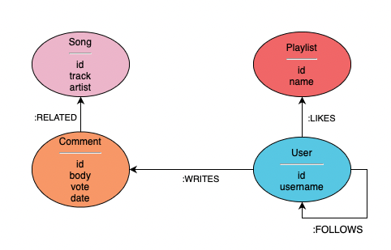

08
GraphDB
Design
Large-Scale and Multi-Structured Databases | Project Discussion

Slide 9
ANALYTICS, STATISTCS AND SUGGESTIONS
09
Find the k most followed users
Find the k most followed playlists
Find the users that follows at least k same playlists of the User provided in input
Find the k songs that has the highest number of comments
Find k playlists followed by users that a specific user follows
How many followers has a playlist in avg?
How many comments has a song in avg?
How many followers has a user in average?
How many playlists are followed by a user in average?
How many songs a user comments in avg?
GraphDB
Queries
Large-Scale and Multi-Structured Databases | Project Discussion

Slide 10
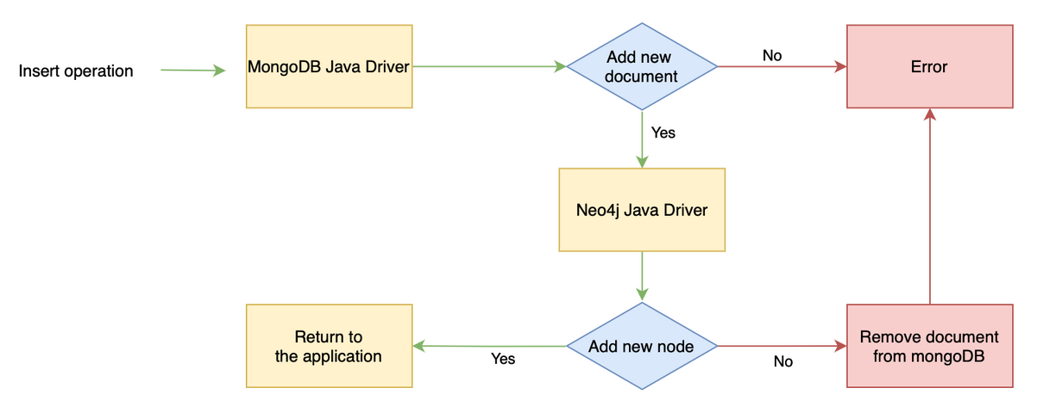
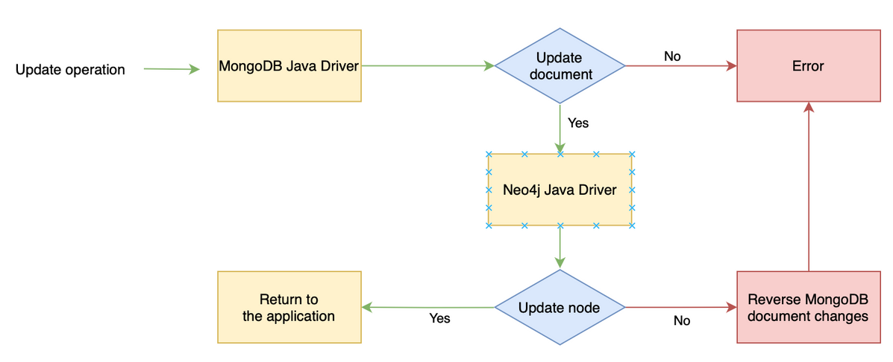
10
Data
consistency
Large-Scale and Multi-Structured Databases | Project Discussion
Large-Scale and Multi-Structured Databases | Project Discussion

Slide 11
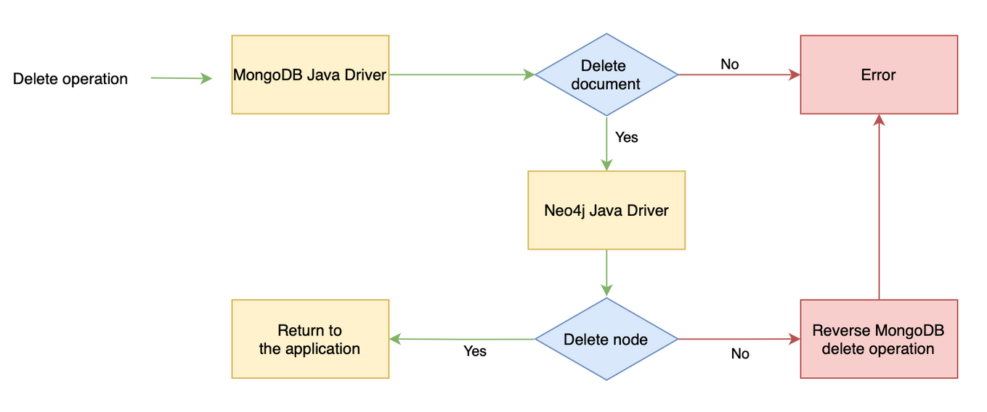
11
Data
consistency
Large-Scale and Multi-Structured Databases | Project Discussion
Large-Scale and Multi-Structured Databases | Project Discussion

Slide 12
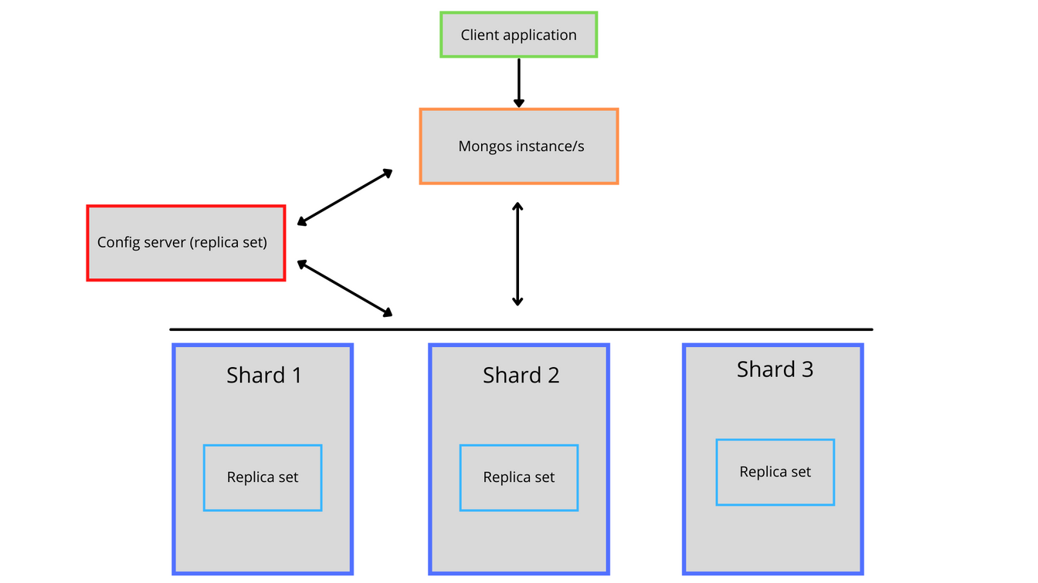
12
Data Sharding
SHARDING KEYS
PARTITION ALGORITHM
Playlist collection: id field
User collection: username field
Song collection: id field
Hashed Strategy: The field chosen as the sharding key will be mapped through a hash function.
Large-Scale and Multi-Structured Databases | Project Discussion

Slide 13
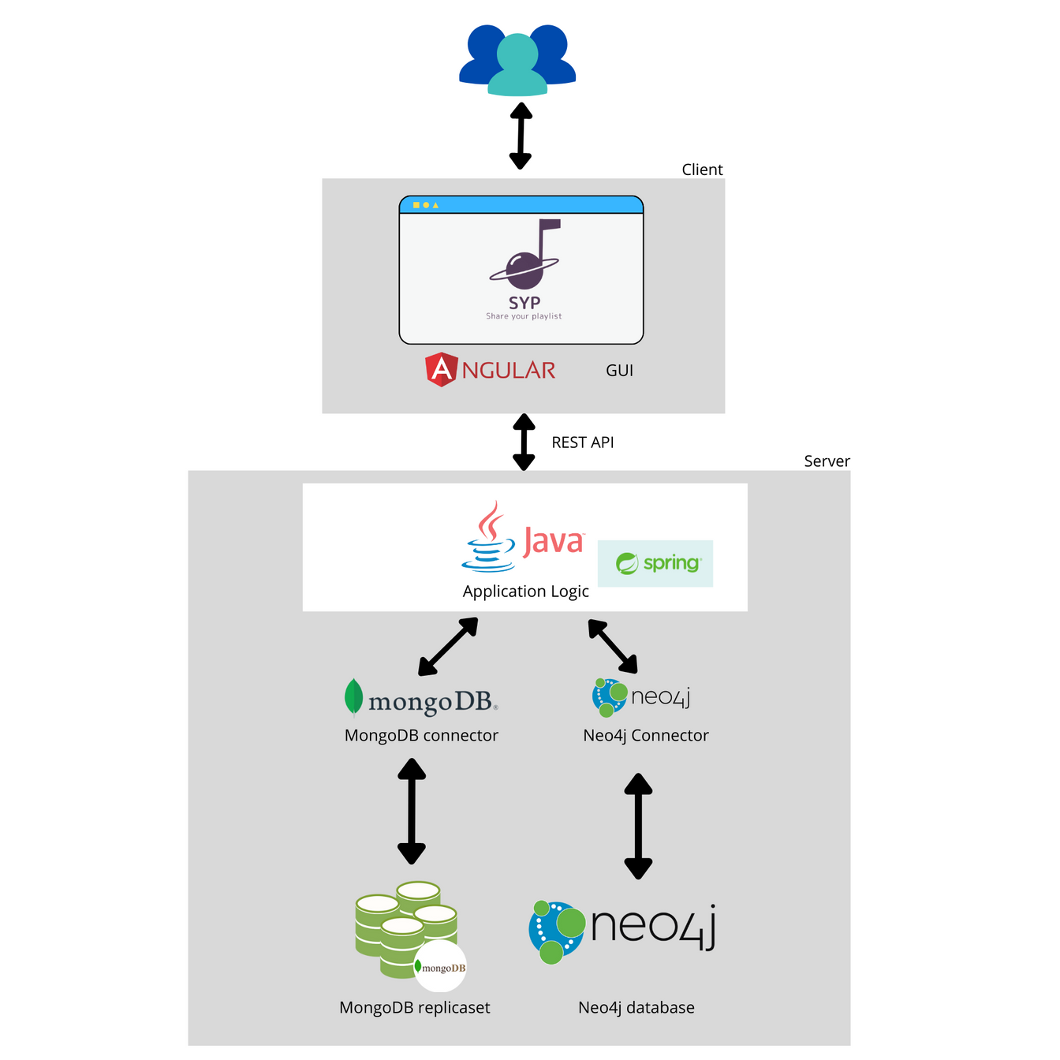
13
Software
&
Hardware Architecture
Large-Scale and Multi-Structured Databases | Project Discussion

Slide 14
14
Add a password encryption system to the application;
Improve the login system of the application (cookies);
Improve the consistency management with a thread that tries automatically to recover failed operations;
Implement an automatic scraping script to add automatically the information of the songs to the databases, instead of add them manually.
Final Considerations
Large-Scale and Multi-Structured Databases | Project Discussion

