Slide 1
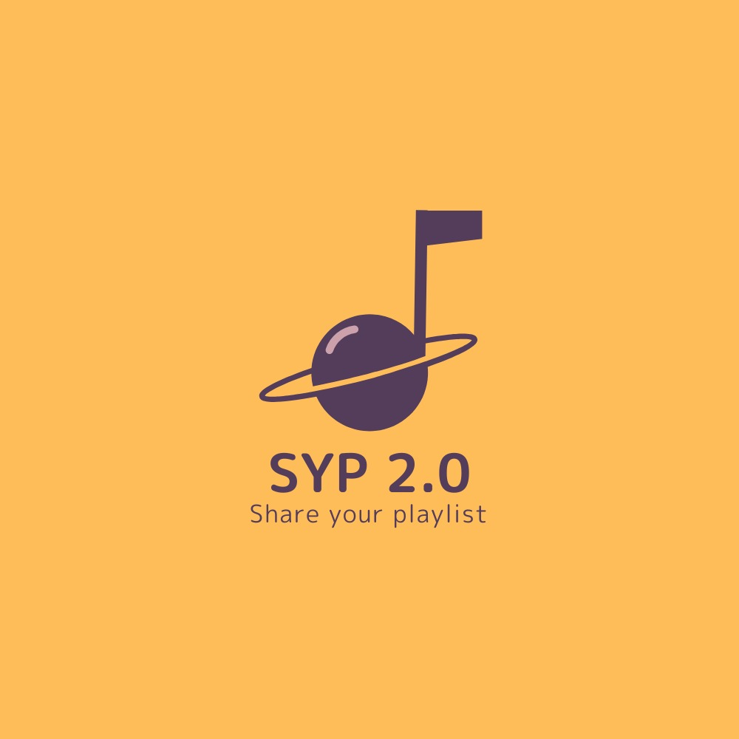
01
SYP 2.0
Share Your Playlist
Connect with others, share your playlists and find new songs that you like!
Data Mining and Machine Learning| Project Discussion

Slide 2
02
Share Your Playlist is an application shaped as a social network about songs and playlists. Users can log into the platform to follow other users, review songs and rate them, create and share their own playlists and follow other ones. The application also has a smart suggestion module that suggest to a user that is creating a new playlist, interesting songs based on the songs he already inserted.
Introduction
Data Mining and Machine Learning| Project Discussion

Slide 3
03
Association Rule Mining
Data Mining and Machine Learning| Project Discussion

Slide 4
04
Dataset Description
Source:
Spotify Playlists (Kaggle) : https://www.kaggle.com/andrewmvd/spotify-playlists
Description: It contains tabular data with four attributes per record: the user_id, the playlist name, the track name and its artist, for a total dimension of 1 Gb. For practical purposes the dataset has been reduced and only 4% of the total dataset has been used to be stored in the application databases. It contains about 9.000 playlists, 40.000 artists and 270.000 songs.
Volume: ~ 60 MB
Data Mining and Machine Learning| Project Discussion

Slide 5
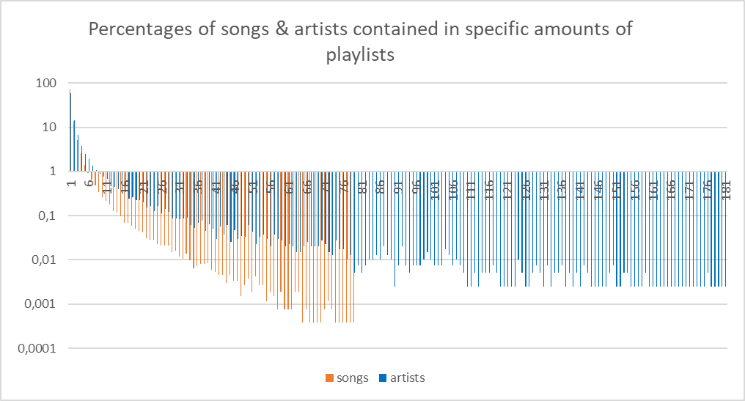
05
Dataset Analysis
Data Mining and Machine Learning| Project Discussion

Slide 6
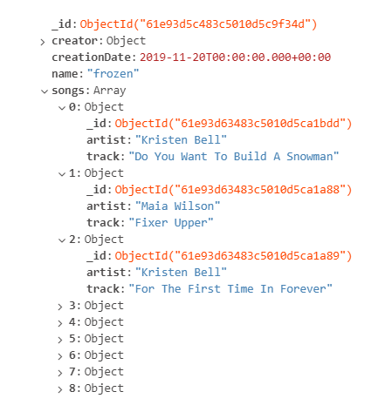
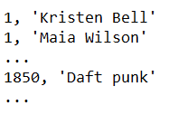
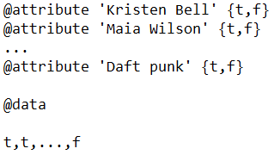
06
Data Preprocessing
Data Mining and Machine Learning| Project Discussion

Slide 7
07
Association rule mining analysis
Data Mining and Machine Learning| Project Discussion

Slide 8
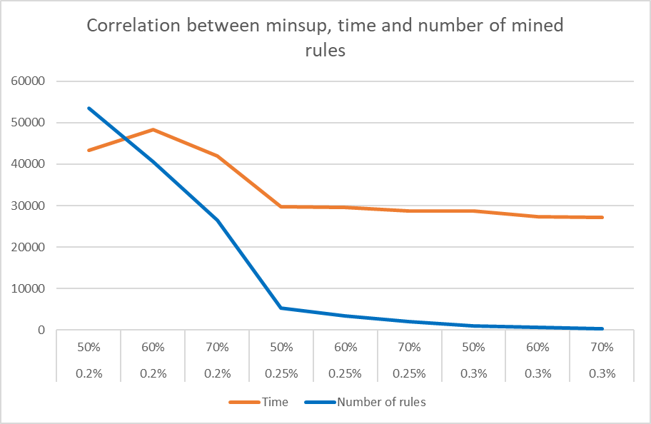
08
Number of mined rules analysis
Data Mining and Machine Learning| Project Discussion

Slide 9
09
Length of the mined rules analysis
Data Mining and Machine Learning| Project Discussion

Slide 10
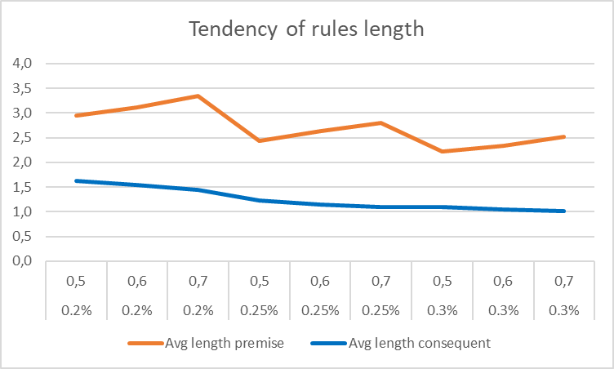
10
Length of the mined rules analysis
Data Mining and Machine Learning| Project Discussion

Slide 11
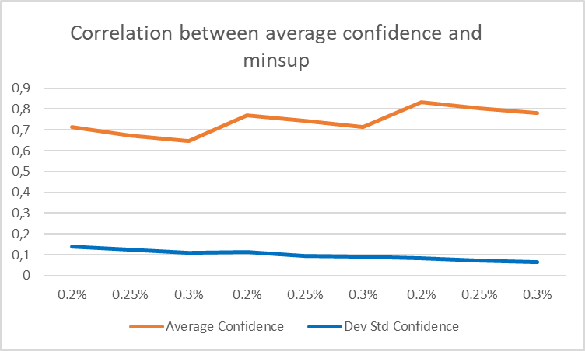
11
Average confidence analysis
Data Mining and Machine Learning| Project Discussion

Slide 12
12
Application description
Data Mining and Machine Learning| Project Discussion

Slide 13
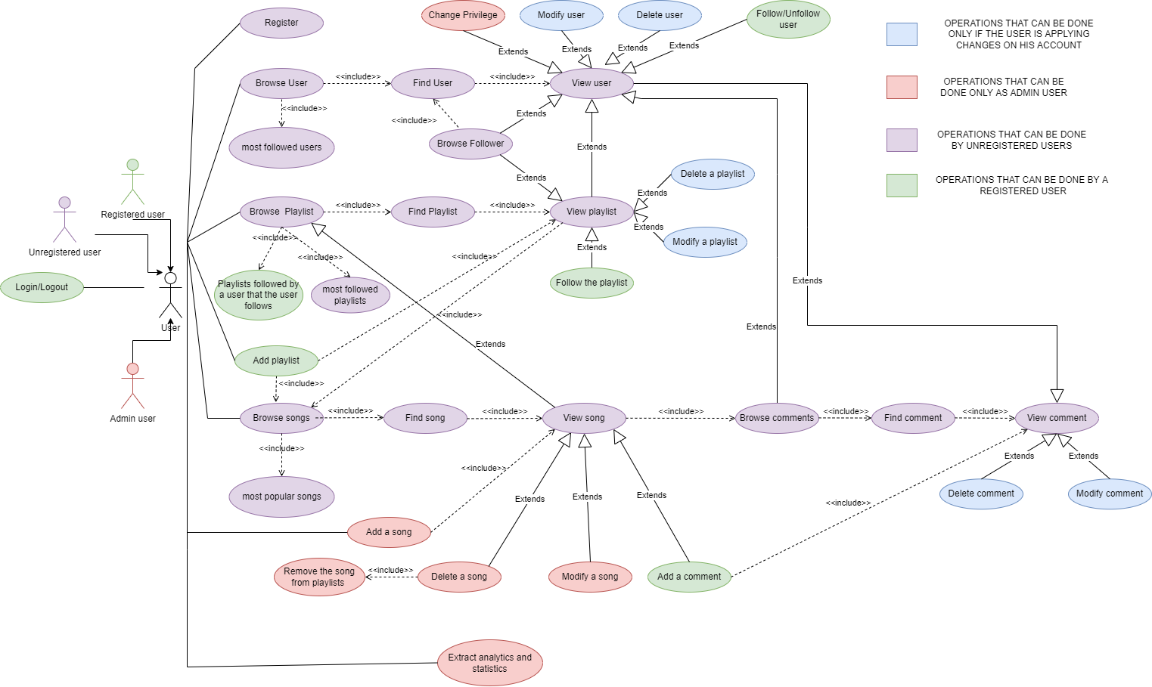
13
Use case diagram
Data Mining and Machine Learning| Project Discussion

Slide 14
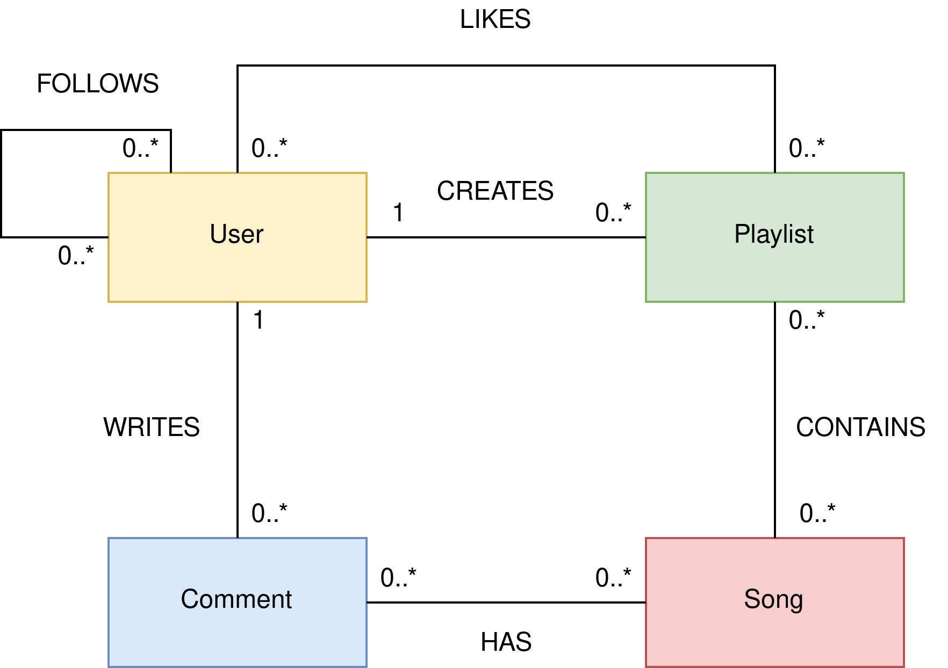
14
Class diagram
Data Mining and Machine Learning| Project Discussion

Slide 15
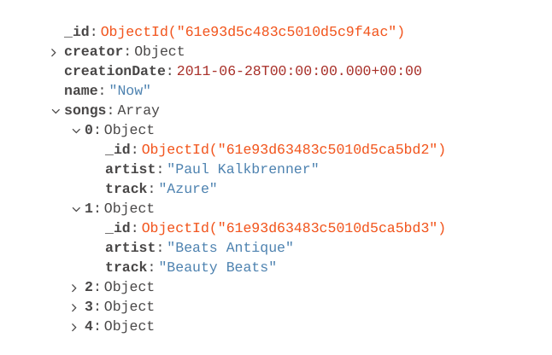
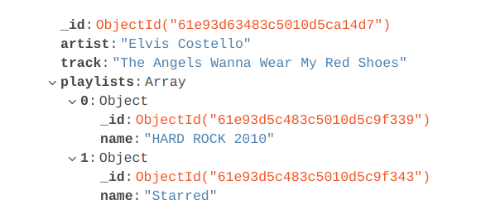
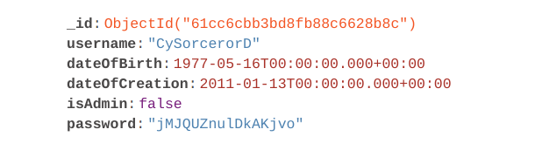
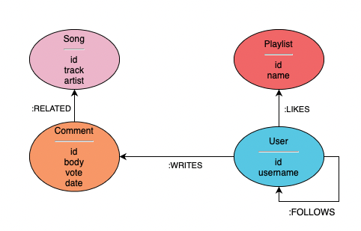
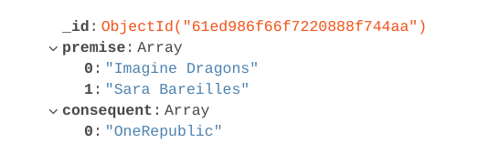


Playlists:
15
Songs:
Databases
Design
Users:
Rules:
Data Mining and Machine Learning| Project Discussion

Slide 16
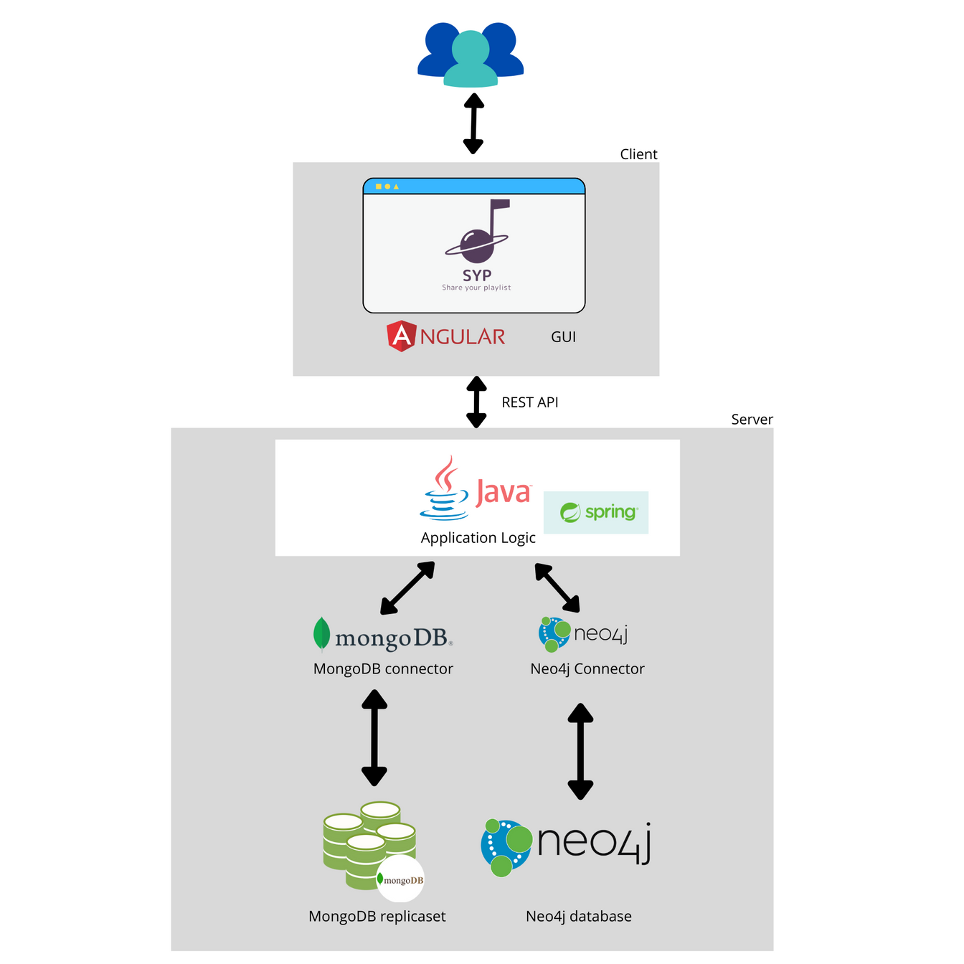
16
System architecture
Data Mining and Machine Learning| Project Discussion

Slide 17
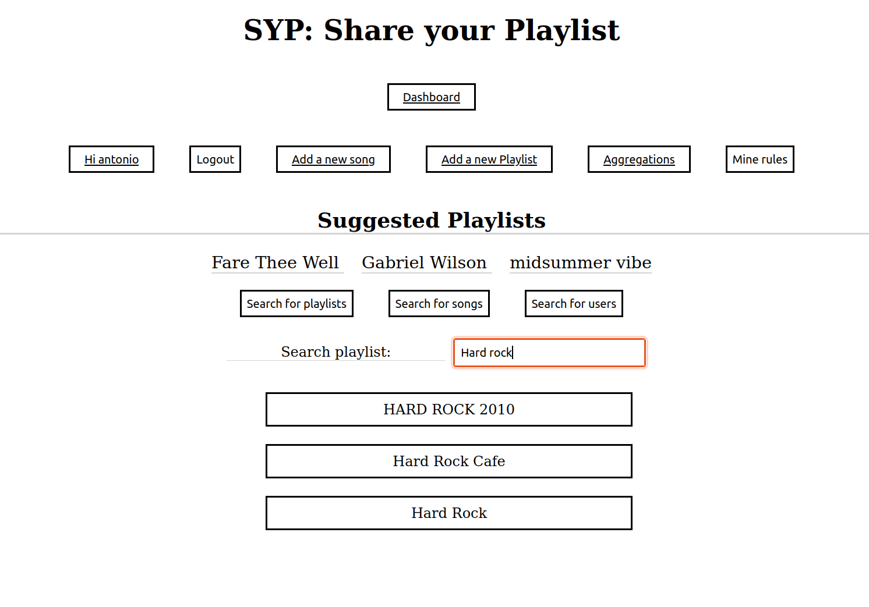
17
Main page
Data Mining and Machine Learning| Project Discussion

Slide 18
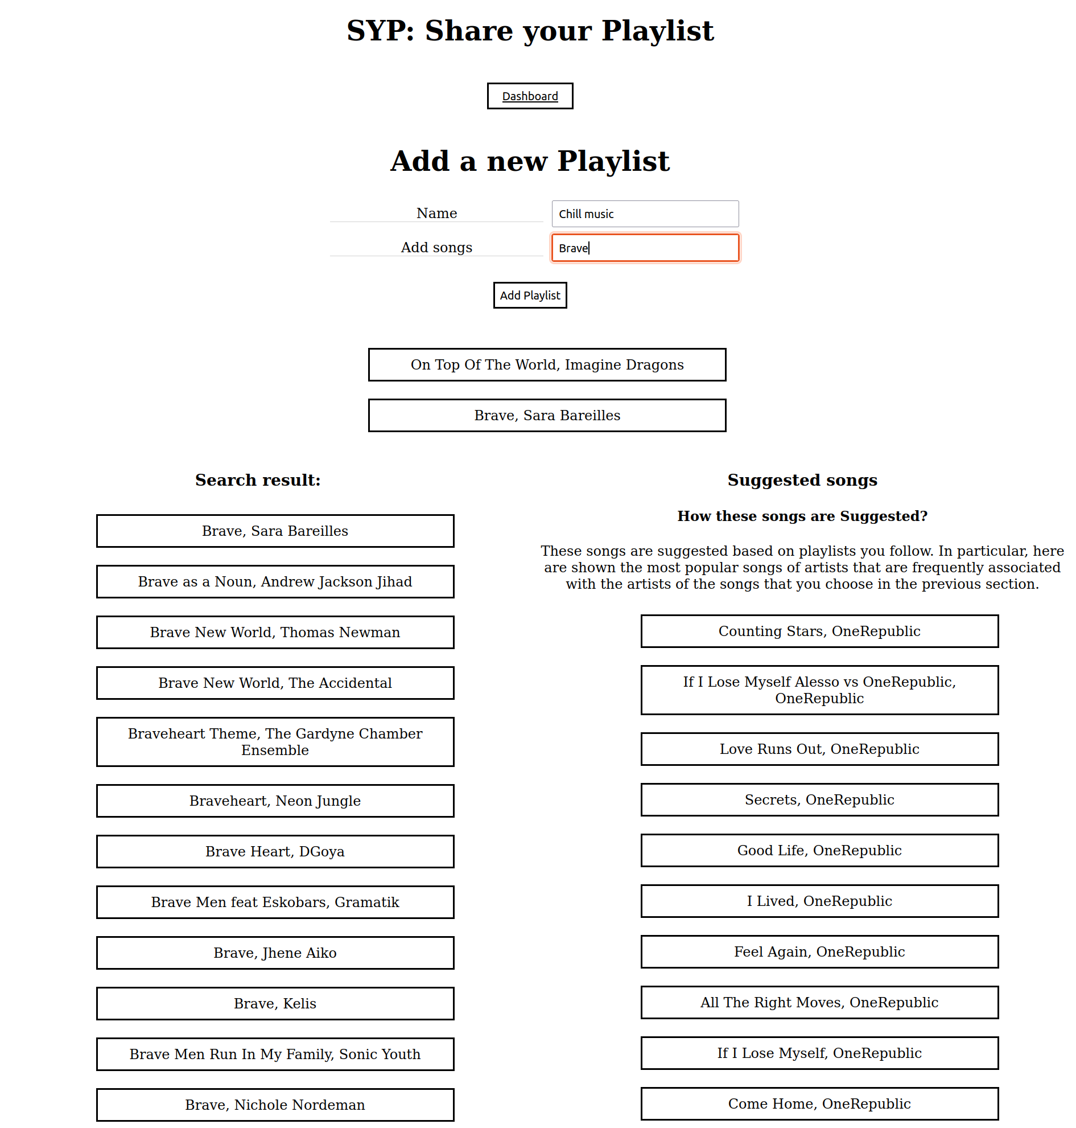
18
Song suggestion Module

