Slide 1
Article Clustering on the Basis of Content-Bias
Shashwat Chandra
13111059

Slide 2
Why?
Search Engines
Content
Source
Research
Looking for viewpoints
Holistic understanding

Slide 3
Dataset/Tools
Yahoo! Voices
Opinionated Articles
News Articles
YQL API
Scikit/SciPy and Mathematica

Slide 4
Dataset/Tools
Topics: Abortion Alcohol Barack Obama Congress Evolution Feminism | Gun Rights Homosexuality NATO Republican Security Terrorism
Around 1000 articles per topic

Slide 5
Features
1. Biased Word Frequency in the Article
List from [1]
Biased words in:
Religious/Moral Terms
Judgment Terms
Social Terms
Words like:
Moral, Immoral, Repulsive, Heathen, Unnatural
Unfair, Fair, Deserve, Fault, Justice
Accuse, Worth, Shame, Appropriate, Decency

Slide 6
Features
2. Wikipedia:
Words to Watch [2]
Neutral Point of View [3][4]
Categories:
Words that may introduce bias
Puffery: legendary, great, …
Contentitious Labels: cult, racist, freedom fighter …
Expressions of doubt: supposed, apparent, …
Weasel-words, Editorializing
Expressions that lack precision
Euphemisms, Clichés, Idioms, Unspecified place/time
Vulgarities, Obscenities and Profanities

Slide 7
Features
3. Featured Article Count
YQL
Indicates popularity/neutrality of author
4. Sentiment of Text
AlchemyAPI [5]
Relevant sentences

Slide 8
Features
5. Number of Comments in Current Article
Degree of interest/controversy generated.
Article-dependant
6. Number of Comments in Recent Articles
YQL
Broader indicator
How controversial the author is (Author-dependant)

Slide 9
Features
7. Biased Word Frequency in Comments
Same List of bias-words [1]
Actually looks at degree of controversial-ness.
8. Search-term Synonym/Antonym Count
NLTK
Bias direction

Slide 10
Features Selected
Biased Word Frequency in the Article
Wikipedia NPOV/W2W
Featured Article Count
Sentiment of Text
Number of Comments in Recent Articles
Reasons:
Not Language-specific
Author is a better indicator of bias
Speed: Cluster as a Service

Slide 11
Clustering
Feature Vectors generated
Two techniques:
Hierarchical Clustering
K-Means Clustering
Intuitively:
K-Means is poorer with outliers.
Hierarchical clustering: number of clusters.
Easier to verify

Slide 12
Clustering
Hierarchical Clustering:
Euclidean Distance
Linkage Function: Single
K-Means:
K = 3 through 6
Best result selected
Manually
using % purity as indicator (using Ground Truth)

Slide 13
Results of K-Means Clustering
C0 7 GT:irrelevant Efficacy in the World of Missions: On Polychronic and Monochronic Concepts of Time
C0 9 GT:people Yayoi Kusama - Artist
C0 10 GT:people Strong Anti-Palin Sentiment Resembles Opposition for "Muslim" Obama
C0 11 GT:works
C0 19 GT:people Feminist or FemMANist? - You Decide
C0 21 GT:works A Feminist Analysis of Michael Antonioni's Film _Blowup _
C0 24 GT:irrelevant How the Founders of Girlfriends Cafe Met Over Coffee
C0 25 GT:works
C1 3 GT:relationships Understanding the Most Basic Needs of a Woman in a Relationship
C1 20 GT:irrelevant The Priorities of a Civilized America
C1 22 GT:people Gender Influenced Justices: Sandra Day O'Connor and Ruth Bader Ginsburg
C2 2 GT:irrelevant Ten Things I Would Be Proud to Have Written
C2 5 GT:irrelevant Epic Encounters: Culture, Media, and U.S. Interests in the Middle East Since 1945
C2 8 GT:irrelevant Partnership and Spirituality at the Women & Spirituality Conference
C2 13 GT:works Where Did Cinderella Come from Anyway?
C2 17 GT:relationships Feminism and the Ignorant Woman
C2 18 GT:irrelevant Writing Tips: The Power of the Paratext
C3 16 GT:works TIME Reveals How to Lose Friends and Alienate People
C4 1 GT:sex "Safe Sex" is a Bust
C4 4 GT:race
C4 6 GT:sex The Abuse of Traditional Gender Roles
C4 12 GT:sex Contemporary Feminism in America: Examining "Female Chauvinist Pigs"
C4 14 GT:works Writing Tips: Discussing Physical Appearance
C4 15 GT:works Writing Tips: Two Reasons to Leave Your Ending Open
C4 23 GT:irrelevant Writing Tips: The Efficacy of Religious Rhetoric

Slide 14
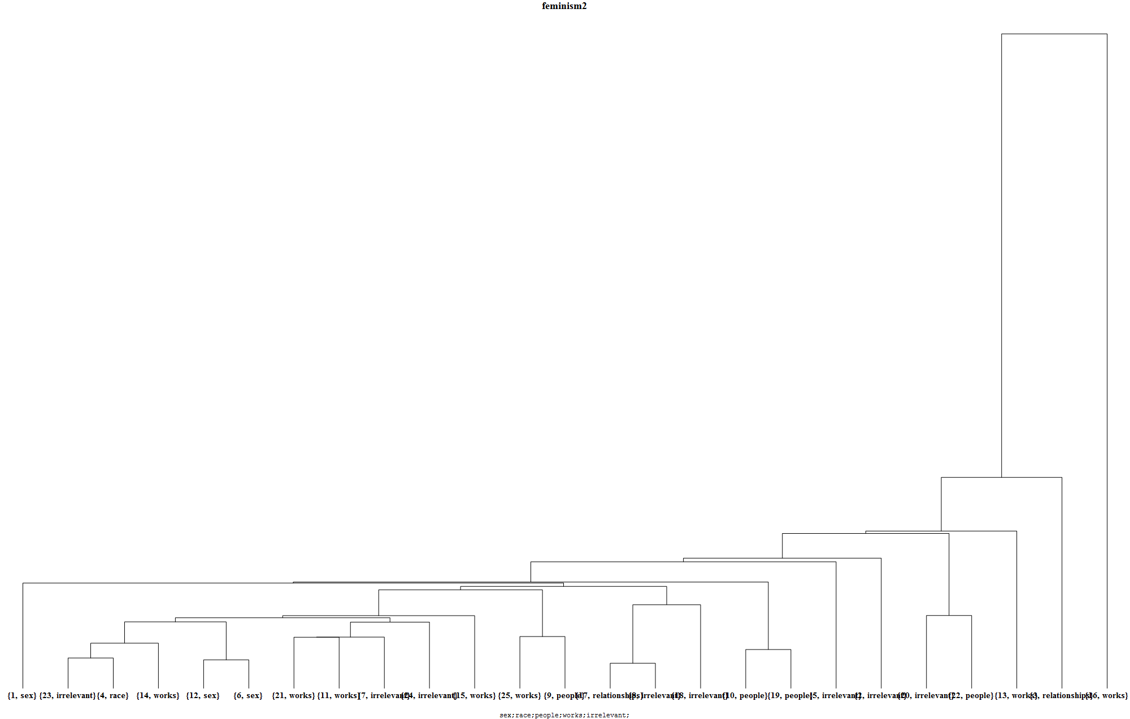
Results of Hierarchical Clustering

Slide 15
Results of K-Means Clustering
C0 1 GT:1 Louis Farrakhan: Barack Obama Is "The Messiah"
C0 2 GT:2 Barack Obama Inaugural Address Part 1 of 5
C0 3 GT:1 Hugo Chavez Wants to Be Friends with Barack Obama
C0 5 GT:3 Barack Obama Jokes for the Politically Incorrect
C0 6 GT:1 Barack Obama Leading John McCain in Wisconsin
C0 10 GT:1 Reinventing America: President Barack Obama Stimulus Reform for America
C0 12 GT:3 Barack Obama 'I'm Really Good at Killing People'
C0 15 GT:2 Barack Obama Begins Train Ride to Washington, DC for Inauguration
C0 16 GT:1 The Comedy/Drama Behind Barack Obama
C0 17 GT:2 President Barack Obama's Health Care Plan to Cover Abortions
C0 25 GT:1 How the Second Coming Could Be Near with Barack Obama as President
C1 4 GT:3 President Barack Obama: Should Have Used 'Opponents' and Not 'Enemies'
C1 7 GT:2 Barack Obama & John McCain: Change This, Change That
C1 8 GT:1 President Barack Obama Wins Nobel Peace Prize; Attacked by Right Wing
C1 11 GT:1 Barack Obama Has All the Momentum in This Democratic Race
C1 13 GT:2 Barack Obama Answers Dick Cheney
C1 21 GT:3 Former Muslim Raises Concerns About the Muslim Background of Presidential Candidate Barack Obama
C1 23 GT:0 Republican Meme Machine: Blame Barack Obama for Sagging Stock Market
C2 9 GT:0 Tips for Creating a Barack Obama Halloween Costume
C2 18 GT:3 Bristol Palin Promotes Her Reality Show by Attacking Barack Obama and ?Glee? with Anti-Gay Marriage Rant
C3 14 GT:1 Barack Obama Can't Do it Alone
C3 19 GT:2 Barack Obama's Big Lead: Will it Last?
C3 20 GT:3 Barack Obama's Growing Problem: The Reverend Dr. Jeremiah Wright
C3 24 GT:2 Barack Obama, a New President
C4 22 GT:0 Interesting Barack Obama Videos

Slide 16
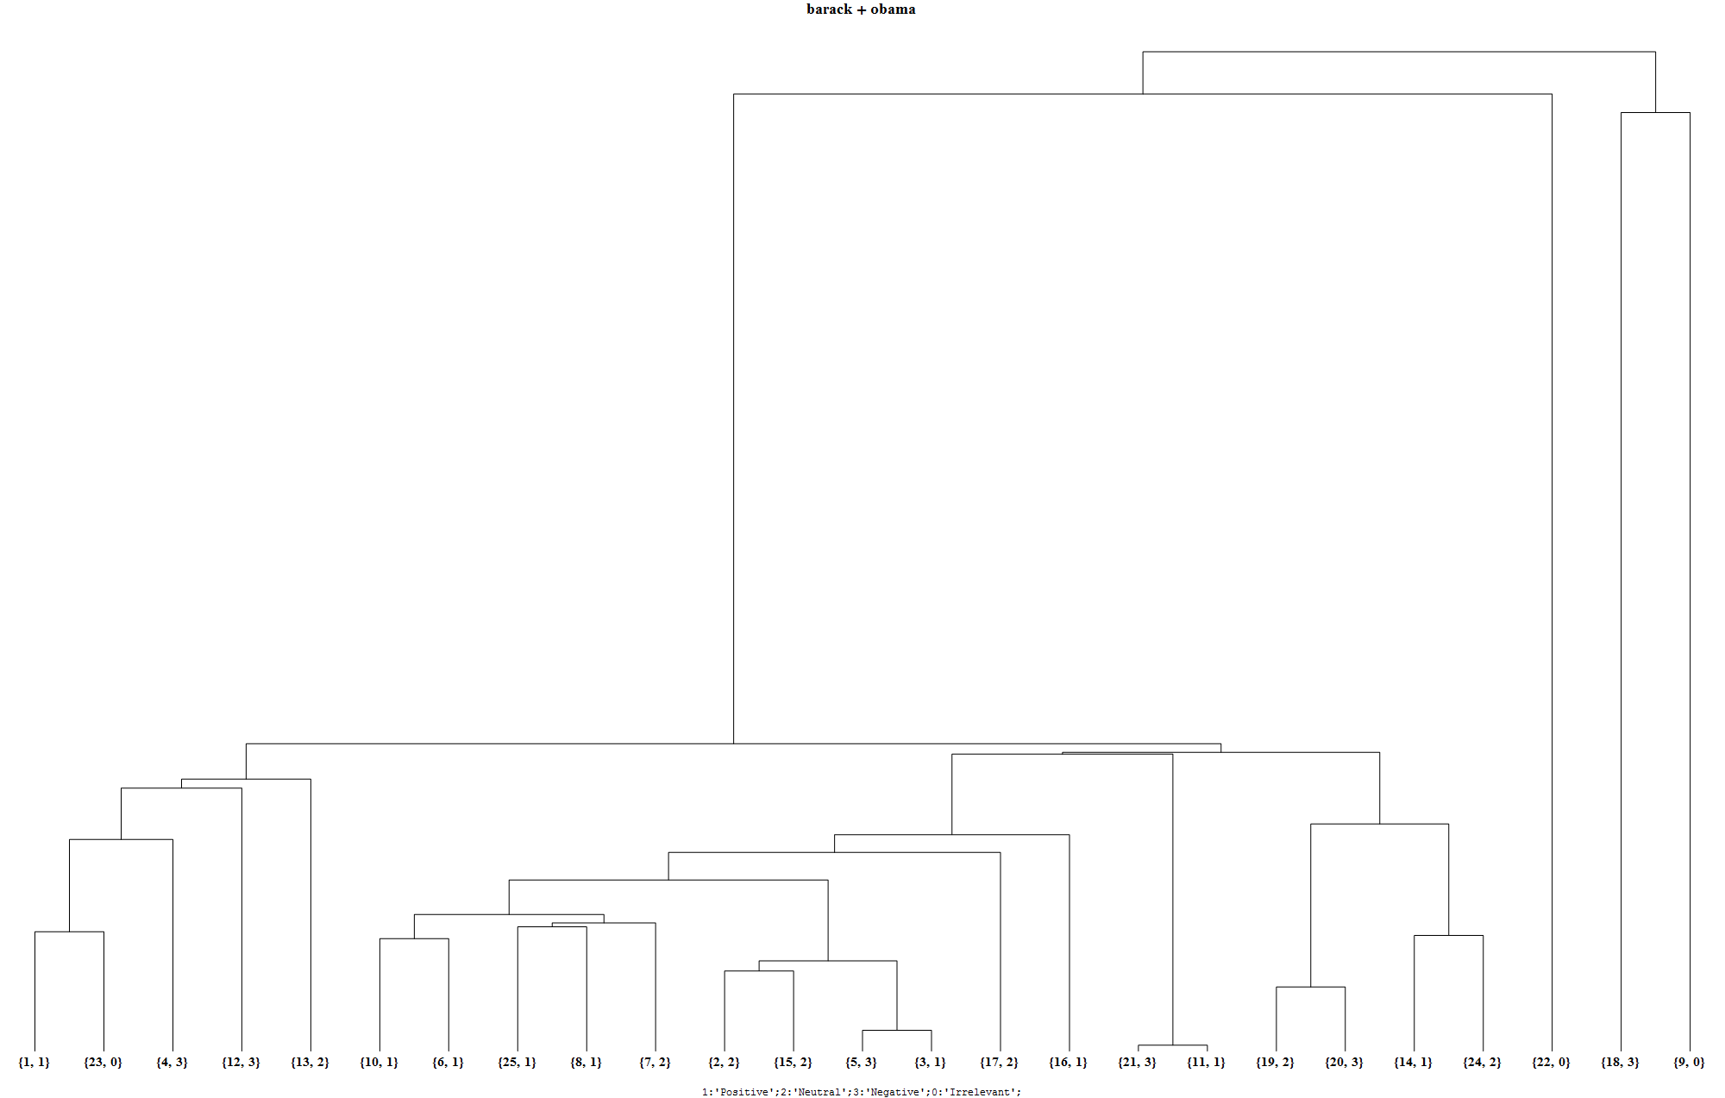
Results of Hierarchical Clustering

Slide 17
Cleaning
Outliers
Application of α-mean technique to detect and reject outliers:
Calculate α-mean using middle (1-2α)
Reject merging thresholds if:
Threshold above 1.5 × α-mean
One of the merging clusters is a single article.
Remove offending articles
Recalculate clustering.
Alternative: Harmonic Mean

Slide 18
Final Results - Feminism

Slide 19
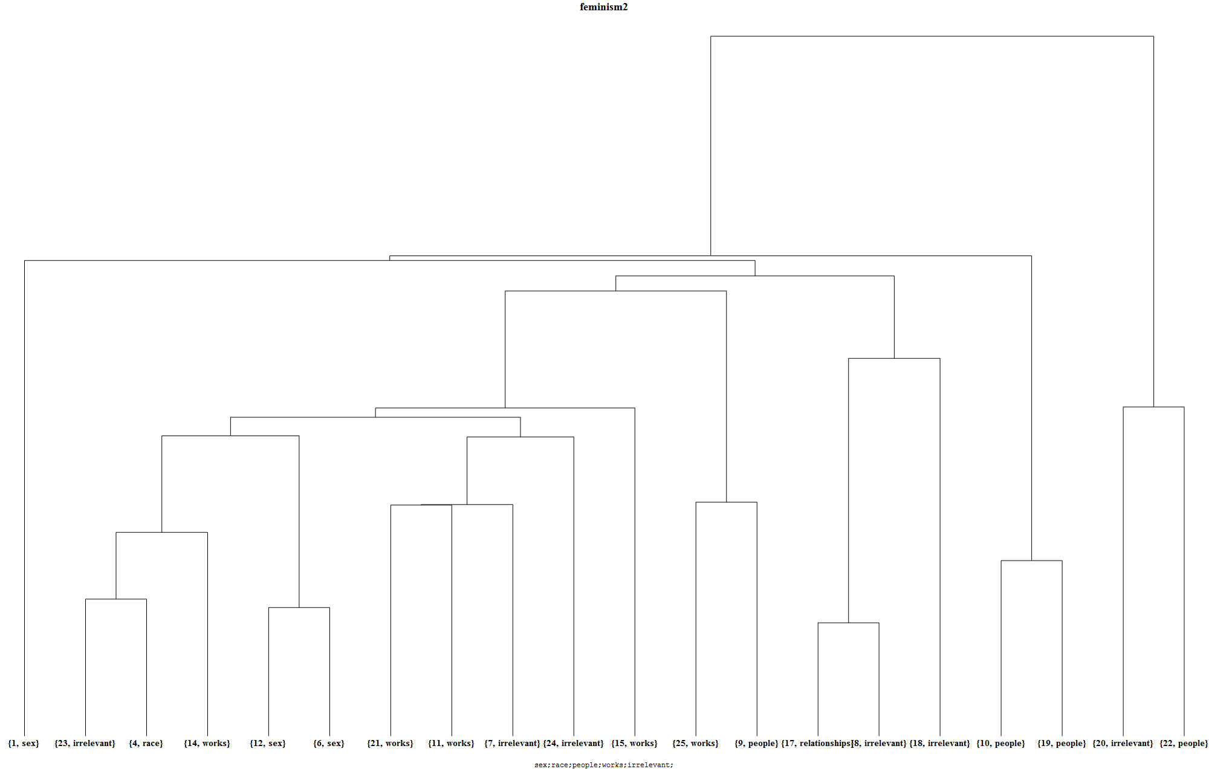
Final Results – Feminism (Cleaned)

Slide 20
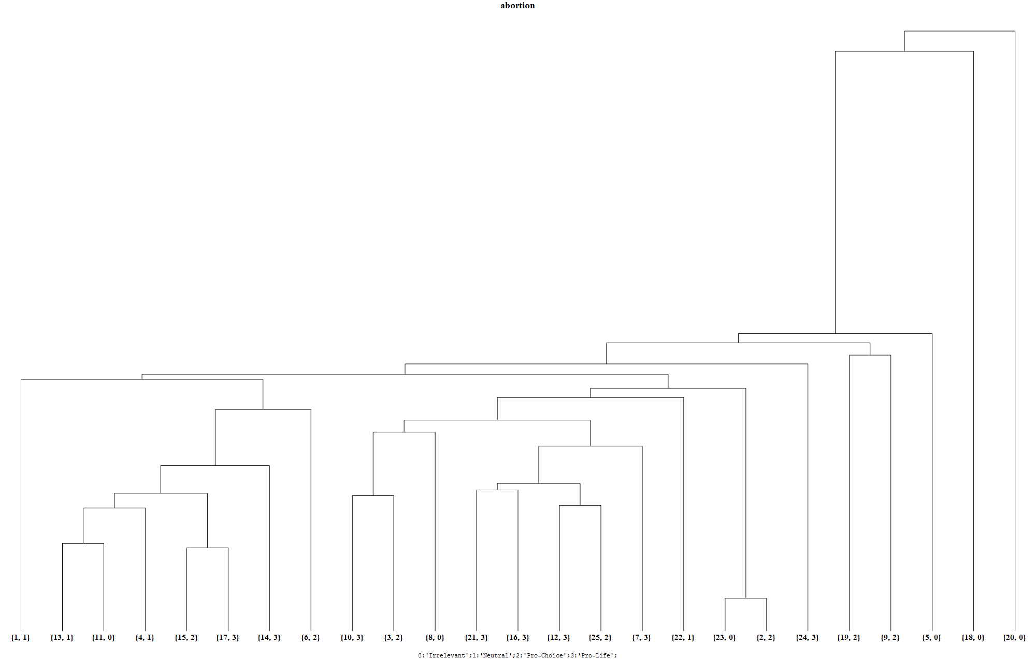
Final Results - Abortion

Slide 21
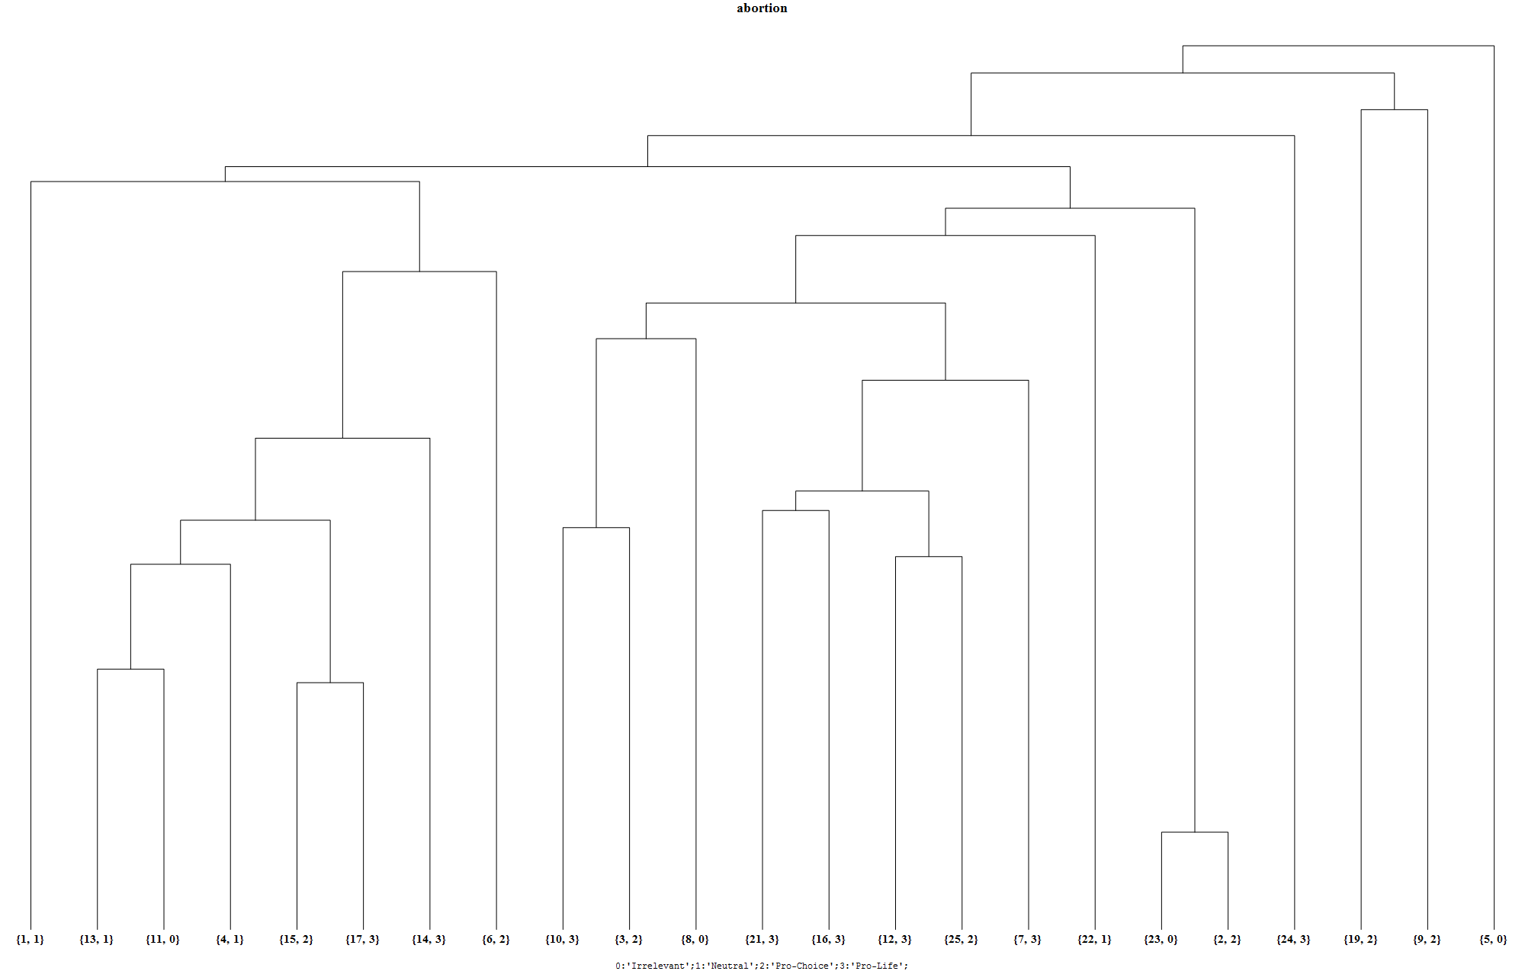
Final Results – Abortion (Cleaned)

Slide 22
Final Results – Barack Obama

Slide 23
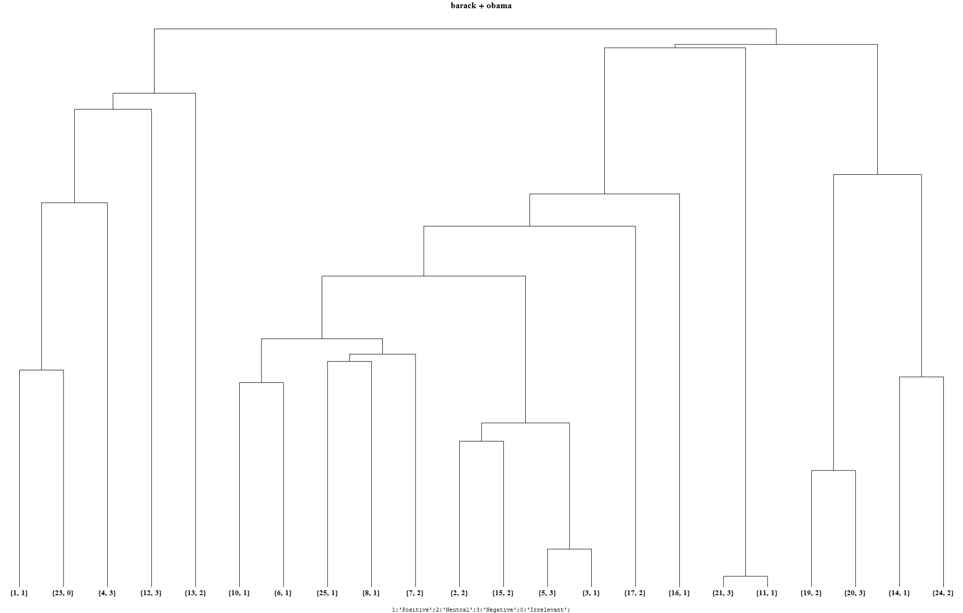
Final Results – Barack Obama (Cleaned)

Slide 24
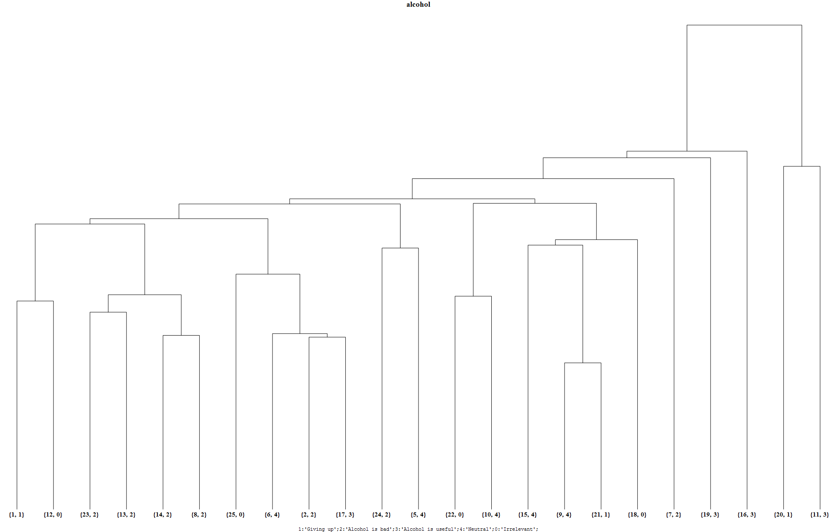
Final Results – Alcohol (Cleaned)

Slide 25
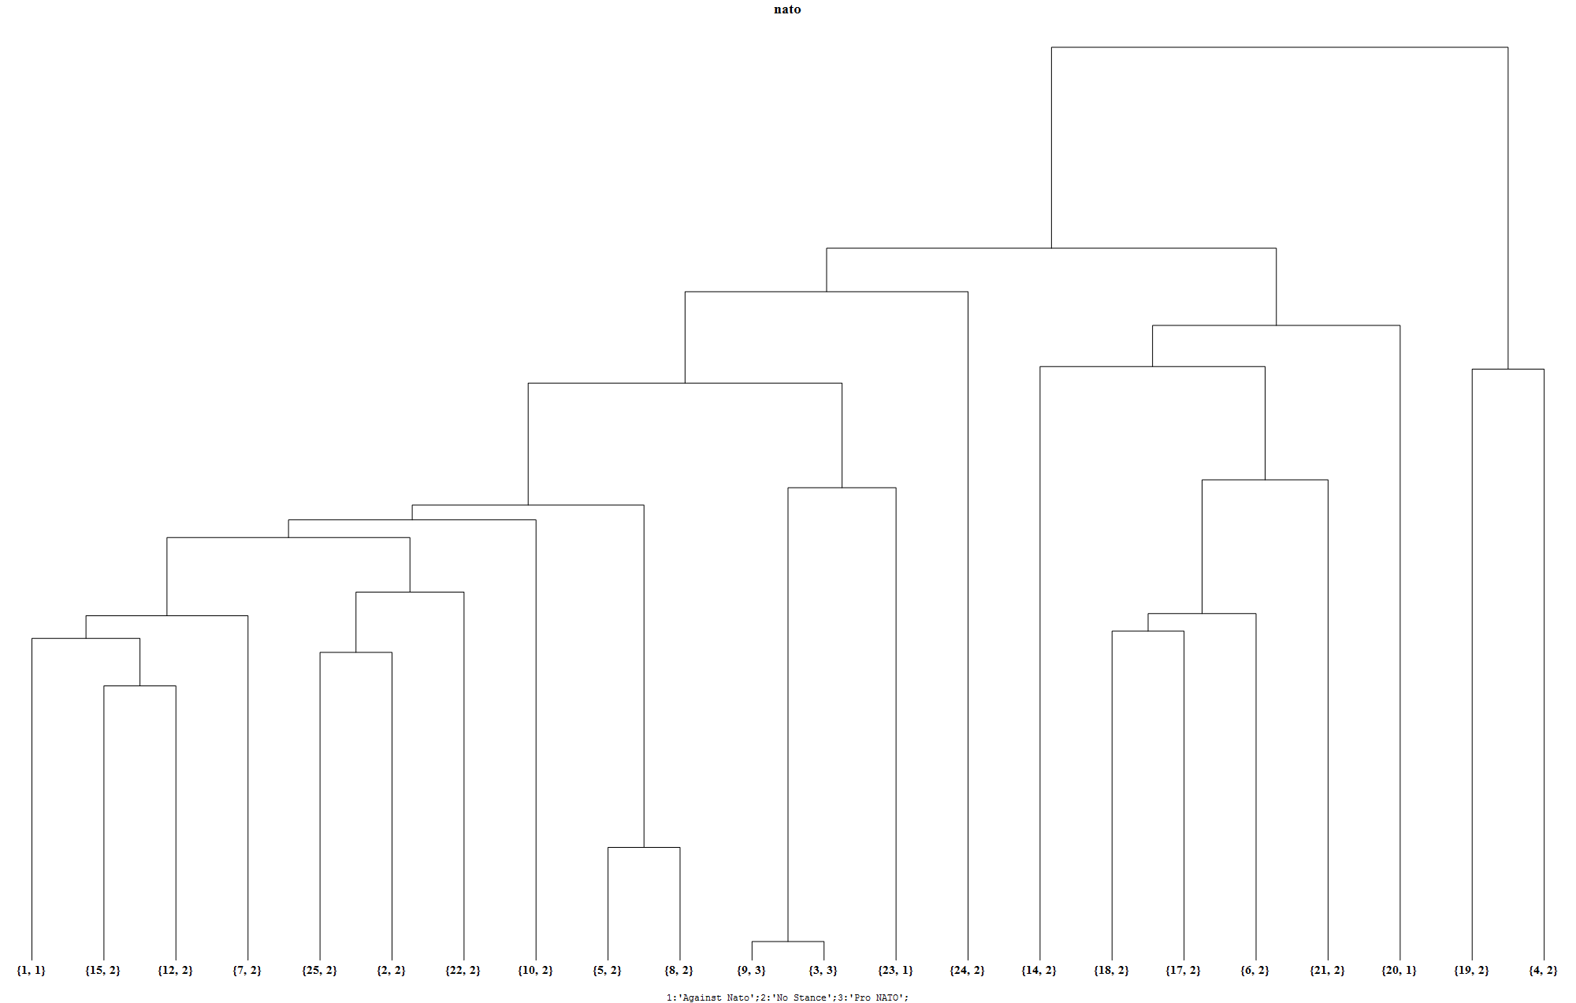
NATO

Slide 26

NATO

Slide 27
Conclusion
Feature vector
Outlier detection
Pro/Anti biases
Neutrality detection
Non-ideological/Content biases

Slide 28
Future Work
Improve Features.
Find splitting point in cleaned Hierarchical clusters. Use splitting point to get number of clusters for K-Means/Hierarchical combination.
Use ‘pyramidal clustering’ to perform sub-clustering using different feature vectors: Ideological/Content divide.

Slide 29
Acknowledgements

Slide 30
References
http://semanticreasoning.org/practical/bias.html
http://en.wikipedia.org/wiki/Wikipedia:Words_to_watch
http://en.wikipedia.org/wiki/Wikipedia:Neutral_point_of_view
Herzig, Livnat, Alex Nunes, and Batia Snir. "An annotation scheme for automated bias detection in Wikipedia." Proceedings of the 5th Linguistic Annotation Workshop. Association for Computational Linguistics, 2011.
http://www.alchemyapi.com
http://voices.yahoo.com
https://developer.yahoo.com/yql/

Slide 31
Thank You

