Slide 1
WHAT IS PANDAS?
Pandas is an open-source programming library offering programmers working in Python a more efficient way to analyze data, create visualizations, and manipulate data sets. Although the primary use for pandas is data analysis, this library also supports machine learning, allowing you to prepare the data that you will ultimately use when training your machine learning model.
Pandas allows efficient handling and manipulation of data in a few lines of code.
Pandas is most widely used for data analysis because:
1. It provides options for sorting, cleaning, and restructuring large data sets, helping you remove irrelevant values and correct missing data.
2. Beyond data analysis, pandas integrates with machine learning libraries, such as TensorFlow, and data science libraries, such as NumPy.
3. You can use pandas across multiple stages of your data science projects, from cleaning and analyzing data to preparing it for machine learning models.

Slide 2
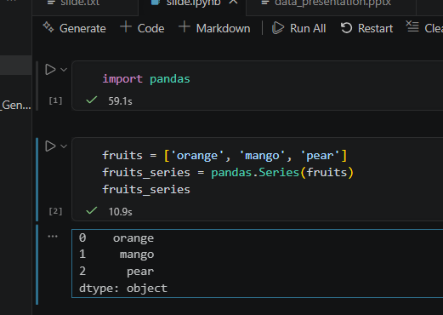
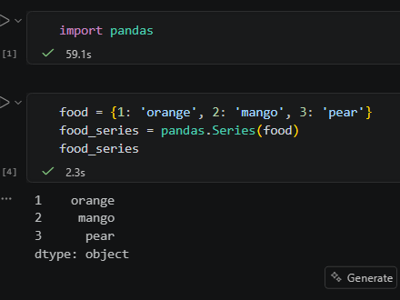
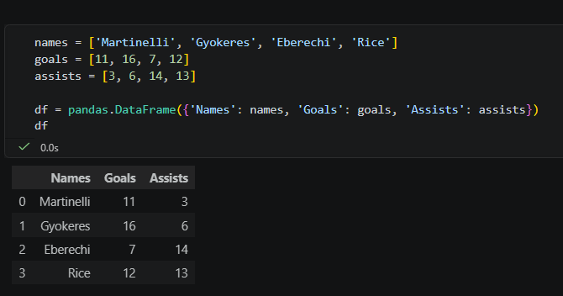
Pandas Data Structures
Pandas provides two main data structures. They are called series and dataframes.
A pandas.Series is a one-dimensional, labeled array capable of holding any data type. It is the building block of pandas; you can think of it as a single column in an Excel spreadsheet. Series can be created from python data structures such as lists and dictionaries.
To create a pandas series using a list,
import pandas
fruits = [‘orange’, ‘mango’, ‘pear’]
fruit_series = pandas.Series(fruits)
print(fruit_series)
Pandas Series can also be created from python dictionaries
Example:
import pandas
food = {1: 'rice', 2:'beans', 3:'garri'}
food_series = pandas.Series(food)
print(food_series)
A pandas.DataFrame is a two-dimensional, size-mutable, and tabular data structure with labeled rows and columns. It represents a complete spreadsheet, SQL table, or a dictionary collection of multiple Series objects shared across a common index. We can create a pandas dataframe using a python dictionary. For example, suppose we want to get the goal contributions of some Arsenal players in a particular season
import pandas
names = ['Martinelli', 'Gyokeres', 'Eberechi', 'Rice']
goals = [11, 16, 7, 12]
assists = [3, 6, 14, 13]
df = pandas.DataFrame({'Names': names, 'Goals': goals, 'Assists': assists})
print(df)

Slide 3
Loading and Inspecting Data
In pandas, data can be read from various sources. From csv files, json formats, excel files, sql databases, web pages, etc.
To read data from any of the sources, we use the appropriate pandas function. For example, to read a from a csv file, we use the pandas.read_csv(filepath of the csv file) function. Similarly, we can also read a json data using the pandas.read_json() function, a table on a web page can be read using the pandas.read_html() function, and so on.
We can also inspect our data using pandas. The basic methods for inspecting data are shape, head(), tail(), info(), describe(),
To inspect data, we must read the data first.
df = pandas.read_csv(filepath of the csv file)
To get the shape(number of rows and columns of the dataframe), we use df.shape
To get the first five rows of the dataframe, we use df.head().
To get the first n rows of the dataframe, we use df.head(n)
To get the last five rows of the dataframe, we use df.tail().
To get the last n rows of the dataframe, we use df.tail(n)
df.info() gives us every necessary information about the dataframe
df.describe() gives us the statistical descriptions of the dataframe eg mean, mode, max, min, etc

Slide 4
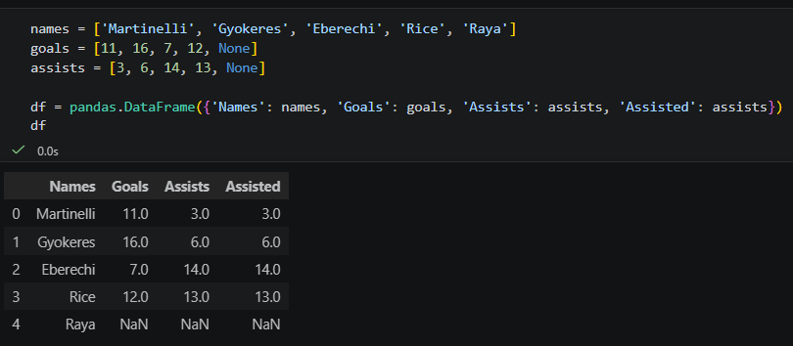
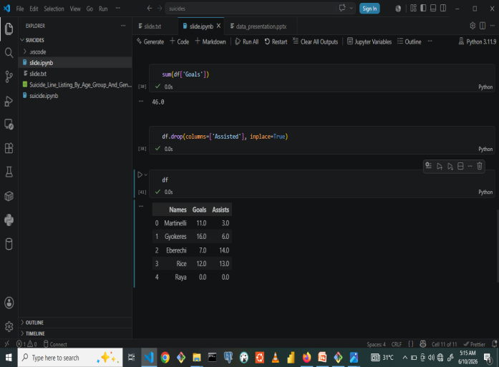
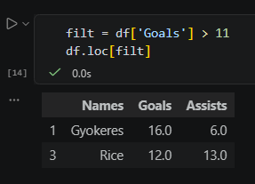
Preparing Data for Analysis
To prepare a dataframe for analysis, there are a number of tasks to be done. This includes handling missing values, removing duplicates, renaming columns, changing datatypes, filtering records, etc.
From our goals contribution dataframe, let us we add a new player with missing values, let us also duplicate the Assists column.
Before we begin to analyze this data, a very important step is to remove all missing items. In this case, Raya has missing goals and missing assists, so we remove him from the dataframe.
To do this we simply df.fillna(0, inplace=True). This tells the dataframe to replace all missing items with a value of 0. Also, we have to remove the duplicate column(Assisted) from the dataframe. To do this, df.drop(columns=[‘Assisted’, inplace=True]
We can also filter the dataframe by some condition. For example, suppose we want to get the names of all the players that scored more than 11 goals during the season,
filt = df[‘Goals’] > 11
df.loc[filt]

Slide 5
Data Analysis and Aggregation
Pandas can also be used to get the statistical properties(mean, median, mode, min, max, etc) of the dataset. For example, we can check the total number of goals with sum(df['Goals']),
we can get average number of goals scored per season df['Goals'].mean(),
we can get the player with the highest assists df.loc[df['Assists']==max(df['Assists'])],
we can also check the player with the lowest number of goals df.loc[df['Assists']==min(df['Assists'])]
We can also sort the dataframe according to the Goals column
df.sort_values(by='Goals')

Slide 6
Visualization
We can also visualize data using pandas. But for the sake of this presentation, I’d use a different python library(matplotlib) for our visualizations
To begin with matplotlib, we head to our terminal and install it using pip with the following command
pip install matplotlib
When this has been successfully installed, we can now begin our visualizations.
We can draw a simple bar chart showing the number of goals scored by all the players using the code below
from matplotlib import pyplot as pyplot
plt.style.use(“fivethirtyeight”) plt.title('Bar Chart showing the number of goals scored this season by some Arsenal players')
plt.xlabel('Players')
plt.ylabel('Number of Goals')
plt.bar(df['Names'], df['Goals'],)
plt.show
For the sake of space, we are going to show the results of all our visualization codes in the next slide
We can also visualize the number of assists by the players using a pie chart
plt.style.use('fivethirtyeight')
wedgeprops = {'edgecolor': 'black'}
plt.title('''Pie Chart showing the number of goals
scored this season by some Arsenal players''')
labels = [i for i in df['Names']]
plt.pie(df['Goals'], labels=labels, wedgeprops=wedgeprops)
plt.tight_layout()
plt.show()
We can also use a multiple bar chart to show the number of goals and the number of assists
w, x = 0.4, numpy.arange(len(df))
plt.style.use('fivethirtyeight')
plt.xlabel('Names of Players')
plt.ylabel('Number of Goals and Assists')
plt.title('''Multiple Bar Chart showing the number of goals
and assists this season by some Arsenal players''')
plt.bar(x - w/2, df['Goals'], w, label='Goals')
plt.bar(x + w/2, df['Assists'], w, label='Assists')
plt.xticks(x, df['Names'])
plt.legend()
plt.show()

Slide 7
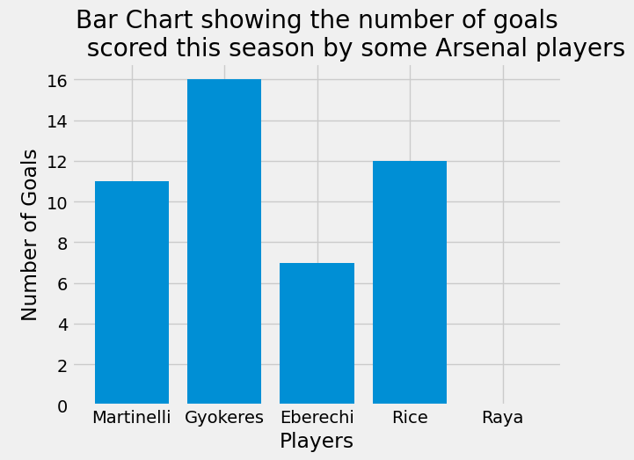
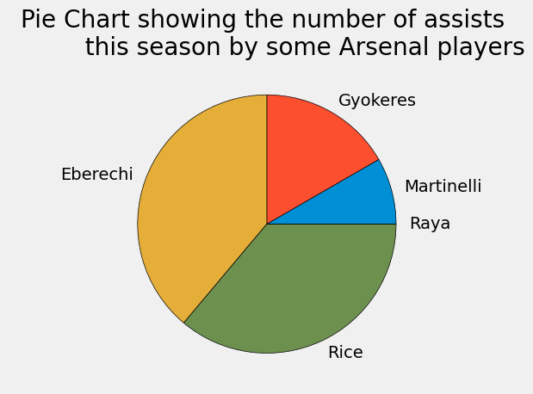
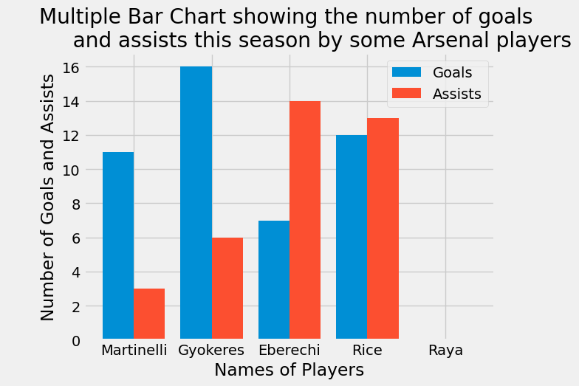
Visualization results

