Slide 1
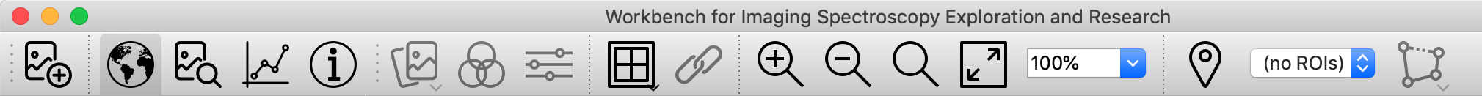
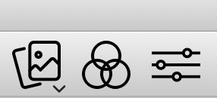
Open
File
Display Toggles
Dataset
Tools
View Tools
Zoom Tools
Region of Interest Tools
Context
Pane
Zoom
Pane
Zoom In
Zoom
Out
Current Zoom
Level (editable)
Spectrum
Plot Window
Dataset
Information
Zoom
to 100%
Zoom
to Fit
Dataset
Chooser
Band
Chooser
Contrast
Stretch

Slide 2
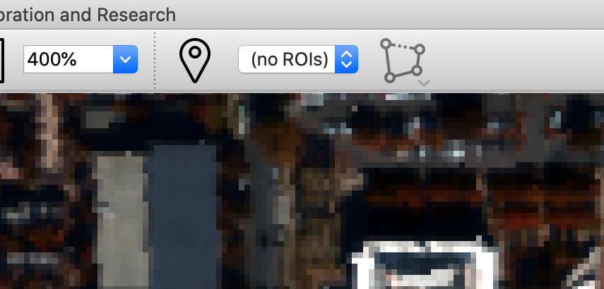
Create Region of Interest
Current Region
of Interest
Add selection to current ROI

Slide 3
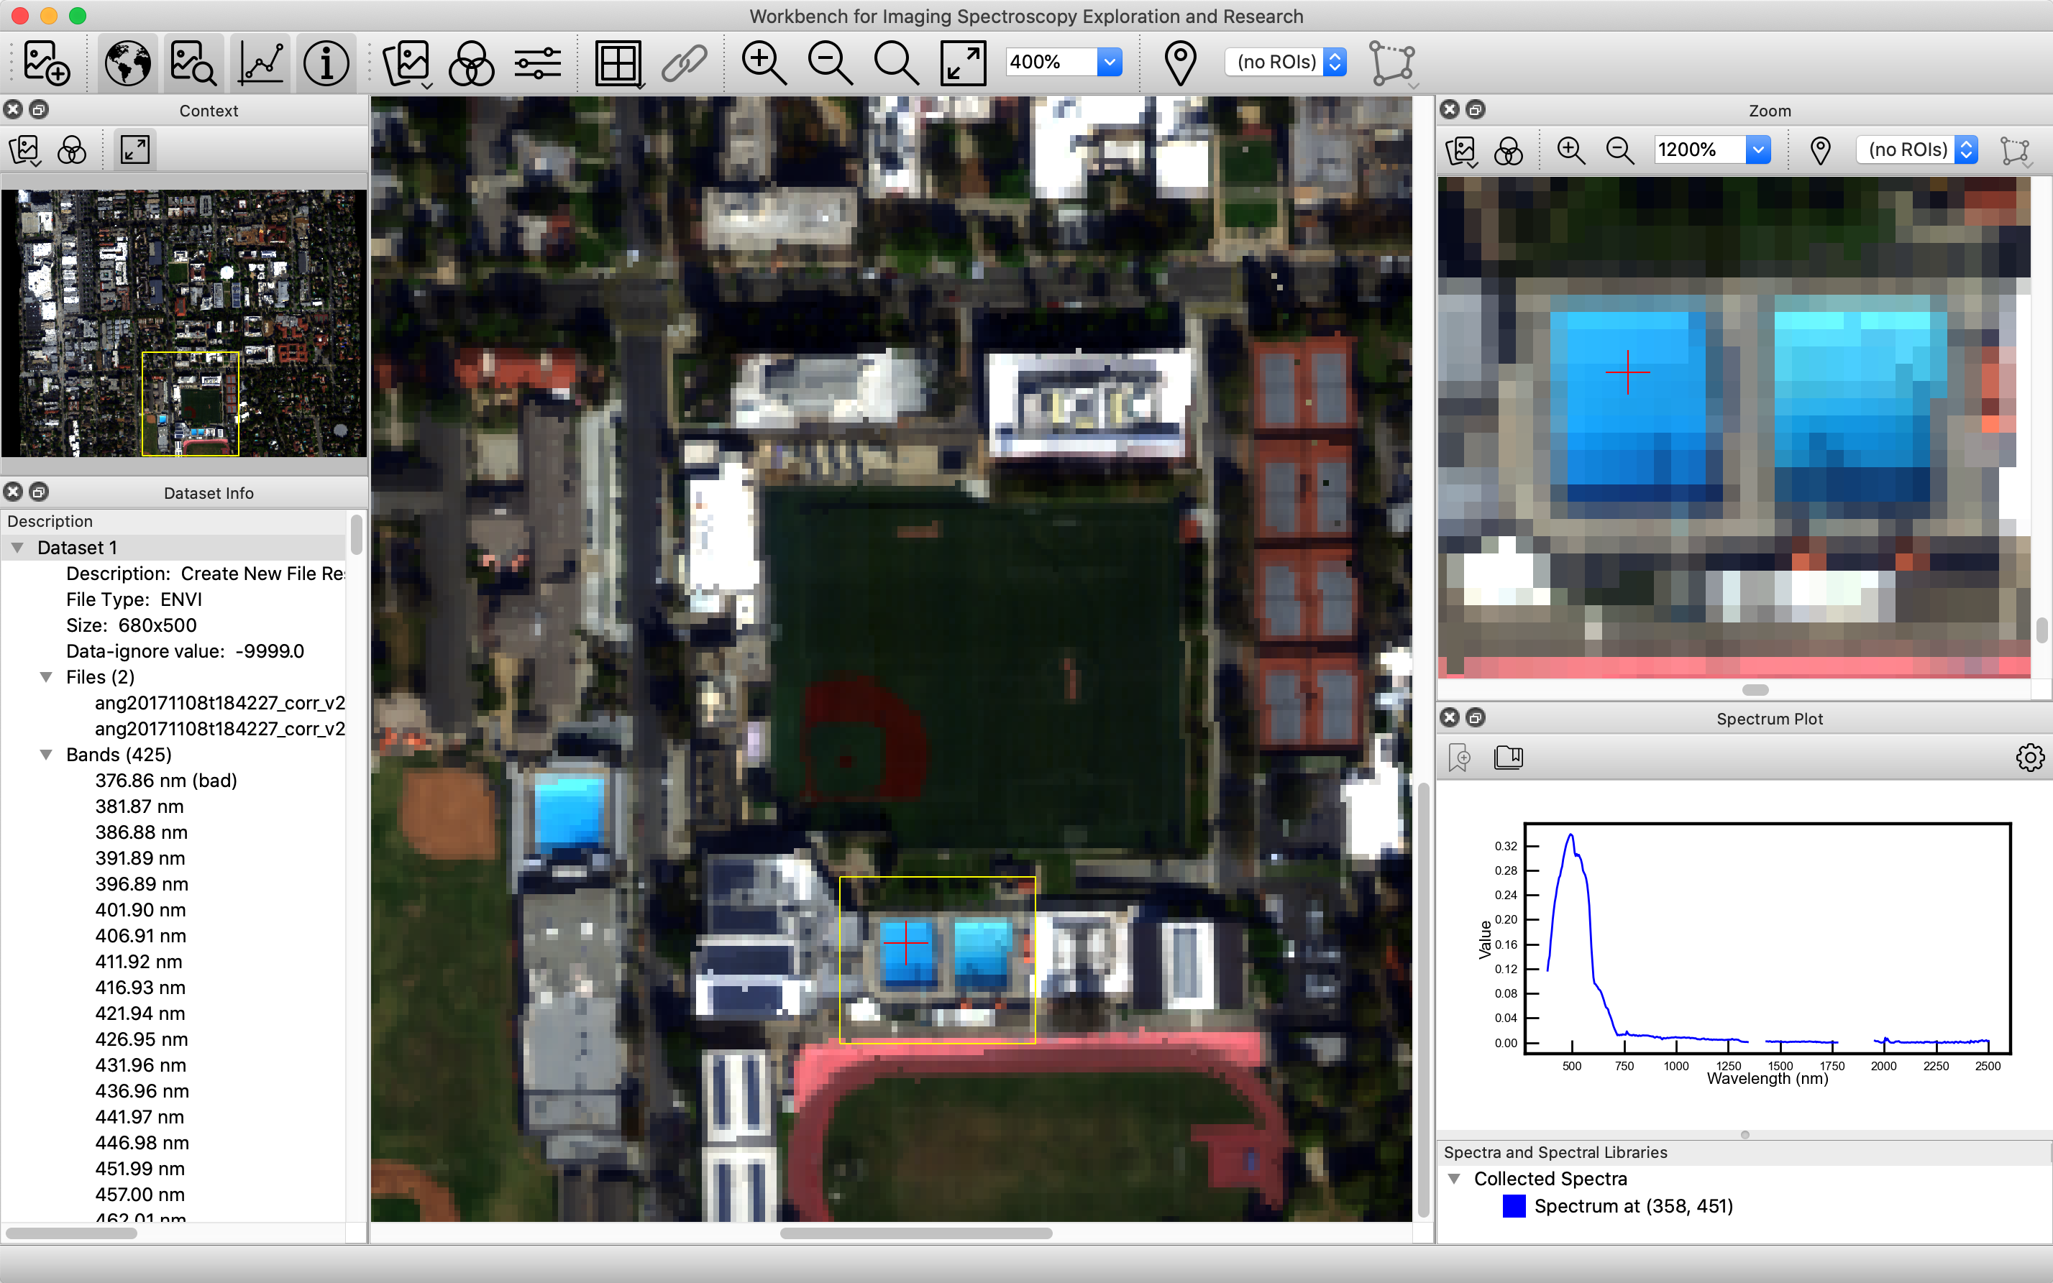
Area visible in main window
Area visible in zoom pane
Current
pixel
Spectrum of pixel
(Caltech Braun pool)

