Slide 1
characteristics

Slide 2
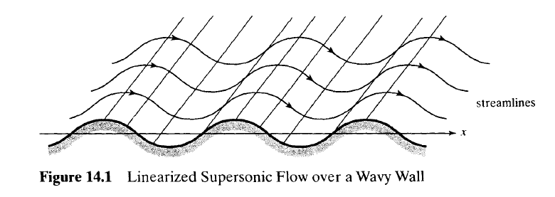
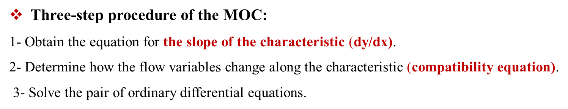
The method of characteristics (MOC) for solving flow problems described by hyperbolic PDEs.
Property 1: A characteristic in a two-dimensional supersonic flow is a curve or line along which physical disturbances are propagated at the local speed of sound relative to the gas.
Important properties of characteristics to derive the equations of MOC :
Property 2: A characteristic is a curve across which flow properties are continuous, although they may have discontinuous first derivatives, and along which the derivatives are indeterminate.
Property 3: A characteristic is a curve along which the governing partial differential equation(s) may be manipulated into an ordinary differential equation(s). (A characteristic is a curve along which the governing PDE becomes an ODE.)

Slide 3
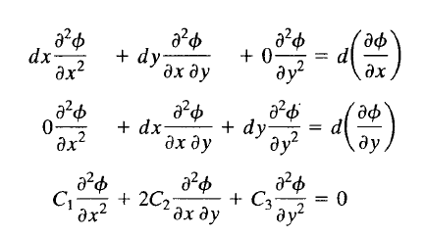
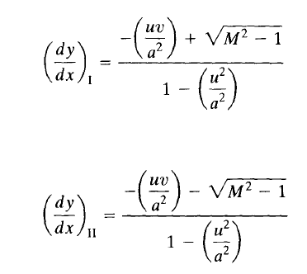

Theory of characteristics:
Three methods available for determining both the slopes of the characteristics and the compatibility equations:
The Method of Indeterminate Derivatives (based on Property 2)
The Method of Linear Combination (based on Property 3)
The Eigen analysis (based on both Properties 2 and 3)
Method 1-The Method of Indeterminate Derivatives:
Characteristics (lines across which there may be a discontinuity in the velocity derivatives or which there is not a unique solution for the velocity derivative)
Equation for two-dimensional isentropic, irrotational steady flow of a perfect gas.
The derivatives of the velocity components for this isentropic flow.
According to property 2 by using Cramer's rule, two characteristics at each point in the flow:
Replacing C1,C2 and C3

Slide 4




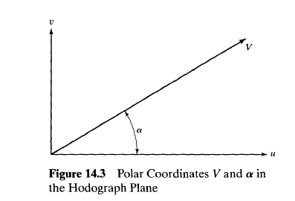
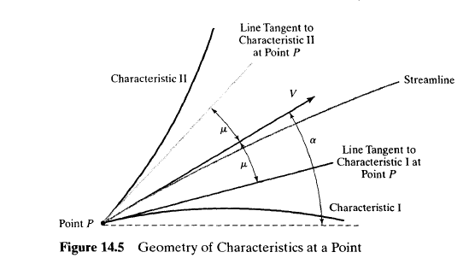
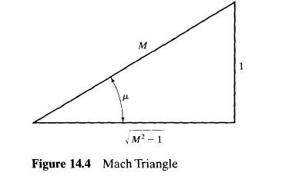


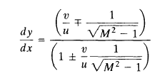

The slopes of the characteristics in the hodograph, or velocity plane (u versus v):
How the velocity components vary with x and y:
By using Cramer's rule :
Replacing C1,C2 and C3
Slope of the characteristic lines in polar coordinates (V, α) (α is the flow inclination):
Mach angle

Slide 5
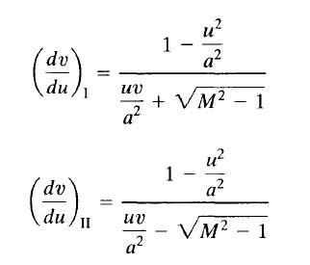
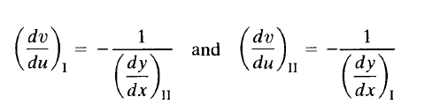

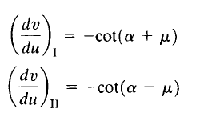
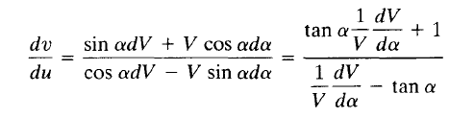


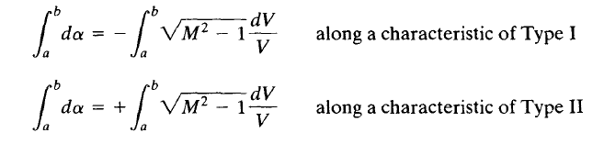



A workable expression for velocity or Mach number along a characteristic:
Mach number as a function of α along characteristics (similar integral in dealing with Prandtl-Mayer flow)

Slide 6
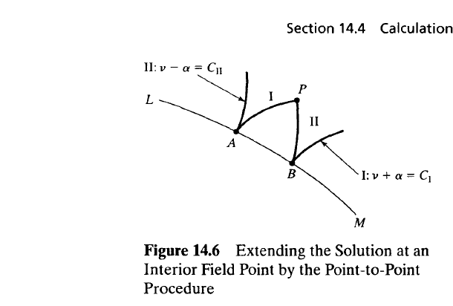

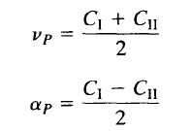

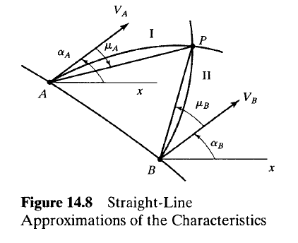
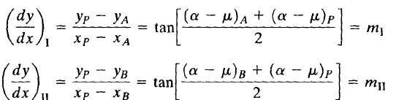


Calculation Procedures :
Two distinct calculation procedures: 1-The Point-to-Point Method 2-the region to region method
The Point-to-Point Method
1-An Interior-Field-Point Unit Process
ʋ + α = constant along a characteristic of Type I
ʋ - α = constant along a characteristic of Type II
Direction of characteristics:

Slide 7

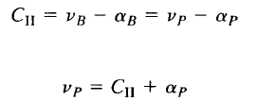

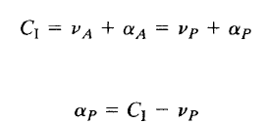
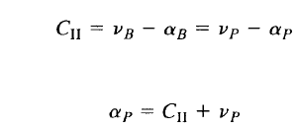
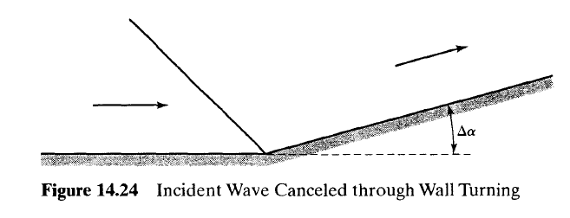
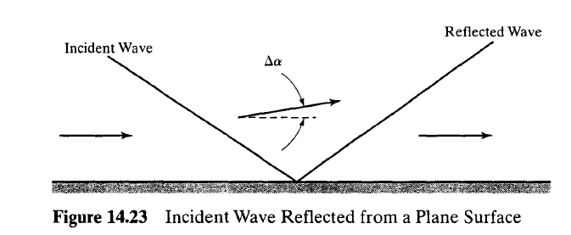
2- A Boundary-Point Unit Process:
The angle at point P is known
3- A Free-Surface Point-Unit Process :
Compute the Mach number and the value of the Prandtl-Meyer function on the free-surface boundary from the static-to-stagnation-pressure
Supersonic Nozzle Design:
If a weak wave of turning angle ∆α is incident upon a plane surface, a reflected wave of turning angle ∆α must be present so as to satisfy the boundary conditions at the wall.
To cancel the incident wave, let the wall turn exactly through an angle ∆α at the point of impingement of the incident wave.

Slide 8
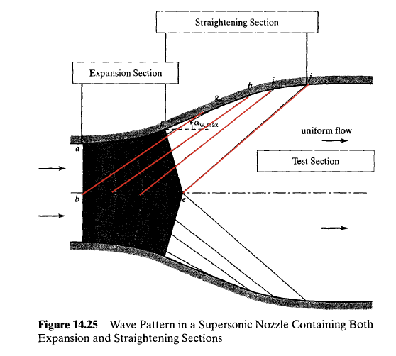
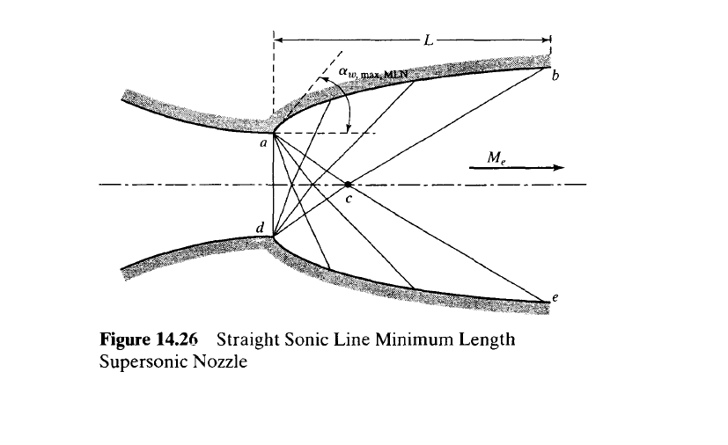


A converging-diverging supersonic nozzle:
Sonic flow at the nozzle throat.
Consider only one half of the flow (the centerline is a streamline).
Four expansion waves (Type I characteristics) in the expansion section of the nozzle and are reflected, as characteristics of Type II.
The waves reflected from the centerline turn the flow back to the horizontal between points e and j.
The wall contours at points g, h, i, and j must turn the flow through the same as the incident waves so as to cancel those waves.
c
d
e
Minimum length nozzles (MLNs): 1- have no expansion section at all .
2- the initial expansion is created by a sharp corner at the nozzle throat.
The flow is expanded from sonic conditions:
For a Type I characteristic between point a and point c:
Because point c is on the centerline and a corner point of the test section,

