Slide 1
Section4: electrical ROCKETS

Slide 2


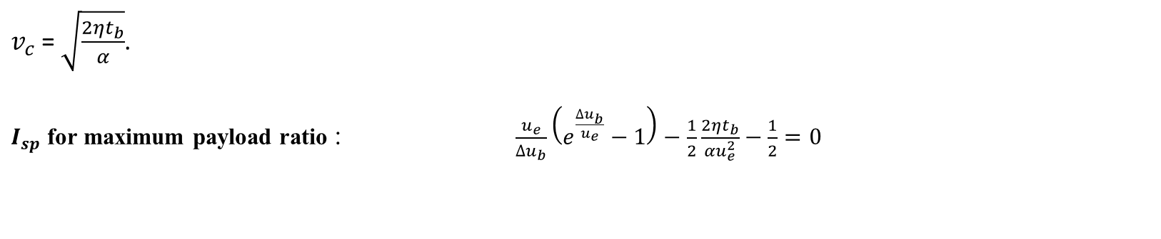
Electric Rockets
Thruster efficiency $η=\frac{\frac{1}{2}\dot{m}u_{e}^{2}}{EP}$
Thruster specific mass $α=\frac{M_{EP}+M_{S}}{EP}$
$M_{0}=M_{L}+M_{P}+M_{S}+$ $M_{EP}$
$M_{b}=M_{0}−M_{P}$
$I_{sp}=\frac{u_{e}}{g_{e}}$
$∆u_{b}=u_{e}\ln{\frac{M_{0}}{M_{b}}}$
$\text{payload} \text{mass} \text{ratio} \frac{M_{L}}{M_{0}}=\left(1+\frac{αu_{e}^{2}}{2ηt_{b}}\right)e^{−\frac{∆u_{b}}{u_{e}}}−\frac{αu_{e}^{2}}{2ηt_{b}}$
Mass of power plant
$$\frac{M_{b}}{M_{o}}=e^{\frac{−∆u_{b}}{u_{e }}}$$
$\frac{α}{η}$ $\frac{kg}{W}$
$v_{c}$ = $\sqrt{\frac{2ηt_{b}}{α}}$.
$I_{sp}$ for maximum payload ratio : $\frac{u_{e}}{∆u_{b}}\left(e^{\frac{∆u_{b}}{u_{e}}}−1\right)−\frac{1}{2}\frac{2ηt_{b}}{αu_{e}^{2}}−\frac{1}{2}=0$
payload mass fraction

Slide 3
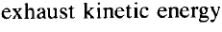







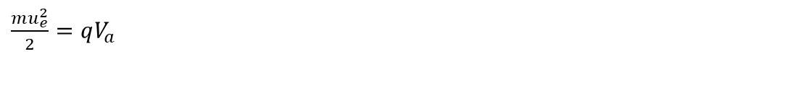
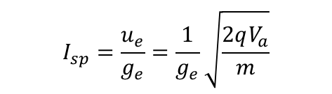

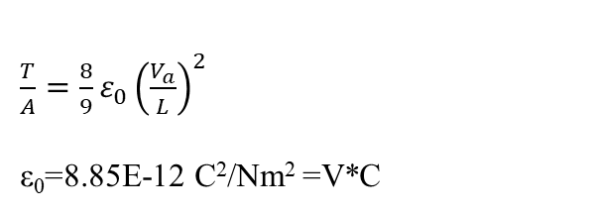

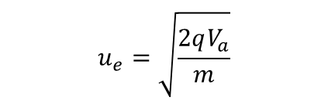
Electrostatic Thrusters
$\frac{mu_{e}^{2}}{2}=qV_{a}$
$$u_{e}=\sqrt{\frac{2qV_{a}}{m}}$$
m = Ion mass q = Ion charge $V_{a}$ = Voltage potential
$$I_{sp}=\frac{u_{e}}{g_{e}}=\frac{1}{g_{e}}\sqrt{\frac{2qV_{a}}{m}}$$
$T=\dot{m}u_{e}$
$$I=\frac{q}{m}\dot{m}=\frac{q}{m}\frac{T}{u_{e}}$$
$\frac{T}{A}=\frac{8}{9}ε_{0}{\left(\frac{V_{a}}{L}\right)}^{2}$
ε₀=8.85E-12 C²/Nm² =V*C
${EP}_{b}=IV_{a}=\frac{\dot{m}u_{e}^{2}}{2}$
$\frac{T}{EP}=\frac{2η}{{I_{sp}g}_{e}}$
$$η=\frac{beam power}{total electric power}=\frac{{EP}_{b}∙∆t}{EP∙∆t}=\frac{\frac{mu_{e}^{2}}{2} }{\frac{mu_{e}^{2}}{2}+e_{l}}$$
energy lost per ion in the ionization chamber to ionize one atom - is about 100 eV, 1 ev=1.60E-19 J.

Slide 4
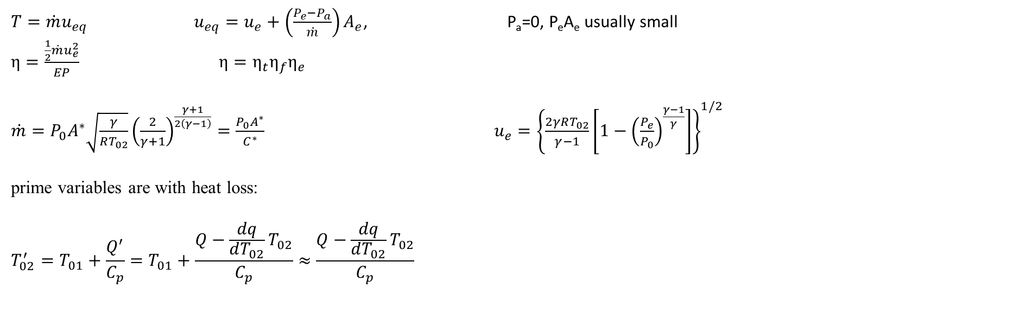
Electrothermal Rockets
$T=\dot{m}u_{eq}$ $u_{eq}=u_{e}+\left(\frac{P_{e}−P_{a}}{\dot{m}}\right)A_{e}$, P_{a}=0, P_{e}A_{e} usually small
$η=\frac{\frac{1}{2}\dot{m}u_{e}^{2}}{EP}$ $η=η_{t}η_{f}η_{e}$
$\dot{m}=P_{0}A^{∗}\sqrt{\frac{γ}{RT_{02}}}{\left(\frac{2}{γ+1}\right)}^{\frac{γ+1}{2\left(γ−1\right)}}=\frac{P_{0}A^{∗}}{C^{∗}}$ $u_{e}={\left\{\frac{2γRT_{02}}{γ−1}\left[1−{\left(\frac{P_{e}}{P_{0}}\right)}^{\frac{γ−1}{γ}}\right]\right\}}^{1/2}$
prime variables are with heat loss:
$$T_{02}^{′}=T_{01}+\frac{Q^{′}}{C_{p}}=T_{01}+\frac{Q−\frac{dq}{dT_{02}}T_{02}}{C_{p}}≈\frac{Q−\frac{dq}{dT_{02}}T_{02}}{C_{p}}$$
Electro Magnetic Thrusters
a body force $\vec{F}=\vec{j}×\vec{B}$
A Lorentz force $\vec{F}=σ\left(\vec{E}+\vec{v}×\vec{B}\right)$.

