Slide 1

HYBRID PROPELLANT ROCKETS
Ehsan Roohi

Slide 2
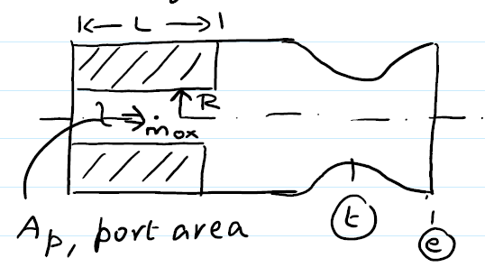
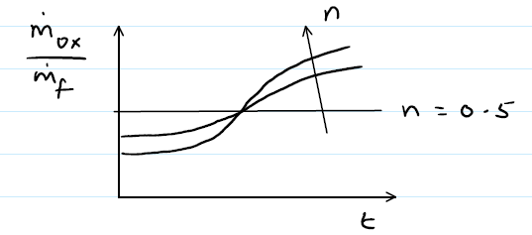
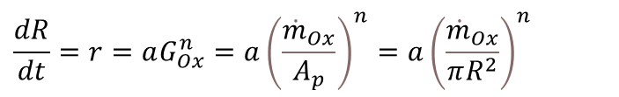

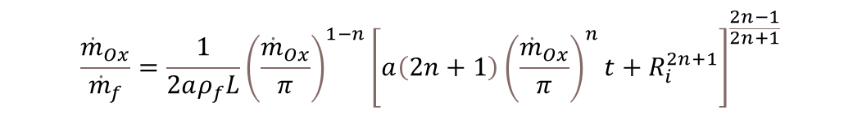
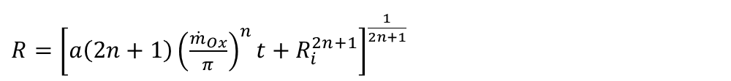


Regression rate of fuel (r) :
$$r=\acute{a}G_{}^{\acute{n}}$$
Mass Flux:
$$G=\frac{\dot{m}}{A}=(G_{f}+G_{ox})$$
Cylindrical arrangement:
$$\frac{dR}{dt}=r=aG_{Ox}^{n}=a{\left(\frac{{\dot{m}}_{Ox}}{A_{p}}\right)}^{n}=a{\left(\frac{{\dot{m}}_{Ox}}{πR^{2}}\right)}^{n}$$
$$R^{2n}dR=a{\left(\frac{{\dot{m}}_{Ox}}{π}\right)}^{n}dt$$
Integrate from t=0 (R=Ri) to t=t (R=R)
$R={\left[a\left(2n+1\right){\left(\frac{{\dot{m}}_{Ox}}{π}\right)}^{n}t+R_{i}^{2n+1}\right]}^{\frac{1}{2n+1}}$
Combustion port radius R :
Mass production rate of fuel (rate the solid fuel is being vaporized ):
Substituting R
$${\dot{m}}_{f}=ρ_{f}rA_{b}=ρ_{f}a{\left(\frac{{\dot{m}}_{Ox}}{πR^{2}}\right)}^{n}2πRL$$
${\dot{m}}_{f}=2aπ^{1−n}ρ_{f}L{{\dot{m}}_{Ox}}^{n}R^{1−2n}=2aπ^{1−n}ρ_{f}L{{\dot{m}}_{Ox}}^{n}{\left[a\left(2n+1\right){\left(\frac{{\dot{m}}_{Ox}}{π}\right)}^{n}t+R_{i}^{2n+1}\right]}^{\frac{1−2n}{2n+1}}$
$$\frac{{\dot{m}}_{Ox}}{{\dot{m}}_{f}}=\frac{1}{2aρ_{f}L}{\left(\frac{{\dot{m}}_{Ox}}{π}\right)}^{1−n}{\left[a\left(2n+1\right){\left(\frac{{\dot{m}}_{Ox}}{π}\right)}^{n}t+R_{i}^{2n+1}\right]}^{\frac{2n−1}{2n+1}}$$
Instantaneous mixture ratio:

